Slide 1

Don’t take the bait
How to stop and avoid phishing emails
Notes:
Phishing is a big issue that we all need to be aware of – and play our part in stopping. It impacts both our organization, but also your personal life too.
In this session we’re going to look at:
- The different types of phishing
- Can you spot a phishing email
- Ten tell tale signs of a phish
- And then some tools to help you avoid phishing in the future

Slide 2



The Rise of Cyberattacks
2 in 3 organizations
fell victim
to a cyberattack in 2018
Notes:
Cyberattacks are becoming more prevalent than ever, and they are getting ever more crafty at getting round cybersecurity defenses.
In a recent survey of 3,100 companies across 12 countries, 68% said that they had been the victim of a cyberattack that breached their network. So that’s two in three organizations hit by a cyberattack. It’s a huge issue – and we are all part of the solution.

Slide 3
Criminals Look For Ways Around Our Defenses
9 in 10 were running up-to-date cybersecurity
at the time of their most significant attack
Notes:
The survey also revealed that 91% of organizations were running up-to-date cybersecurity at the time of the attack. So despite having protection in place, the attackers were able to find a way through.
And this is where phishing comes in. Phishing is one of the most popular approaches that attackers use to trick employees in order to get round a company’s defenses.

Slide 4




Most Threats Come By Email
33%
Email
30%
Web
23%
Software
14%
USB/ devices
Notes:
In fact, email is the most common way that cyberthreats get into organizations – in fact email is the way that one in three attacks get in.
Followed by web (so visiting compromized web sites), software vulnerabilities, and then USBs/ removable devices.

Slide 5
What is Phishing?
Any type of attempt to trick you into doing something to benefit the crooks.
Opening an attachment in email
Clicking on a link
Sharing confidential information
Transferring funds
MASS
PHISHING
SPEAR
PHISHING
Notes:
Phishing is any type of attempt to trick you into doing something to benefit the crooks, usually through email.
Overwhelmingly, cyber criminals are interested in money. Either they’ll extort money from you or the company using ransomware or social engineering, or they’ll steal data and credentials that can be sold on.
And what started as simply “phishing” has now evolved into two main tactics of phishing attack – Mass Phishing and Spear Phishing.

Slide 6
Mass Phishing
Target: Individuals’ Assets e.g. bank accounts, identity, login credentials.
Typically aimed at consumers
Impersonal: mass email
mail outs
Credentials used or sold for financial gain
Notes:
Mass phishing attacks particularly target you as individuals: your data, your money, your credentials.
These attacks are largely opportunistic, taking advantage of a company’s brand name to try and lure the brand’s customers to spoofed sites where they are tricked into parting with credit card information, login credentials, and other personal information that will be later resold for financial gain.
Typically impersonal batch and blast emails
They’re focused on stealing personal data, such as login credentials that can be sold on

Slide 7
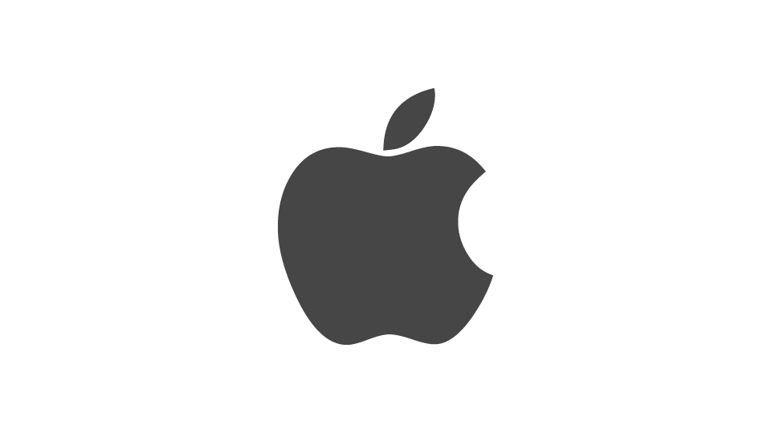
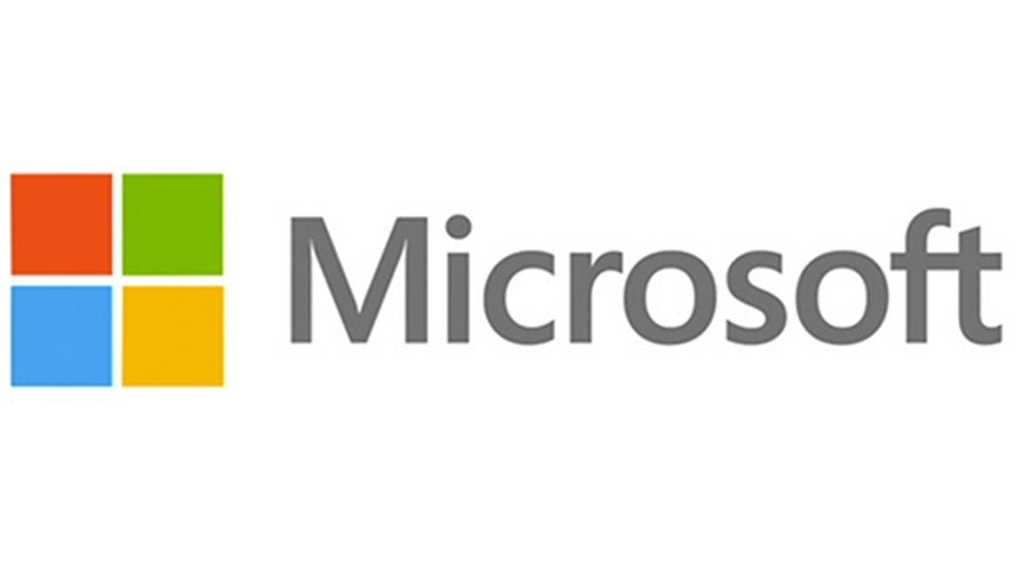

What do these brands have in common?
3 Most Spoofed Brands in Phishing Attacks
Notes:
Now a question for you.
What do these three brands have in common: Apple, Amazon, Microsoft.
They are the three most-spoofed brands used in phishing attacks.
Their global coverage and high brand recognition makes them ideal targets for cybercriminals in their phishing attacks.

Slide 8
Spear Phishing
Target: The assets of a specific organization e.g. data, money
Typically target an individual or specific group in an organization
Often use spoofed
(look-a-like) email addresses
Impersonate trusted sources and senior executives
Notes:
The other kind of threat is of the spear phishing variety, where emails impersonating a specific sender or trusted source are sent to targeted individuals within organizations to try to get them to take certain actions, like sending money to spurious accounts.
These are usually harder to spot, with spoofed email addresses that look like the real thing used to fool you into replying or clicking. They also particularly target businesses.

Slide 9
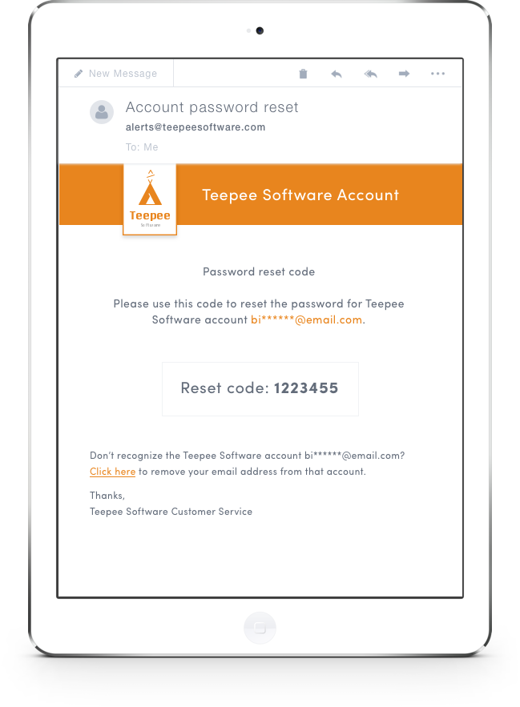
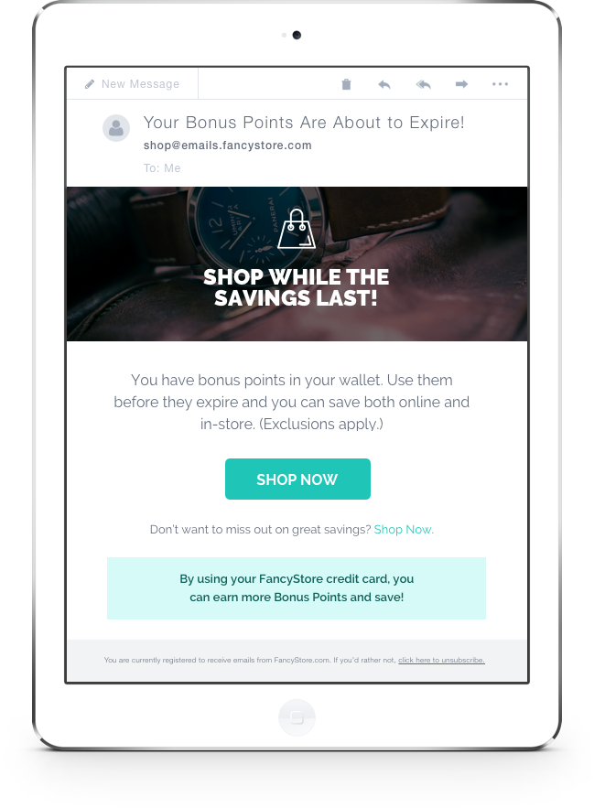
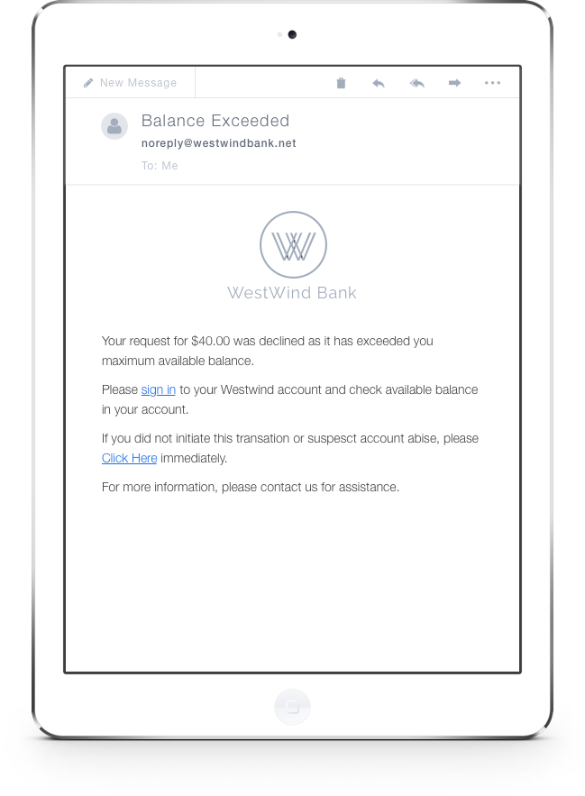
Can You Spot the Phish?
Notes:
So, can you spot a phish. Which of these do you think is suspect?

Slide 10
Can You Spot the Phish?
Genuine
Genuine
Phish
Poor grammar
Poor spelling
Urgency
Notes:
Did you get it?
Let’s have another go….

Slide 11
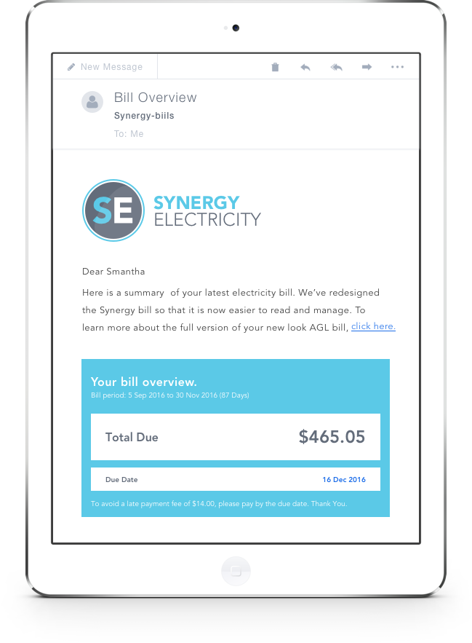
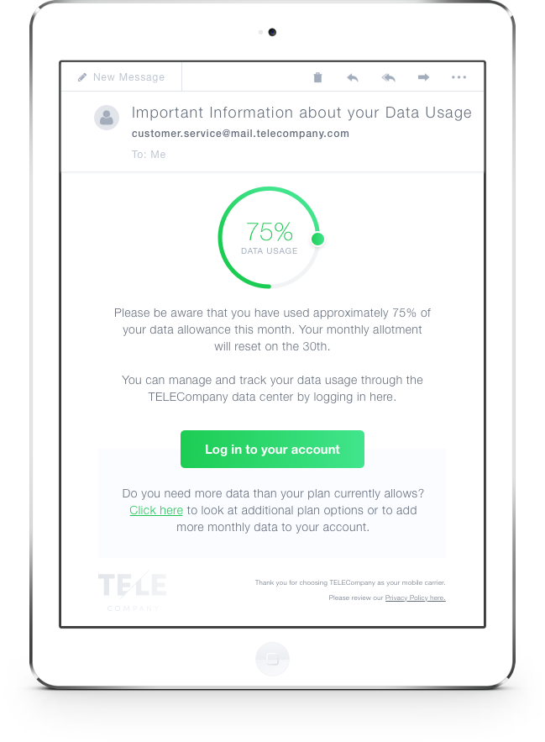
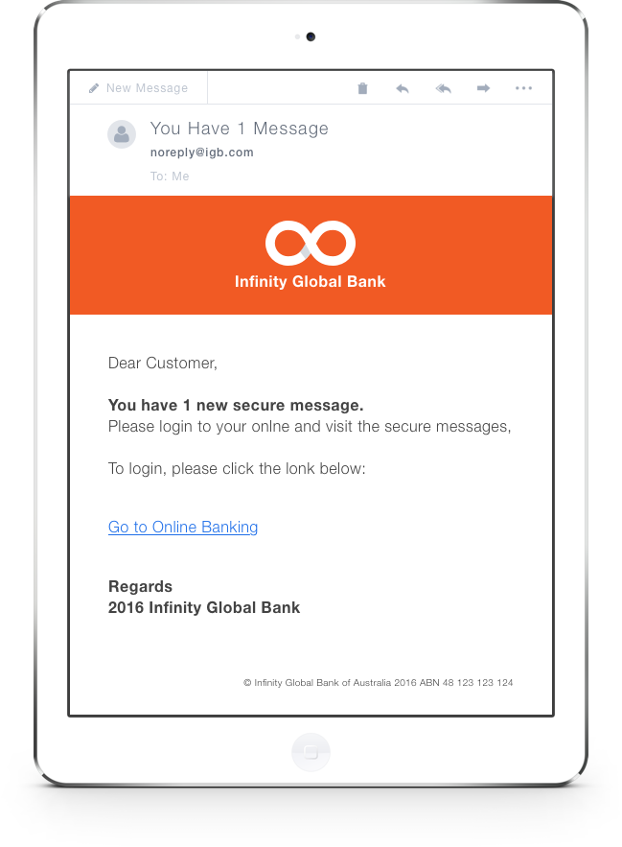
Can You Spot the Phish?
Notes:
Which of these do you think is phishing?

Slide 12
Can You Spot the Phish?
Phish
Genuine
Phish
Poor Spelling
Bad Formatting
Generic Salutation
Strange Wording
Poor punctuation
Poor spelling
Odd sign-off
Notes:
How did you get on this time?

Slide 13
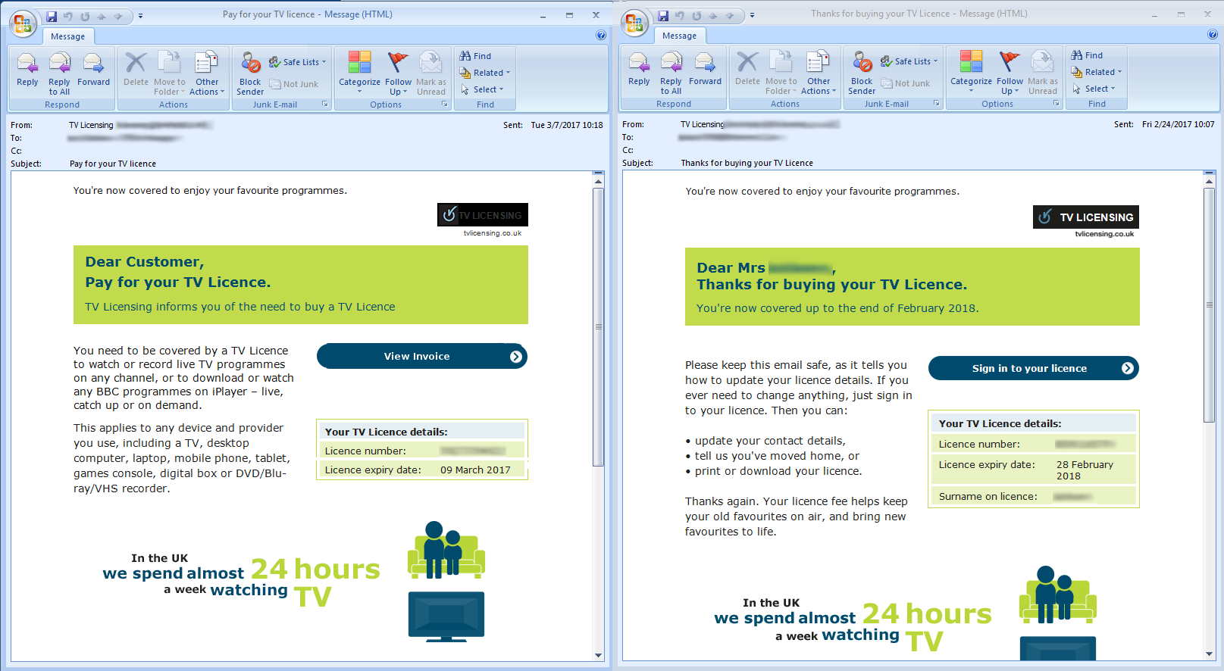
Genuine and Phishing Emails Are Often Very Similar
Phish
Genuine
Notes:
Phishing emails can be very, very convincing. This is an example of a UK TV licensing phish. You can see how similar the phishing email is to the genuine one.

Slide 14
Top 10 Phishing Email’s People Fall For
Email Subject | % Opened and Clicks
[JIRA] A task was assigned to you | 39%
Let's meet next week | 29%
Harassment Awareness Training | 26%
Car lights left on | 25%
eFax message from {Customer Name} - 2 page(s) | 24%
Traffic Citation for {Email First Name} {Email Last Name} | 22%
In arrears for driving on toll road | 21%
Suspicious male spotted outside {Customer Name} Building | 20%
PLEASE READ - Annual Employee Survey | 19%
New Email System at {Customer Name} -- Please Read | 18%
* Percentage of emails that were opened and user clicked on a link
Notes:
Phishing techniques continue to evolve. As people become more attuned to too-good-to-be-true emails with fabulous prizes, the crooks are moving towards simple, mundane emails that are less likely to stand out.
This research here shows the top 10 emails that people fell for in Sophos’ Phish Threat simulation training. As you can see, these are all very ‘normal’ email subject lines – topics that don’t usually raise any eyebrows.
The most effective phishing email referenced JIRA, a popular software tool, followed by a meeting request or a harassment training email – designed to make us panic and not go through usual security checks!
[CLICK]
These are just two examples of some of the types of email listed from the table.

Slide 15
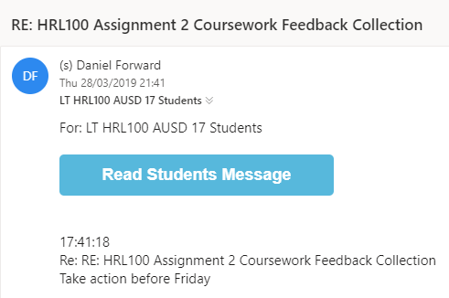
Cybercrooks Are Increasingly Crafty
Notes:
So you might think that if you’re a student with no money you won’t be targeted…
But your personal information and data is still valuable to people.
Above is a real life example of a student being attacked by a phishing email. You’ll also notice the sense of urgency with “take action before Friday” and forcing you to click on the link to find out more which is two stereotypical features to phishing emails.
This example also reiterates the point that mundane, transactional emails are the ones which people are most liable to click on.

Slide 16
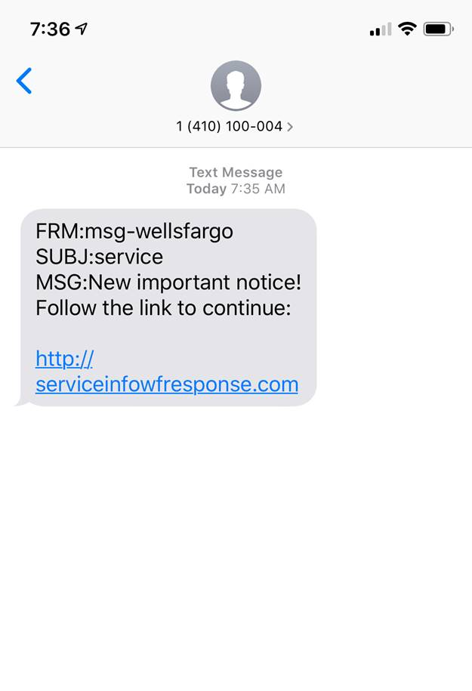
Not Limited to Emails
Notes:
Continuing from the last slide, phishing isn’t just limited to emails.
Phishing texts are common too and can be sometimes hard to identify. That’s because there is a lot less features and obvious giveaways of it being a phish.
They are short but sweet which is why they don’t look as suspicious.
Here is an example.

Slide 17
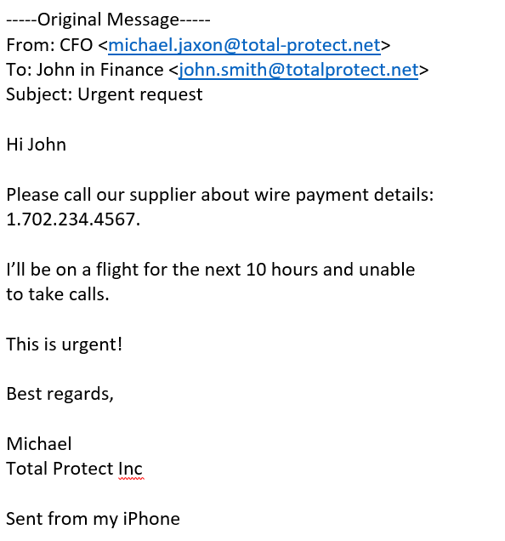
Don’t be Fooled by Format
Notes:
Following on from the theme of ‘normal’ email subjects, crooks are also moving away from fancy email formatting and are also using simple formats that appear to come from a phone – further increasing urgency.
In this example here, the attacker has spoofed the CFO’s email address (see it’s total hyphen protect, not total protect), and makes it seem that the email is sent by his iPhone to make it more convincing.

Slide 18
Importance of Training
% that consider it a top-three security risk
1
Phishing emails 50%
2
People (internal staff, contractors, visitors) 49%
3
Software exploits 46%
4
Insecure wireless networking 36%
5
Unknown devices 31%
Notes:
Having learnt about phishing, you won’t be surprised that phishing emails are considered the biggest security risk by organizations across the globe.
And that is why it is so important that we all take the time to understand how to spot a phishing email, and make sure we apply this learning every day.
The security of our organization is in our hands.

Slide 19
Ten Tell Tale Tips to Spot Phishing Emails

Slide 20
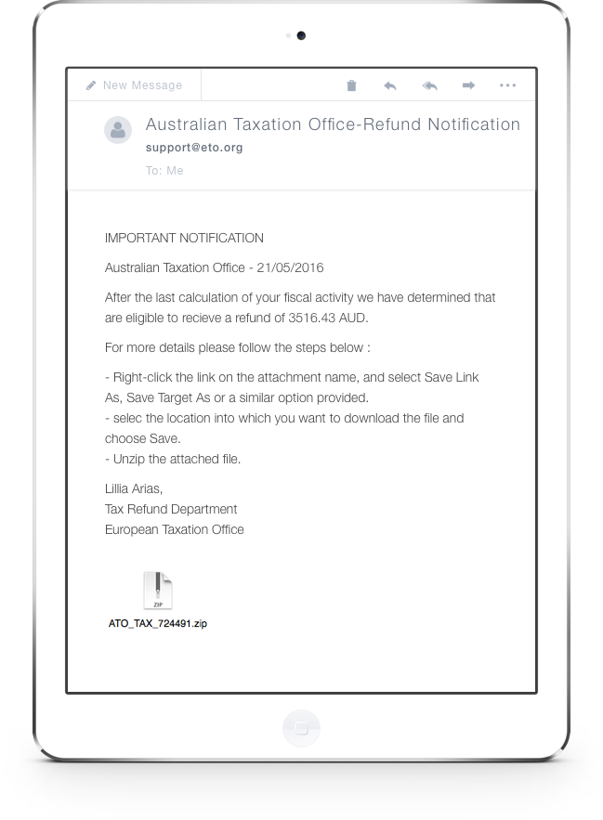
Ten Tell-Tale Signs of Phishing
1. Just doesn’t look right
Something off?
Too good to be true?
Trust your instincts
Too good to be true!
Notes:
Is there something a little off with the emails? Too good to be true? Trust your instincts if they tell you to be suspicious.

Slide 21
Ten Tell-Tale Signs of Phishing
1. Just doesn’t look right
2. Generic salutations
Generic Salutation
Notes:
Instead of directly addressing you, phishing emails often use generic salutations like “Dear Customer.” Using impersonal salutations saves the cybercriminals time so they can maximize their number of potential victims.

Slide 22
Ten Tell-Tale Signs of Phishing
1. Just doesn’t look right
2. Generic salutations
3. Official-looking site asking you to enter sensitive data
Sign in and provide sensitive (valuable) data
Notes:
These spoofed sites are often very convincing, so before revealing personal information or confidential data examine the site to make sure it’s real.

Slide 23
Ten Tell-Tale Signs of Phishing
1. Just doesn’t look right
2. Generic salutations
3. Official-looking site asking you to enter sensitive data
Specific on you
4. Unexpected email; specific information on YOU
Unexpected, from Senior Manager
Notes:
Information like job title, previous employment, or personal interests can be gleaned from social networking sites like LinkedIn and then used to make a phishing email more convincing.

Slide 24
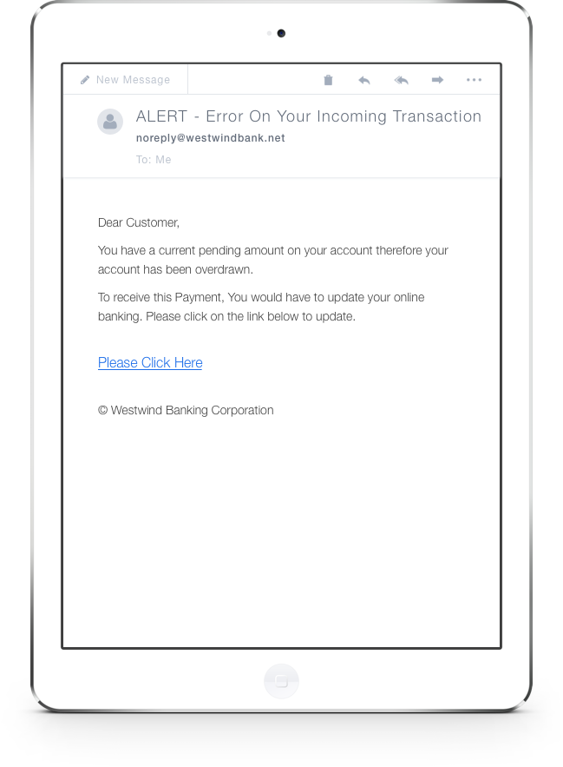
Ten Tell-Tale Signs of Phishing
1. Just doesn’t look right
2. Generic salutations
3. Official-looking site asking you to enter sensitive data
4. Unexpected email; specific information on YOU
5. Unnerving wording
Cause concern
Notes:
Thieves often use phrases meant to scare you (such as saying your account has been breached) to trick you into acting without thinking, and in doing so revealing information you ordinarily would not.

Slide 25
Ten Tell-Tale Signs of Phishing
Phish
1. Just doesn’t look right
2. Generic salutations
3. Official-looking site asking you to enter sensitive data
4. Unexpected email; specific information on YOU
Poor grammar
5. Unnerving wording
6. Poor grammar or spelling (or both)
Poor spelling
Notes:
Poor grammar or spelling is often a dead giveaway. Unusual syntax is also a sign that something is wrong.

Slide 26
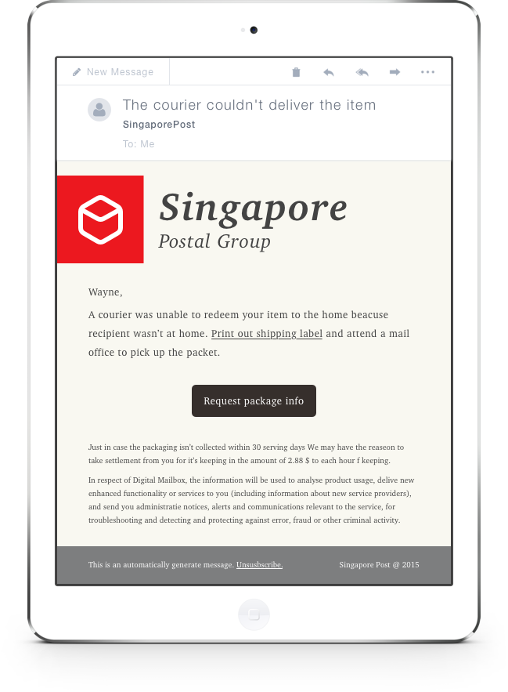
Ten Tell-Tale Signs of Phishing
1. Just doesn’t look right
2. Generic salutations
3. Official-looking site asking you to enter sensitive data
4. Unexpected email; specific information on YOU
5. Unnerving wording
6. Poor grammar or spelling (or both)
Urgency
7. Sense of urgency
Notes:
For example: “If you don’t respond within 48 hours, your account will be closed.” By convincing you the clock is ticking, thieves hope you’ll make a mistake.

Slide 27
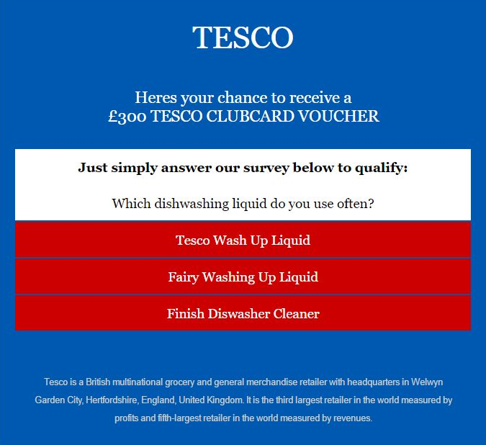
Ten Tell-Tale Signs of Phishing
1. Just doesn’t look right
Survey with incentive
2. Generic salutations
3. Official-looking site asking you to enter sensitive data
4. Unexpected email; specific information on YOU
5. Unnerving wording
6. Poor grammar or spelling (or both)
7. Sense of urgency
8. “You’ve won the grand prize” or take survey
Notes:
“You’ve won the grand prize!” or “You’ve got a parcel”. These phishing emails are common, but easy to spot. A similar, trickier variation is asking you to complete a survey in return for a prize.

Slide 28
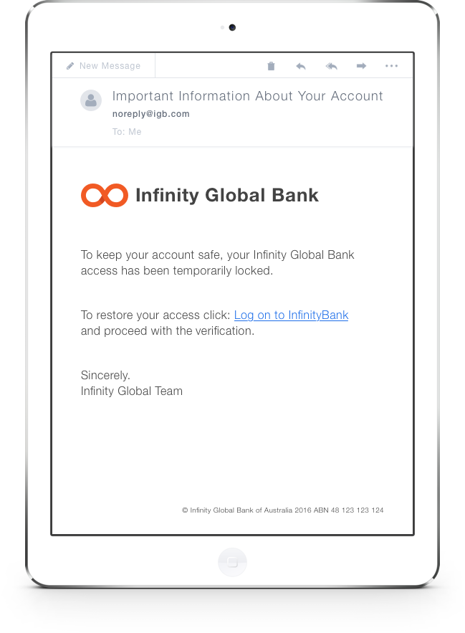
Ten Tell-Tale Signs of Phishing
1. Just doesn’t look right
2. Generic salutations
3. Official-looking site asking you to enter sensitive data
4. Unexpected email; specific information on YOU
5. Unnerving wording
6. Poor grammar or spelling (or both)
Visit site and enter sensitive data
7. Sense of urgency
8. “You’ve won the grand prize”
9. “Verify your account”
Notes:
These messages spoof real emails asking you to verify your account with a site or organization. Always question why you’re being asked to verify – there’s a good chance it’s a scam.

Slide 29
Ten Tell-Tale Signs of Phishing
1. Just doesn’t look right
2. Generic salutations
www.g00gle.com
vs.
www..google.com
3. Official-looking site asking you to enter sensitive data
4. Unexpected email; specific information on YOU
5. Unnerving wording
6. Poor grammar or spelling (or both)
7. Sense of urgency
8. “You’ve won the grand prize”
9. “Verify your account”
10. Cybersquatting
Notes:
Often, cybercriminals will purchase and “squat” on website names that are similar to an official website in the hopes that users go to the wrong site, such as www.google.com vs. www.g00gle.com. Always take a moment to check out the URL before entering your personal information.

Slide 30

Handy Checklist
PHISH
Promises
Harassment
Instincts
Sense of Urgency
Hit DELETE
Notes:
We know this is a lot of information to take in one go so we’ve created a handy checklist!
This is aimed to be use when looking at an email to try and unpick the suspicious behavior and pick out those phishing emails.
P: Promises unbelievable things?
H: Harassment to get you to reply?
I: Instincts does it ‘feel’ wrong?
S: Sense of urgency? Insisting you do something?
H: In that case, Hit delete!
If in doubt, report it to your IT team and hit delete to make everyone else in the company aware of the phish!

Slide 31
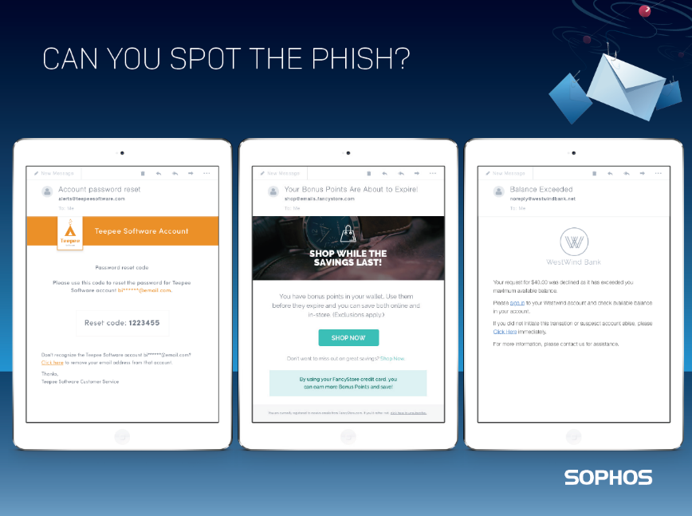
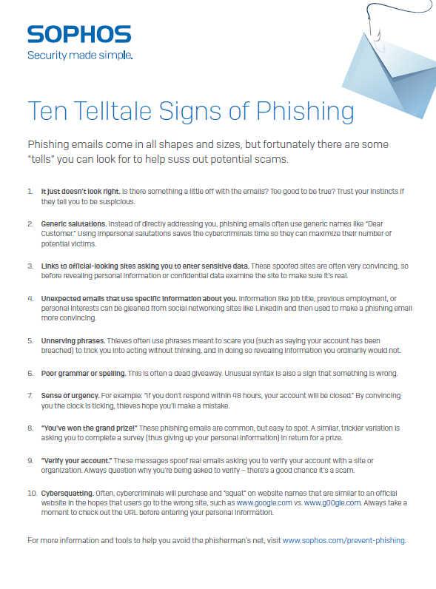
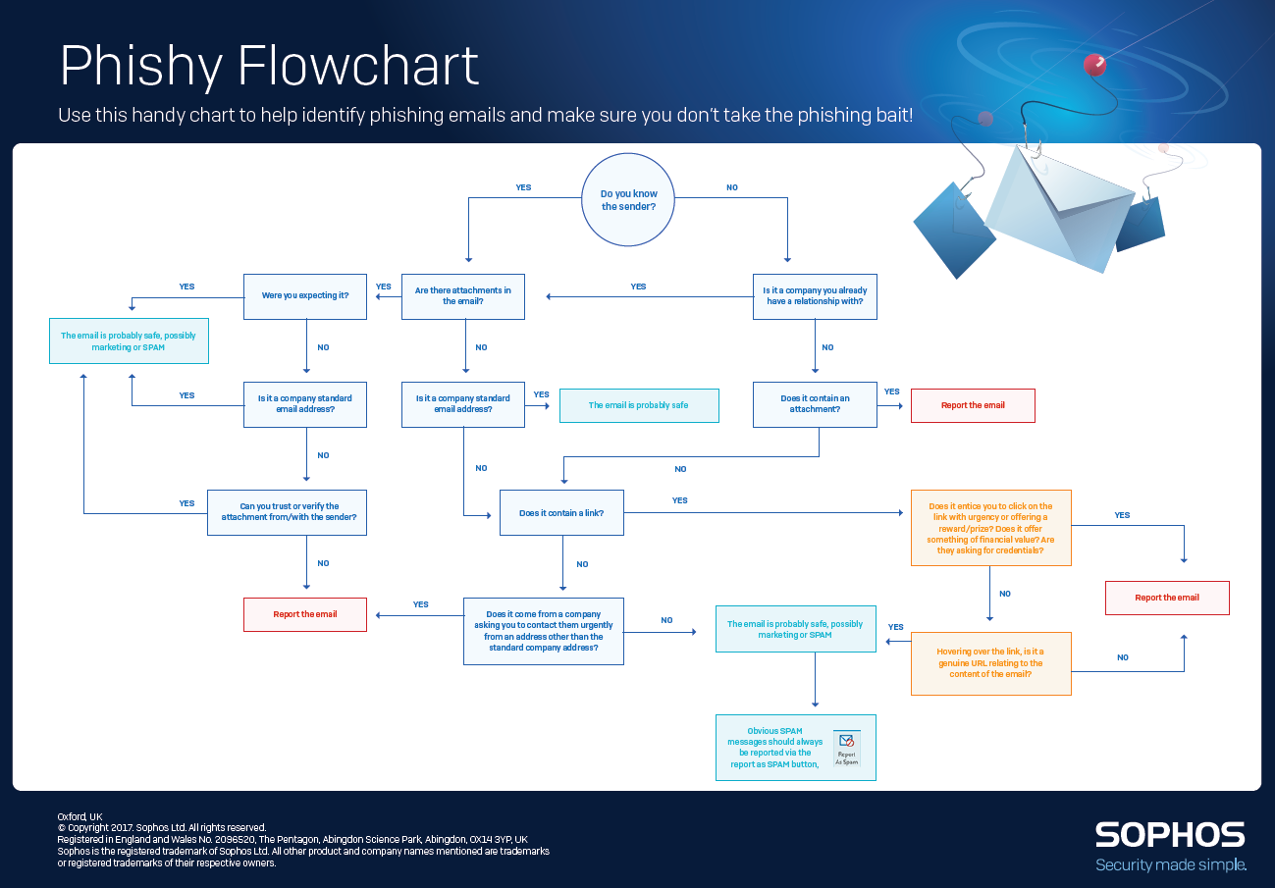
Resources to Help You Spot Phishing
10-tips to spot phishing emails
Phishy Flowchart
www.Sophos.com/prevent-phishing
Notes:
There are some handy resources to help you spot phishing at www.sophos.com/prevent-phishing

Slide 32
And Some Extra Online Banking Tips
Never respond to emails requesting personal financial information
Visit bank websites by typing their URL in the address bar
Keep a regular check on your accounts
Notes:
And here are some other tips to help make sure you don’t take the phishing bait.

Slide 33


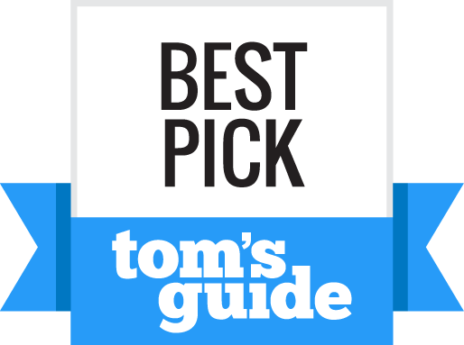
Sophos Home: Free Home PC and Mac Protection
“Our test was flawless…”
“Best-in-class protection…while leaving a small performance impact.”
“…able to detect and remove all malware samples 100 percent”
  www.sophos.com/home

