Slide 1
Remote Learning for Teachers Already Using Seesaw

Slide 2
Seesaw brings together students, teachers, and families to deepen student learning.
Remote learning is a core part of Seesaw’s Learning Loop.

Slide 3
Learning at Home is Different...
A child’s home and community is a unique, powerful learning environment.
Teachers and family members need to work together to support continuous learning experiences.
Content that integrates the home environment and relationships makes remote learning more effective.
It is not realistic to replicate the school day at home. Focus on high priorities and encourage families to look for daily learning moments they can enjoy together..
Supporting students to work independently is important. Because students are working at home, we need to provide content that respects the family role and gives families the tools they need to support their child.
Based on research by Epstein, Mapp, Moll, Yosso, and The Developmental Assets® Framework

Slide 4
Set Up Remote Learning with Seesaw

Slide 5
Get ready to watch
Seesaw supports home learning around the world

Slide 6
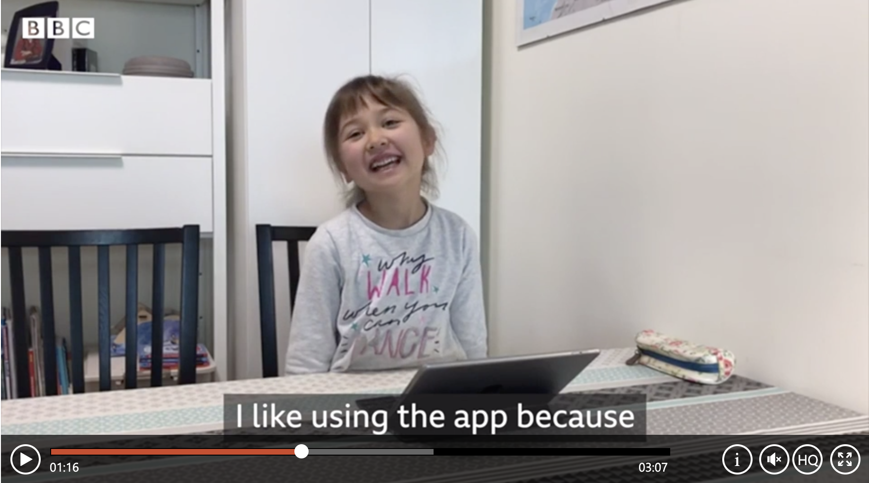
Video link: https://www.msn.com/en-sg/video/watch/keeping-kids-learning-during-a-coronavirus-outbreak/vi-BB10dVOI
Notes:
Video link: https://www.msn.com/en-sg/video/watch/keeping-kids-learning-during-a-coronavirus-outbreak/vi-BB10dVOI

Slide 7
Get Students
Set Up for
Home Learning
Notes:
SEESAW FOR SCHOOLS TEACHERS: Your administrator MAY get your students’ codes for you. If your administrator wants you to get students codes, they will need to enable this setting in their admin dashboard.

Slide 8
Students already using email or Clever badges to sign in can continue to do so.

Slide 9
Families Play an Important Role
Encourage families to...
Create a home learning routine and distraction-free space.
Support learning at home by collaborating with (vs. instructing) students to complete assignments
Provide positive, encouraging feedback that reinforces a growth mindset
Feel ok about not having all of the answers
Here are home learning ideas to share with families: English | Spanish
Notes:
Home learning ideas in English:
https://docs.google.com/document/d/1HGDDYZ1LD0LeNkzvEeMeIduDUQ72khmmsBwgsw2KZo0/edit?usp=sharing
Home learning ideas in Spanish: https://docs.google.com/document/d/1g432FWQHvyO4u5EDLkiKOERou9n3EyOomcU98Ma4Vc0/edit?usp=sharing

Slide 10
Designing Engaging Home Learning Experiences

Slide 11
LEVER # 1
Include Family Members
Push student thinking forward by creating content that gets students interacting with family members and takes advantage of learning moments that happen daily at home.
Invite students to:
Engage in simulations, role plays, and interviews
Do shared reading exercises
Share day-to-day tasks like errands, laundry, cooking, chores
Ideas for activities that leverage home and family: English | Spanish
Notes:
Home and family activities in English: https://docs.google.com/document/d/1HGDDYZ1LD0LeNkzvEeMeIduDUQ72khmmsBwgsw2KZo0/edit?usp=sharing
Home and family activities in English:
https://docs.google.com/document/d/1g432FWQHvyO4u5EDLkiKOERou9n3EyOomcU98Ma4Vc0/edit?usp=sharing

Slide 12
LEVER #2
Include Physical Items
Talk about culturally responsive pedagogy - the home offers a breadth of assets and items that can be used to push student thinking forward in equitable and relevant ways.
Invite students to:
Access and use their physical space
Use items around the house in learning experiences, artifacts can include picture, heirlooms, kitchen utensils
Use objects as props to tell stories and build oral language

Slide 13
LEVER #3
Include Open-Ended ?s
Learning from home provides students with the gift of time and choice. Asking open-ended questions means students can think critically, pursue topics of interest, explore multiple points of view, and problem solve in a variety of ways.
Invite students to:
Consider questions that don’t have specific, predetermined answers.
Analyze, deconstruct and redesign things they are curious about.

Slide 14
Learning at Home Strategies
Relationships:
Students need to feel surrounded by supportive, caring relationships. Continue to connect and engage with students virtually.
Routines:
Students feel safer and more secure when they know what to expect and when to expect it. Set a schedule for you, and encourage families to stick to routines at home.
Ongoing Encouragement:
Use Seesaw and other tools to provide motivation and positive reinforcement. Use technology as a serve and return, so you are responsive to students’ learning moments.

Slide 15
Need Ideas?
Keep in mind, it is not realistic to completely replicate your classroom at home.
Here's a curriculum map to get you started
This resource includes links to ready-to-go Seesaw Activities, organized by grade and subject. Plus, each activity includes a description so it can be completed without tech.
Find more ideas in the Seesaw Activity Library

Slide 16
If you need a refresher...
Create activities in Seesaw

Slide 17
STEP 1: Click the green Add+ button and choose Assign Activity.
STEP 2: You’ll be in My Library. Choose Create New Activity.
STEP 3: Enter the title and directions, add multimedia instructions or an example, add a template. And more!
STEP 4: Click Save.
STEP 5: You’ll be back in My Library. Click Assign, choose the class or specific students. Click Assign.
Your activity will show up in the Activities tab.
Notes:
What are templates?
Students will complete the activity using the template. They will be able to use all learning tools on top of anything you upload here.
Video link: https://youtu.be/JN0ry2kFlM0

Slide 18
The Seesaw icons shortcuts (referenced in the video)
can be found HERE.
Great resource!
Notes:
Icon shortcuts link: https://help.seesaw.me/hc/en-us/articles/115005120583-Seesaw-Icon-Shortcut

Slide 19
We created a map of ready-to-go Seesaw activities for home learning organized by grade and subject.
You can find it HERE.
Notes:
Link to activities: here

Slide 20
Communicating with
students and families...
If families are already connected on the Family app, we recommend sending all Seesaw Announcements to both students and families. The Family app provides one-on-one messaging and translation.
If you have not yet connected families on the Family app, we recommend keeping it simple and communicate with students and families via the Class app. Note: If one-on-one messaging or translation is important, learn how families use the Family app here.

Slide 21
Troubleshooting & FAQs
Due to unusually high demands on our Help Center at this time, we kindly ask that you try to find the answer to your questions before submitting a help ticket. Here are three resources to help:
Main site for teachers: web.seesaw.me/remote-learning
FAQs: http://bit.ly/RemoteFAQs
Live Help Webinar: http://bit.ly/LIVEhelp

Slide 22
We’d love your feedback!
We are learning right alongside you!
Please take 60 seconds to answer 2 questions here.
Notes:
Survey link: https://docs.google.com/forms/d/e/1FAIpQLSeu4JjuGO74QVCNXyoPflKWLI3FLPMcBu7HLnNgIg65PNSl2w/viewform?usp=sf_link

