Slide 1
PPS Data Dashboard Overview
Dr. Jala Olds Pearson
Chief Academic Officer
May 2, 2023

Slide 2
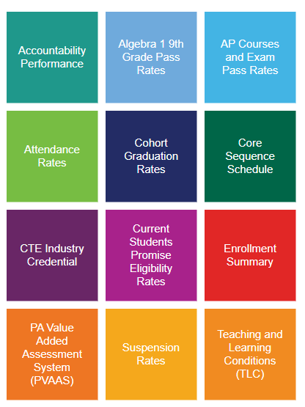
Agenda
Our "Why"
Alignment to the Superintendent’s Goals
Overview of the PPS Data Dashboard

Slide 3
Data Dashboard and Our "Why"
Unapologetically Student First
Data, Research, and Evidence-Based
Decision Making
Educate, Collaborate, and Expand
Stakeholder Engagement & Partnerships

Slide 4
Superintendent’s Goals
Invest
Construct
Construct safety, health, and wellness protocols.
Expand
Expand stakeholder communication and partnerships.
Design
Design effective organizational systems.
Allocate
Strategically allocate resources to ensure equity, excellence, and efficiency.
Invest in culturally responsive, evidence-based training, tools, and instructional practices.
Notes:
Ann
1 Minute
Review the district goals. Today’s session will focus on Goal 1, which is ….... "Invest in culturally responsive, evidence-based training,…..."

Slide 5
PPS Data Dashboard
Fully accessible to all stakeholder groups
Includes relevant student data
Supports stakeholder engagement and partnership expansion
Students

