Slide 1
HACIENDA LA PUENTE UNIFIED SCHOOL DISTRICT
La Puente Quad
Los Altos Quad
Wilson Quad
Workman Quad
School Site Improvement Projects
Regular Board Meeting May 9th , 2024
Business Services
Notes:
Good evening Ma’dam President, Ms. Christine Salazar, Distinguish Board Members; Superintendent, Dr. Jimenez, Executive Cabinet, Colleagues, and community members.
A special greetings to our Principals, Administrators, staff member who are joining us via the virtual platform.

Slide 2
PROJECT COMPLETE LIST
2023-2024
Site | Item Description | Funding Source | Completed Date
Los Molinos | Basketball Court Restriping | Facilities | 04/2024
Lassalette | Basketball Court Restriping | Facilities | 04/2024
Sparks Elementary | Basketball Court Restriping | Facilities | 04/2024
Workman Elementary | Basketball Court Restriping | Facilities | 04/2024
Del Valle Headstart | Headstart Restroom Flooring | Child Development | 04/2024
Winglane Headstart | Headstart Restroom Flooring | Child Development | 04/2024
Los Molinos Elementary | Hillside Fencing | Facilities | 04/2024
Valinda School of Academics | Flooring Room K3 | Facilities | 04/2024
Workman Elementary | Flooring Front Office | Facilities | 04/2024
La Puente High School | Library Ceiling Repair & Paint | Facilities | 04/2024
Workman High School | Exterior Gym Lighting | Facilities | 04/2024
Changes And Progress Since Last Report - Blue

Slide 3
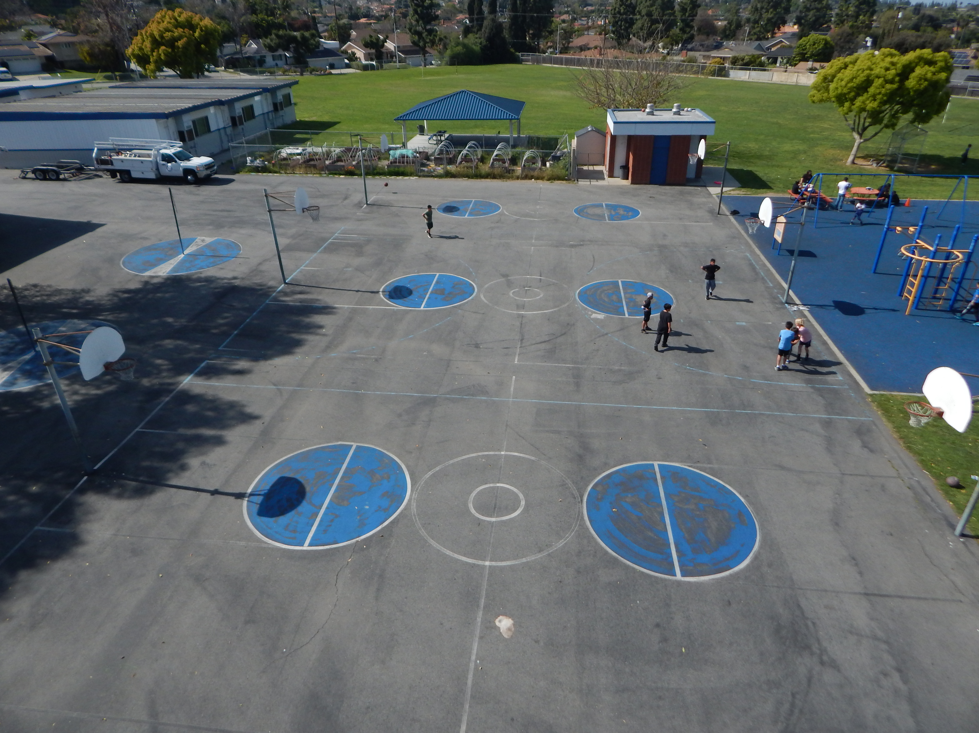
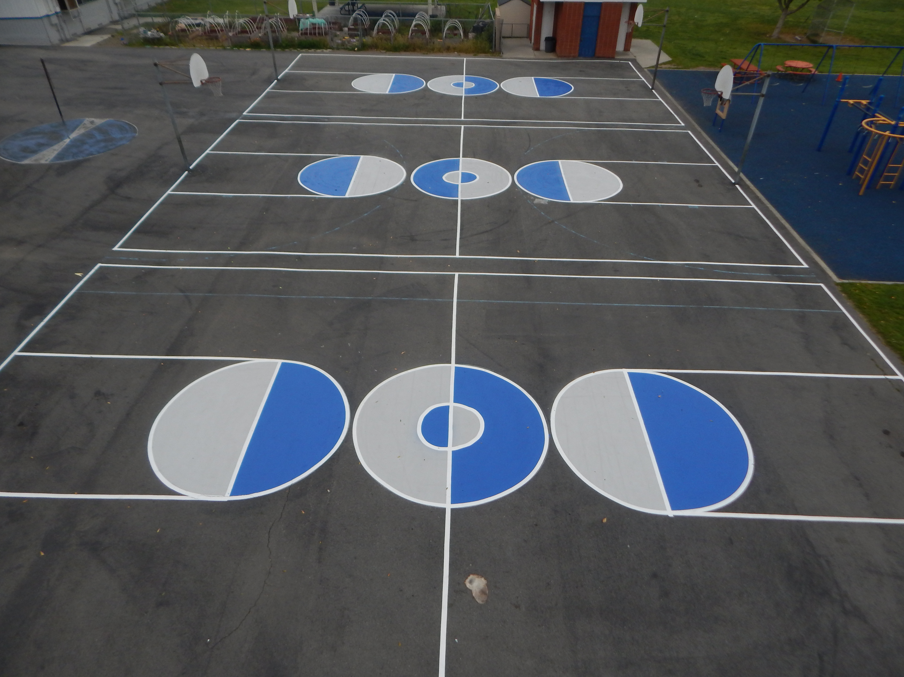
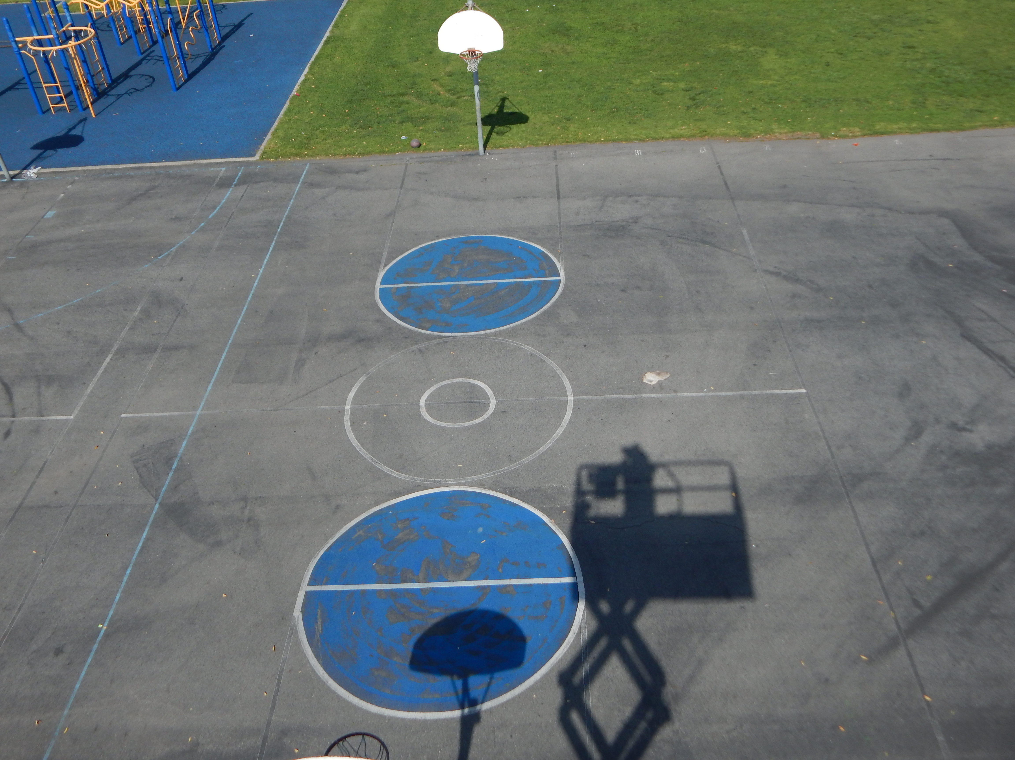
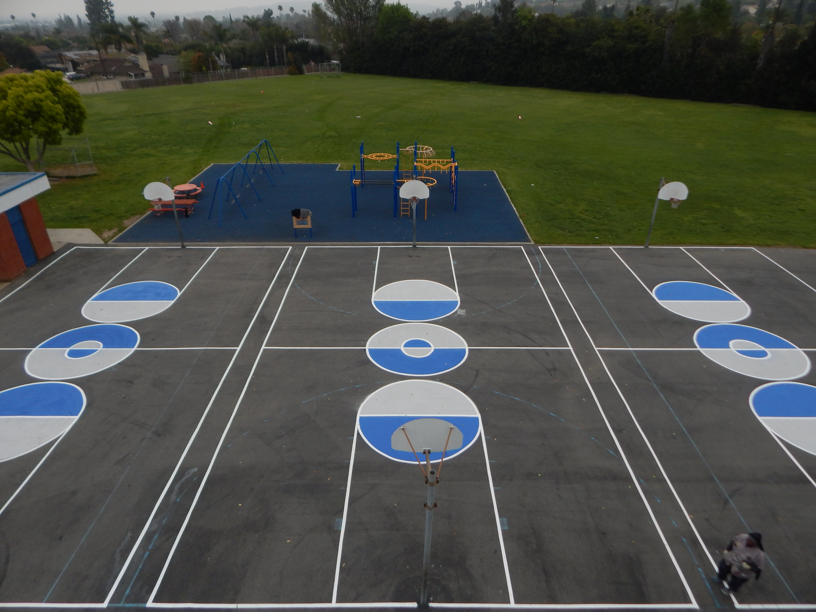
Projects Completed as of May 9th, 2024 Los Molinos Elementary- Restriping Basketball Courts
BEFORE
AFTER
BEORE
AFTER

Slide 4
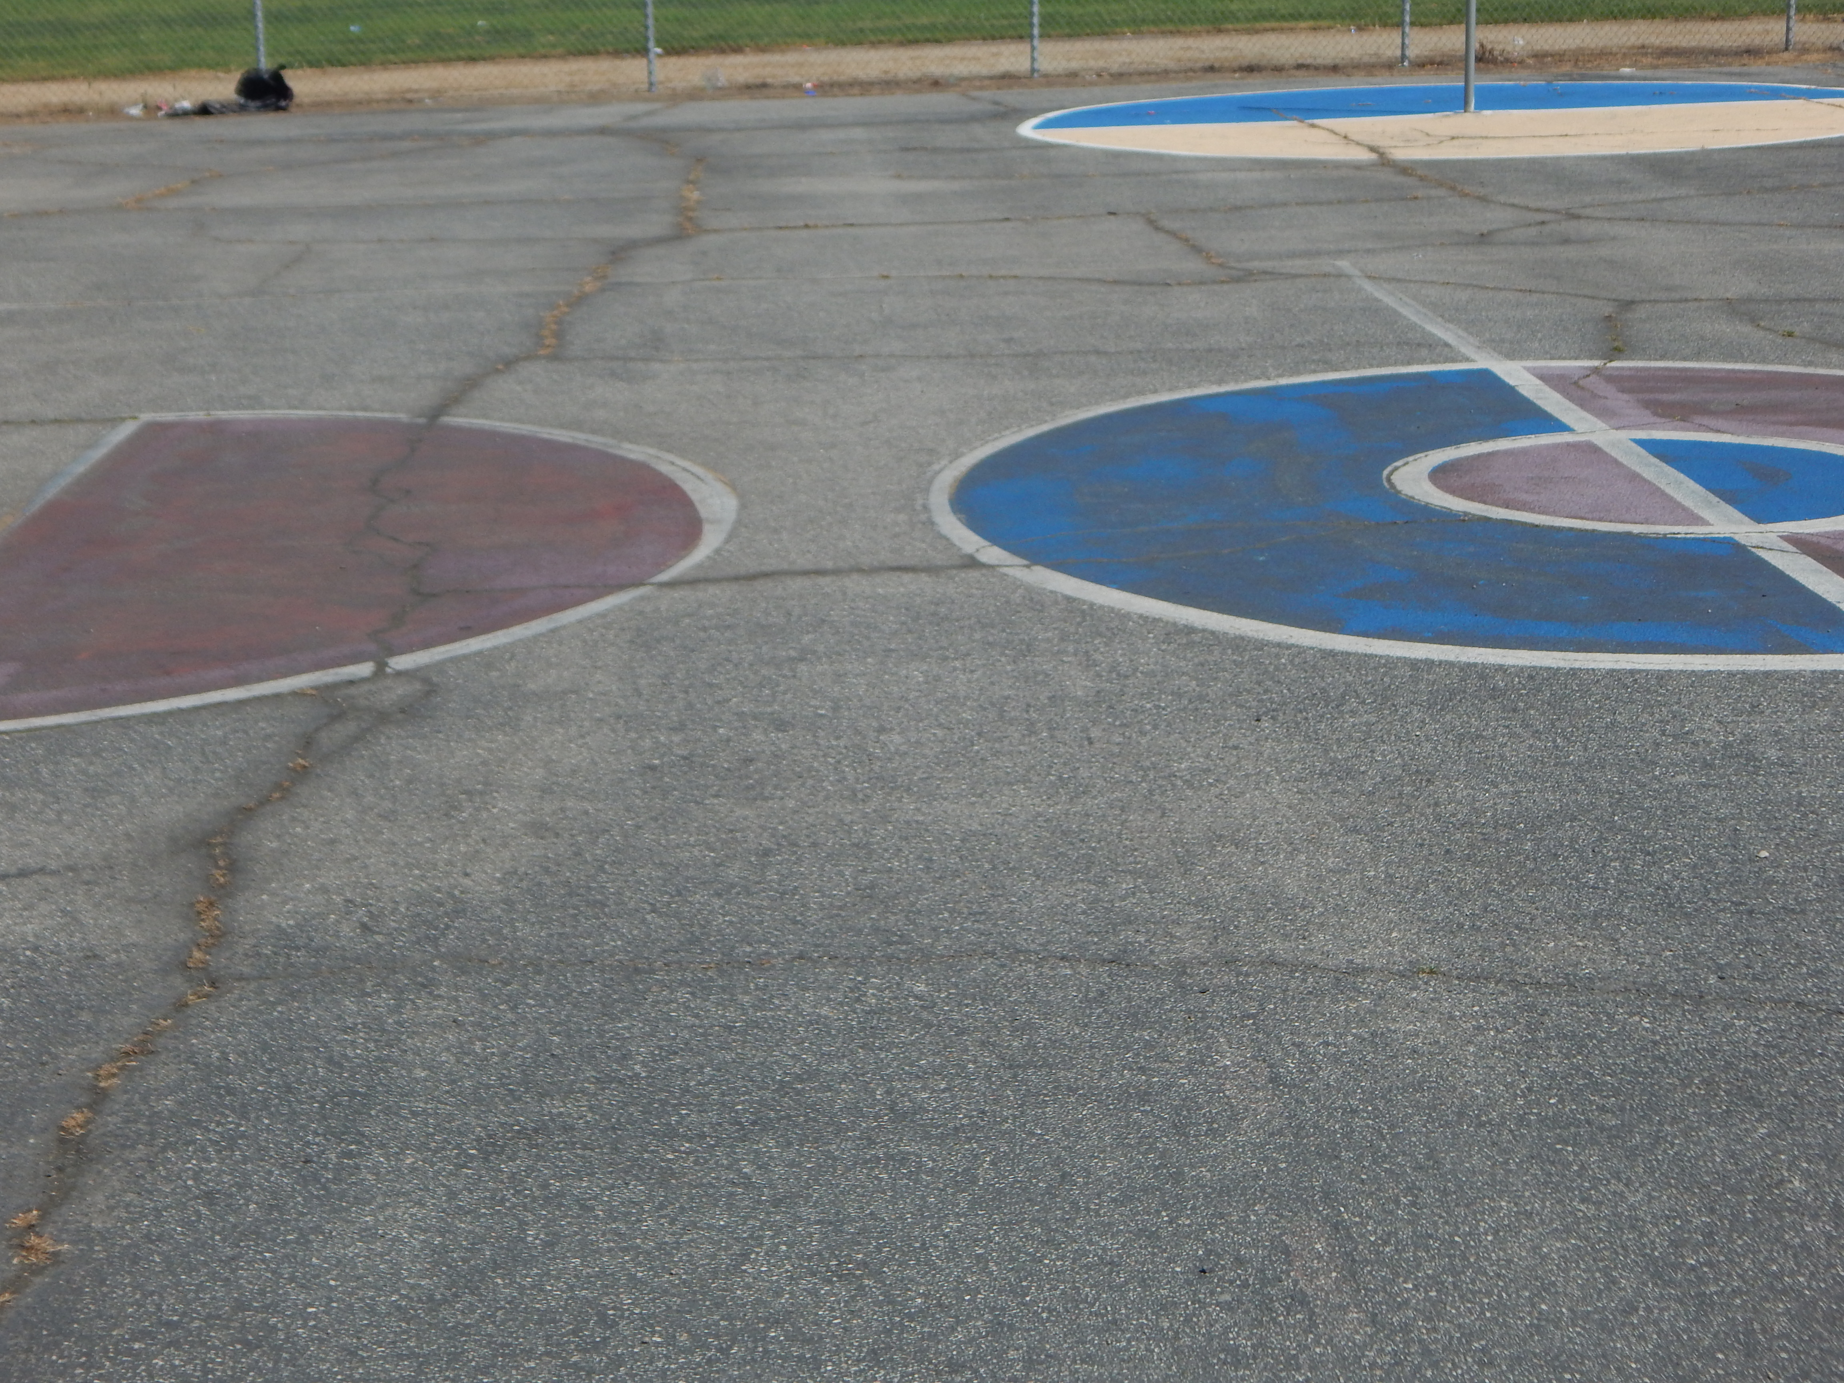
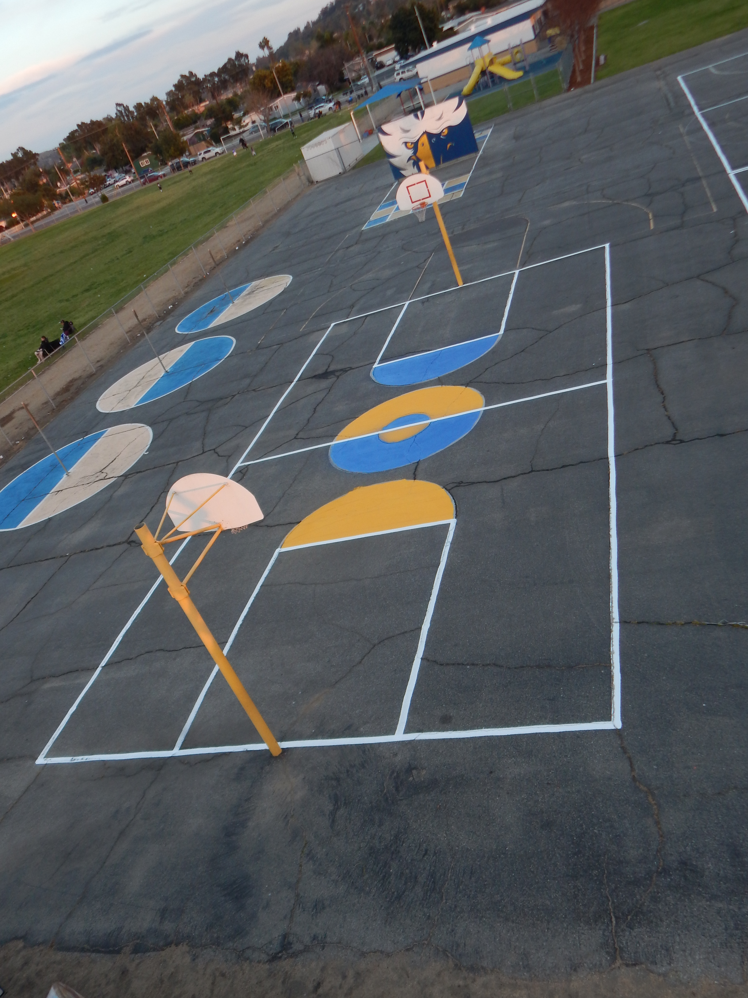
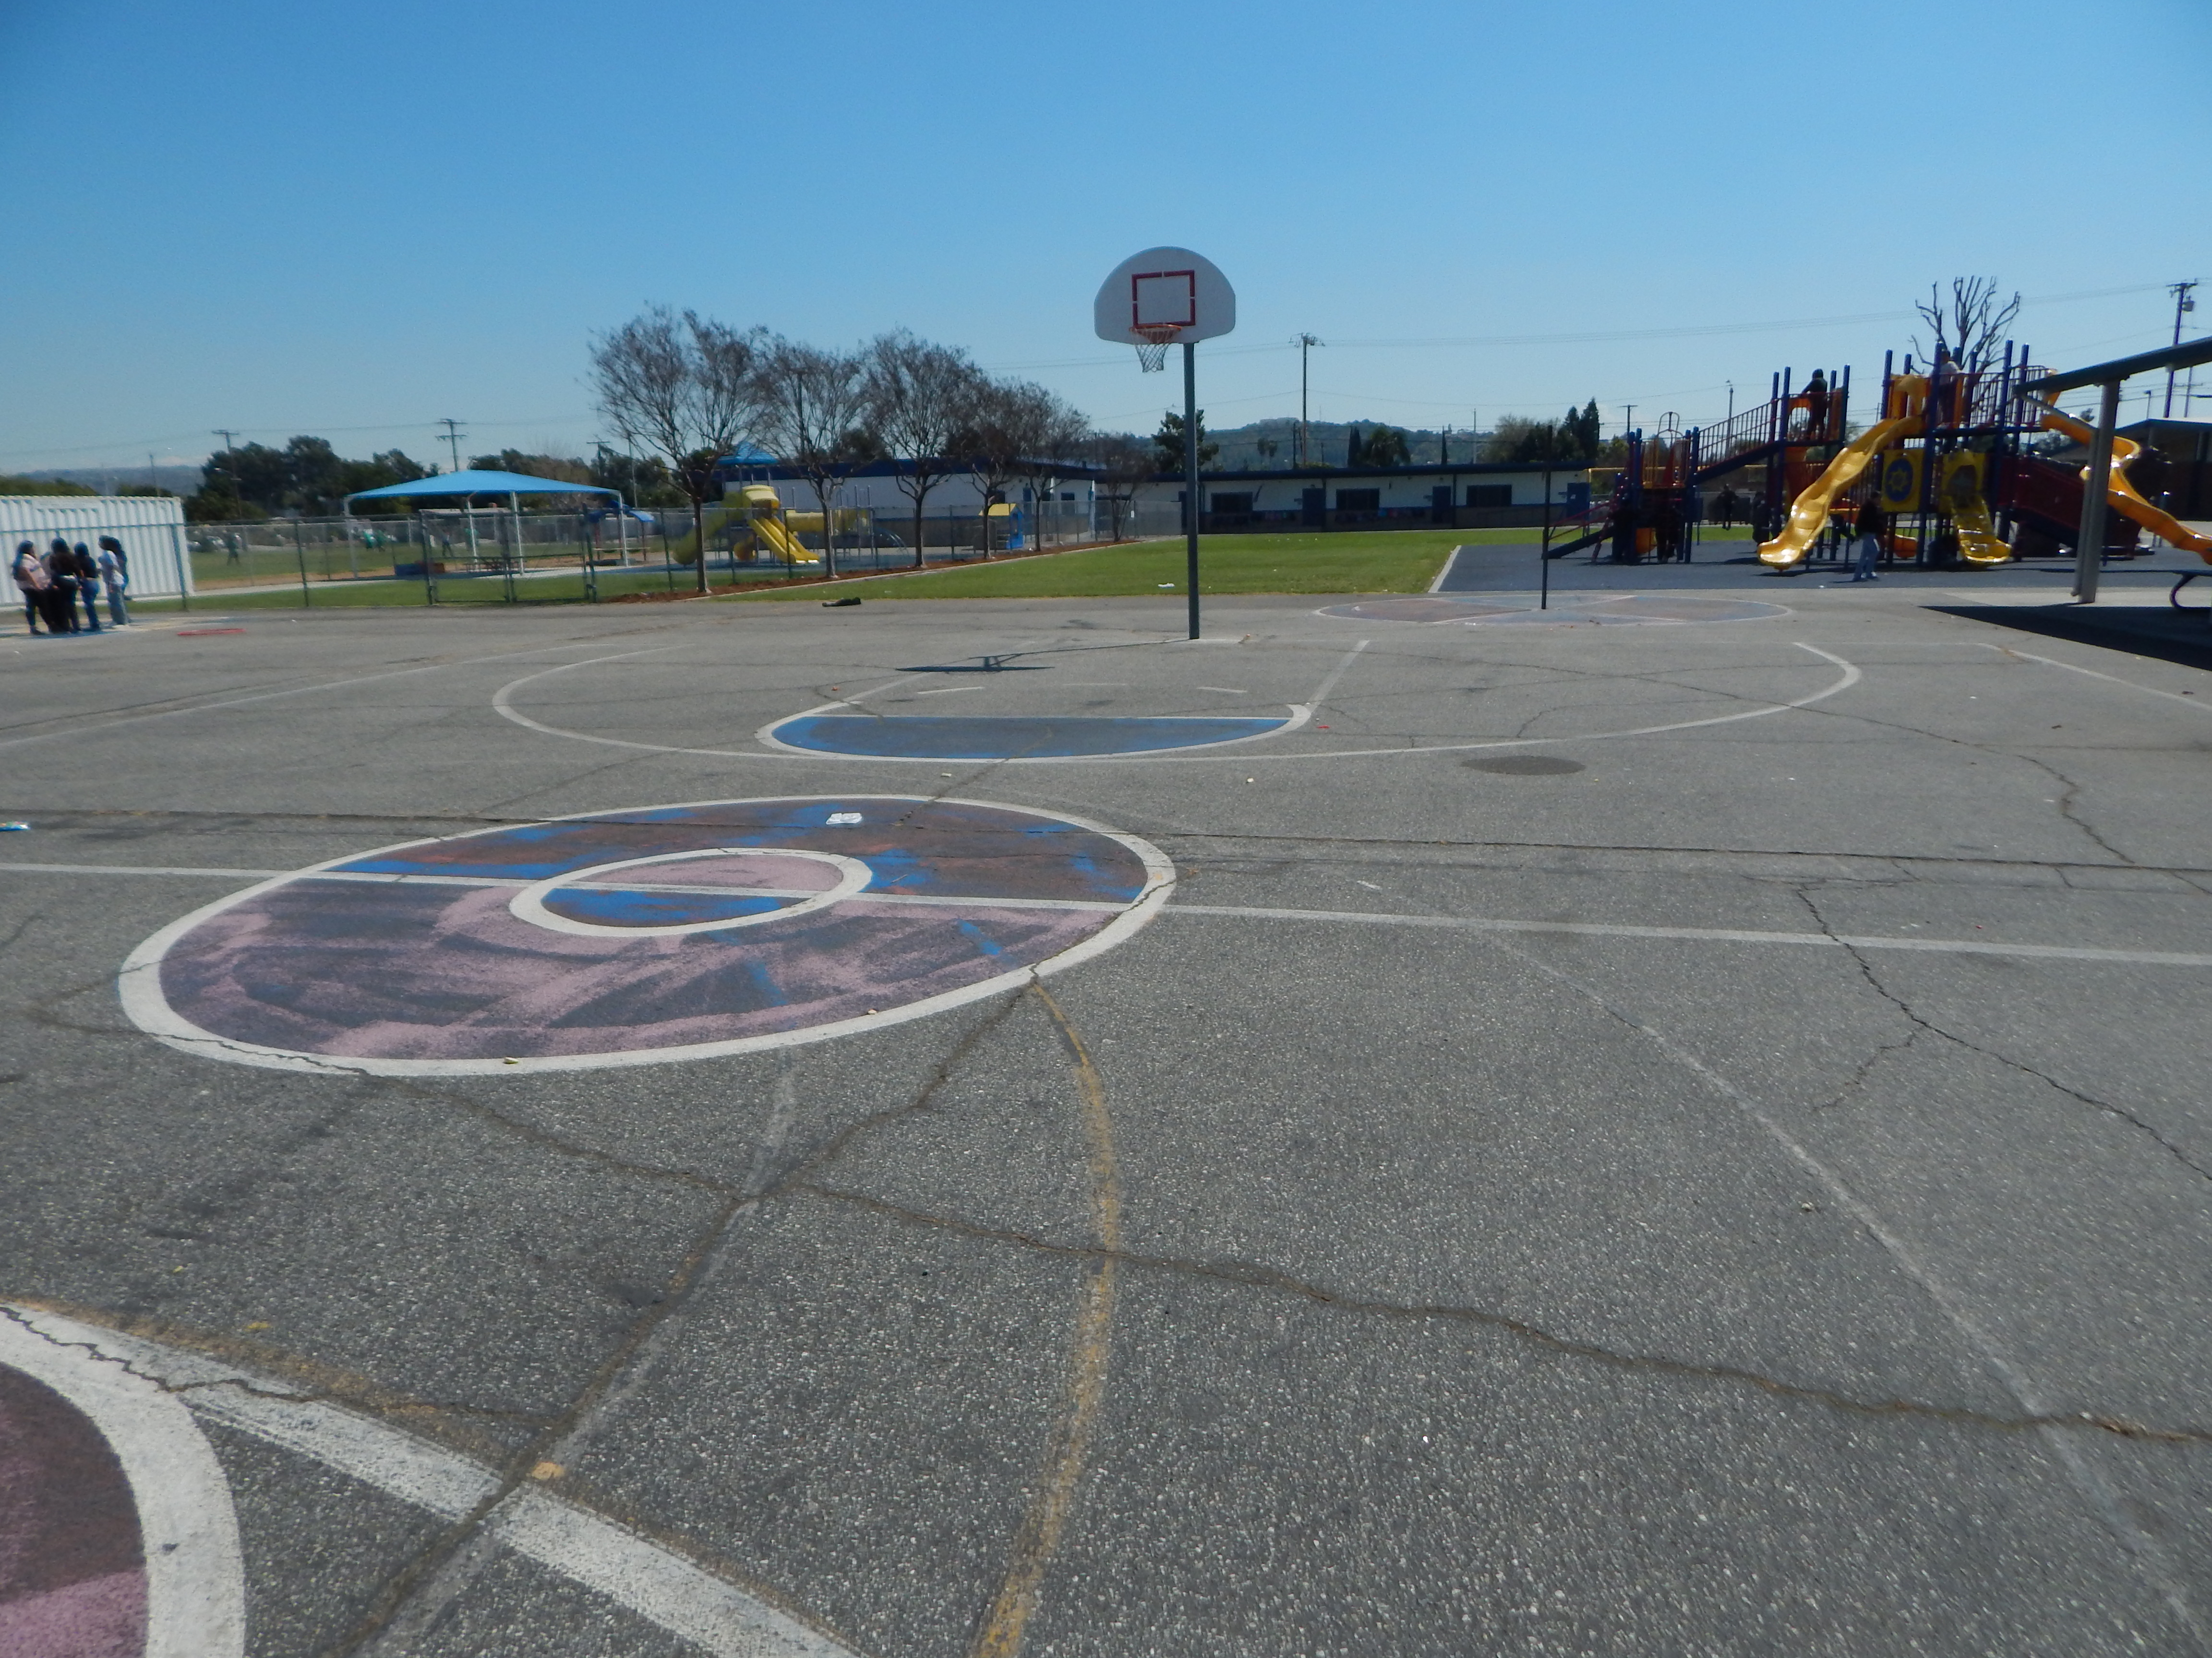
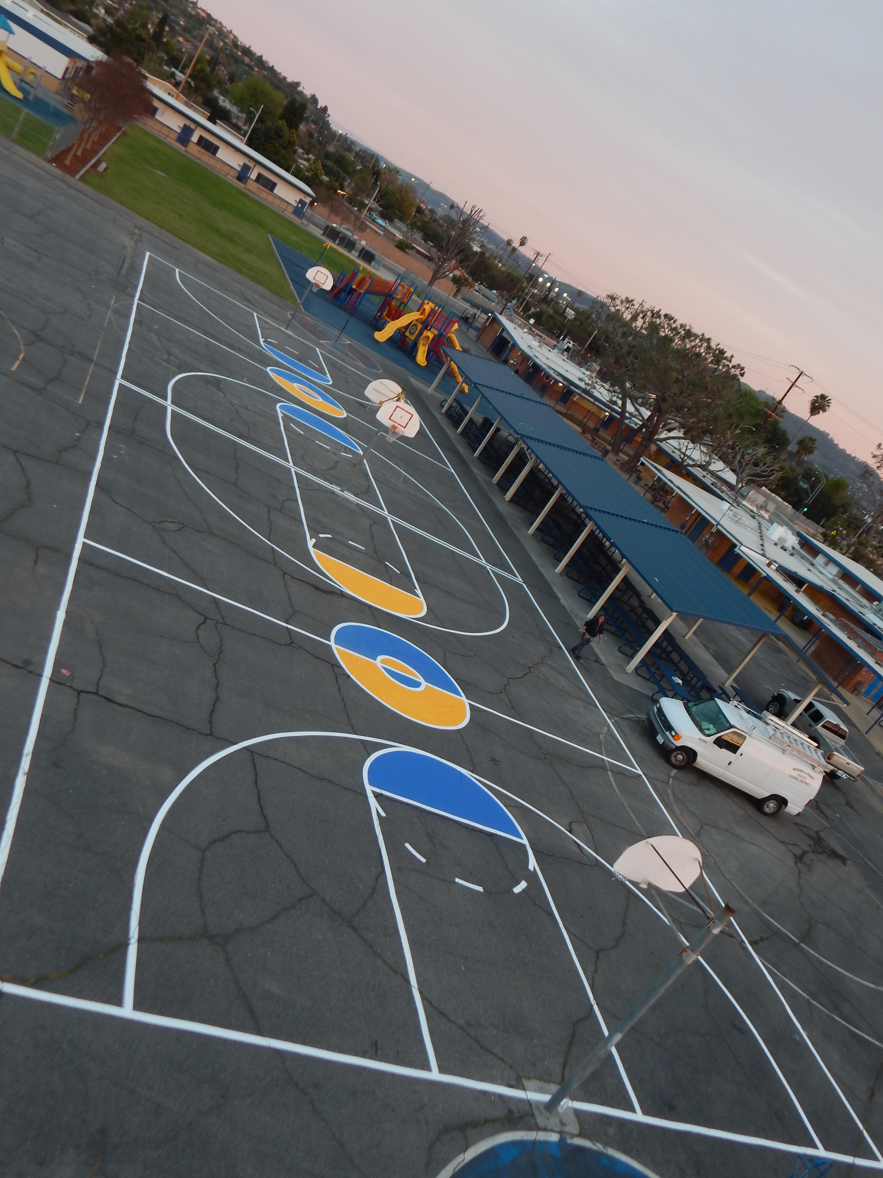
Projects Completed as of May 9th, 2024 Sparks Elementary- Restriping Basketball Courts
BEFORE
AFTER
BEORE
AFTER

Slide 5
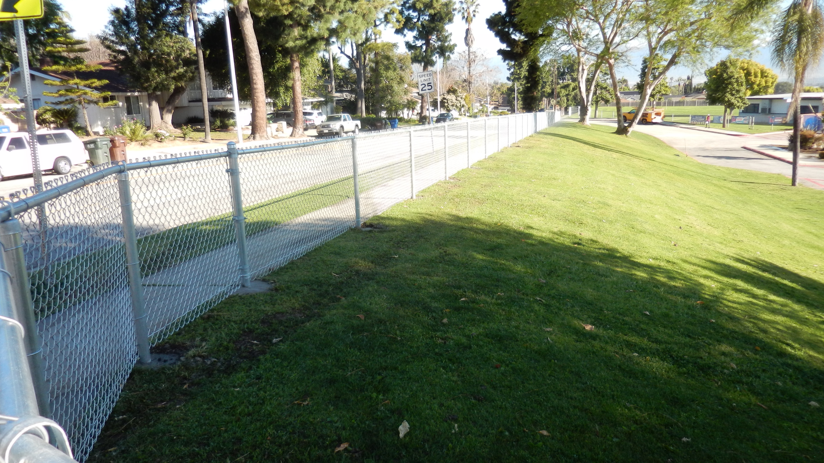
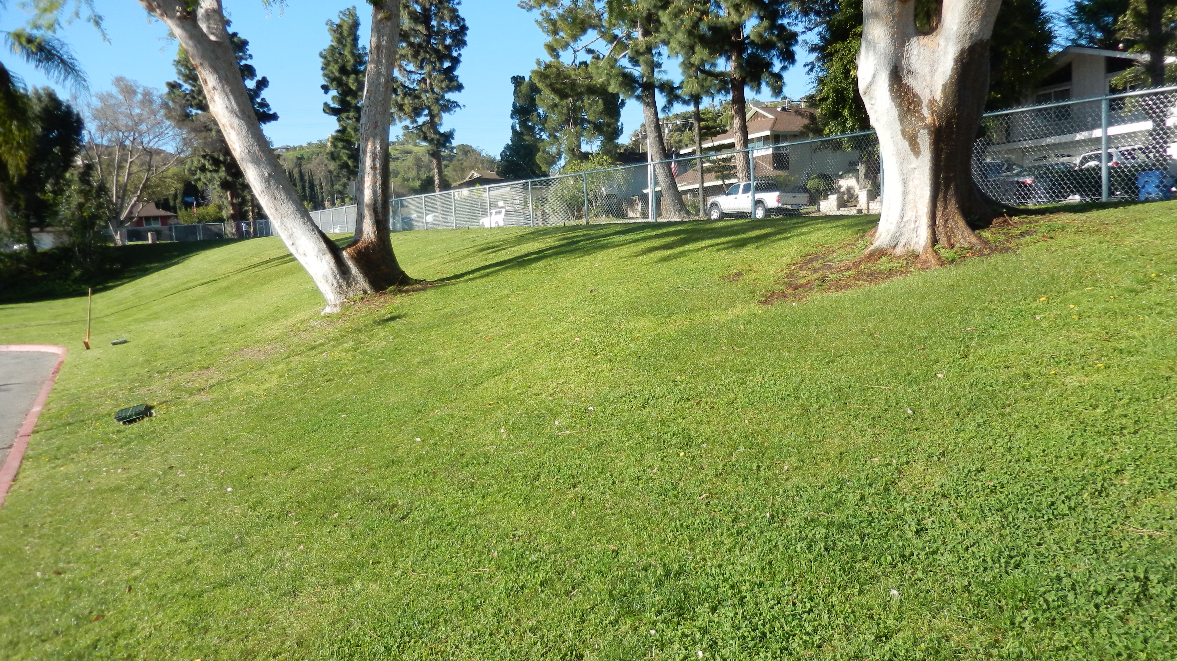
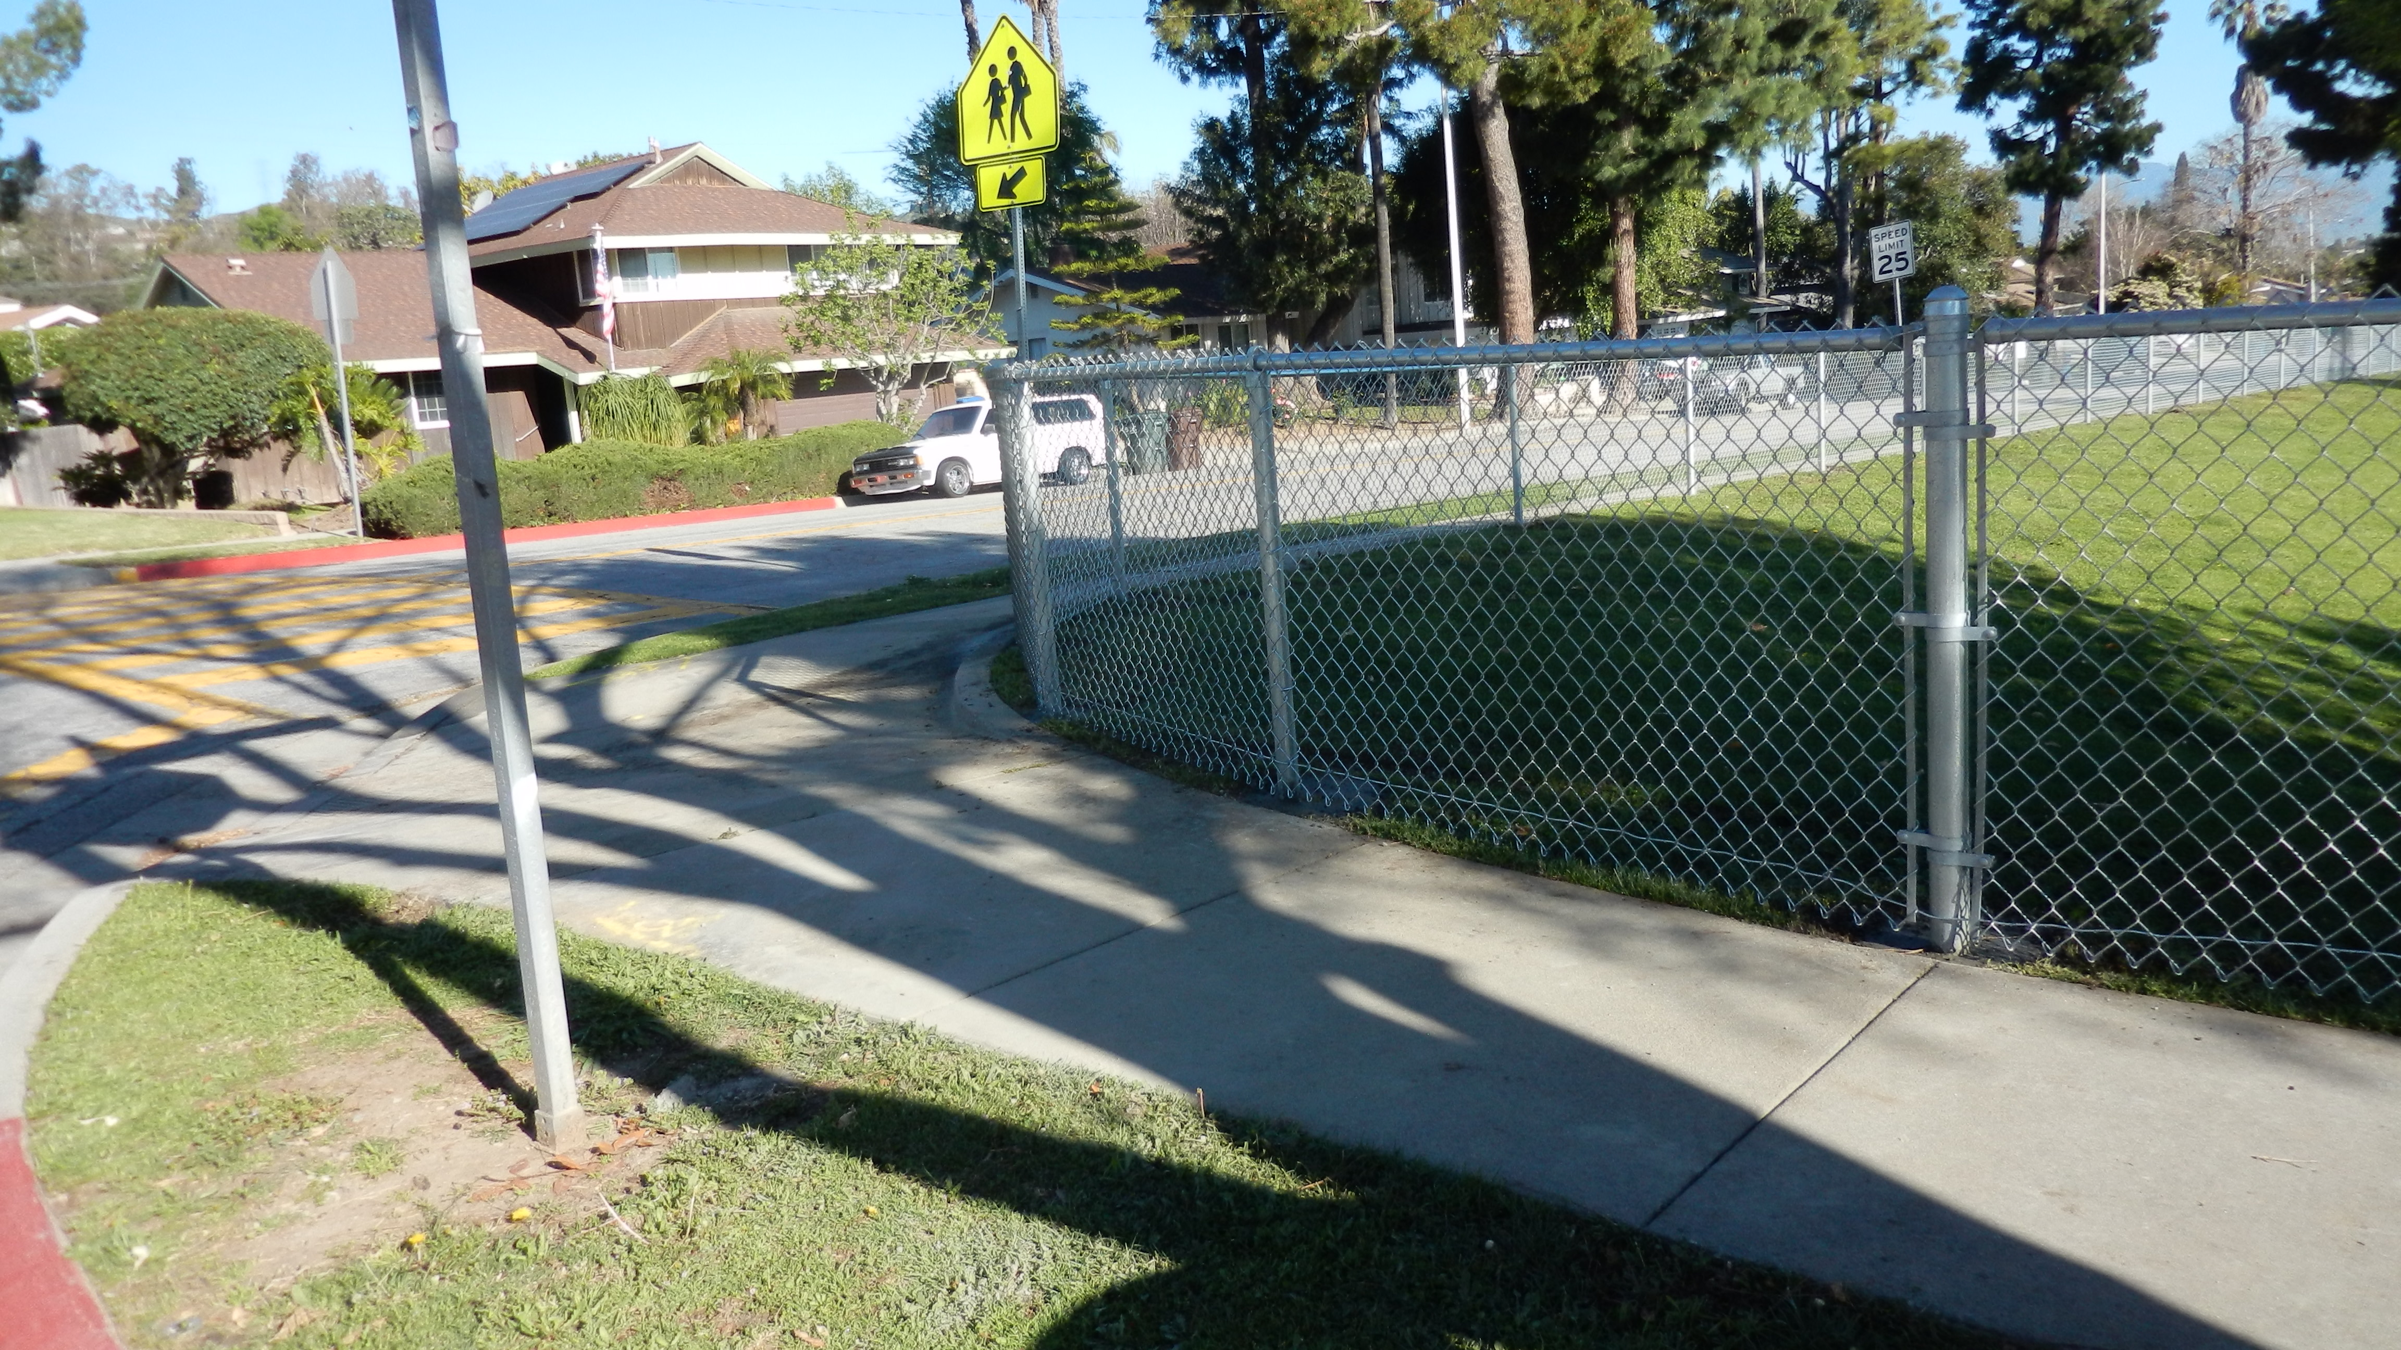
Projects Completed as of May 9th, 2024 Los Molinos Elementary Hillside Fencing
BEORE
AFTER

Slide 6
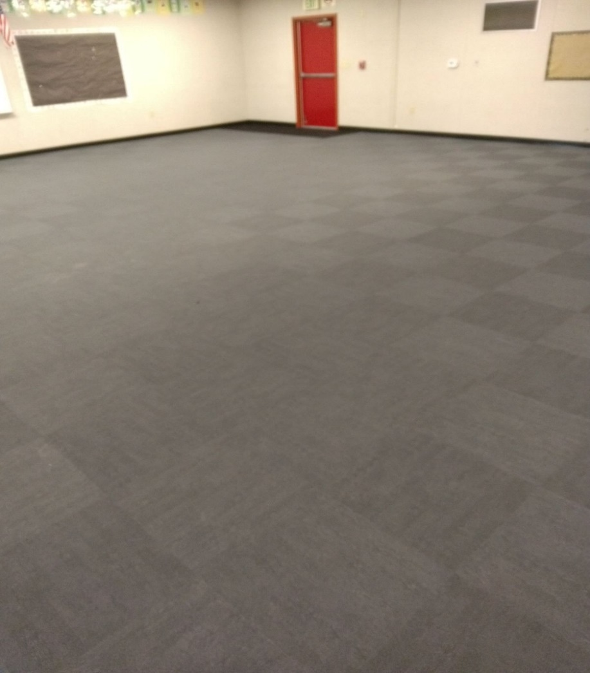
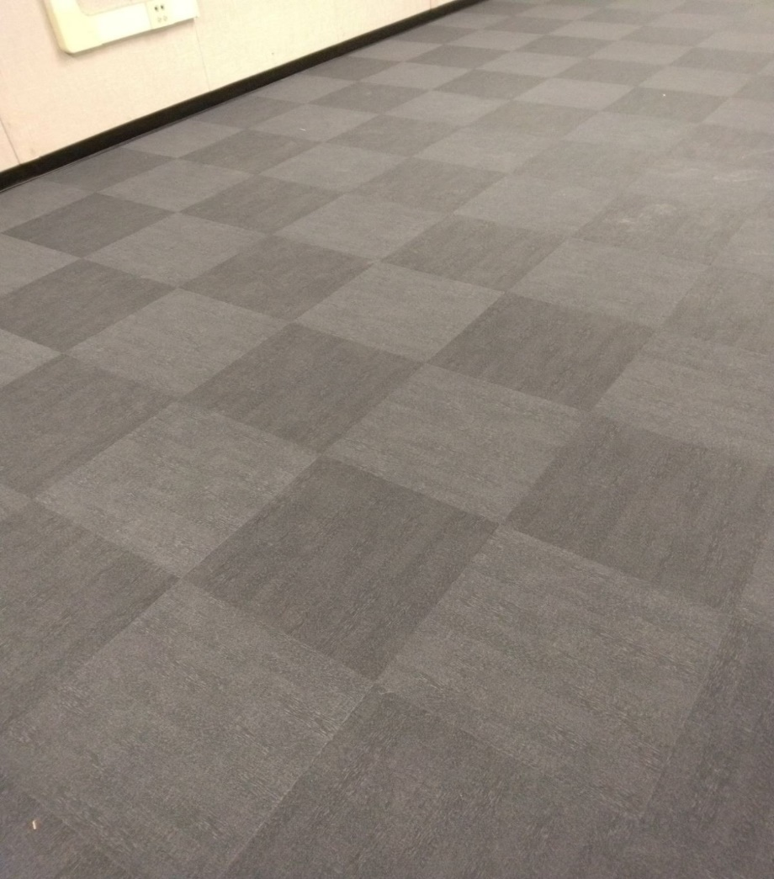
Projects Completed as of May 9th, 2024 Valinda School of Academics- Room K3 Flooring
AFTER
BEORE
AFTER

Slide 7
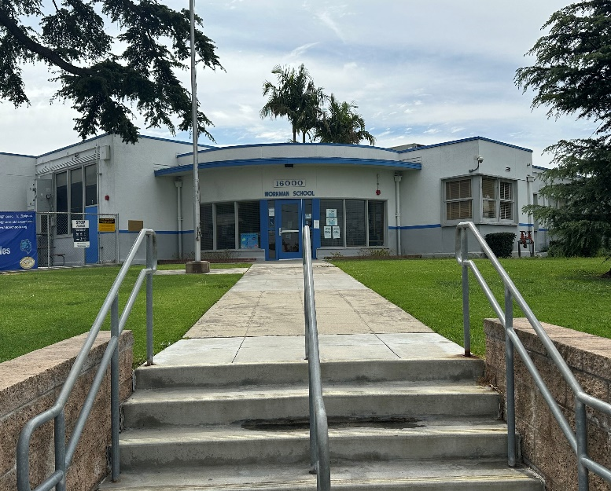
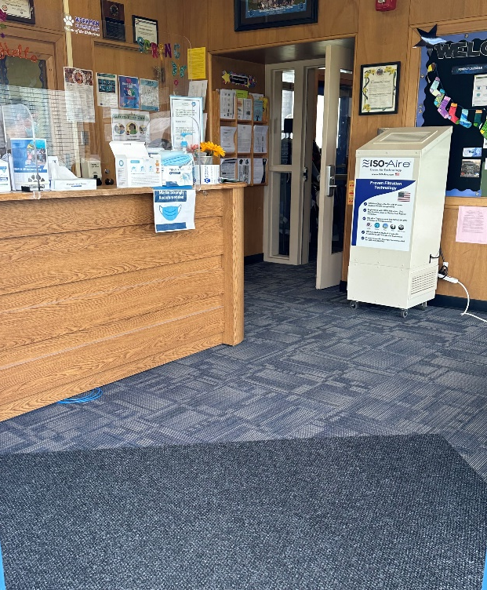
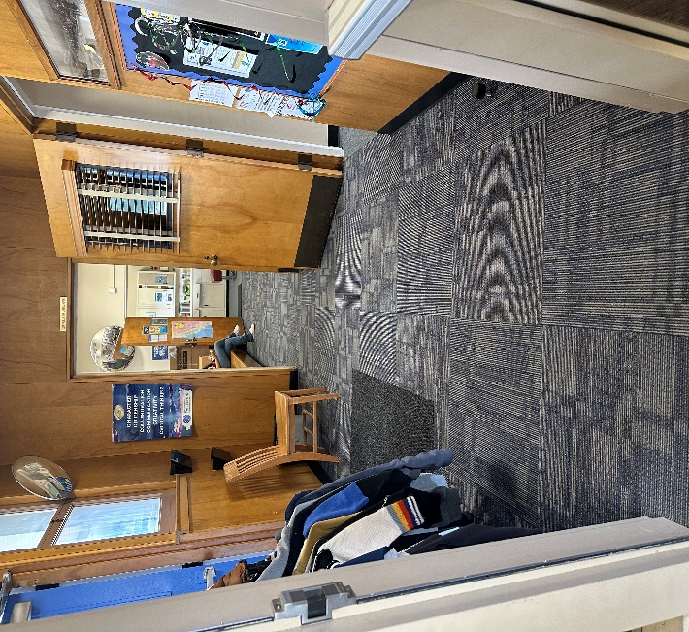
Projects Completed as of May 9th, 2024 Workman Elementary – Front Office Flooring
BEORE
AFTER

Slide 8
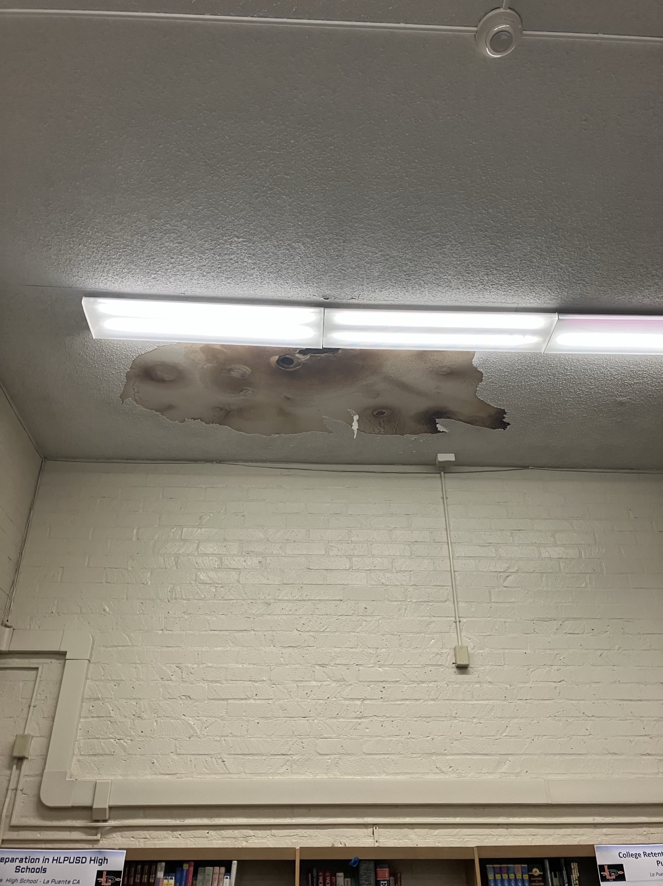
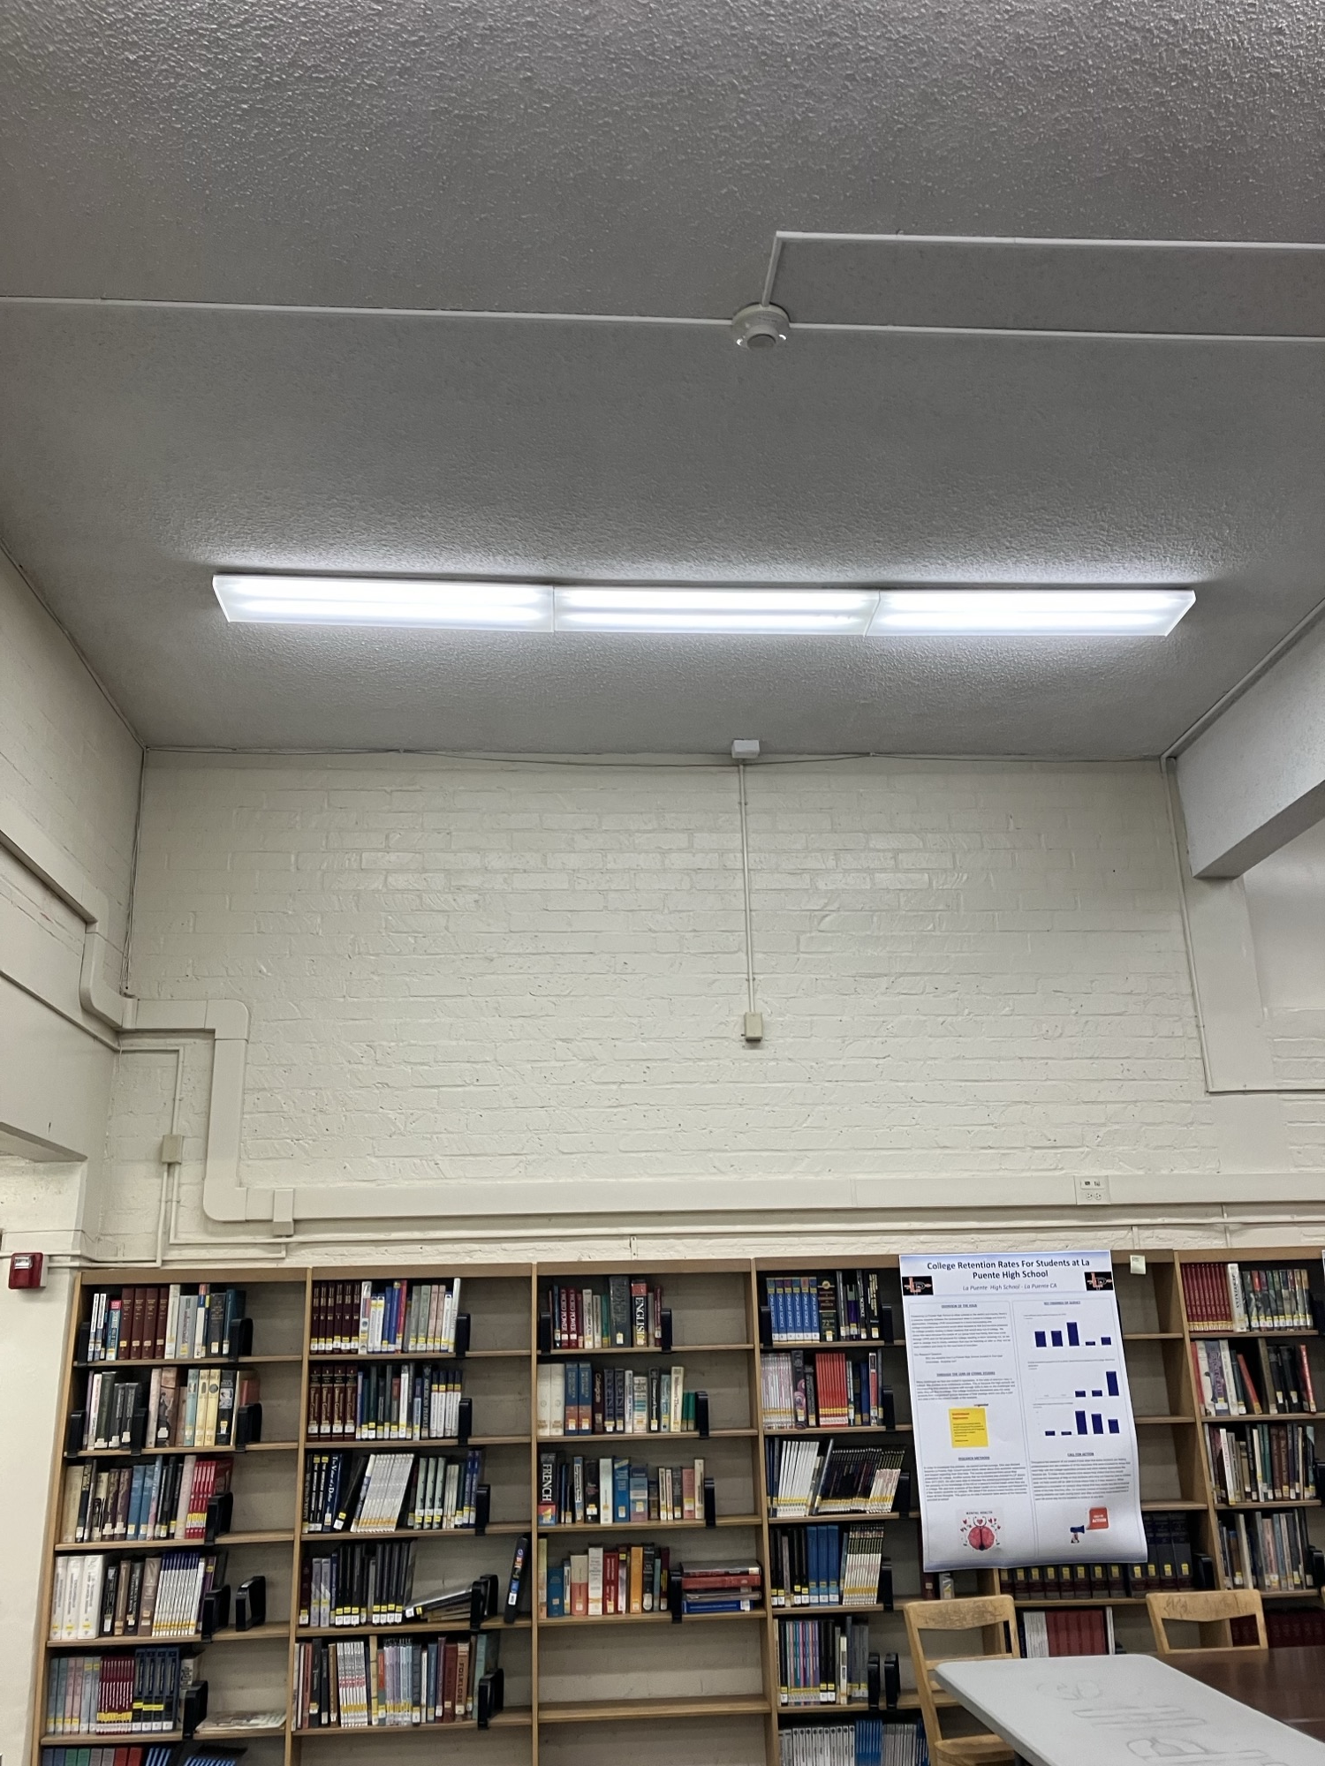
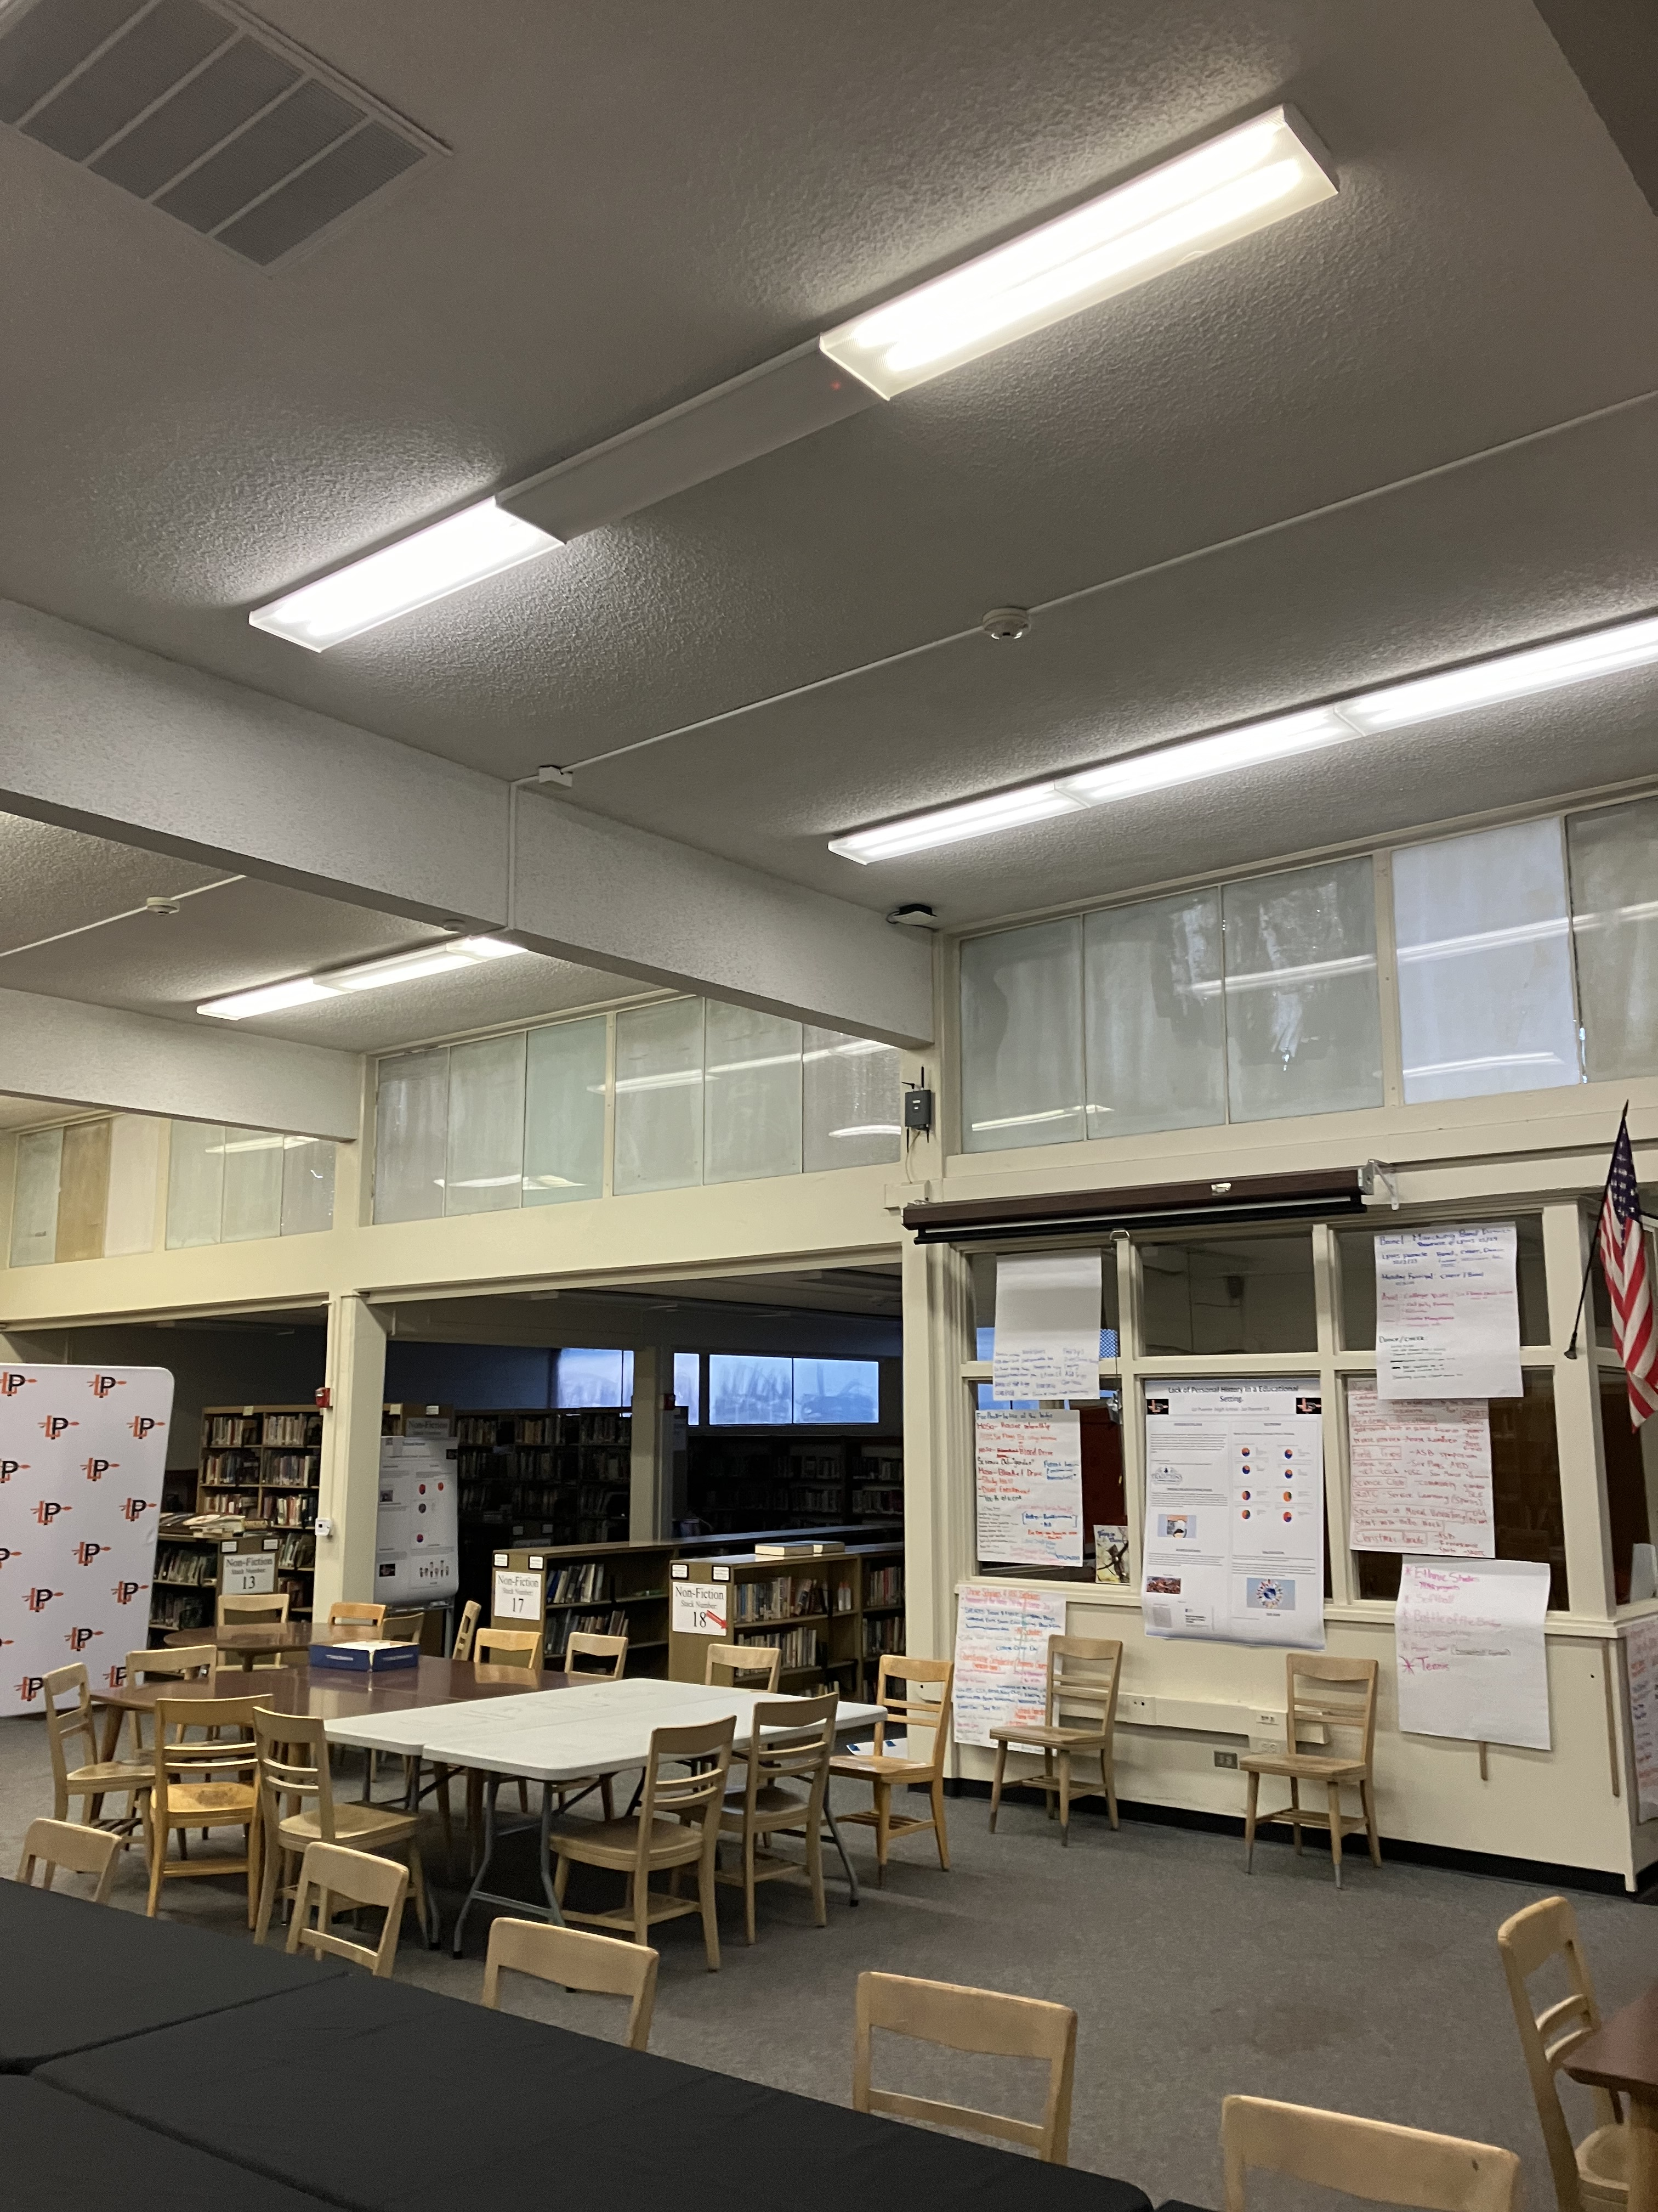
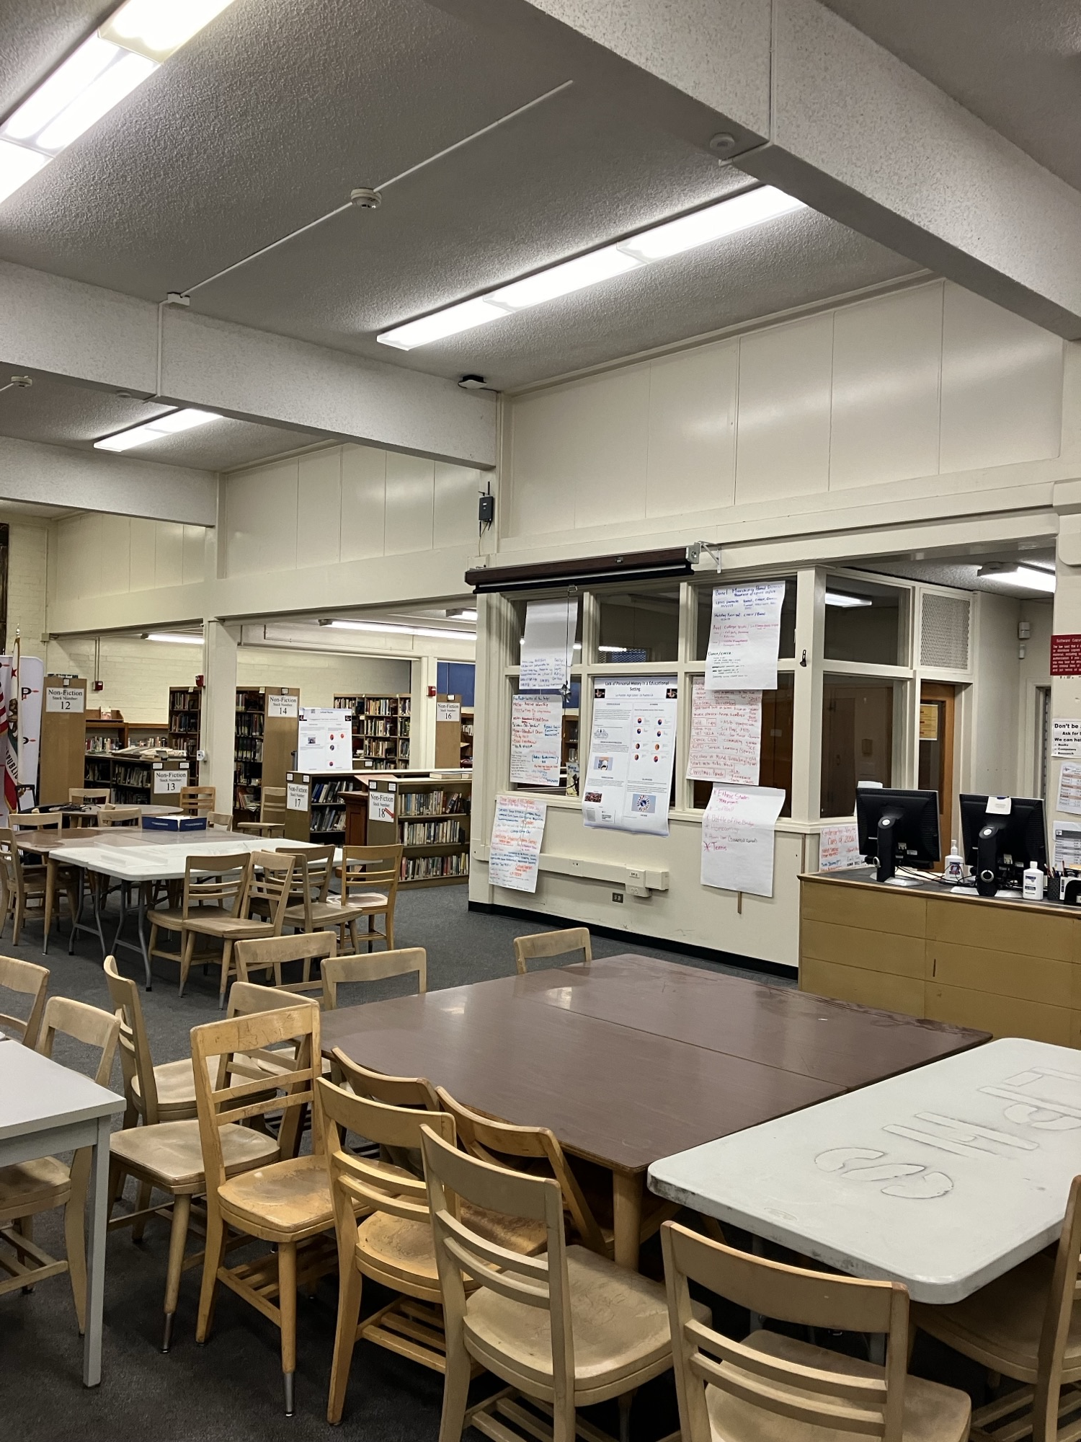
Projects Completed as of May 9th, 2024 La Puente High School – Library Ceiling Repair
BEFORE
AFTER
BEORE
AFTER

Slide 9
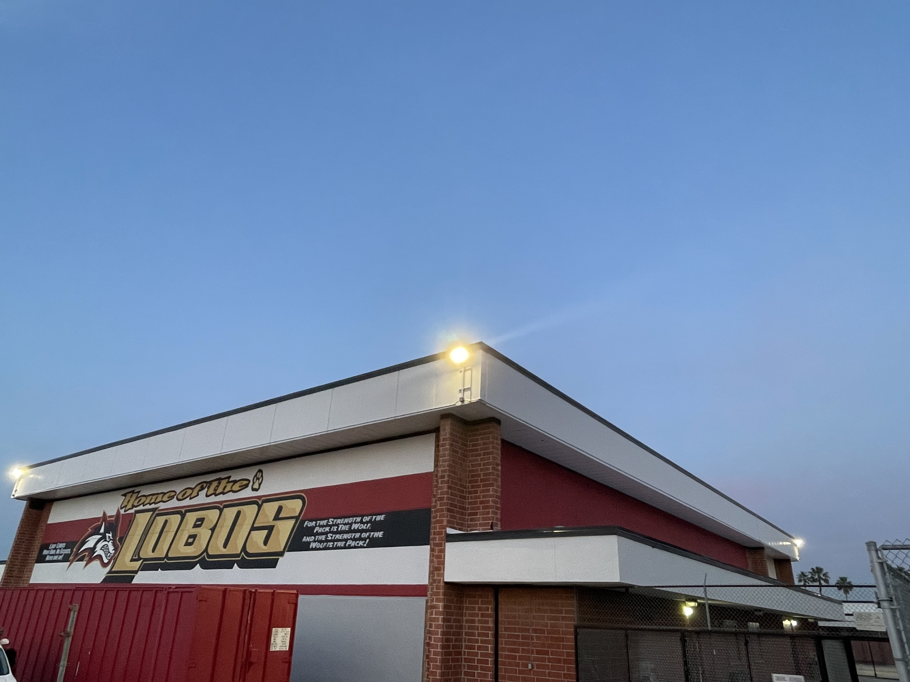
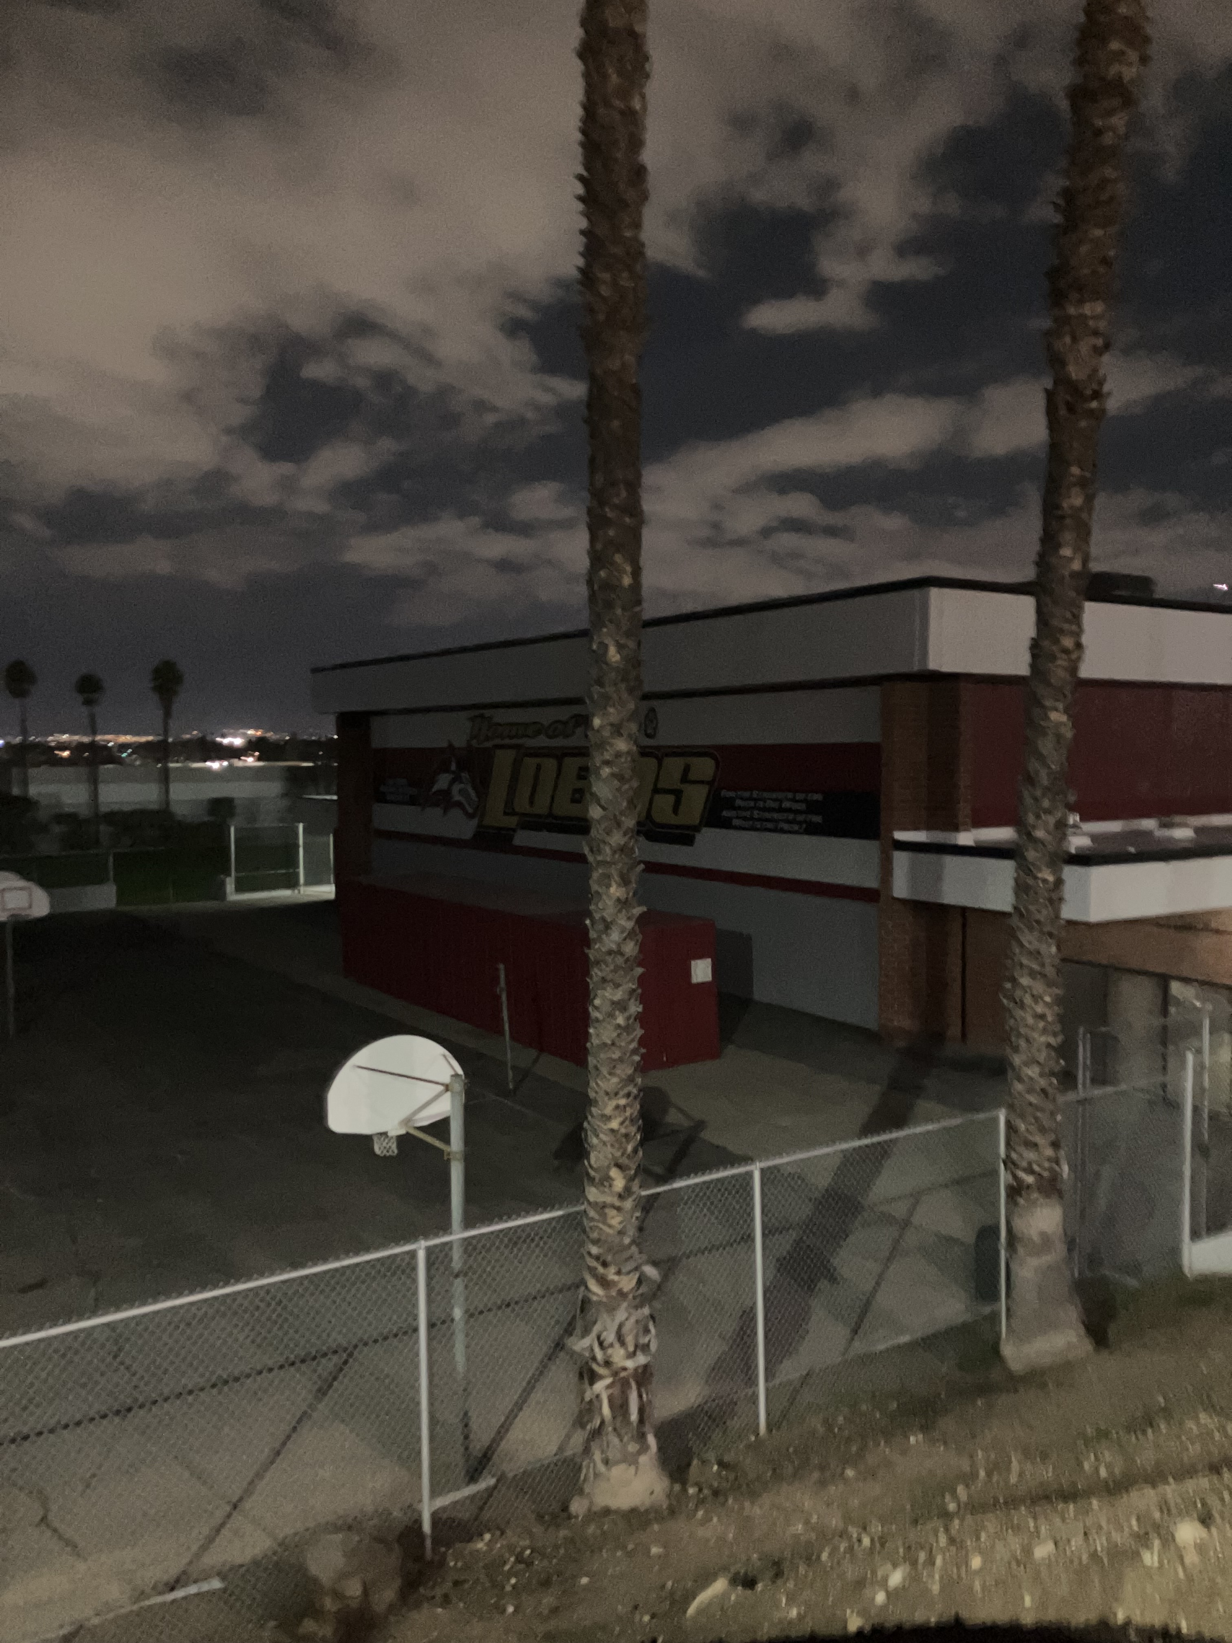
Projects Completed as of May 9th, 2024 Workman High School – Exterior Gym Lighting
BEFORE
AFTER
BEORE
AFTER

Slide 10
Projects In Progress
2023-2024

Slide 11
Projects in Progress as of May 9th, 2024
Facilities
Site | Item Description | Architect Plans | DSA Approval | Procurement | Construct | Funding Source | Target Completion Date
Los Altos High School | Reroof Various Buildings | NA | NA | Complete | Complete | Deferred Maintenance | Complete
Wedgeworth | K-5 Permanent School | Complete | Approved | Complete | In Progress | COPS | 06/2025
Los Altos High School | Gym & Locker Room HVAC (65 tons of temporary HVAC units have been installed) | Complete | Approved | Complete | Pending | Facilities | 12/2024
Cedarlane Academy | Portable Installation | Complete | Pending (Back Check) | Pending | Pending | Facilities | 08/2024
Palm Elementary | Front of School Fencing | NA | NA | In Process | Pending | Facilities | 08/2024
Changes And Progress Since Last Report - Blue
Notes:
Los Altos High School, expected to begin in July

Slide 12
Projects in Progress as of May 9th, 2024
Site | Item Description | Architect Plans | DSA Approval | Procurement | Construct | Funding Source | Target Completion Date
Lassalette Elementary | Inclusive Playground | NA | NA | Pending | Pending | Special Ed | TBD
Adult Ed
Site | Item Description | Architect Plans | DSA Approval | Procurement | Construct | Funding Source | Target Completion Date
Willow Adult | Two-Story Medical Building | Complete | NA | Complete | In Progress | Adult Ed | 05/2024
Dibble Adult | HVAC Replacement - MPR | Complete | NA | Complete | In Progress | Adult Ed | 05/2024
Changes And Progress Since Last Report - Blue

Slide 13
Projects in Progress as of May 9th, 2024
Child Development
Site | Item Description | Architect Plans | DSA Approval | Procurement | Construct | Funding Source | Target Completion Date
Winglane ES Headstart | Portable Installation | Complete | Approved | Complete | In Progress | Child Development | 06/2024
Nelson Elementary School Head Start | Playground & Shade Structure | Complete | Approved | Pending | Pending | Child Development | TBD
Workman Elementary School Head Start | Playground & Accessibility Path of Travel | Complete | Pending | Pending | Pending | Child Development | TBD
Fairgrove Academy Headstart | Playground & Shade Structure | Complete | Approved | Pending | Pending | Child Development | TBD
Amar Center | Entry Security Project | Complete | Approved | Pending | Pending | Child Development | TBD
Sierra Vista - SSC | SSC Office Reception Counter | Complete | NA | Complete | Pending | Child Development | 05/2024
Changes And Progress Since Last Report - Blue

Slide 14
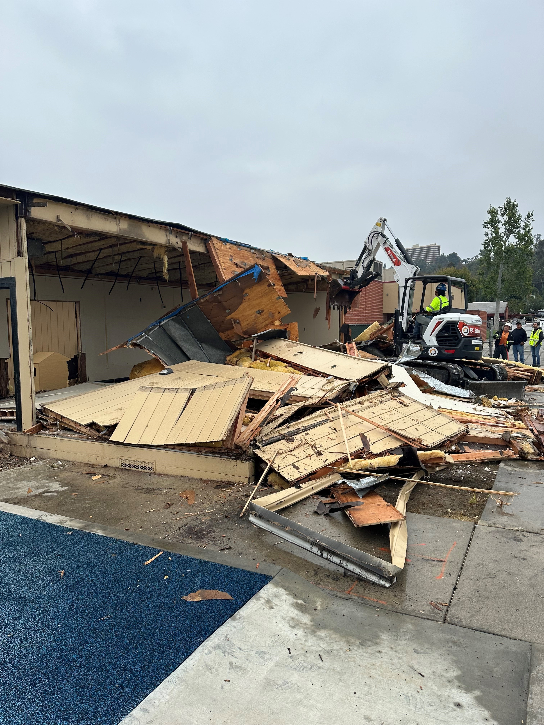
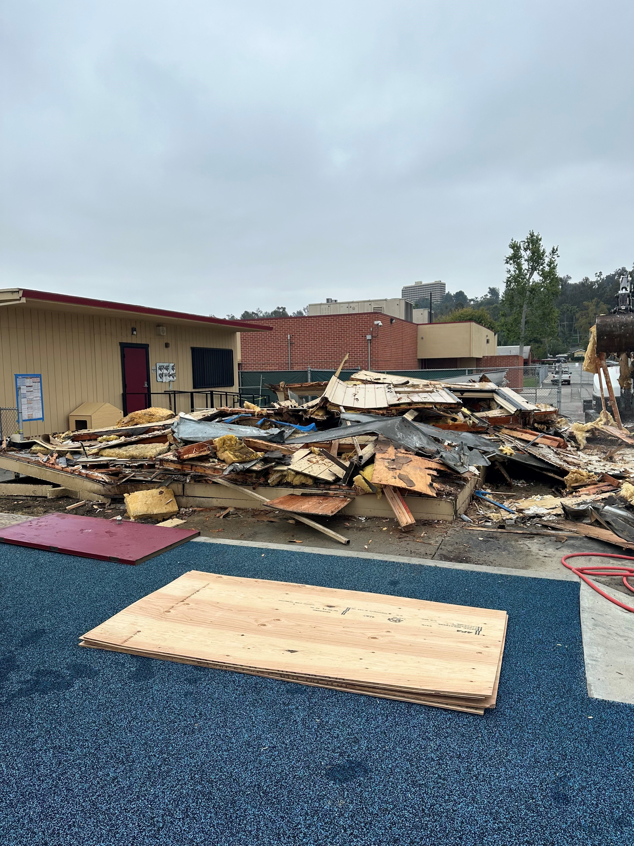
Projects in Progress as of May 9th, 2024 Winglane Headstart Portable Installation- Demolition
BEORE
AFTER

Slide 15
Projects in Progress as of May 9th, 2024
Nutrition Services
Site | Item Description | Architect Plans | DSA Approval | Procurement | Construct | Funding Source | Target Completion Date
District Office | Warehouse Freezer | Complete | NA | Pending | TBD | Food Services | TBD
Wilson High School | Kitchen Modernization | Complete | Pending | Pending | TBD | Food Services | TBD
Mesa Robles Middle School | Kitchen Renovation | Complete | Pending | Pending | TBD | Food Services | TBD
Baldwin Elementary School | Kitchen Renovation - Three Compartment Sink Installation | Complete | NA | Pending | TBD | Food Services | TBD
Changes And Progress Since Last Report - Blue
Notes:
Kwis Baseball – Will be Re-Bid, uncertified entry was added to scope of work into the project.
Cedarlane Portable – In design phase with PBK architecture. Soils samples being conducted.
Willow Adult School = Two Story Building continues to be under construction. It coming along very well.

Slide 16
Facilities Upcoming Projects
Site | Item Description | Architect Plans | DSA Approval | Procurement | Est. Construct Start | Target Completion Date
District Wide | HVAC System Replacement | Pending | Pending | Pending | TBD | TBD
Kwis Elementary | Baseball Fields | Complete | Approved | Pending | TBD | TBD
Los Altos High School | Stadium Press Box & Bleachers | Complete | Approved | Pending | TBD | TBD
La Puente High School | Custom Shade Structure | Complete | Approved | Pending | TBD | TBD
Wilson High School | Stadium Press Box & Bleachers | Complete | Pending | Pending | TBD | TBD
Workman HS | Phase II Stadium and Baseball Field (Phase I Track & Field and Softball Field Complete) OPTION B | Complete | Pending | Estimated | Estimated | TBD (14-18 months after Board approval of the Bid)
Changes And Progress Since Last Report - Blue
Notes:
Amar- In DSA, waiting for approval
LAHS- HVAC-
Press Box- working on the rehabilitation for DSA Approval
LPHS- Addressing DSA comments and awaiting approval
WIHS- Addressing DSA comments and awaiting approval
Wing Lane- Project Bid, waiting for Board Approval

Slide 17
Next Report – June 27, 2024

