Slide 1
Measure BB Bond
21st Century Classroom Improvements
July 18, 2024

Slide 2
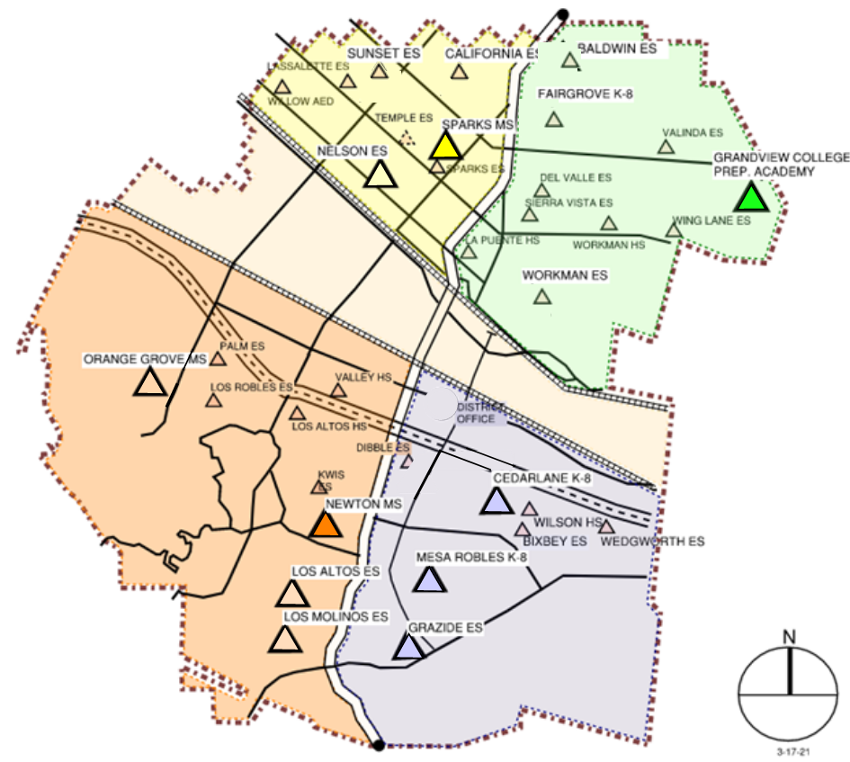
HLPUSD MEASURE BB - SUMMARY SCHOOLS IN PROGRESS
IN PROGRESS
CONSTRUCTION
La Puente HS
Workman HS
Los Altos HS
Wilson HS
Stimson EC
PREP FOR BID
California ES
Baldwin ES
AT DSA FOR REVIEW
Los Molinos ES
Grazide ES
IN DESIGN
Kwis ES
Lassalette ES
Fairgrove K-8
Orange Grove MS
Sierra Vista MS
Palm ES
Valinda ES
Sparks ES
Wing Lane ES
Valley Alternative
COMPLETED
Nelson ES
Los Altos ES
Workman ES
Mesa Robles K-8
Cedarlane K-8
Sparks MS
Newton MS
Grandview MS
STIMSON

Slide 3
PHASE B PROGRESS
1. Baldwin ES Construction Documents to DSA 1/23/2024 DSA approved 6/27/2024
2. California ES Construction Documents to DSA 1/23/2024 DSA approved 6/27/2024
Anticipated Construction Start Fall of 2024
3. Los Molinos ES Construction Documents at DSA returned 5/7/2024 Back-Check Submitted to DSA 6/7/2024
4. Grazide ES Construction Documents at DSA returned 4/18/2024 Back-Check Submitted to DSA 6/17/2024
Anticipated Construction Start Winter of 2024
5. Kwis ES Construction Documents 50% Construction Documents District Reviewed 6/26/24
6. Lassalette ES Construction Documents 50% Construction Documents District Review 6/26/2024
Anticipated Construction Start New Year of 2025
7. Palm ES Construction Documents Schematic Design District Review 6/24/2024
8. Valinda ES Construction Documents Schematic Design District Review 6/24/2024
Anticipated Construction Start Spring of 2025
9. Fairgrove K-8 Construction Documents 50% Construction Documents District Reviewed 7/3/2024
10. Orange Grove MS Construction Documents Schematic Design Documents
Anticipated Construction Start Summer of 2025
11. Sierra Vista Construction Documents Schematic Design District Reviewed 6/14/2024
12. Sparks ES Construction Documents Schematic Design District Reviewed 6/21/2024
Anticipated Construction Start Summer -Fall of 2025
13. Wing Lane ES Construction Documents Schematic Design District Review Scheduled 7/10/2024
14. Valley Alternative Construction Documents Schematic Design District Review Scheduled 8/12/2024
Anticipated Construction Start Fall of 2025

Slide 4
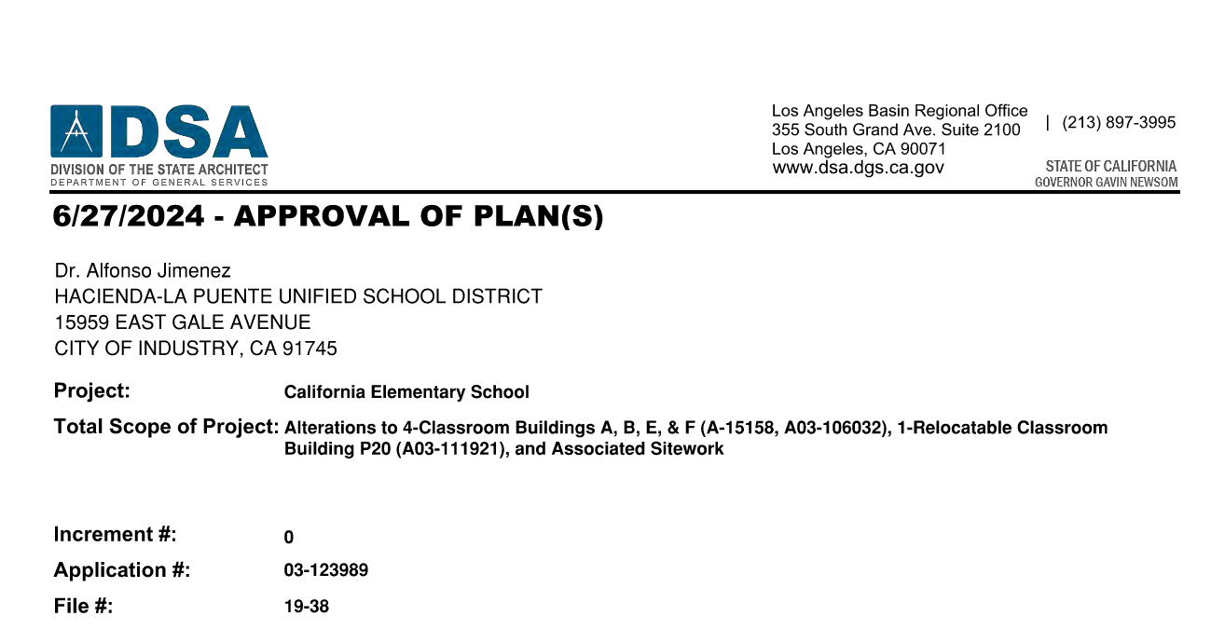
DSA PLAN APPROVAL BALDWIN & CALIFORNIA

Slide 5
HIGH SCHOOL REFRESH PROJECTS

Slide 6
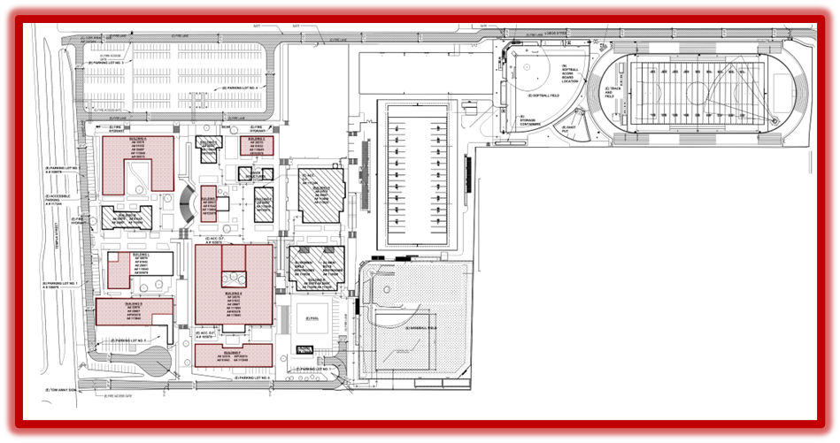
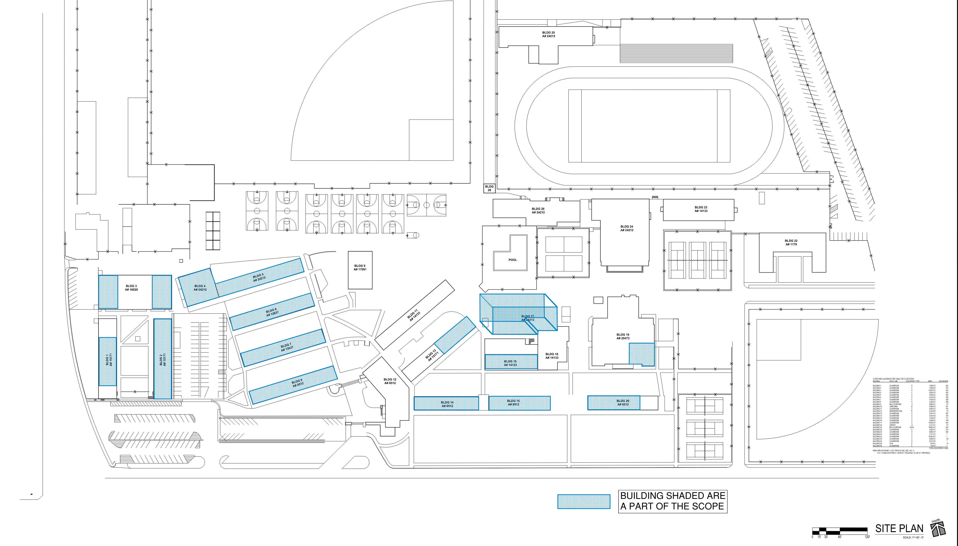
HIGH SCHOOL REFRESH GROUP 1
WORKMAN HIGH SCHOOL
43 CLASSROOMS
LA PUENTE HIGH SCHOOL
55 CLASSROOMS
SCHOOL | START DATE | ANTICIPATED COMPLETION DATE
WORKMAN HS | 1/16/2024 | 11/1/2024
LA PUENTE HS | 1/16/2024 | 11/1/2024

Slide 7
REFRESH GROUP 1
Workman HS Phase 3:
Classroom E-25.
Bee
After
Before

Slide 8
REFRESH GROUP 1
La Puente HS Phase 4:
Classroom 106.
Bee
In Progress
Before

Slide 9
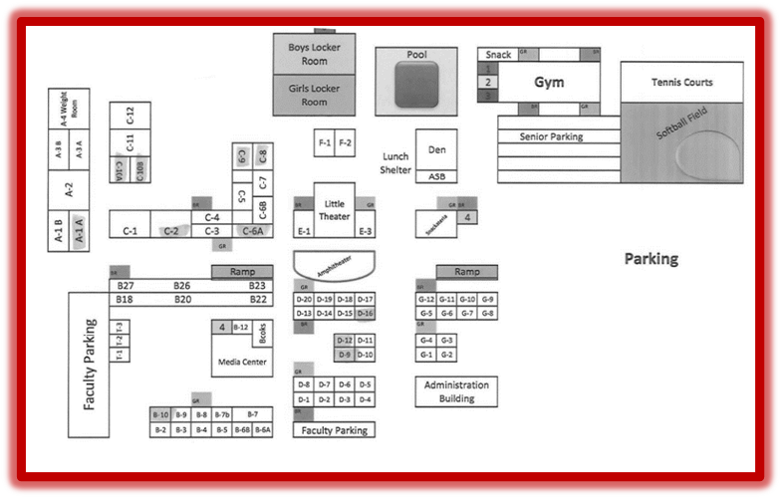
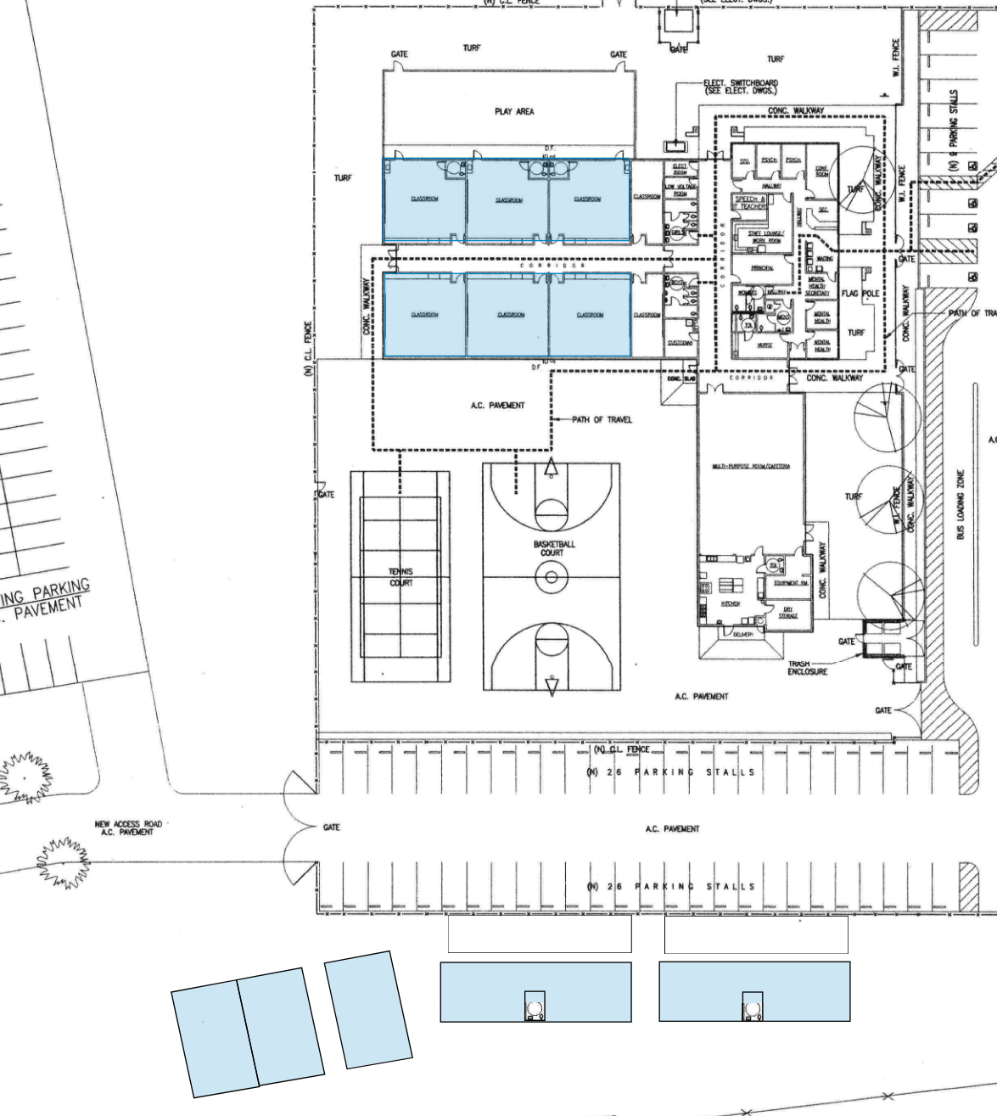
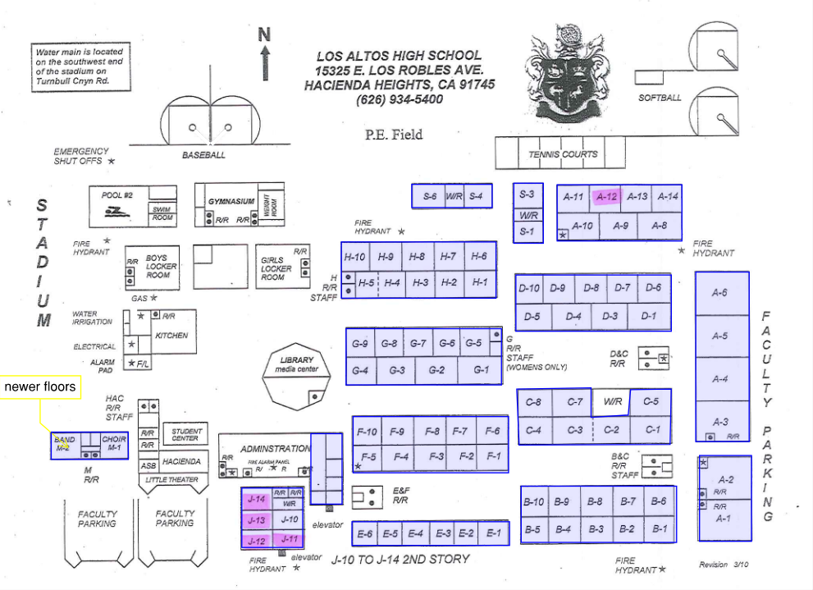
HIGH SCHOOL REFRESH GROUP 2
WILSON HIGH SCHOOL
59 CLASSROOMS
STIMSON LEARNING CENTER
10 CLASSROOMS
LOS ALTOS HIGH SCHOOL
69 CLASSROOMS
SCHOOL | START DATE | ANTICIPATED COMPLETION DATE
WILSON HS | 3/4/2024 | 2/21/2025
LOS ALTOS HS | 3/4/2024 | 4/18/2025
STIMSON LC | 7/1/2024 | 7/31/2024

Slide 10
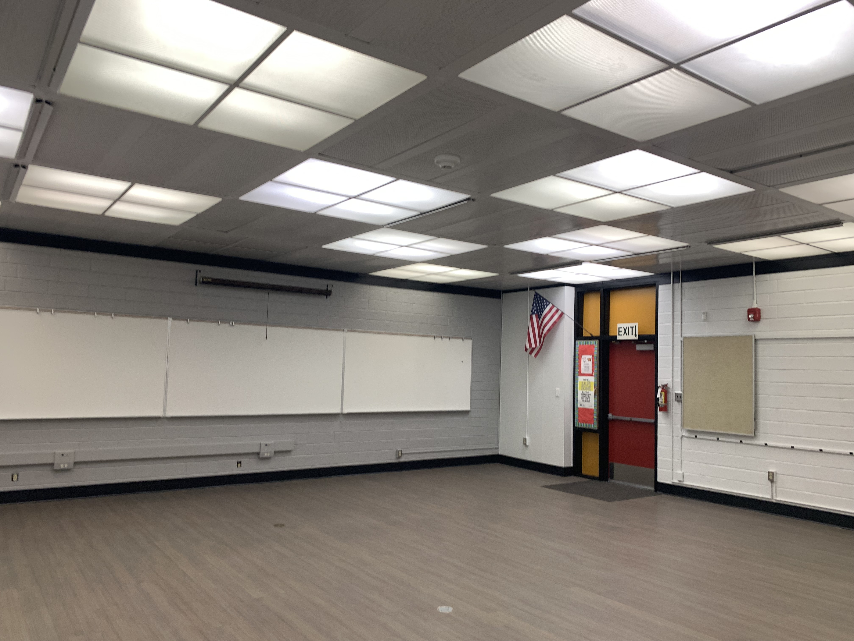
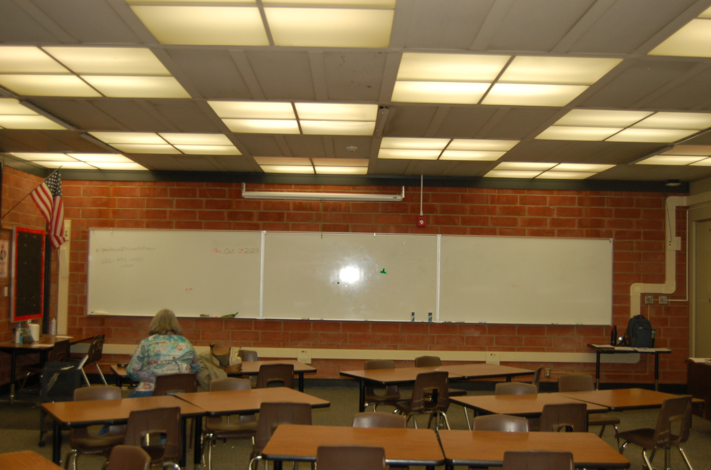
REFRESH GROUP 2
Wilson HS Phase 2:
Classroom B-7.
After
Before

Slide 11
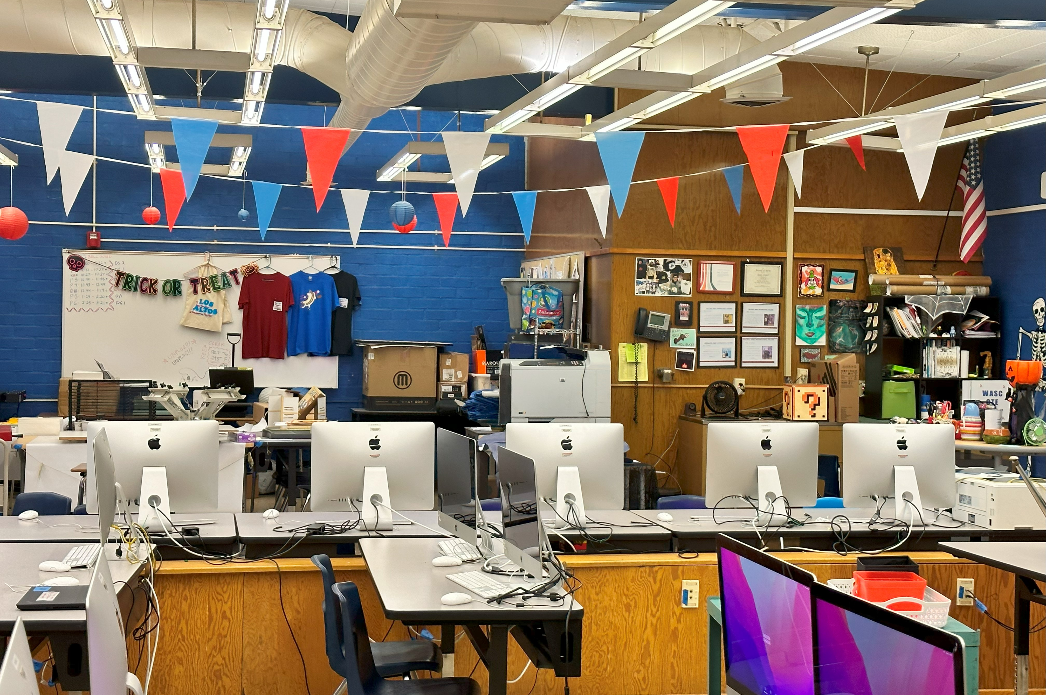
REFRESH GROUP 2
Los Altos HS Phase 2: Classroom A-10.
Near Completion
Before

Slide 12
REFRESH GROUP 2
Stimson Learning Center:
Classroom.
Preparation
Demolition

Slide 13
QUESTIONS & ANSWERS

