Slide 1
Measure BB Bond
21st Century Classroom Improvements
May 9, 2024

Slide 2
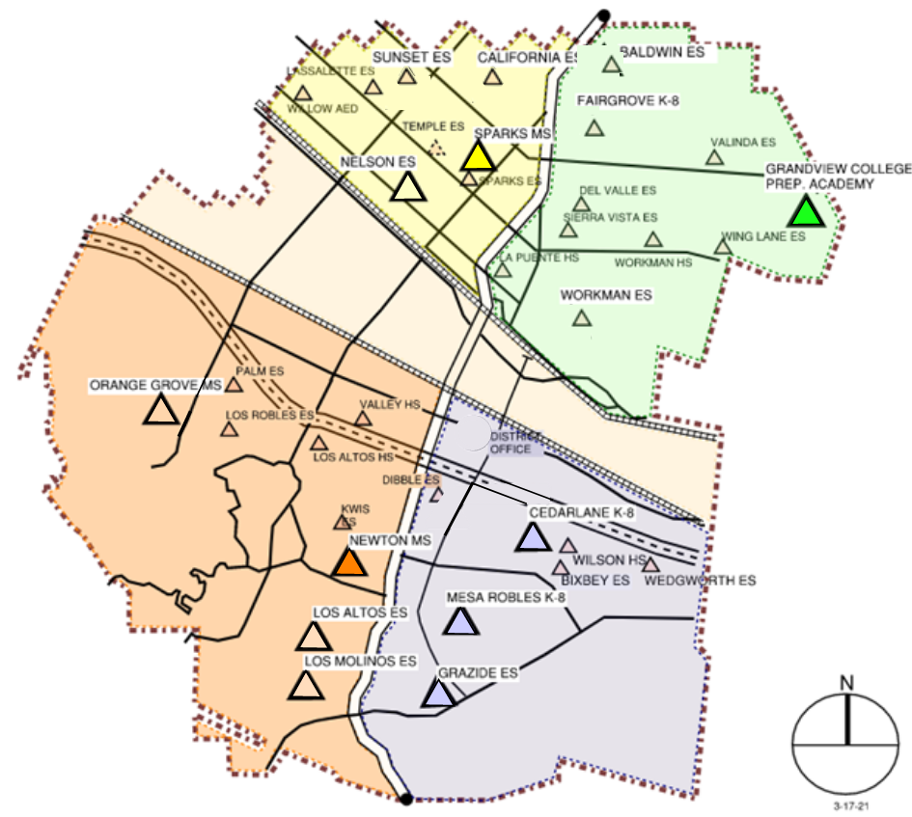
HLPUSD MEASURE BB - SUMMARY SCHOOLS IN PROGRESS
IN PROGRESS
CONSTRUCTION
La Puente HS
Workman HS
Los Altos HS
Wilson HS
Stimson EC
PREP FOR BID
California ES
Baldwin ES
AT DSA FOR REVIEW
Los Molinos ES
Grazide ES
IN DESIGN
Kwis ES
Lassalette ES
Fairgrove K-8
Orange Grove MS
Sierra Vista MS
Palm ES
Valinda ES
Sparks ES
Wing Lane ES
IN DESIGN PROPOSAL PHASE
Valley Alternative
COMPLETED
Nelson ES
Los Altos ES
Workman ES
Mesa Robles K-8
Cedarlane K-8
Sparks MS
Newton MS
Grandview K-8
STIMSON

Slide 3
PHASE B PROGRESS
1. Baldwin ES Construction Documents to DSA 1/23/2024 Back-Check with DSA 4/29/2024
2. California ES Construction Documents to DSA 1/23/2024 Back-Check with DSA 5/6/2024
Anticipated Construction Start Fall of 2024
3. Los Molinos ES Construction Documents at DSA 3/12/2024 Anticipated Plan Check Completion TBD
4. Grazide ES Construction Documents at DSA 3/12/2024 DSA Plan Check Returned 4/182024
Anticipated Construction Start Winter of 2024
5. Kwis ES Construction Documents Design Development
6. Lassalette ES Construction Documents Design Development
Anticipated Construction Start New Year of 2025
7. Palm ES Construction Documents Schematic Design
8. Valinda ES Construction Documents Schematic Design
Anticipated Construction Start Spring of 2025
9. Fairgrove K-8 Construction Documents Design Development
10. Orange Grove MS Construction Documents Schematic Design
Anticipated Construction Start Summer of 2025
11. Sierra Vista Construction Documents Design Contract Awarded
12. Sparks ES Construction Documents Design Contract Awarded
Anticipated Construction Start Summer -Fall of 2025
13. Wing Lane ES Construction Documents Design Contract Awarded
14. Valley Alternative Construction Documents Design Proposal
Anticipated Construction Start Fall of 2025

Slide 4
HIGH SCHOOL REFRESH PROJECTS

Slide 5
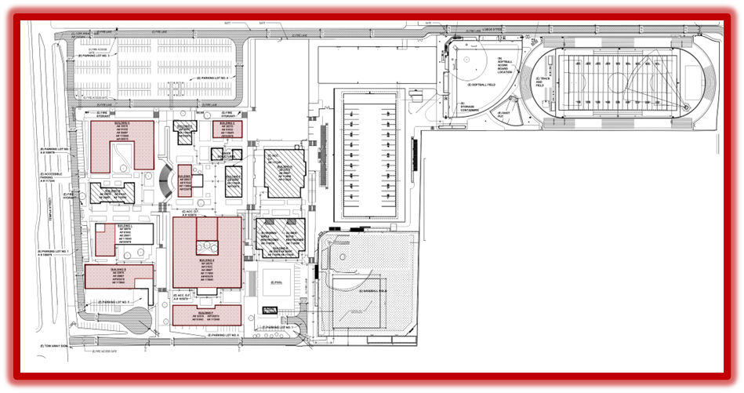
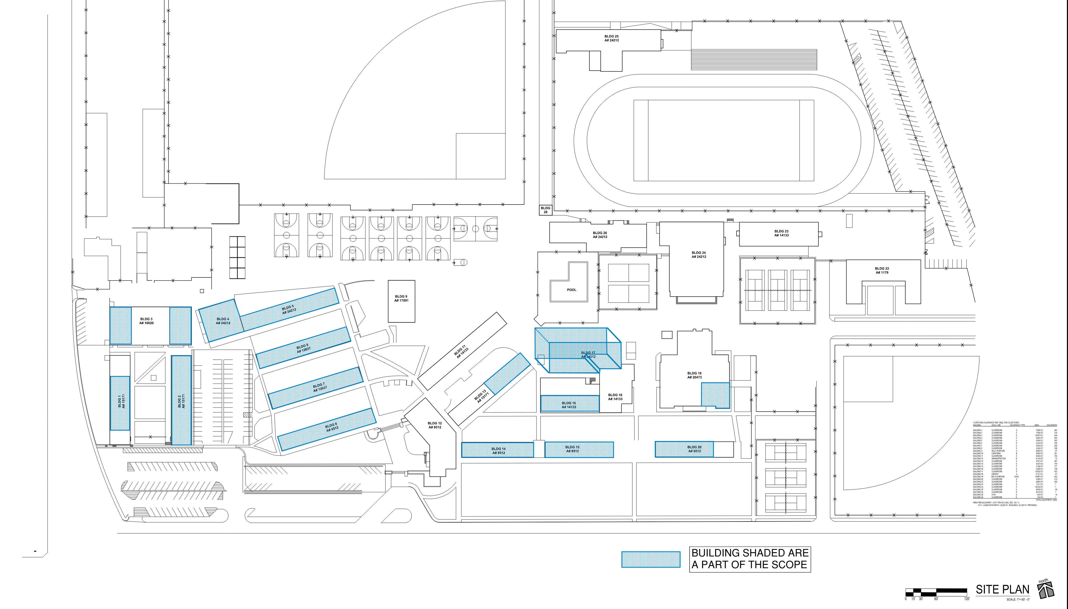
HIGH SCHOOL REFRESH GROUP 1
WORKMAN HIGH SCHOOL
43 CLASSROOMS
LA PUENTE HIGH SCHOOL
55 CLASSROOMS
SCHOOL | START DATE | ANTICIPATED COMPLETION DATE
WORKMAN HS | 1/16/2024 | 11/1/2024
LA PUENTE HS | 1/16/2024 | 11/1/2024
WILSON HS | 3/4/2024 | 2/21/2025
LOS ALTOS HS | 3/4/2024 | 4/18/2025

Slide 6
REFRESH GROUP 1
Workman Classroom
Phase 2: Punch List Pending
Before
After
Room A-20

Slide 7
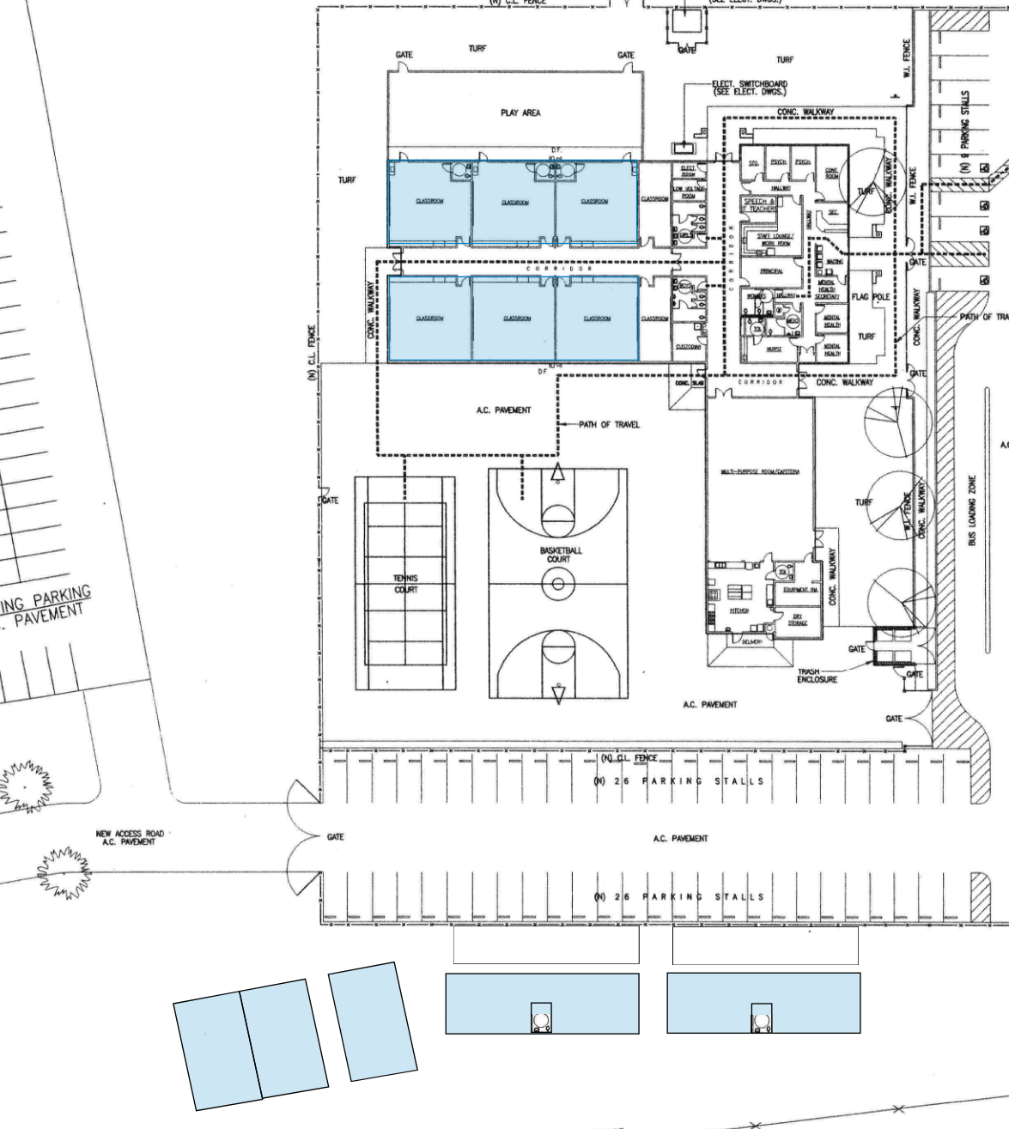
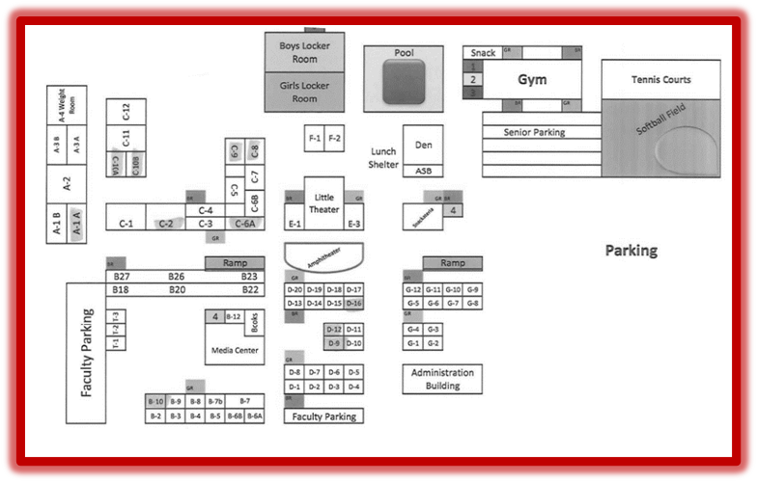
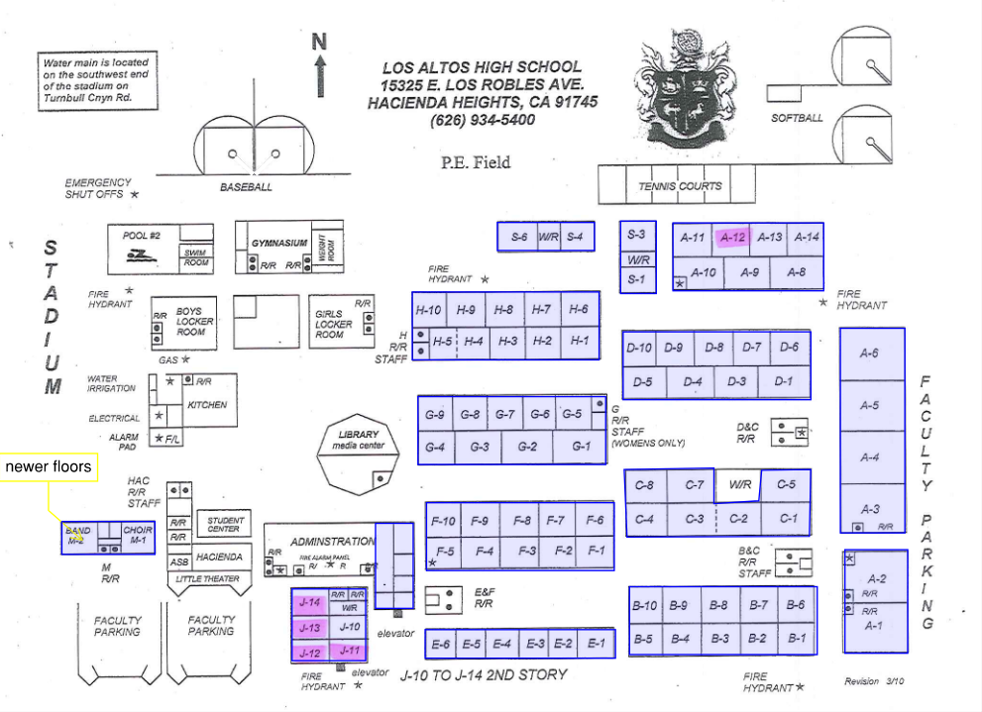
HIGH SCHOOL REFRESH GROUP 2
STIMSON LEARNING CENTER
10 CLASSROOMS
WILSON HIGH SCHOOL
59 CLASSROOMS
LOS ALTOS HIGH SCHOOL
69 CLASSROOMS

Slide 8
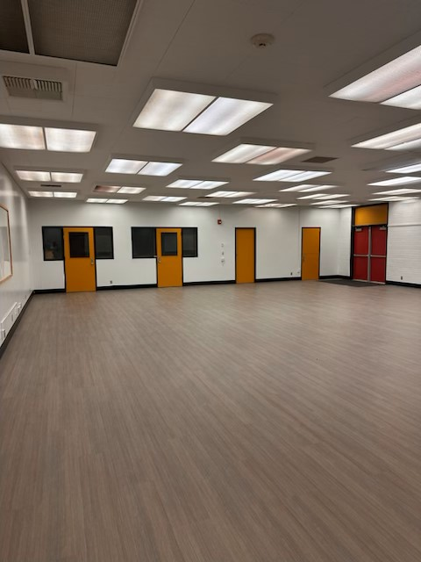
REFRESH GROUP 2
Wilson HS Phase 1 Classroom C-12 Complete

Slide 9
REFRESH GROUP 2
Before
Los Altos HS Phase 1 Classroom B-4. Before and During Demo
After

Slide 10
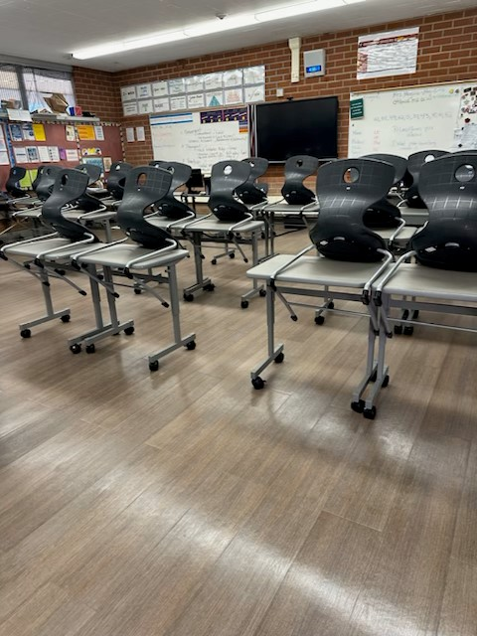
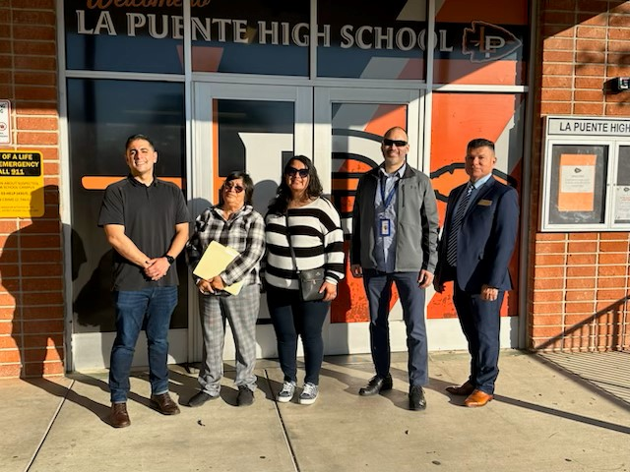
C.B.O.C. SITE TOUR
“Thank you for taking the time for the site visit on Tuesday at Grandview and La Puente High School. As an educator who’s seen many, many classrooms, the upgrades, especially the floors and walls, look fantastic! I was also thrilled to hear that my 9th grade daughter’s 1st period classroom at Wilson High School will be getting the same treatment.
Positive learning environments can make a big difference. I believe these upgrades will give instruction a real edge by fostering a more positive atmosphere for students and teachers alike.”
Jason Hinojosa, C.B.O.C.
Grandview College Prep Academy
La Puente High School

Slide 11
QUESTIONS & ANSWERS

