Slide 1
HACIENDA LA PUENTE UNIFIED SCHOOL DISTRICT
School Site Improvement Projects
Regular Board Meeting July 18, 2024
Business Services
Notes:
Good evening Ma’dam President, Ms. Christine Salazar, Distinguish Board Members; Superintendent, Dr. Jimenez, Executive Cabinet, Colleagues, and community members.
A special greetings to our Principals, Administrators, staff member who are joining us via the virtual platform.

Slide 2
PROJECT COMPLETE LIST
2023-2024/2025
Site | Item Description | Funding Source | Completed Date
Los Altos Elementary | Basketball Court Restriping | Facilities | 05/2024
Valinda School of Academics | Basketball Court Restriping | Facilities | 05/2024
Grandview College Preparatory Academy | Kitchen Upgrade (Serving Areas and Walls) | Facilities | 05/2024
Palm Elementary | Campus Safety Fencing | Facilities | 06/2024
La Puente High School | Little Theatre Improvement | CTE Grant | 06/2024
Nelson Elementary Child Development | Restroom Flooring | Child Development | 06/2024
Lassalette Elementary Child Development | Restroom Flooring | Child Development | 06/2024
Sierra Vista SSC | Front Office Counter | Child Development | 06/2024
Wilson High School | Little Theatre Improvement | CTE Grant | 07/2024
Districtwide | Banners | Facilities | 07/2024
Changes And Progress Since Last Report - Blue

Slide 3
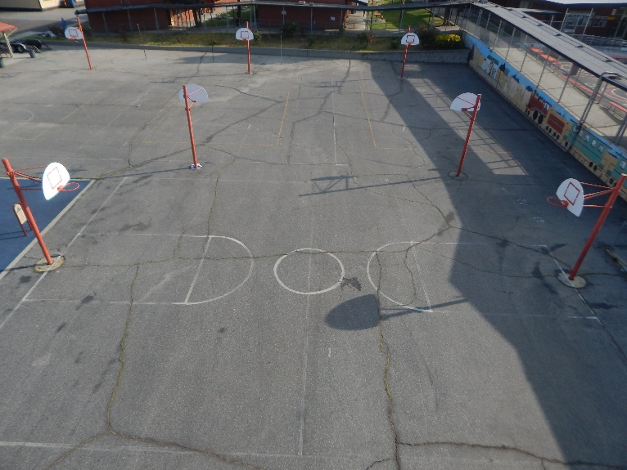
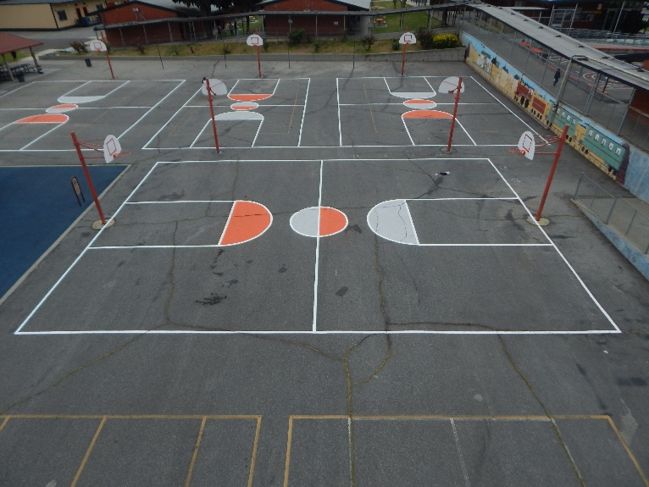
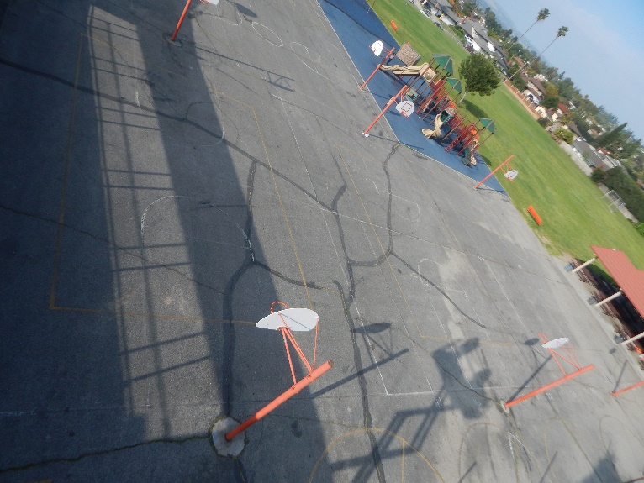
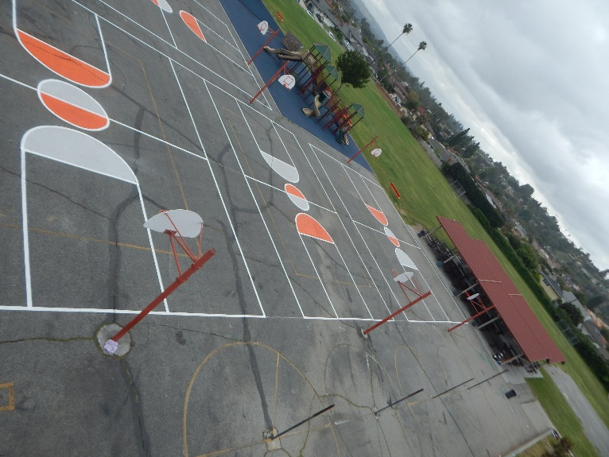
Projects Completed as of July 18, 2024 Los Altos Elementary - Restriping Basketball Courts
BEFORE
AFTER
BEORE
AFTER

Slide 4
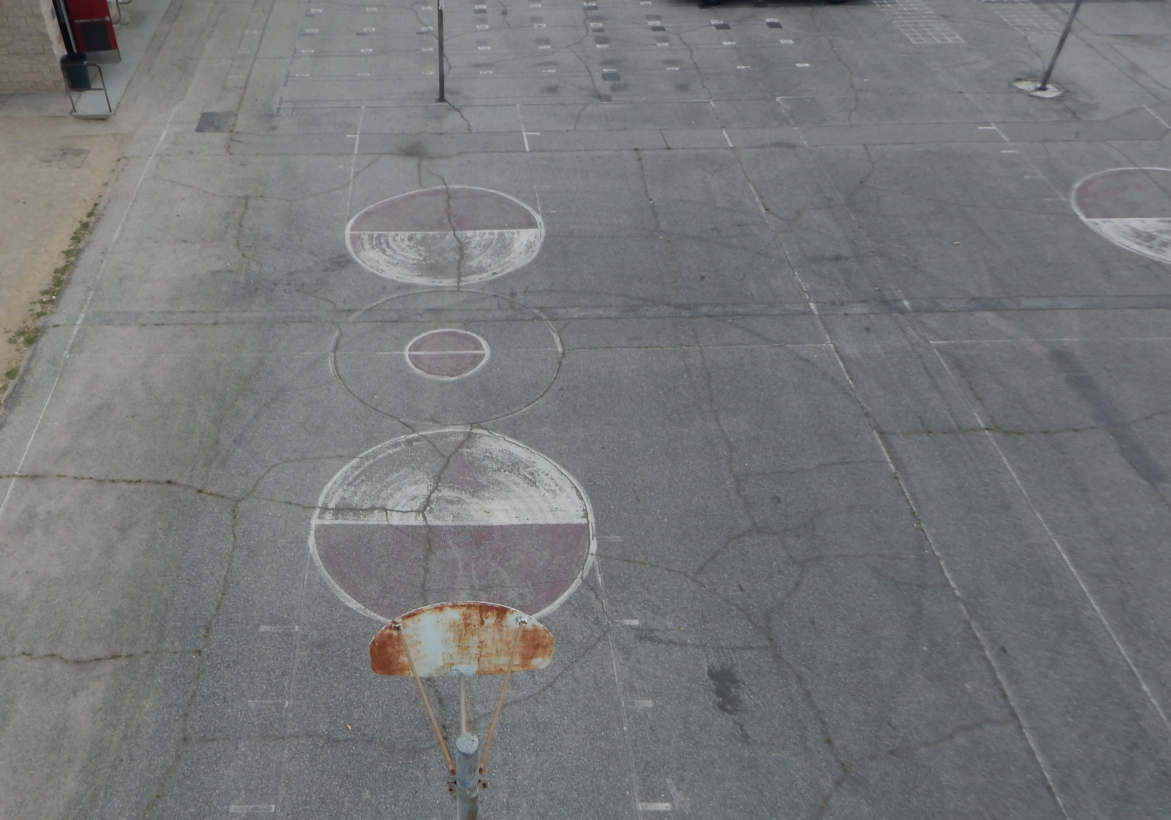
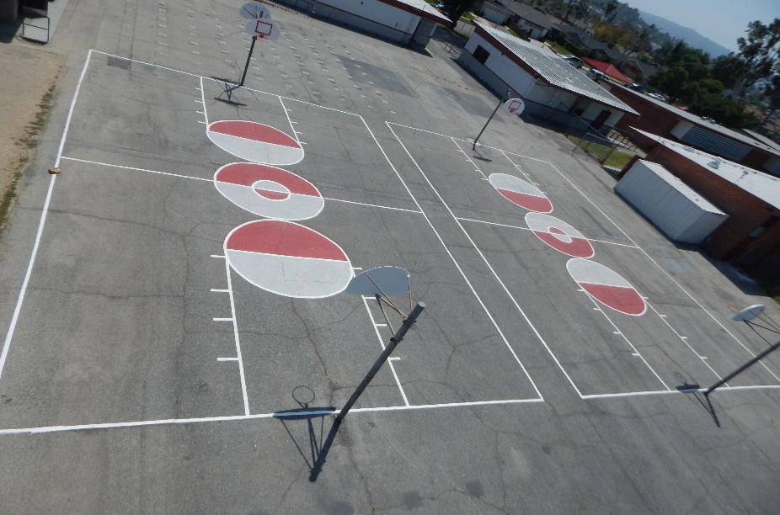
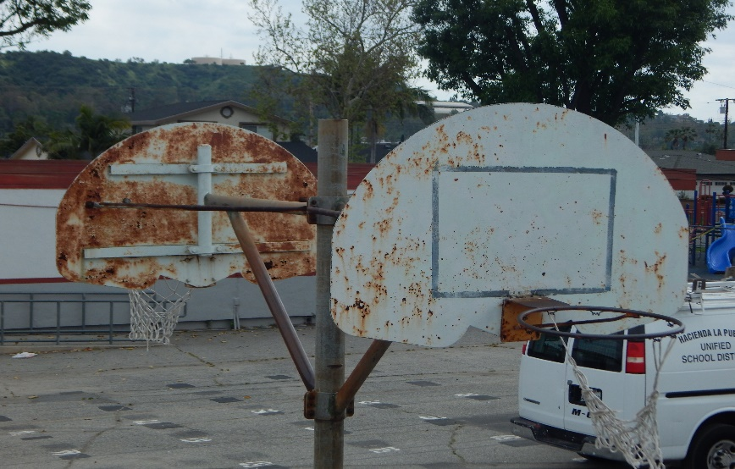
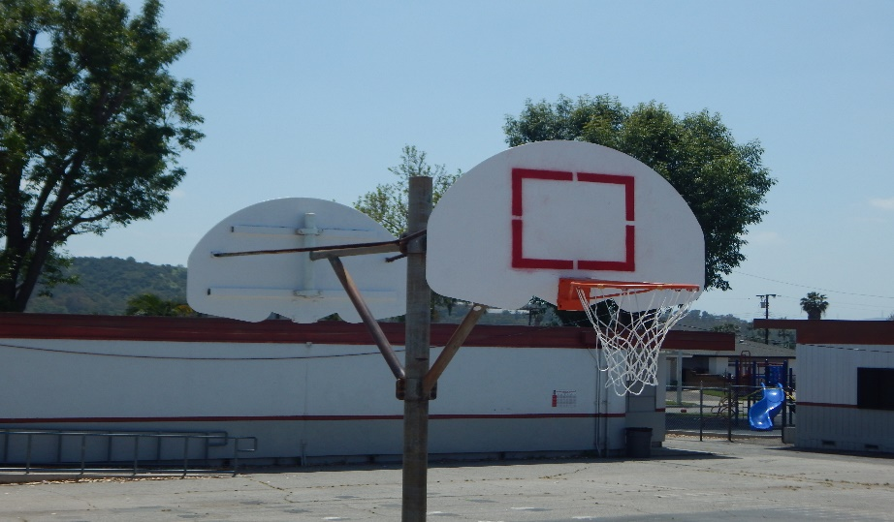
Projects Completed as of July 18, 2024 Valinda School of Academics - Restriping Basketball Courts
BEFORE
AFTER
BEORE
AFTER

Slide 5
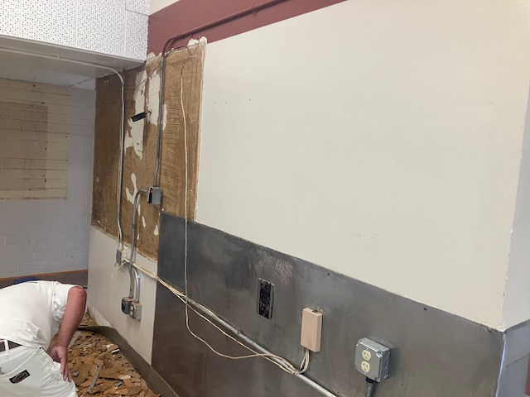
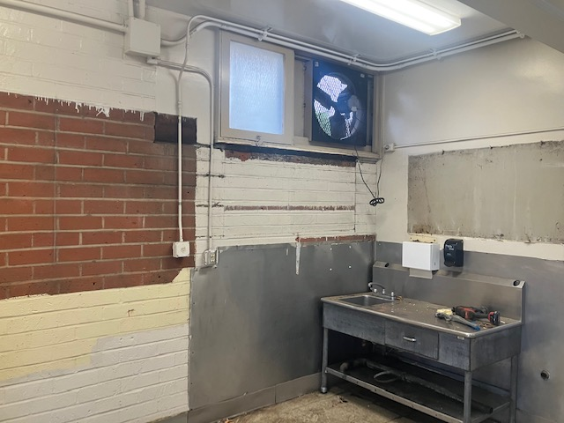
Projects Completed as of July 18, 2024 Grandview – Before Kitchen Improvements

Slide 6
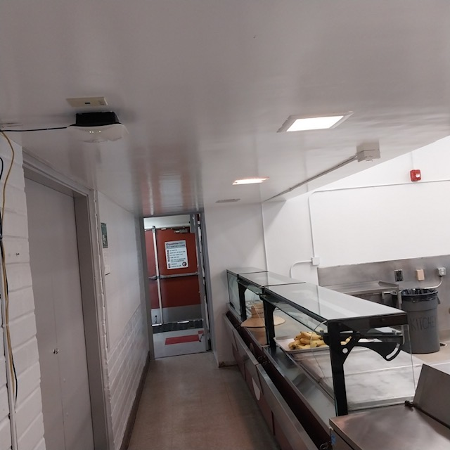
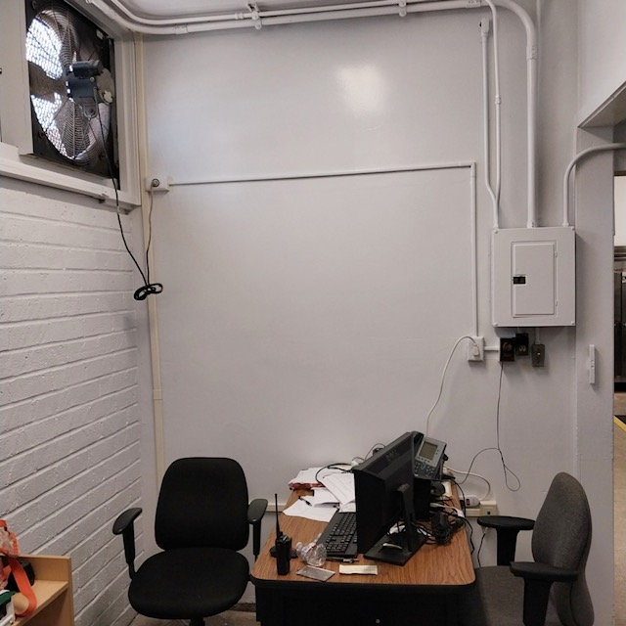
Projects Completed as of July 18, 2024 Grandview – After Kitchen Improvements

Slide 7
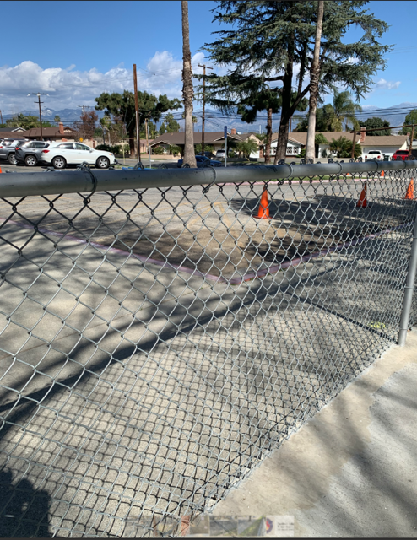
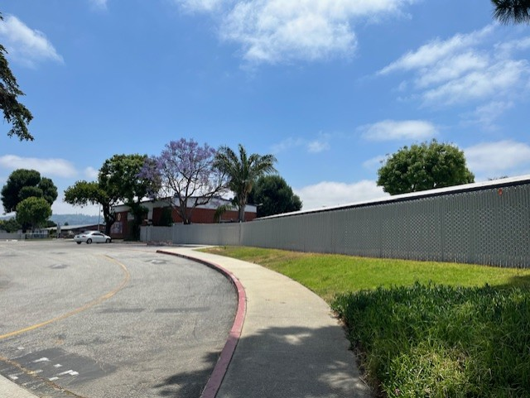
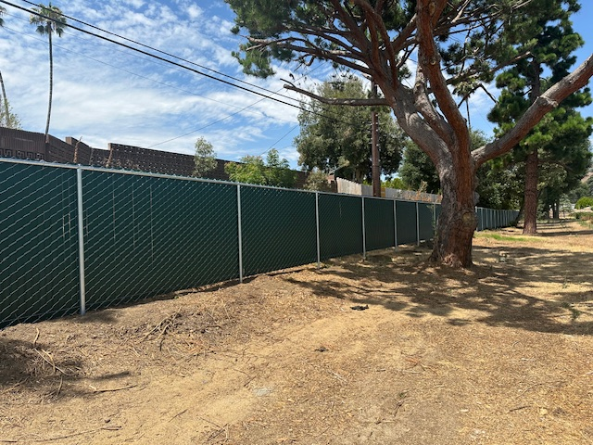
Projects Completed as of July 18, 2024 Palm Elementary – Safety Fencing
BEFORE
AFTER
BEORE
AFTER

Slide 8
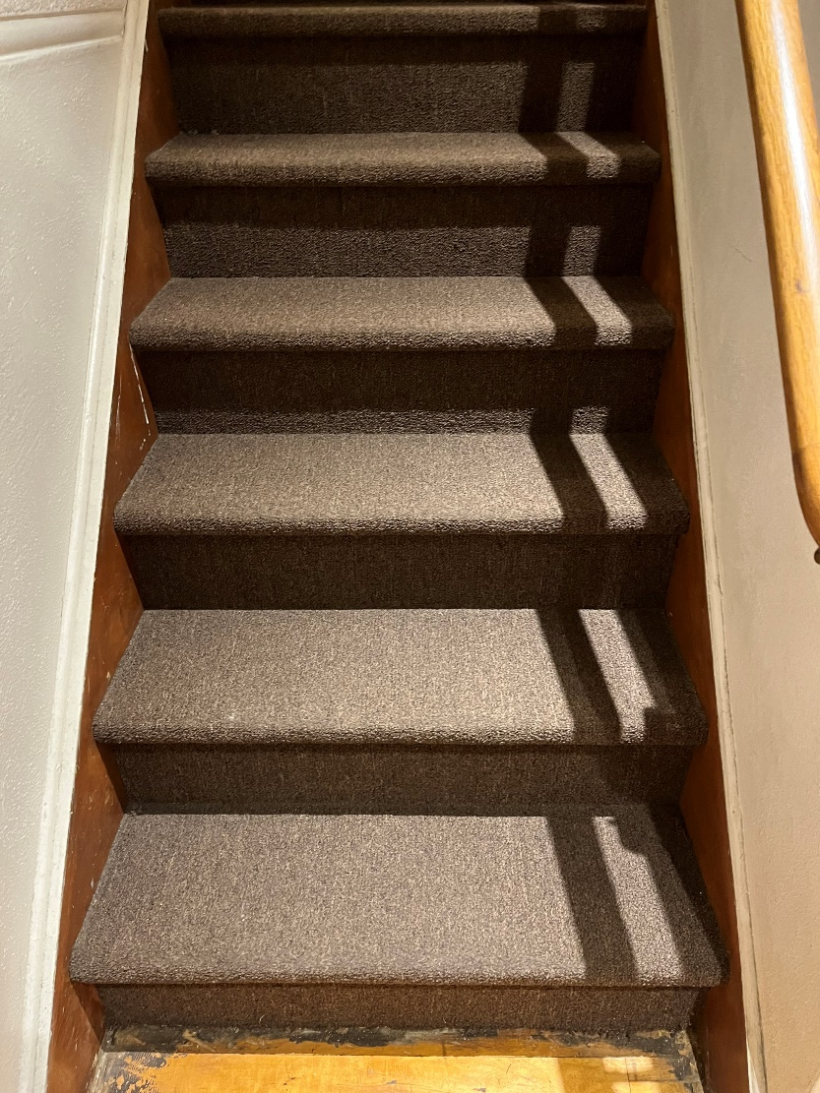
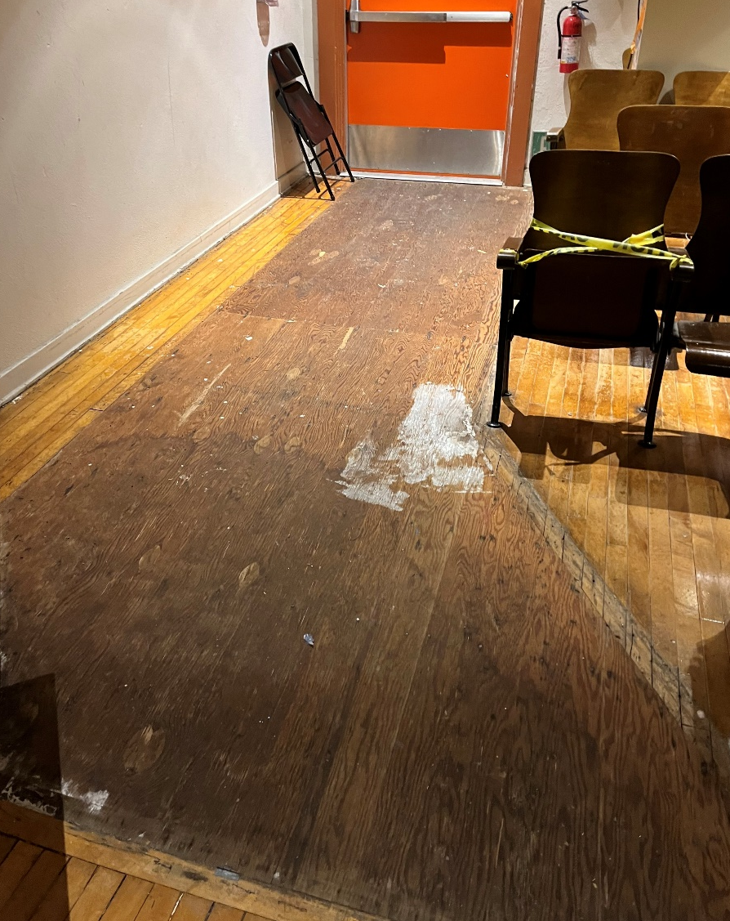
Projects Completed as of July 18, 2024 La Puente High School - Little Theatre
BEFORE
AFTER
BEORE
AFTER

Slide 9
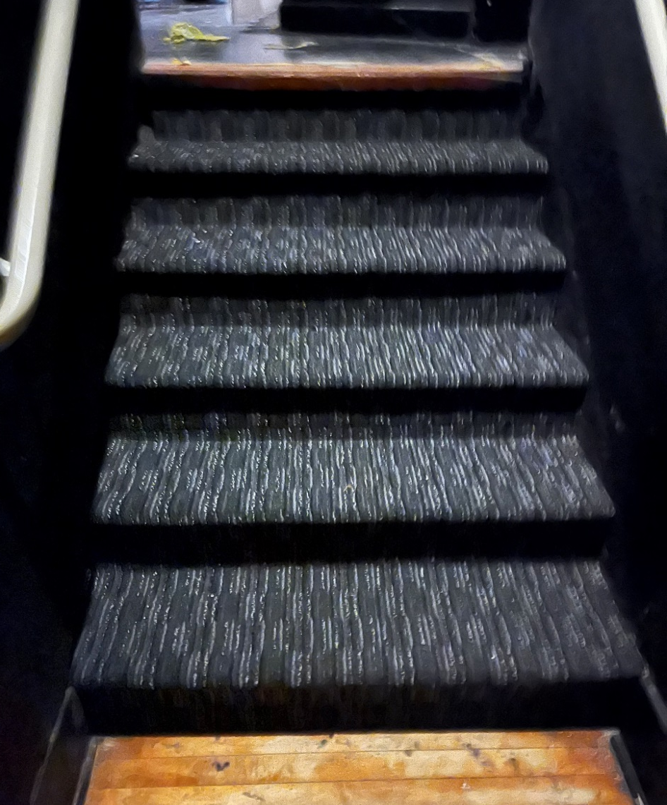
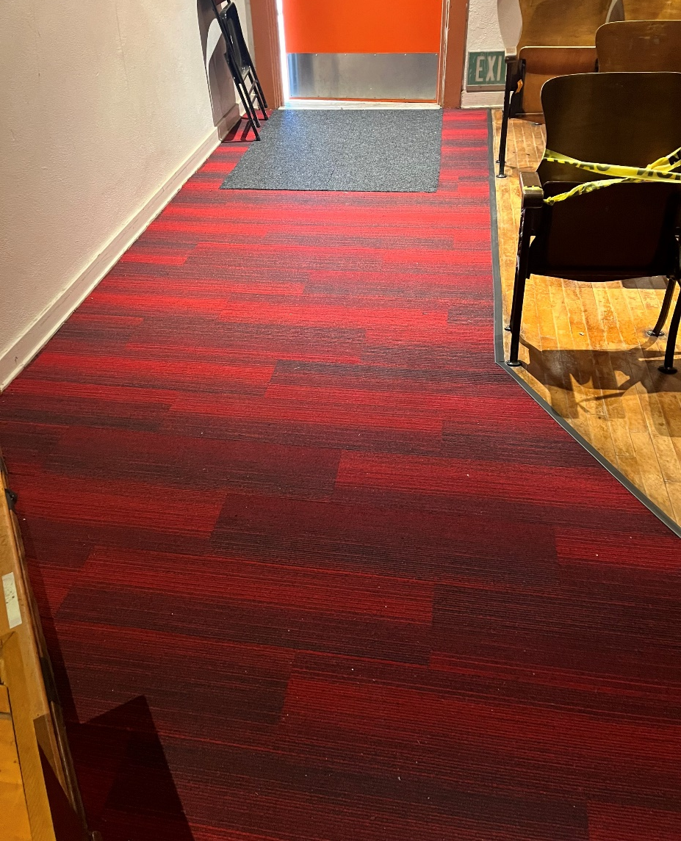
Projects Completed as of July 18, 2024 La Puente High School - Little Theatre
AFTER
BEORE
AFTER

Slide 10
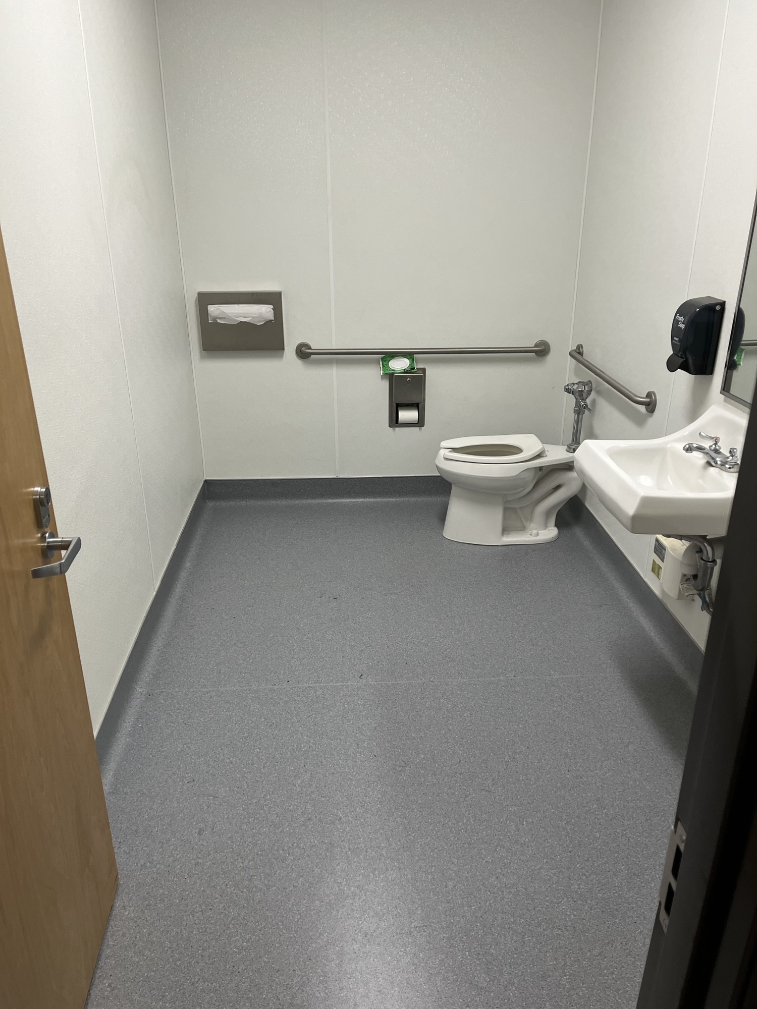
Projects Completed as of July 18, 2024 Lassalette Elementary Child Development - Restroom Flooring
BEFORE
AFTER

Slide 11
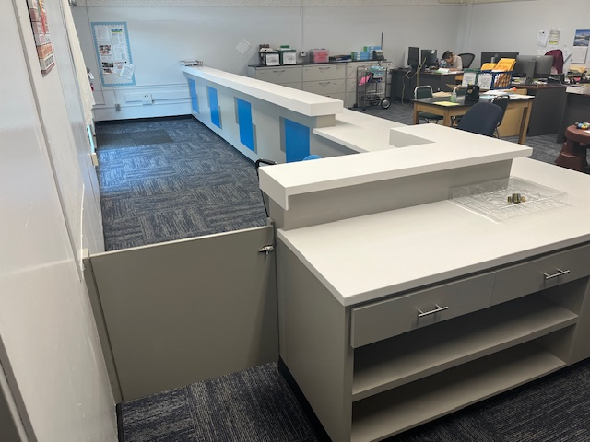
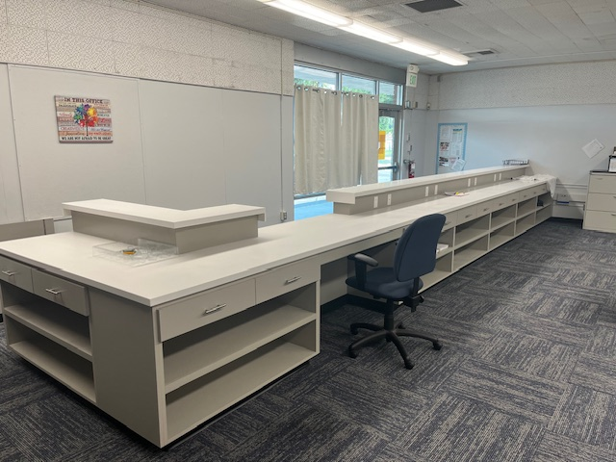
Projects Completed as of July 18, 2024 Sierra Vista SSC - Front Office Counter
NEW FRONT COUNTER
BEORE
AFTER

Slide 12
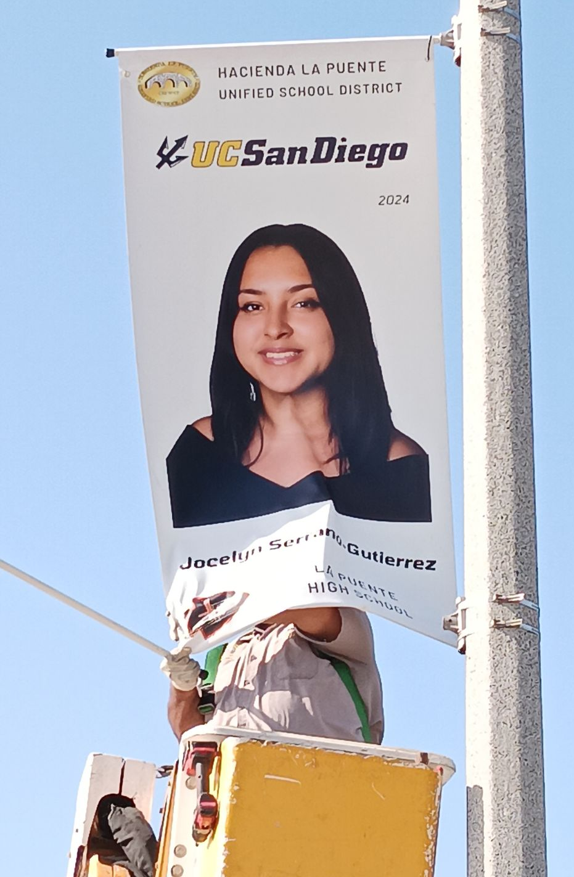
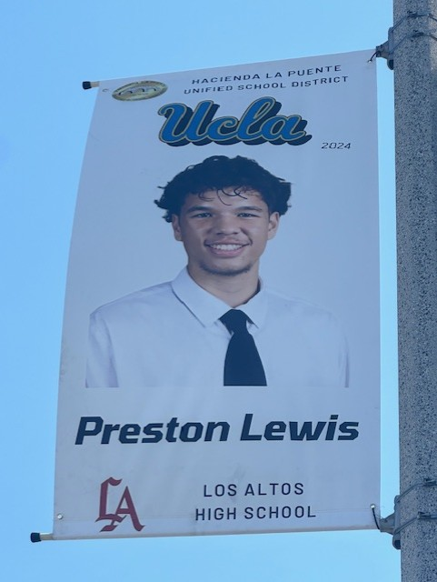
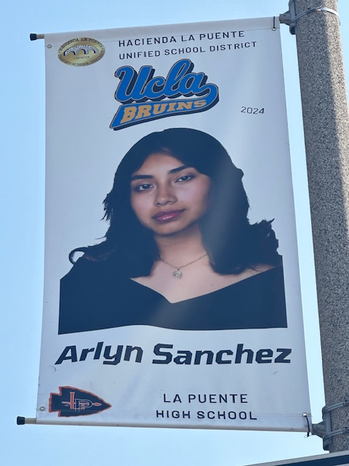
Projects Completed as of July 18, 2024 Districtwide - Banners
BEORE
AFTER

Slide 13
Projects In Progress 2024-2025

Slide 14
Projects in Progress as of July 18, 2024
Facilities
Site | Item Description | Architect Plans | DSA Approval | Procurement | Construct | Funding Source | Target Completion Date
Wedgeworth | K-5 Permanent School | Complete | Approved | Complete | In Progress | COPS | 06/2025
Los Altos High School | Gym & Locker Room HVAC (65 tons of temporary HVAC units have been installed) | Complete | Approved | Complete | In Progress | Facilities | 12/2024
Cedarlane Academy | Portable Installation | Complete | Approved | Complete | In Progress | Facilities | 08/2024
Sparks Middle School | Front Office Counter | NA | NA | Pending | Pending | Facilities | TBD
Notes:
Los Altos High School, expected to begin in July

Slide 15
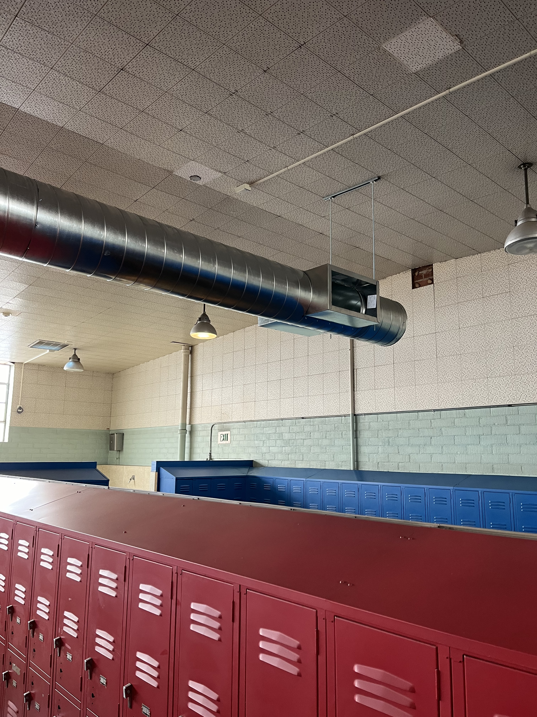
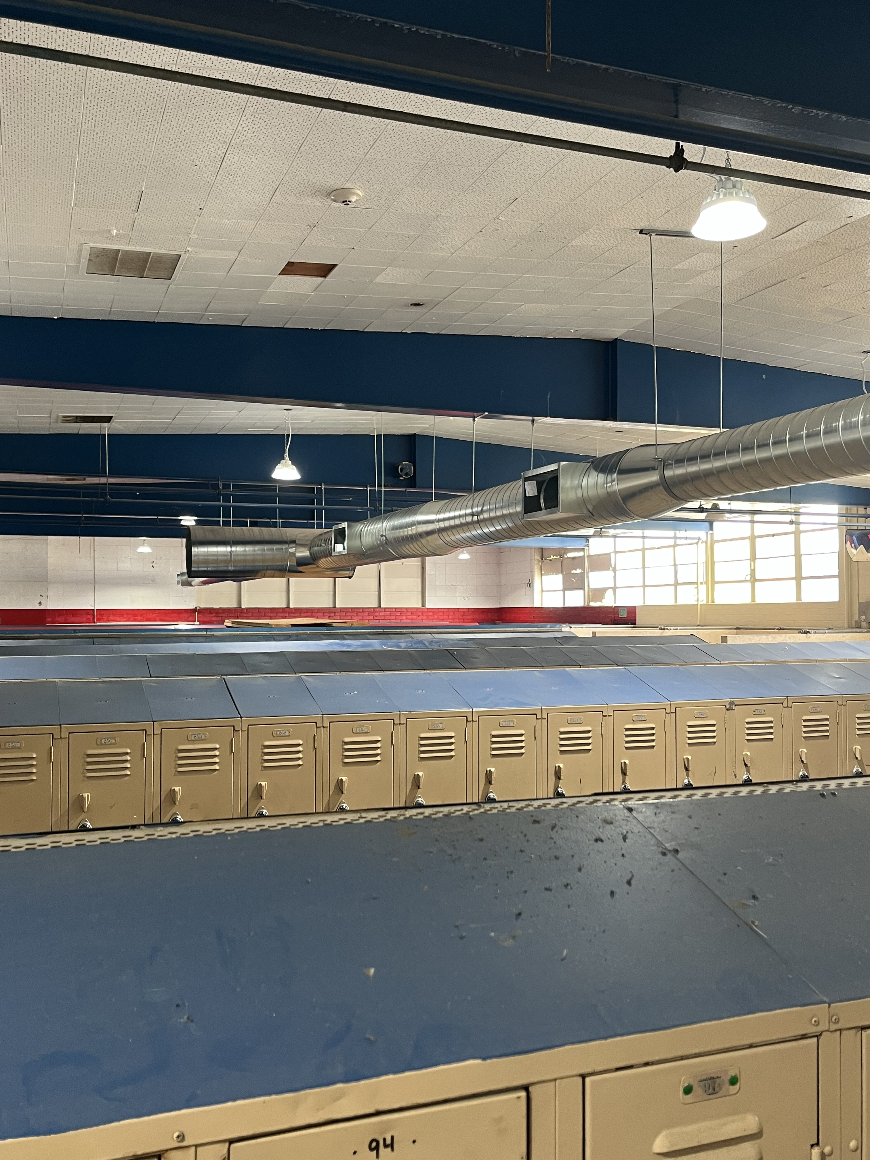
Projects In Progress as of July 18, 2024 Los Altos High School - Locker Room
BEORE
AFTER

Slide 16
Projects in Progress as of July 18, 2024
Facilities
Site | Item Description | Procurement | Construct | Funding Source | Target Completion Date
Amar Children's Center | Phase II of re-roofing | Complete | In Progress | Facilities | TBD
Baldwin Elementary | Phase II of re-roofing | Complete | In Progress | Facilities | TBD
Dibble Adult | Phase II of re-roofing | Complete | In Progress | Facilities | TBD
Grazide Elementary | Phase II of re-roofing | Complete | In Progress | Facilities | TBD
Kwis Elementary | Phase II of re-roofing | Complete | In Progress | Facilities | TBD
La Puente High School | Phase II of re-roofing | Complete | In Progress | Facilities | TBD
Los Molinos Elementary | Phase II of re-roofing | Complete | In Progress | Facilities | TBD
Stimson Learning Center | Phase II of re-roofing | Complete | In Progress | Facilities | TBD
Wilson High School | Phase II of re-roofing | Complete | In Progress | Facilities | TBD
Notes:
Los Altos High School, expected to begin in July

Slide 17
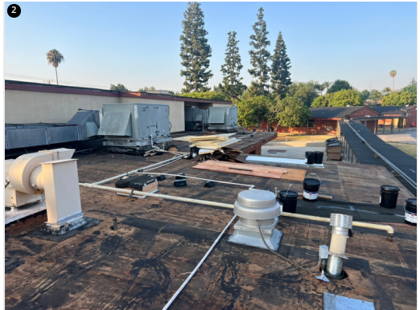
Projects In Progress as of July 18, 2024 Kwis Elementary - Roofing

Slide 18
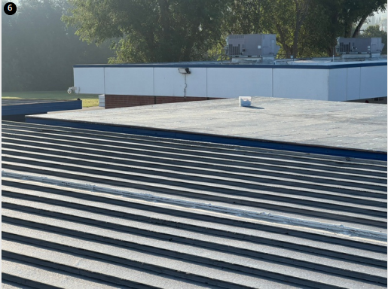
Projects In Progress as of July 18, 2024 Los Molinos Elementary - Roofing

Slide 19
Projects in Progress as of July 18, 2024
Child Development
Site | Item Description | Architect Plans | DSA Approval | Procurement | Construct | Funding Source | Target Completion Date
Winglane Elementary Head Start | Portable Installation | Complete | Approved | Complete | Complete | Child Development | 07/2024
Nelson Elementary Head Start | Playground, Shade Structure, & Accessibility Path of Travel | Complete | Approved | Complete | In Progress | Child Development | TBD
Fairgrove Academy Head Start | Playground & Shade Structure | Complete | Approved | Complete | In Progress | Child Development | TBD
Workman Elementary Head Start | Playground & Accessibility Path of Travel | Pending | Pending | Complete | In Progress | Child Development | TBD
Amar Children’s Center | Entry Security Project | Complete | Approved | Pending | Pending | Child Development | TBD
Changes And Progress Since Last Report - Blue

Slide 20
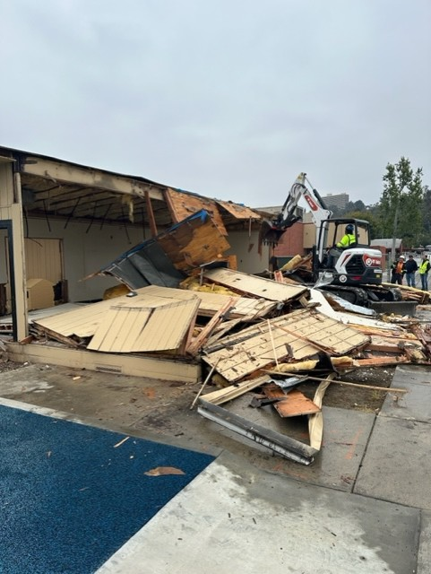
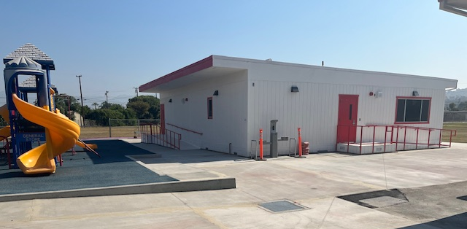
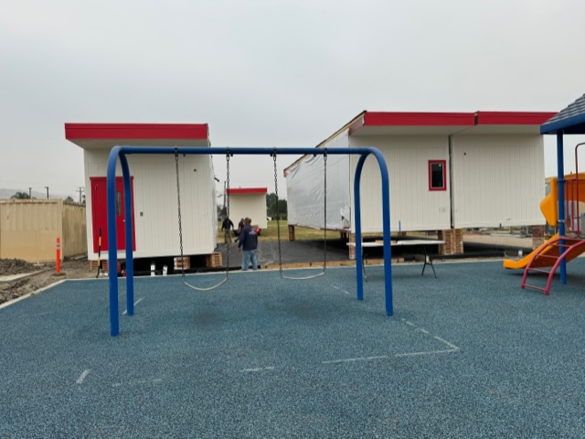
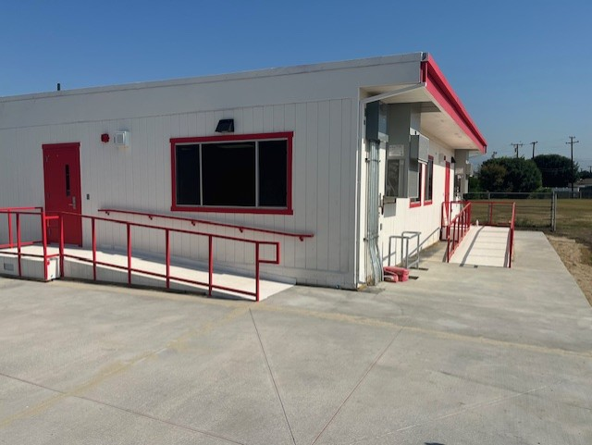
Projects in Progress as of July 18, 2024 Winglane Elementary Head Start Portable Installation- Demolition
BEFORE
AFTER
BEORE
AFTER

Slide 21
Projects in Progress as of July 18, 2024
Special Education
Site | Item Description | Architect Plans | DSA Approval | Procurement | Construct | Funding Source | Target Completion Date
Lassalette Elementary | Inclusive Playground | NA | NA | Complete | Pending | Special Ed | TBD
Adult Education
Site | Item Description | Architect Plans | DSA Approval | Procurement | Construct | Funding Source | Target Completion Date
Willow Adult Ed | Marquee | Complete | NA | Pending | Pending | Adult Ed | TBD
Dibble Adult Ed | Admin Upgrade | In Progress | NA | Pending | Pending | Adult Ed | TBD
Center for the Performing Arts | Construction of NEW Performing Arts Center @ Temple Academy | Complete | Complete | Pending | TBD | Adult Ed | TBD
Changes And Progress Since Last Report - Blue

Slide 22
Projects in Progress as of July 18, 2024
Nutrition Services
Site | Item Description | Architect Plans | DSA Approval | Procurement | Construct | Funding Source | Target Completion Date
District Office | Warehouse Freezer | Complete | NA | Pending | TBD | Food Services | TBD
Wilson High School | Kitchen Modernization | Pending | Pending | Pending | TBD | Food Services | TBD
Mesa Robles Middle School | Kitchen Renovation | Complete | Pending | Pending | TBD | Food Services | TBD
Baldwin Academy | Kitchen Renovation - Three Compartment Sink Installation | Complete | NA | Pending | TBD | Food Services | TBD
Changes And Progress Since Last Report - Blue
Notes:
Kwis Baseball – Will be Re-Bid, uncertified entry was added to scope of work into the project.
Cedarlane Portable – In design phase with PBK architecture. Soils samples being conducted.
Willow Adult School = Two Story Building continues to be under construction. It coming along very well.

Slide 23
Facilities Upcoming Projects
Site | Item Description | Architect Plans | DSA Approval | Procurement | Est. Construct Start | Target Completion Date
Districtwide | HVAC System Replacement | Pending | Pending | Pending | TBD | TBD
Kwis Elementary | Baseball Fields | Complete | Approved | Pending | TBD | TBD
Los Altos High School | Stadium Press Box & Bleachers | Pending | Pending | Pending | TBD | TBD
La Puente High School | Custom Shade Structure | Complete | Approved | In Process | TBD | TBD
Wilson High School | Stadium Press Box & Bleachers | Complete | Pending | Pending | TBD | TBD
Workman High School | Phase II Stadium and Baseball Field (Phase I Track & Field and Softball Field Complete) OPTION B | Complete | Approved | Pending | Estimated | TBD (14-18 months after Board approval of the Bid)
Workman High School | Shade Structure, Wall, & Lighting | In Progress | Pending | Pending | TBD | TBD
Changes And Progress Since Last Report - Blue
Notes:
Amar- In DSA, waiting for approval
LAHS- HVAC-
Press Box- working on the rehabilitation for DSA Approval
LPHS- Addressing DSA comments and awaiting approval
WIHS- Addressing DSA comments and awaiting approval
Wing Lane- Project Bid, waiting for Board Approval

Slide 24
Next Report – August 22, 2024

