Slide 1
Online Safety
Presented by St. Mary Parish School Board Technology Department.
Amy Vaccarella, CTO
LeeAnn Hepler, Technology Facilitator
Angelle Ransonet, Technology Facilitator
Notes:
Introductions

Slide 2
Technology is here to stay. The World Economic Forum estimates that
65% of children today will end up in
careers that don't even exist yet.
commonsensemedia.org
Notes:
Throughout this presentation, we’re going to talk about ways you can protect your children online no matter how they access the Internet.
Kids go online from:
School computers.
Friends’ computers.
Laptops and tablets.
Cell phones.
MP3 players like the iPod Touch.
E-readers like the Nook and Kindle.
Game consoles like the Nintendo Wii U, PlayStation 4 or Xbox One.
Handheld gaming devices like the Nintendo 3DS or the PlayStation Vita.
Technology changes all the time, and kids are constantly finding the newest websites, apps and gadgets. It’s up to you to teach them the basic rules of Internet safety so they can use all of these responsibly.

Slide 3
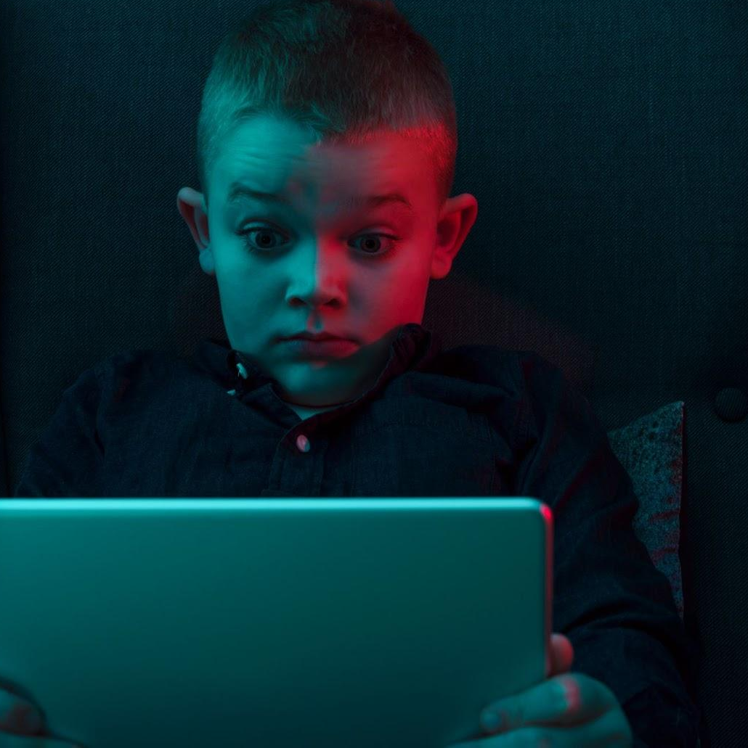
Benefits
Fears/Challenges
Communicating with loved ones far away
New careers
Access to information
Broadcast yourself
Entertainment
New learning tools
Connection to the world
Learn anything online
Monitoring use of tech
Tech addiction
Inappropriate content
Online predators
Online bullying
Violence
Dangerous "challenges" and trends
Too much access at an early age
Fears/ Challenges
Benefits
commonsensemedia.org
Notes:
let's talk about the benefits and challenges we face in today's digital world, especially when it comes to raising a family.
Here are some potential benefits and challenge.

Slide 4
Cyberbullying
As child’s age increased, so did the likelihood of cyberbullying.
As the child aged in two-year intervals between the ages of 10 and 18, their likelihood of being cyberbullied increased by 2 percent.
Using technology to bully or harass someone.​
Notes:
We also found that, as a child’s age increased, so did the likelihood of cyberbullying. As the child aged in two-year intervals between the ages of 10 and 18, their likelihood of being cyberbullied increased by 2 percent.
Kids on YouTube are the most likely to be cyberbullied at 79 percent, followed by Snapchat at 69 percent, TikTok at 64 percent, and Facebook at 49 percent.

Slide 5
Cyberbullying
Kids Cyberbullied Online
79%
69%
64%
49%
Notes:
Kids on YouTube are the most likely to be cyberbullied at 79 percent, followed by Snapchat at 69 percent, TikTok at 64 percent, and Facebook at 49 percent.
We also found that, as a child’s age increased, so did the likelihood of cyberbullying. As the child aged in two-year intervals between the ages of 10 and 18, their likelihood of being cyberbullied increased by 2 percent.

Slide 6
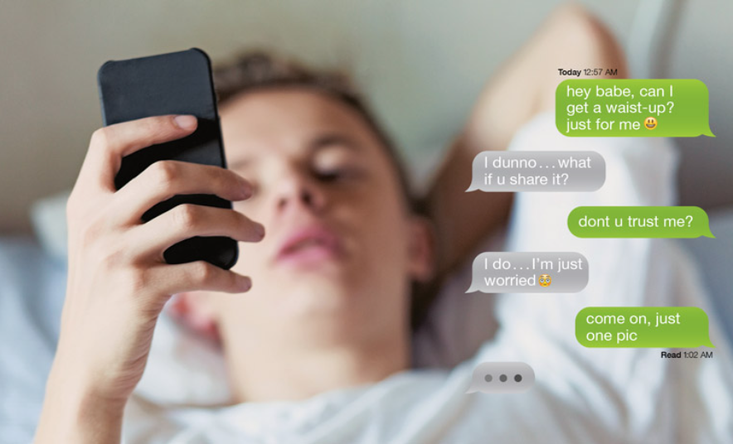
Sexting
Notes:
Thorn Research: Understanding sexually explicit images, self-produced by children | Thorn

Slide 7
Sexting
Sending nude or partially nude pictures/videos to another
Having sexual conversations in text messages/online
Notes:
Thorn Research: Understanding sexually explicit images, self-produced by children | Thorn

Slide 8
Sexting
Percentage of minors who say they have sent or shared a nude photo or video of themselves online.
Notes:
Thorn Research: Understanding sexually explicit images, self-produced by children | Thorn

Slide 9
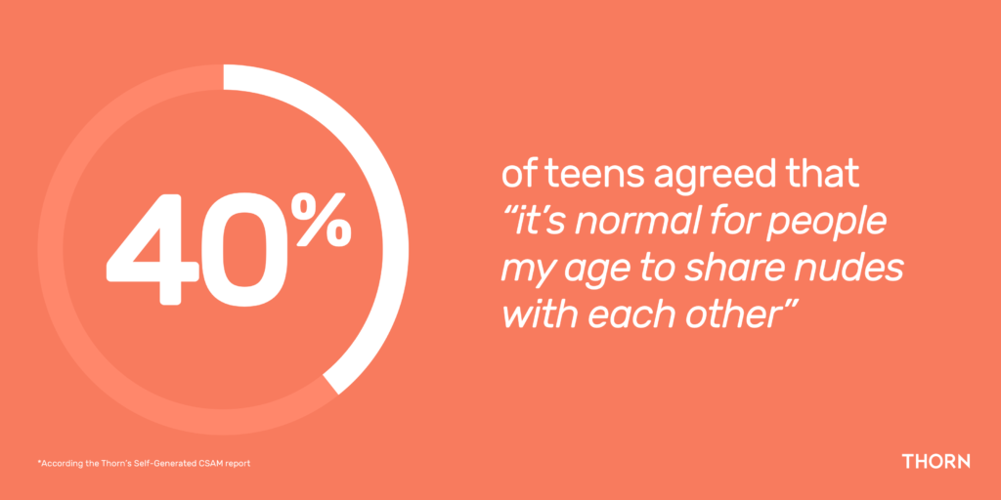
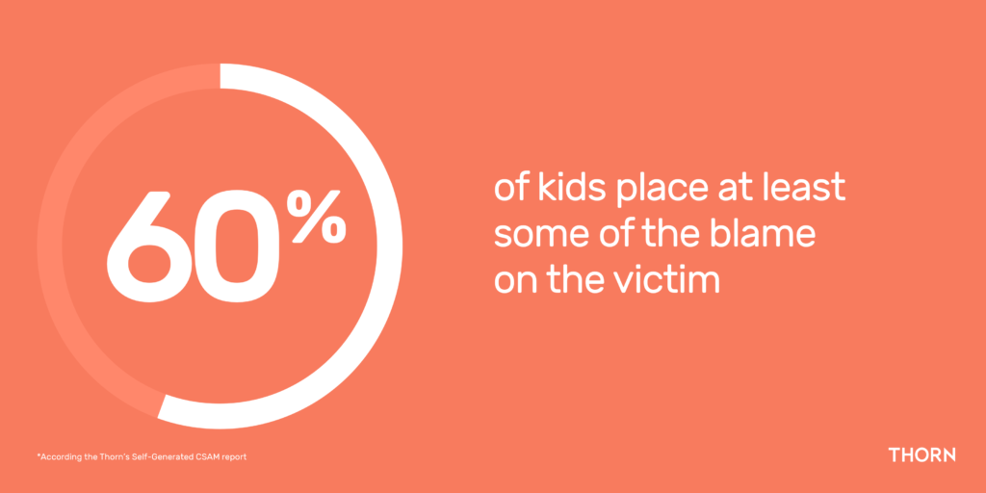
Sexting
Notes:
Thorn Research: Understanding sexually explicit images, self-produced by children | Thorn

Slide 10
Online Enticement & Sextortion
ONLINE ENTICEMENT involves an individual communicating with someone believed to be a child via the internet with the intent to commit a sexual offense or abduction.

Slide 11
Online Enticement & Sextortion
SEXTORTION is a broad category of online exploitation, in which a child is being groomed to take sexually explicit images and/or ultimately meet face-to-face with someone for sexual purposes, or to engage in a sexual conversation online or, in some instances, to sell/trade the child’s sexual images.

Slide 12
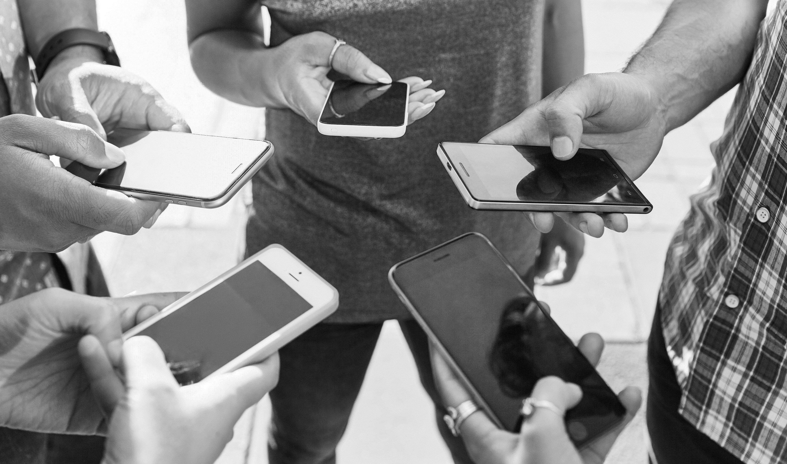
Social Media Apps
Notes:
10 Best Popular Social Media for Teens - 2022 Updated (clevguard.com)

Slide 13
TikTok
Users create, share and watch short clips
TikTok has around 1 billion monthly active users and most are teens.
62% of users in the US are between 10 and 29 years old.
Notes:
10 Best Popular Social Media for Teens - 2022 Updated (clevguard.com)
10 TikTok Statistics You Need to Know in 2022 [New data] (oberlo.com)

Slide 14
TikTok-Challenges
Many are harmless and fun, but others need to be monitored closely
Can harm a child’s physical and mental health
The Blackout Challenge: Users interrupting their oxygen until they get close to losing consciousness. This challenge led to deaths of multiple children aged 9-12.
The Benadryl Challenge: Encouraged users to take excessive amounts of the medication to try to experience a high that could cause hallucinations. The FDA asked TikTok to remove the videos, warning that taking too much of the medication can lead to serious heart problems, seizures, coma, or even death.
Notes:
10 Best Popular Social Media for Teens - 2022 Updated (clevguard.com)
10 TikTok Statistics You Need to Know in 2022 [New data] (oberlo.com)

Slide 15
TikTok-Concerns
Users can see all content without creating an account
Make sure account isn’t public so anyone on app can’t see what child shares
Users can like or react to video, follow or send messages, so risk strangers will be in direct contact of child
Children tempted to take risks to get more followers
Notes:
10 Best Popular Social Media for Teens - 2022 Updated (clevguard.com)
10 TikTok Statistics You Need to Know in 2022 [New data] (oberlo.com)

Slide 16
TikTok-Safety Features
Restricted Mode: filters out inappropriate content on the app
Set up Private account:
All videos can only be seen by creator
Can approve/deny users and limit incoming message to followers only
Note: child’s profile photo, username and bio are still visible to all users
Notes:
10 Best Popular Social Media for Teens - 2022 Updated (clevguard.com)
10 TikTok Statistics You Need to Know in 2022 [New data] (oberlo.com)

Slide 17
Social Media Apps
Notes:
10 Best Popular Social Media for Teens - 2022 Updated (clevguard.com)

Slide 18
Snapchat
Users send videos, pictures, and chats (called a snap)
Snaps are temporary and is available for 24 hours unless you delete it or set a different limit
Snapchat app is ranked 2nd in the world for mobile usage.
69% of Snapchat users in the US are ages 13-17.
Notes:
10 Best Popular Social Media for Teens - 2022 Updated (clevguard.com)
2022 Snapchat Statistics // Everything You Need to Know from SMPerth

Slide 19
Snapchat – Snap Map
Allows users to share location in real time with anyone on their Snapchat friend list and see locations of friends
CONCERN:
Some Snapchat contacts may not be real friends (fake accounts) causing safety risk
Hurt feelings if kids feel excluded from a gathering
Notes:
10 Best Popular Social Media for Teens - 2022 Updated (clevguard.com)
2022 Snapchat Statistics // Everything You Need to Know from SMPerth

Slide 20
Snapchat – Discover
Allows users to see content from popular media channels-many which offer sexually oriented content
A lawsuit filed in California in 2016 cited some offensive Snapchat Discover content including "people share their secret rules for sex" and "10 things he thinks when he can't make you orgasm." Some parents may not be comfortable with their tweens and teens having immediate access to articles like these.
Notes:
10 Best Popular Social Media for Teens - 2022 Updated (clevguard.com)
2022 Snapchat Statistics // Everything You Need to Know from SMPerth

Slide 21
Snapchat – Snapstreaks
Two users have snapped back and forth within a 24-hour period for three days in a row
A flame emoji and a number will appear next to users’ names to show how long the streak was maintained
CONCERNS:
Streaks are a measure of their friendships
Pressure of maintaining streaks takes a toll on kids
Notes:
10 Best Popular Social Media for Teens - 2022 Updated (clevguard.com)
2022 Snapchat Statistics // Everything You Need to Know from SMPerth

Slide 22
Snapchat - Family Center
Allows parents to
View new friends' teens added and sent messages to
See complete list of existing friends
Report any accounts parents may be concerned about to 24/7 Trust and Safety teams to investigate
Notes:
10 Best Popular Social Media for Teens - 2022 Updated (clevguard.com)
2022 Snapchat Statistics // Everything You Need to Know from SMPerth

Slide 23
Snapchat - Privacy Settings
Choose who can contact child (only friends)
Choose who can view child’s story (friends only)
Location Sharing (Ghost Mode: completely hide location)
Manage chat settings for each friend your child messages
More Information: Snapchat Parental Controls | Internet Matters - Is Snapchat Safe
Notes:
10 Best Popular Social Media for Teens - 2022 Updated (clevguard.com)
2022 Snapchat Statistics // Everything You Need to Know from SMPerth

Slide 24
Social Media Apps
Notes:
10 Best Popular Social Media for Teens - 2022 Updated (clevguard.com)

Slide 25
Instagram
Users share images and videos using filters; Send chat messages.
More than 1 billion active users each month.
72% of users are 13 – 17 years old.
Notes:
10 Best Popular Social Media for Teens - 2022 Updated (clevguard.com)
2022 Instagram Statistics // Everything You Need to Know from SMPerth

Slide 26
Instagram-Privacy
Private Profile: only followers your child approves can see posts
Public Profile: posts and activity can be seen by everyone
By default, profiles are Private for children. However, the feature can be turned off.
Notes:
10 Best Popular Social Media for Teens - 2022 Updated (clevguard.com)
2022 Instagram Statistics // Everything You Need to Know from SMPerth

Slide 27
Instagram-Privacy
Sharing and Posting Content
Public: all photos and videos can be viewed and commented on by all users
Private: only seen by “approved followers” – followers must be approved by your child
Notes:
10 Best Popular Social Media for Teens - 2022 Updated (clevguard.com)
2022 Instagram Statistics // Everything You Need to Know from SMPerth

Slide 28
Instagram-Privacy
Remove followers
Private accounts can remove any followers and the person will not be notified
Notes:
10 Best Popular Social Media for Teens - 2022 Updated (clevguard.com)
2022 Instagram Statistics // Everything You Need to Know from SMPerth

Slide 29
Instagram Stories
A photo or video you upload to your profile
Visible on the app for 24 hours then it disappears
Follower can send you a message while viewing story, but others will not be able to see comment
Instagram keeps a log of your viewers
Notes:
10 Best Popular Social Media for Teens - 2022 Updated (clevguard.com)
2022 Instagram Statistics // Everything You Need to Know from SMPerth

Slide 30
FINSTA
A fake Instagram account
Child uses a fake or alternative name to post things they wouldn’t post on real Instagram (Rinsta)
The goal is to create usernames that will be recognizable to friends but not parents
Notes:
10 Best Popular Social Media for Teens - 2022 Updated (clevguard.com)
2022 Instagram Statistics // Everything You Need to Know from SMPerth

Slide 31
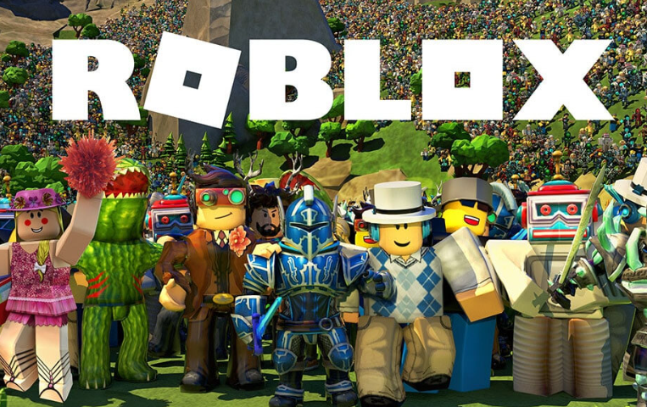
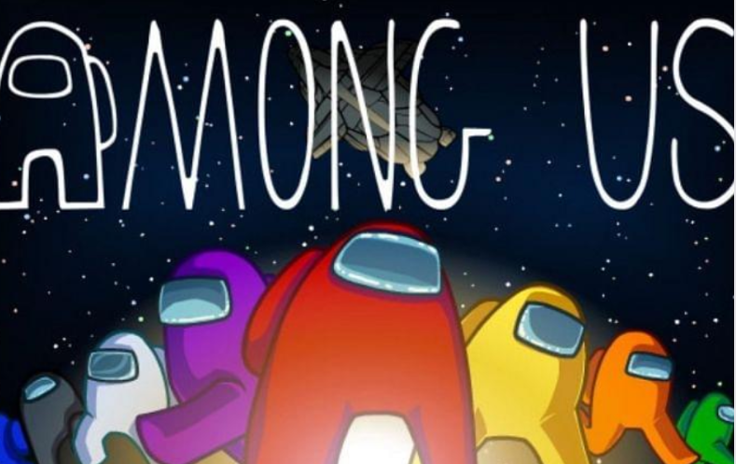
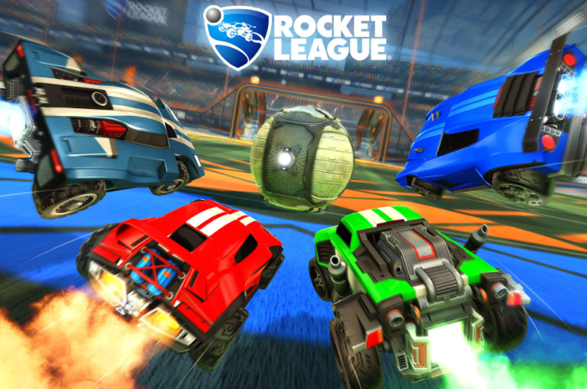
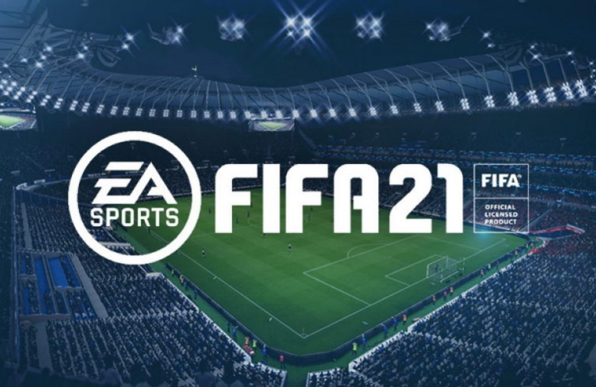
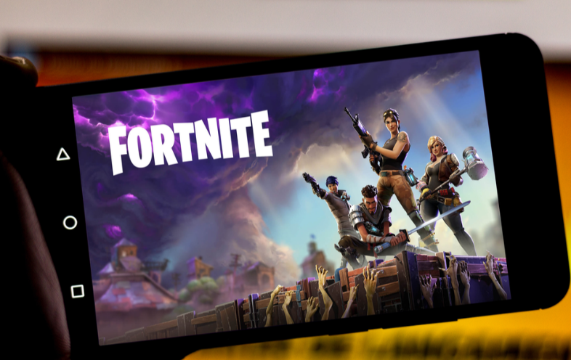
Online Gaming
Notes:
10 Best Popular Social Media for Teens - 2022 Updated (clevguard.com)

Slide 32
Online Gaming
Video games that offers online interactions with other players
Fun and sociable way to spend time, encourage teamwork and developing skills
Almost all parents claim children have played video games in some capacity
3 in 4 children between the ages 4-5 have experienced playing games on a tablet
Time Gaming: 2 hours a day during the week and 5 hours on the weekend
Notes:
10 Best Popular Social Media for Teens - 2022 Updated (clevguard.com)

Slide 33
Online Gaming-Risks
Online Game Addiction
World Health Organization added “gaming” under the section “Disorders due to addictive behaviors”
Average child that plays games is not addicted
Signs of Addiction: Severe detriment to parts of life – schoolwork, relationships, personal hygiene, health, etc.
Support:
Review what they are playing and how long
Set time limits
Encourage for them to take breaks
Notes:
10 Best Popular Social Media for Teens - 2022 Updated (clevguard.com)

Slide 34
Online Gaming-Risks
Contact with Strangers
Children can play with people from around the world
Ex: Fortnite-can have 100 strangers in the same fight to the death
Child’s first interaction with someone they don’t know online is more likely on a video game like Roblox
Use of personas to hide real identities
Don’t know who they are playing with
Can set up a fake identity
Parents understand the game and set them up for your children
Notes:
10 Best Popular Social Media for Teens - 2022 Updated (clevguard.com)

Slide 35
Online Gaming-Advice
Check settings on devices
When you purchase a video game, go to “Parental Controls” and set up the online interaction settings
Keep devices in shared family spaces
Play sound on speakers not headset
Turn on notifications on your account
Set up children’s accounts
Set up separate accounts for children of different ages in your home
Ensure children take breaks and move around
Notes:
10 Best Popular Social Media for Teens - 2022 Updated (clevguard.com)

Slide 36
Additional Resources

