Slide 1
Teacher Incentive Allotment and National Board Certification
Notes:
Amy will open.

Slide 2
What is the Teacher Incentive Allotment?
The Teacher Incentive Allotment (TIA) was created by the Texas Legislature as part of House Bill 3 to help attract and retain highly effective teachers at traditionally hard-to-staff schools. Particular emphasis is being placed on high need and rural schools. The TIA is a statewide program that aims to recruit, reward, and retain effective teachers through the building and implementing of local designation systems with multiple measures of effectiveness.
The TIA would provide additional funding to eligible teachers who earn local designations through this allotment system.
In April 2024, (Cohort G); Fredericksburg ISD plans to submit an application to the Texas Education Agency (TEA) to participate in this process.
The intent is to provide a realistic pathway for highly effective teachers to earn more while remaining in the classroom, and to help attract and retain highly effective teachers.

Slide 3
Pathways for Teacher Designation
Pathway 1: (what we will be discussing today)
National Board Teacher Certification https://www.nbpts.org/
Automatically qualifies a teacher at the RECOGNIZED designation.
Pathway 2: Local Designation System
FISD’s teacher designation system must include teacher observation (T-TESS) and the performance of a teacher’s students (student growth).
TEA and Texas Tech University will review the quality, validity, and reliability of the observation tools and student performance measures as part of the designation system approval process.

Slide 4
Teacher Incentive Allotment Funding
*Once you qualify for TIA funds, you must remain coded as a teacher to continue receiving the funds.
*Designation is good for 5 years or duration of National Board Certification
Notes:
Amy

Slide 5
Teacher Incentive Allotment Funding
Funding amounts are based on two primary sources:
Rural or non-rural designations by TEA
Percent economically disadvantaged
Amounts based on 2022-2023 Data:
Status | Campus | Recognized | Exemplary | Master
non-rural | FPS | $4,790 | $9,580 | $17,966
non-rural | FES | $4,448 | $8,897 | $16,828
non-rural | FMS | $4,334 | $8,669 | $16,448
non-rural | FHS | $4,116 | $8,233 | $15,721
rural | SES | $6,042 | $12,083 | $22,139
*Once you qualify for TIA funds, you must remain coded as a teacher to continue receiving the funds.
*Designation is good for 5 years or duration of National Board Certification
Notes:
Amy

Slide 6
What is the National Board?
The National Board for Professional Teaching Standards is a not-for-profit professional organization, created and governed by practicing teachers and their advocates. The founding mission of the National Board is to advance the quality of teaching and learning by
maintaining high and rigorous standards for what accomplished teachers should know and be able to do;
providing a national voluntary system certifying teachers who meet these standards; and
advocating related education reforms to integrate National Board Certification into American education and to capitalize on the expertise of National Board Certified Teachers.
Recognized as the “gold standard” in teacher certification, the National Board believes in higher standards for teachers means better learning for students.

Slide 7
Certification Process
Four Components: three portfolio entries, which are submitted online, and a computer-based assessment, which is administered at a testing center.
Component 1 - Content Knowledge: computer-based assessment in your field
Component 2 - Differentiation in Instruction: classroom-based portfolio entry (student work samples and written commentary)
Component 3 - Teaching Practice and Learning Environment: classroom-based portfolio entry which includes video recordings and two written commentaries
Component 4 - Effective and Reflective Practitioner: portfolio entry

Slide 8
Eligibility Requirements
Eligibility Requirement | Requirement Must Be Met
Must possess a bachelor’s degree from accredited institution | Before a candidate registers and purchases their first component
Hold a valid state teaching certification | Before a candidate registers and purchases their first component Candidate must also hold a valid teaching certificate for each of the three years they verify towards the employment requirement
Successfully completed three years of teaching at one or more early childhood, elementary, middle, or secondary schools | No later than June 30 of a candidate’s third year of candidacy
World Language Candidates: ACTFL language proficiency requirement | No later than June 30 of the assessment cycle in which the candidate completes initial testing on all four components

Slide 9
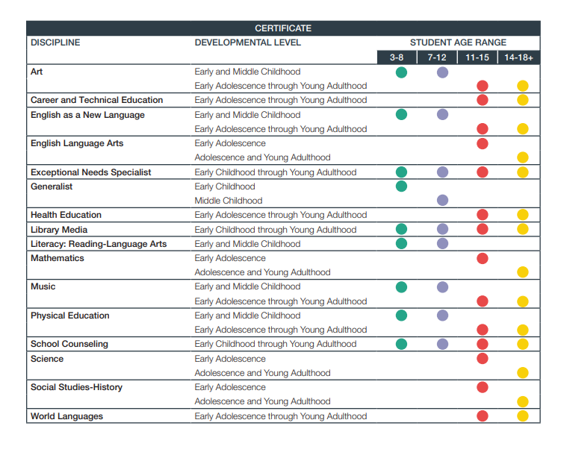
Additional Information
25 certification areas https://www.nbpts.org/wp-content/uploads/2021/05/Certification-Areas-1.pdf

Slide 10
Additional Information
Completing the certification may take anywhere from one to five years, depending on the approach you take
The following rules apply:
You must attempt each of the four components within the first three years of your candidacy.
You have a five-year window to achieve certification.
Components must be completed during the assessment cycle in which they are purchased.
You have up to two retake attempts for each component. Each retake requires additional fee.

Slide 11
Fees and Reimbursement
The teacher seeking the National Board Certification will pay the registration fee.
FISD, within their current budget, will pay the component fees upfront for a cohort of 10 teachers. The Fredericksburg Education Foundation will also pay the $3000 fee, per teacher, for BloomBoard services for this cohort. An application process will be used for the cohort - coming January.
Fees:
Registration fee: $75 (does not qualify for reimbursement)
Components 1-4: $475 each (qualifies for reimbursement, able to set up a payment plan) ($1900 total)
Retake an assessment or re-doing a component (does not qualify for reimbursement)
**If you do not want to be a part of the cohort - you can get reimbursement for the component fees once you become certified. The district submits your certification to TEA, TEA reimburses the district, then the district will reimburse you.
This does not cover BloomBoard.

Slide 12
Timeline for 2023-2024 Assessment Cycle
2023-24 Important Dates and Deadlines
Registration Window | May 22, 2023 - February 29, 2024
Registration (includes $75 fee) | February 29, 2024
Component Selection (includes payment of component fees) | February 29, 2024
Change of Component Selection | February 29, 2024
Withdrawal Deadline | February 29, 2024
Change of Certificate and/or Specialty Area | March 22, 2024
Component 1: Content Knowledge Testing Window | March 1 - June 15, 2024
ePortfolio Submission Window | April 1 - May 18, 2024
Score Release | December 7, 2024
**The 2024-25 Assessment Cycle should open sometime between May-July 2024

Slide 13
Timeline for BloomBoard Program

Slide 14
Questions??
https://www.nbpts.org/
https://bloomboard.com/program/nbct/

