Slide 1
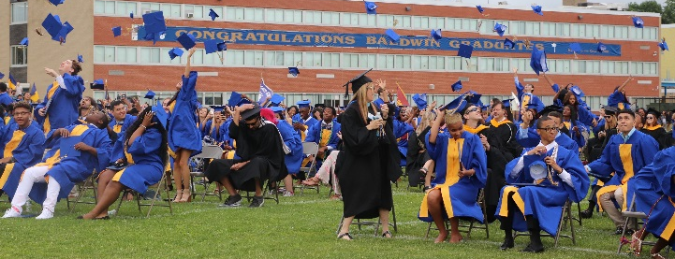
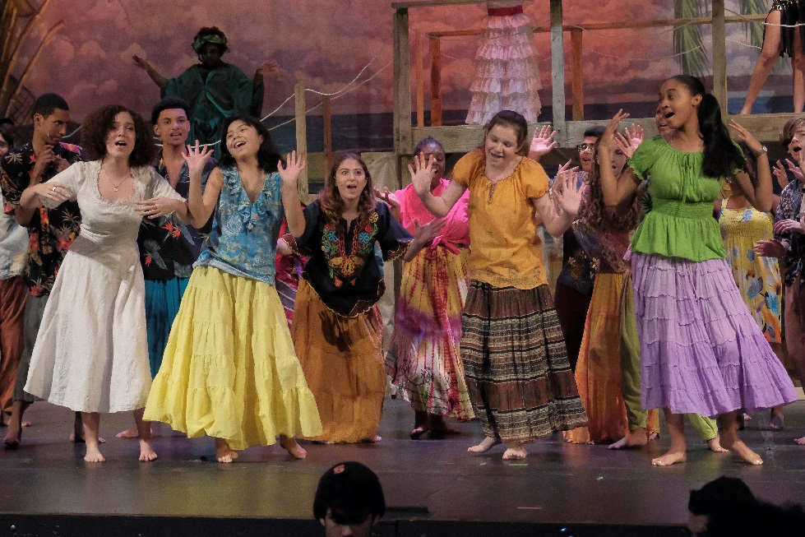
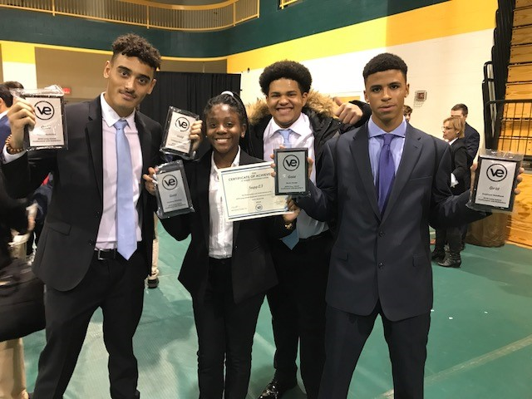
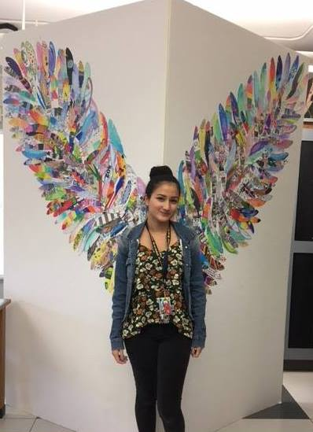
Baldwin UFSD 2019-2020 Proposed Budget
Notes:
Updated 2/13/19

Slide 2
2019-2020 Proposed Budget Propositions
Proposition 1 – School Budget
Proposition 2 – Transportation Referendum
Proposition 3 – Library Budget
Proposition 4 – Establishment of a Capital Reserve

Slide 3
2019-2020 Proposed
3-Part Budget

Slide 4
2019-2020 Proposed Budget Expenditures
*
$95,480,806
tax levy
$38,598,194 other income (state aid, reserves, appropriated fund balance, miscellaneous income)
Total budget to budget increase
* If Transportation Proposition is passed, the Anticipated Property Tax will be $95,631,806 (an increase of 2.54%).
Notes:
2018-2019 adj between admin and program ($1,474,590) due to clerical support staff with benefits previously in program now in admin and recoding of copy machine expense coming out of program and going to admin.

Slide 5
2019-2020 Revenue Budget
***
Real Property Tax $81,076,967
STAR 12,186,598
Total Tax Levy $93,263,565
Approx. Real Property Tax $83,294,208
Approx. STAR 12,186,598
Total Tax Levy $95,480,806
*** If Transportation Proposition is passed, the Anticipated Property Tax will be $95,631,806 (an increase of 2.54%).

Slide 6
WHAT ARE THE VARIABLES THAT AFFECT YOUR TAXES?

Slide 7
Factors Impacting Tax Bills
Assessed Values
Base Proportions
Equalization Rates
Fair Market Value of Homes
Multiple Taxing Jurisdictions
Other Exemptions (i.e.. Veteran’s, Volunteer, Disabled, etc.)
PILOT Properties
School District Tax Levy
STAR Program
Tax Grievances

Slide 8
Base Proportions & Assessed Values
There are four classes of property in Nassau County, each with its own assessed value contributing to the total assessed value for a district:
Class I – Residential
Class II – Condos/Coops
Class III – Utilities
Class IV – Commercial

Slide 9
Base Proportions and Assessed Values
Base Proportions Allocate the District Tax Levy Amongst the Classes
Property Class | Assessed Value | Base Proportion | Allocated Tax Levy
Class I | $6,276,472 | 85.59% | $79,824,500
Class II | $345,282 | 2.33% | $2,170,784
Class III | $412,421 | 2.11% | $1,973,345
Class IV | $1,587,823 | 9.97% | $9,294,936
Total | $8,621,998 | 100.00% | $93,263,565

Slide 10
Partnerships and Cooperation
District Controlled
Tax Levy
Exemptions (Board of Education Authorizes)
State Controlled
Equalization Rates
Other Exemptions (Made available by the State)
STAR
County/Town Controlled
Assessment Process
Base Proportions
Fair Market Values
Tax Grievances
IDA Controlled
PILOT Properties

Slide 11
Per Pupil Expenditure Comparison
Source: Nassau BOCES – Annual Study of School Costs

Slide 12
Per Pupil Expenditure Comparison of K-12 Districts
District Enrollment Per Pupil
District Enrollment Per Pupil
 | Glen Cove City | 4,091 | $19,766
 | Roosevelt | 4,364 | 23,137
 | Freeport | 7,141 | 23,489
 | Hempstead | 8,080 | 24,987
 | Hicksville | 5,291 | 25,238
 | Oceanside | 5,579 | 25,265
 | Westbury | 5,255 | 25,505
 | Uniondale | 7,218 | 25,508
 | Island Trees | 2,300 | 26,359
 | East Meadow | 7,272 | 26,444
 | Wantagh | 2,846 | 26,788
 | Port Washington | 5,553 | 27,220
 | Herricks | 3,998 | 27,279
 | Massapequa | 7,515 | 27,456
 | Manhasset | 3,310 | 28,000
 | Lynbrook | 2,790 | 28,412
 | Levittown | 7,014 | 28,445
 | Seaford | 2,240 | 28,822
 | Garden City | 3,875 | 29,063
 | Baldwin | 4,526 | 29,114
 | Farmingdale | 5,597 | 29,415
Bethpage | 2,947 | $29,418
West Hempstead | 1,888 | 29,999
Plainview-Old Bethpage | 4,935 | 30,274
Plainedge | 2,864 | 30,573
East Rockaway | 1,178 | 30,696
Rockville Centre | 3,580 | 31,011
Great Neck | 6,597 | 32,342
Roslyn | 3,258 | 32,495
East Williston | 1,735 | 32,710
Mineola | 2,900 | 33,111
Malverne | 1,700 | 33,183
Oyster Bay | 1,613 | 34,108
Long Beach City | 3,826 | 34,342
Syosset | 6,504 | 35,008
Lawrence | 2,726 | 35,401
Carle Place | 1,363 | 37,078
Jericho | 3,193 | 39,271
North Shore | 2,632 | 39,306
Locust Valley | 2,076 | 40,435
Hewlett-Woodmere | 3,025 | 41,457

Slide 13
2018-2019 Out-of-District Students & Related Services
Parentally Placed Students Private/Parochial/Charter/BOCES
School Services
Transportation
Textbooks
Library Materials
Special Education: Resource Room OT/PT/Speech/Psychological Counseling 1:1 Aide
Health & Welfare:
Nurse
Speech
Counseling
Services for 824 Students
CSE Placed Students
Out-of-District
Special Education Services
Tuition
Transportation
Occupational Therapy
Physical Therapy
Speech
Psychological
Counseling
Nursing
Dormitory
Maintenance
Services for 79 Students
Notes:
For 2017-2018: Parentally Placed Students Private/Parochial/Charter/BOCES School Services – 838 students
CSE Placed Students Out-of-District Special Education Services – 57 students

Slide 14
State Aid Percentages Baldwin
Year | Percent
1990-91 | 28.38%
2017-18 | 24.30%
The state aid portion of Baldwin’s education has dropped 4.08% from 28.38% to 24.30% over the last 27 years.
Notes:
Needs to be updated

Slide 15
State Aid Percentages
Long Island
Year | Percent
1989-90 | 32%
2017-18 | 25%
The state aid portion of public education has dropped from 32% to 25% over the last 28 years.

Slide 16
Long Island Funding Facts
When New York City is excluded:
Long Island educates nearly 17% of the state’s students.
Only 12% of state aid is directed to Long Island schools.
Notes:
Needs to be updated

Slide 17
Most Recent Unfunded Mandates
ESSA Reporting Requirements
Part 154 Changes
Common Core
APPR
DASA
Local Assistance Plans for Schools That Don’t meet AYP
Academic Intervention Services Plan Implementation
Uniform Violent Incident Reporting System & Data Collection/Reporting
District Wide Information Officer
Grades 3-8 Testing, Scoring, Analyzing and Mailing Results, Subs, Paper
Uniform Voting Dates and 2 Budget Votes
Project SAVE Annual Training
Segregation of Duties – Purchasing Agents, Treasurer, District Clerk
Loan Instructional Computer Hardware/Textbooks/Software to Non-Public Schools
Required Student Body Mass Indexes
Impartial Hearing – Burden of Proof Shift from Parent to School District
Parentally Placed Students Attending Non-Public Schools
Online Bullying Responsibilities
Affordable Care Act
Residency

Slide 18
Most Recent Unfunded Mandates
Automatic External Defibrillators
5 Year Building Condition Survey
Minimum Classroom Temperatures (65 degrees)
Green Cleaning Products
Cancer Screening/Blood Donation Release Time
Asbestos Designee
Wellness Policies
Homeless Legislation
Health Services to Private and Parochial Schools
School Physician
Internal Auditor
Claims Auditor
TRS Legislation (10 year contribution limit)
TRS Pension Funding
ERS Pension Funding
GASB 45 OPEB Planning
Wicks Law
Mentoring
Academic Intervention Services
Graphing Calculators
Scoring of State Assessments
BOCES Fees
Limit of Daily Classroom Instructional Periods
Physical Education Requirements
Section 3020-a of Education Law and its subsequent revisions concerning teacher termination
Taylor Law – Extra Pay for Extra Work
Triborough Agreement – Interpretation of law protecting step increase

Slide 19
Average Tax Levy Increases Percent Changes
If the Transportation Proposition passes, the tax levy increase will be 2.54%

Slide 20
Program Highlights
20

Slide 21
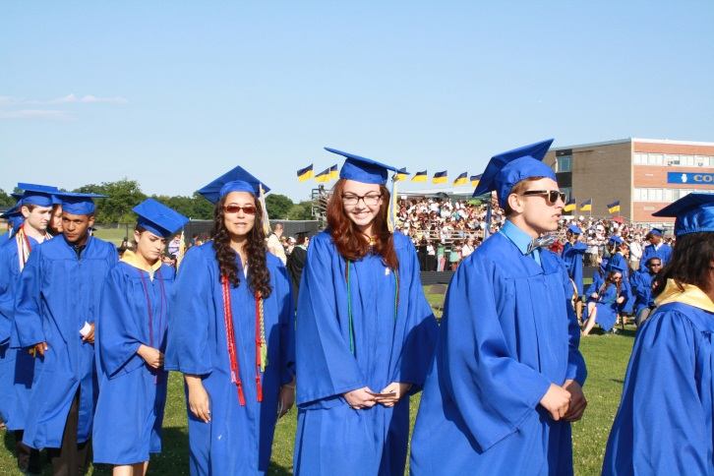
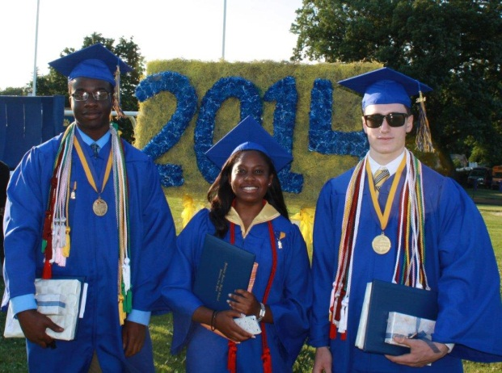
Cohort Graduation Rates
Cohort | Graduation Rate
Diploma by August ’18 | 96%
Diploma by August ‘17 | 97%
Diploma by August ‘16 | 93%
Diploma by August ‘15 | 90%
Diploma by August ‘14 | 92%
Diploma by August ‘13 | 92%
Diploma by August ‘12 | 92%
Diploma by August ‘11 | 90%
Diploma by August ‘10 | 90%
Diploma by August ‘09 | 91%
Notes:
Graduation rate using the cohort number is how graduation rate is reported. The cohort includes all students who would have entered the ninth-grade in the year indicated including new entrants from out of the State, out of the Country, or otherwise deficient in credits. As you can see, we are consistently achieving and sustaining graduation rates above ninety percent.
Emphasize continuing increase in the Cohort Graduation Rate – Please Note: Hastings having the anticipated impact.

Slide 22
College Acceptances
1,972 college applications were processed in 2017-2018
Baldwin High School students were accepted at over 340 colleges
Barnard College
Boston College
Brown University
Columbia University
Cornell University
Dartmouth College
Duke University
Emory University
Georgetown University
Harvard University
Johns Hopkins University
Northwestern University
Princeton University
SUNY Binghamton
SUNY Stony Brook
University of Chicago
University of Michigan
University of Pennsylvania
University of Virginia
Yale University
22
Notes:
Updated 2/14/19 – Stephanie Boldur and Barbara Tynan

Slide 23
Advanced Placement Open Enrollment Policy
Total AP enrollment in 2018-2019 - 622
AP Placement Scholar - 95
Art History
Art 4H
English Lang. & Comp.
English Lit.
Math Calculus AB
Math Calculus BC
Computer Science
French
Spanish
Italian
Psychology
Biology
Chemistry
Physics 1
Physics C
World History 1
World History 2
U. S. History
U. S. Gov’t & Politics
Statistics
AP Seminar

Slide 24
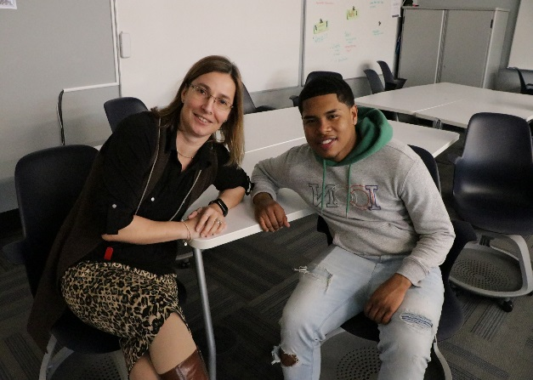
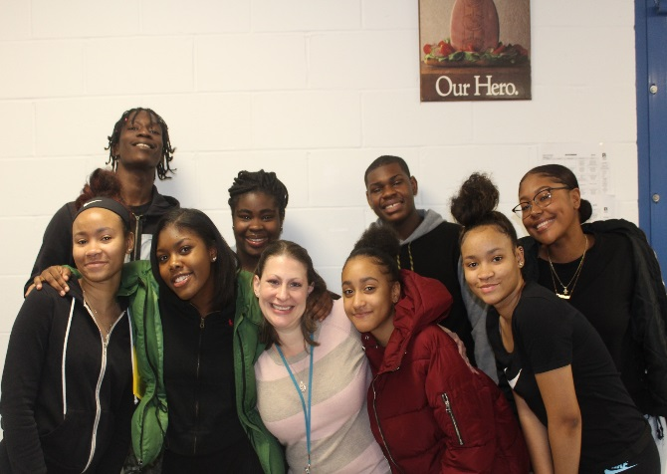
Mentoring Program
High School:
190 students participate
Middle School:
100 students participate
Elementary Schools:
88 students participate
24
Notes:
Update 2/13/19 – Pat Banhazl

Slide 25
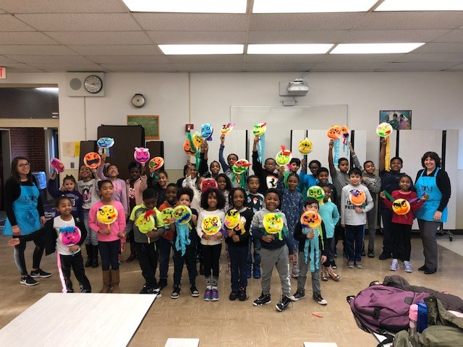
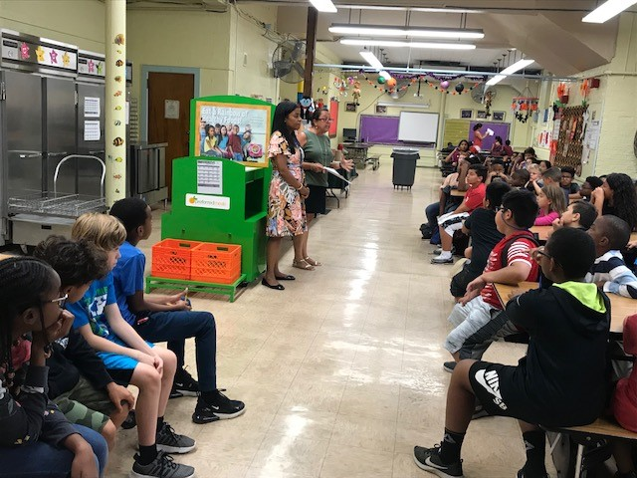
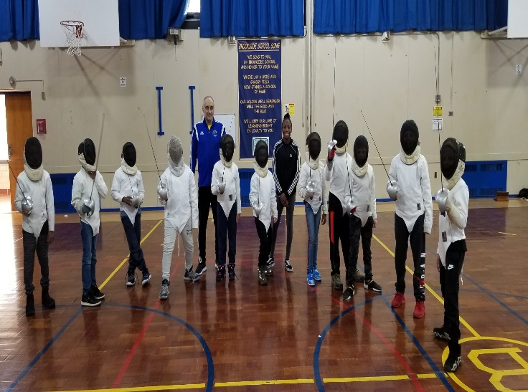
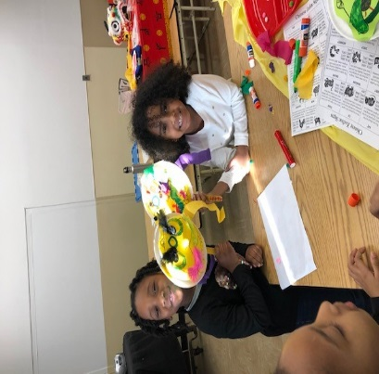
Extra-Curricular Clubs: Elementary
Art Club
Character Counts Club
Drama Club
Fencing Club
Jazz Club
Literature Club
Newspaper Club
Safety Patrol
Science Club
Stage Crew
Student Council
Team ORCHID
Yoga Club
25
Notes:
Updated 2/14/19 – Checked with elementary schools

Slide 26
Extra-Curricular Clubs: Middle School
Art Club
Book Club
Bruin Singers
Builders Club
Chamber Orchestra
Chess Club
Dance Club
Drumming Club
Glow Club
Multicultural Club
National Jr. Honor Society
School Store
Science Club
Student Interest Organization
Technology Club
Yearbook Club
26
Notes:
Updated 2/14/19 – Rosemarie Socci’s report

Slide 27
Pre-Academy Opportunities: Middle School
Virtual Enterprise
Computer Coding
Natural History Day
Odyssey of the Mind
Public Speaking
Science Research
Theater Improvisation
Business
Design and Architecture
Journalism
Project Lead the Way
Robotics
Speech and Debate
Video Production

Slide 28
Extra-Curricular Clubs: High School
Academons
Art for Charity
Athletes Helping Athletes
Bakers Club
Book Club
Bruin Yearbook
Chess Club
Class of 2019
Dance Club
Debate Club
Drama Club
Family & Consumer Science
Future Business Leaders of America
Golden Wave
Key Club
Marksmanship Club
Mathletes
Mercy Medical Explorers
Mock Trial
National Honor Society
Phoenix Magazine
Photography Club
Robotics
SADD (Students Against Destructive Decisions)
Science Olympiad
Sign Language Club
Sound & Light Crew
S.T.A.R. Club (Students That Are Rising)
Step Club
Virtual Enterprise Club
28
Notes:
Updated 2/15/19 – Patti Sisco’s report

Slide 29
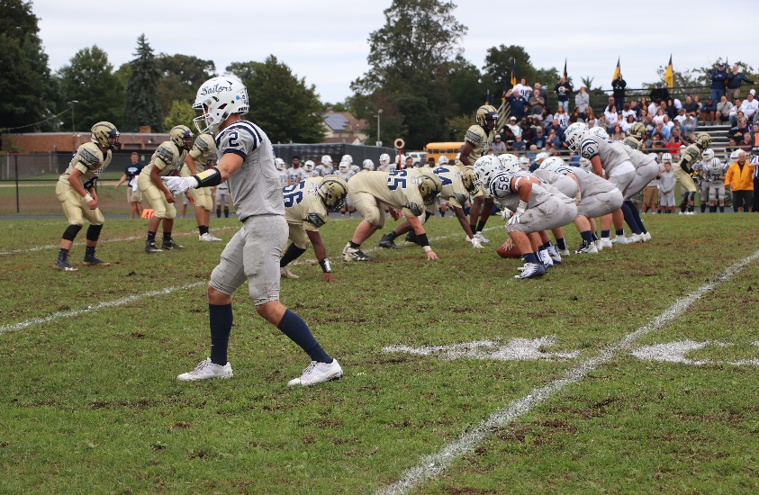
Athletics: High School
Football
Boys/Girls Soccer
Field Hockey
Cheerleading
Cross Country
Boys/Girls Tennis
Girls Volleyball
Boys/Girls Basketball
Boys/Girls Bowling
Coed Marksmanship
Boys/Girls Indoor Track
Wrestling
Girls Badminton
Boys/Girls Lacrosse
Boys/Girls Track & Field
Baseball
Softball
29
Notes:
Per Ed Ramirez – No update necessary 2/25/19

Slide 30
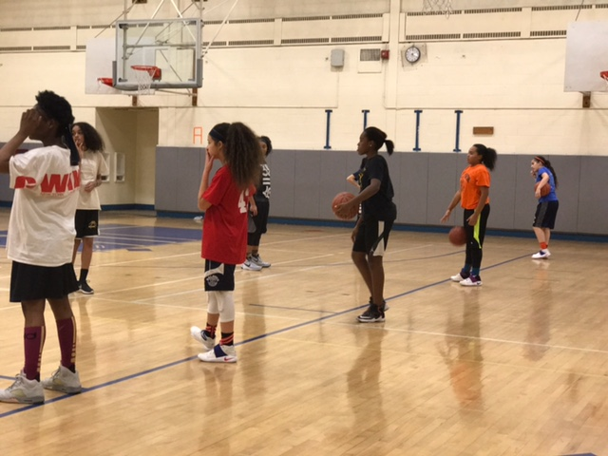
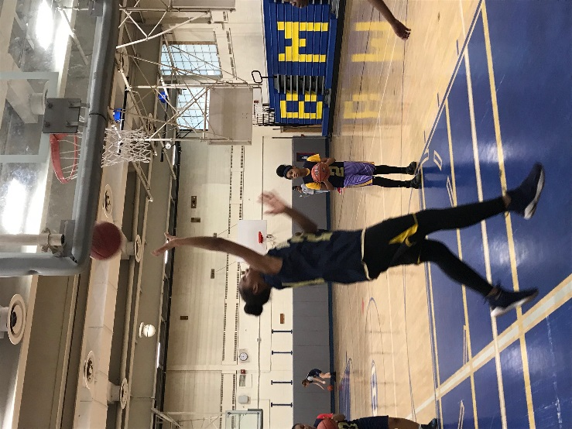
Athletics: Middle School
Football
Boys/Girls Soccer
Field Hockey
Boys/Girls Tennis
Girls Volleyball
Boys/Girls Basketball
Boys Track & Field
Boys/Girls Lacrosse
Baseball
Softball
30
Notes:
Per Ed Ramirez – No update necessary 2/25/19

Slide 31
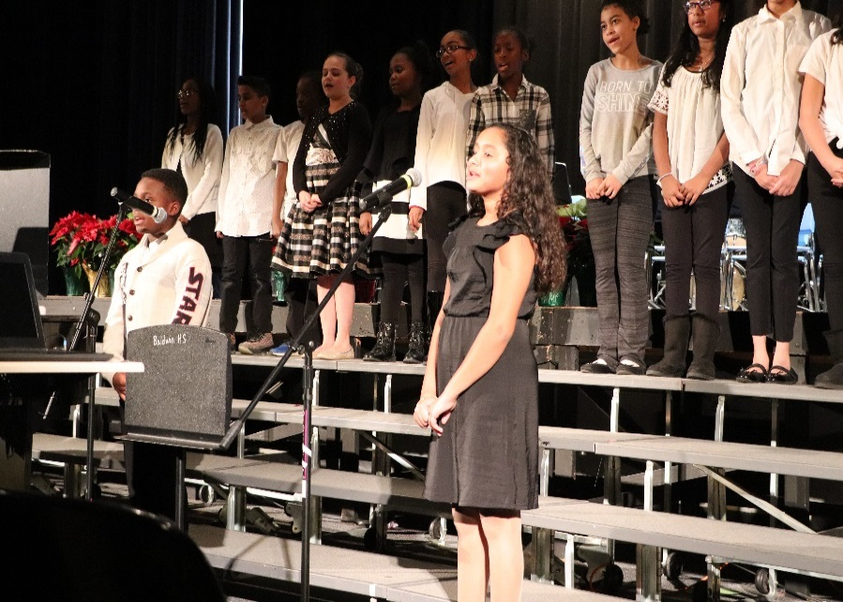
Fine & Performing Arts: Elementary Annual Events
Winter Concerts, K-2 & 3-5
Dr. Martin Luther King, Jr.
Poster Contest in January
Spring Concerts, K-2 & 3-5
District Office Art Exhibit
31
Notes:
Updated 2/15/19 – Andre Poprilo

Slide 32
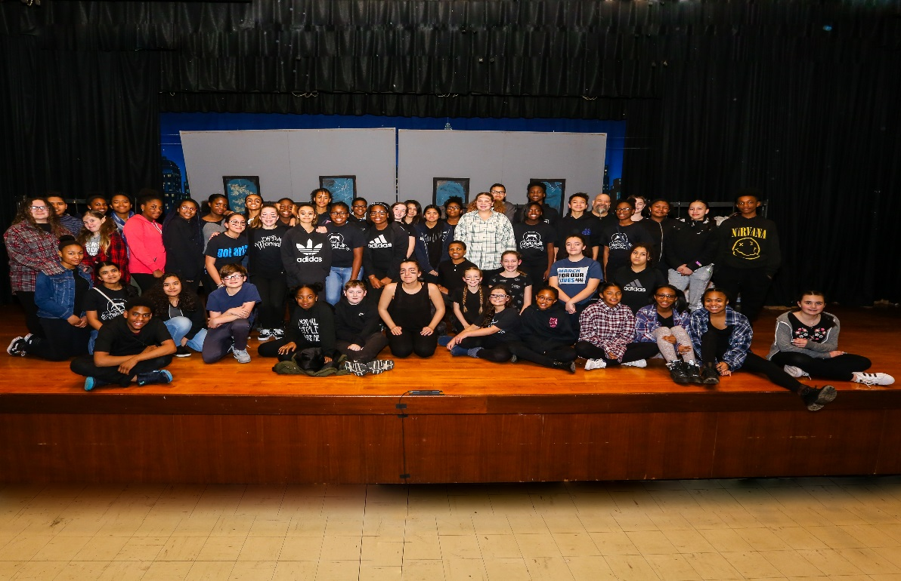
Fine & Performing Arts: Middle School Annual Events
District Office Art Exhibit
Winter Concerts
District Choral Festival
Musical
District String Festival
Musical Production
Secondary Art Exhibit
Jazz Night
32
Notes:
Updated 2/15/19 – Andre Poprilo

Slide 33
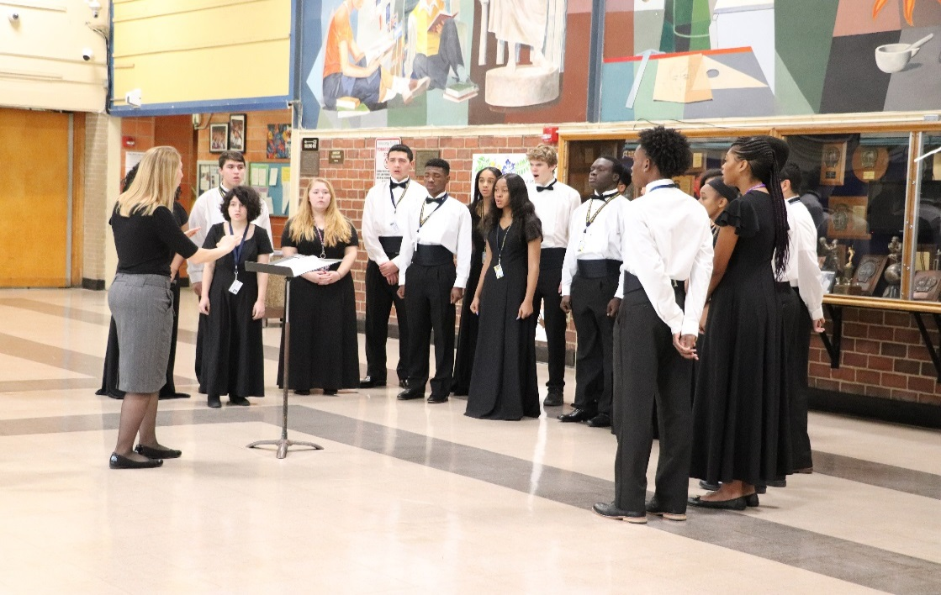
Fine & Performing Arts: High School Annual Events
Secondary Art Exhibit
District Choral Festival
District String Festival
Fall Honors Concert
Homecoming/Band Day
Art Honor Society Induction
Jazz Night
Small Ensemble Concert
Student Production
Suites & Sweets
Spring Concert I & II
Tri-M Music Honor Society Induction Ceremony
Winter Concert I & II
Drama Production
Musical Production
33
Notes:
Updated 2/15/19 – Andre Poprilo

Slide 34
Internship/Shadow Experience Placements
Ace Mentor Program
All Care Physical Therapy
African American Museum of Hempstead
Baldwin Public Library
The Public Access Television (PATV)
CW Post – WCWP Radio
Long Island Crisis Center
Congresswoman Kathleen Rice
Long Island Aquarium and Exhibition Center
Nassau County Department of Public Works
Peak Performance Physical Therapy
Nassau County Executive Laura Curran
Nassau County Legislator Kevan Abrahams
Certilman Balin Adler & Hyman, LLP
Inti Technology
Law Office of Robert Martinez
Michael A. Arbeit, PC
Collins, Gann, McCloskey & Barry, PLLC
Nassau County Police Explorers Bellmore
34
Nassau University Medical Center
Premier Network /iHeart Media
Baldwin Herald
New York Islanders-Twin Rink
Mercy Medical Center
South Nassau Communities Hospital
Northwell Health Long Island Jewish Valley Stream Hospital
Reyes/Reyes Physical Therapy
Mark Weinberger’s Law Office
Paul Vesnavar Law Firm
Deans and Archer Accounting Firm
New York State Senator Todd Kaminsky
Cradle of Aviation
Baldwin Middle School
Brookside School
State Farm
Steve Madden
Lizardos Engineering Associates, PC

Slide 35
Shadow Day Events and Locations
Northwell Health Long Island Jewish Valley Stream
Hospital Shadow Day Valley Stream, NY
Northwell Health Spark Challenge - Culinary Manhasset, NY
Northwell Health Spark Challenge – Operating Room Valley Stream, NY
Northwell Health Spark Challenge – Corporate Lawyer Lake Success, NY
Northwell Health Spark Challenge - EMT New Hyde Park, NY
Northwell Health Spark Challenge - Laboratories Manhasset, NY
Northwell Health Spark Challenge – Risk Management New Hyde Park, NY
Northwell Health Spark Challenge – Medical Office Bayshore, NY
Madison Square Garden New York City, NY
Molloy College Shadow Day and Boot Camp Rockville Center, NY
Locust Valley Media Art Show-Video Production Locust Valley, NY
Mercy Medical Center Shadow Day Rockville Centre, NY
South Nassau Communities Hospital Shadow Day Oceanside, NY
Hofstra University Shadow Day Hempstead, NY
New York State Society of Certified Public Accountants (NYSSCPA) Adelphi Univ., Garden City
Certified Opportunities in the Accounting Profession (COAP)
35

Slide 36
Shadow Day Events and Locations
Junior Achievement’s High School Heroes Meadow & Steele
National Grid Shadow Day – Power Plant Northport, NY
National Grid Shadow Day – Training Plant Melville, NY
Student Panel: Superintendent’s Redefining Ready Presentation Baldwin High School
Mock Trial Competition Mineola, NY
Nassau County Comptroller’s Entrepreneurial Challenge Mineola, NY
Jack & Jill of America Teen Leadership Summit Adelphi University, Garden City
STEM Career Fair-Cradle of Aviation Garden City, NY
First Robotics – Regional Competition – Hofstra University Hempstead, NY
VE (Virtual Enterprise) Long Island Trade Show and Competition LIU Post, Old Westbury
VE (Virtual Enterprise) Trade Show and Competition Brooklyn, NY
Mentoring Matters Conference LIU Post, Old Westbury
Jones Beach Partnership Wantagh, NY
Calming Murals Presentation – Northwell Health L.I. Jewish Valley Stream, NY
Calming Murals Presentation – Northwell Health, (CFAM) New Hyde Park, NY
Third Annual Work Based Learning Expo Baldwin High School
Northwell Health Spark Challenge Awards Celebration Woodbury, NY
36

Slide 37
Shadow Day Events
Mentoring – Baldwin School District – 18th Year of Mentoring
Emerging Leaders Competition
Adelphi Apprentice Challenge Business Conference
Northwell Health DNA Learning Center
Northwell Health Patient Safety Institute Tour
Baldwin Chamber of Commerce
FBLA (Future Business Leaders of America) Spring Conference – Hofstra University

Slide 38
Points of Pride Academics
Districts | High School 2018 * | High School 2017 * | Students with disabilities | Economically disadvantaged | % going to 2 year or 4 year colleges**
Baldwin | 94% | 95% | 78% | 88% | 91%
Nassau | 88% | 90% | 74% | 80% | 91%
Suffolk | 88% | 88% | 73% | 79% | 86%
New York State | 80% | 80% | 56% | 73% | 78%
* Graduates through June
** Post Grad Plans - 2017
Notes:
Updated from NYSED 2/25/19 – New York State Report Card – Leslie Duffy

Slide 39
Points of Pride Academics
The High School’s Virtual Enterprise company, SuppLI, participated in the Regional Trade Show Competition held at C.W. Post, and were awarded the following:
Gold Awards – Impact Marketing Billboard, Employee Handbook, Booth Design, Company Branding, and Company Newsletter
Silver Award – Sales Materials
Notes:
Updated 2/27/19 – Dr. Candice Brodie

Slide 40
Points of Pride Academics
High School students participated in a national competition sponsored by Next Gen Personal Finance (NGPF) called the Payback Challenge.
Donnoven Panky received Honorable Mention as well as a $500 Scholarship from NGPF.
Notes:
Updated 2/27/19 – Dr. Candice Brodie

Slide 41
Points of Pride Academics & Baldwin Family
August Graduation Rates – 96%
Meadow – NY State School of Character
Plaza – National and NY State School of Character
Lenox and Plaza – PTA Schools of Excellence
Lenox received the 2018 PTA Pick a Reading Partner (PARP) Award
Dr. Toni-Ann Barone received NYS English Teacher of Excellence Award
Baldwin UFSD was invited to join elite Innovation and Transformational Leadership Network
Baldwin UFSD won the News 12 Long Island Spirit Contest
Notes:
Updated 2/26/19 – Mary Furcht

Slide 42
Points of Pride Baldwin Family
Megan Ferguson-Koci and Leonardo Rivera received Distinguished Teachers of 2019 Awards from the Harvard Club of Long Island.
Dr. Shari Camhi received the BOCES Education Partner Award and the Nassau County Legislature’s 2019 Trailblazers in the New Millennium Award.
Notes:
Updated 2/26/19 – Mary Furcht

Slide 43
Points of Pride Music & Art
2018 and 2019 - Baldwin Voted One of the Best Communities for Music Education
1 All Eastern Honor Ensemble Musicians
6 All State Ensemble Musicians
58 All County Ensemble Musicians
6 Long Island String Festival Musicians
30 Art Supervisor Association All County Art Exhibition Artists
4 Artists Awarded as Best in Show-Long Island Media and Art Show
Baldwin Pep Band & Concert Choir featured at Hofstra University
43
Notes:
Updated 4/1/2019 – Andre Poprilo to show 2019 awards

Slide 44
Points of Pride Athletics
Softball – Conference Champions
Girls’ Basketball – New York State Federation Champ #4 Nationally Ranked
Class of 2018 awarded $2,629,650 in Athletic Scholarships
Frank Zachman & Robert Reifsnyder – Nassau County Athletic
Hall of Fame
NY State Girls’ Basketball Coach of the Year – Tom Catapano
(First Nassau coach to win this award twice)
44
Notes:
Updated 2/25/19 – Ed Ramirez

Slide 45
Points of Pride Pupil Services
Work Based Learning Sites for students in our Life Skills Program: Ideal Foods, Glory Beezzz, Ace Hardware, Stop and Shop, Applebees, Baldwin Bowl (All local businesses)
High School Challenger Basketball Team: 4-1 record for 3 consecutive years (2018-19 season began on March 14, 2019)
District–wide implementation on the elementary level of various Mindfulness programs (i.e. Calm Classroom) and Social Emotional Learning Curriculum (i.e. Lion Quest, Second Step)
Residency Investigations – 51 non-residents excluded
45
Notes:
Updated 2/26/19 – Sherrisse Young
Slide reflects residency investigations for the 2017-18 school year.
Additional data: 2018-19 year-to-date – 43 exclusions
2016-17 – 62 exclusions
2015-16 – 56 exclusions

Slide 46
2019-2020 Program Additions
Professional Development
Instructional Technology in the Classrooms
AP Art 2D
AP Computer Science Principles
AP Research
46
Notes:
Updated 2/26/19 – Anthony Mignella

Slide 47
Rules for
Contingency Budget
If the budget is defeated twice, pursuant to NYS Tax Cap legislation, there can be no increase in the tax levy – 0.0%.
Thus a defeated budget will require that the tax levy be reduced by $2,217,241 and the budget for 2019-2020 by the same amount.

Slide 48
Proposition – Transportation Referendum
A Proposition that would authorize a modification of the district’s public school transportation eligibility effective at the beginning of the 2019-20 school year.
K-12 pupils would be eligible for transportation if they reside more than 1½ miles from the school they attend.
The cost to the district would not exceed $151,000.

Slide 49
Proposition – Capital Reserve
A Proposition that would authorize the creation of a new capital reserve not to exceed $25 million.
This is similar to opening a savings account; there is no additional cost to the taxpayers.
Funds would be added at the end of the school year from unexpended appropriations for up to five years.
A separate vote at a later date would be required to authorize expenditures.

Slide 50
What is the Purpose of a School Budget?
Notes:
Updated 2/13/19

Slide 51
Budget Vote and Board Election
Please vote on Tuesday, May 21, 2019
Polls are open from 7 A.M. to 10 P.M.
at the Baldwin High School

Slide 52
Questions on the Budget?
Questions on the Budget?
We want you to be informed!
Board of Education
Annie Doresca
President
Mary Jo O’Hagan
Vice President
Susan Cools
Trustee
Joel Press
Trustee
Karyn Reid
Trustee
Dr. Shari L. Camhi
Superintendent of Schools
Dr. Stephen Draper
Assistant Superintendent
for Business
Carol Smith
Assistant Business Manager
Business Office
516-434-6040

