Slide 1
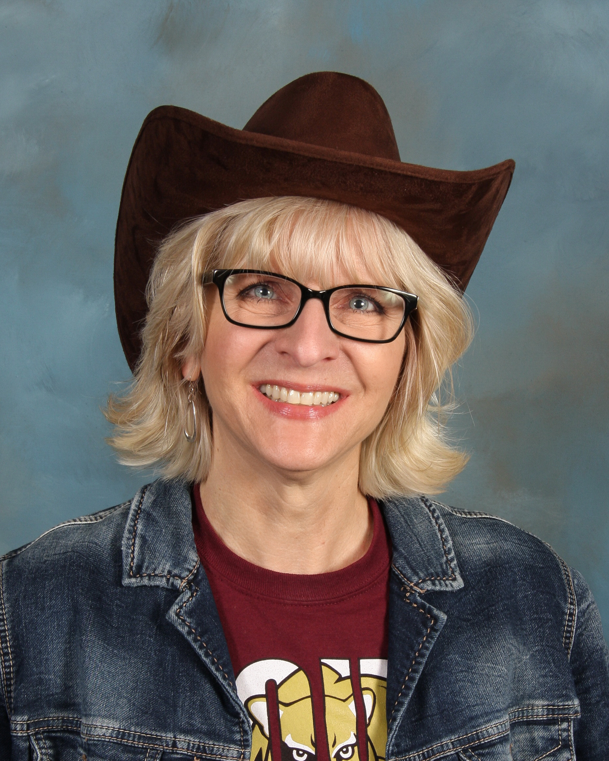
Meet Mrs. Bartness!
ECE is awesome!
Your School Counselor

Slide 2
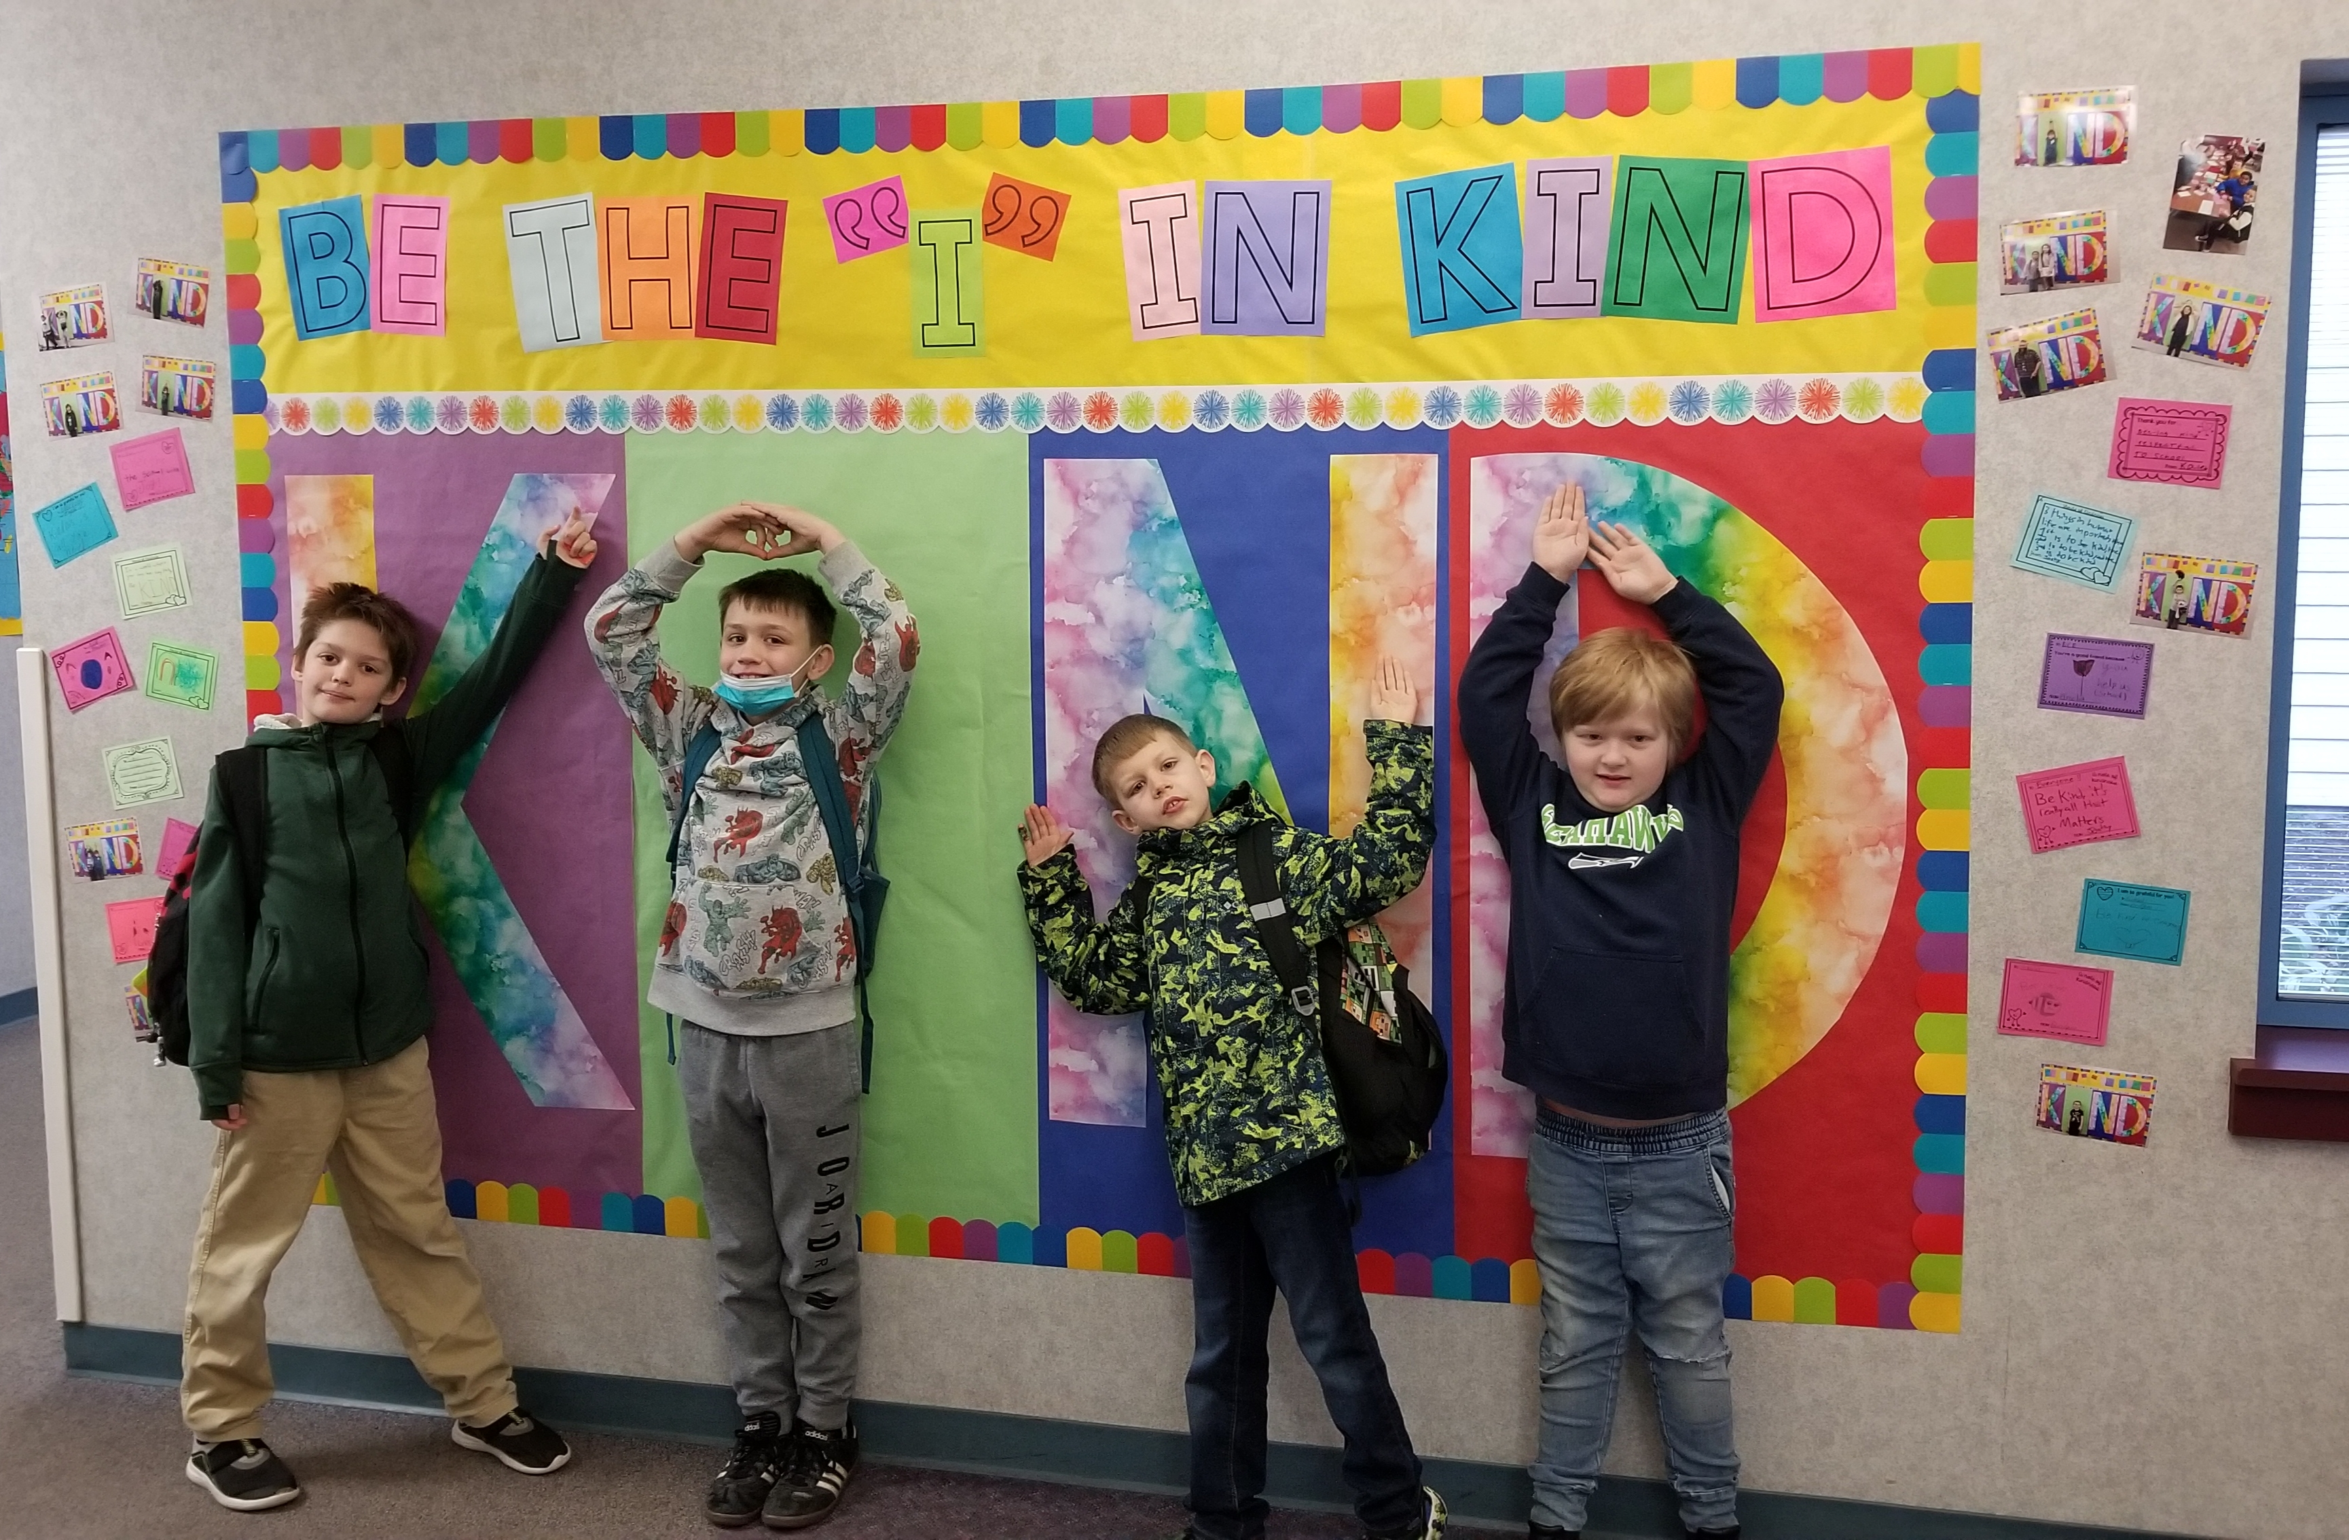
What does a School Counselor do?

Slide 3
How to See Me!
Ask your teacher
Tell me before school
Tell me in the lunchroom
Tell me at recess
Sign up in my office for
1st recess (on a clipboard)

Slide 4
Asking for help
 | Ask for help | Solve it yourself | Ignore/try again
Emergency/crisis | Y
Big problem | Y
Medium problem | Y | ?
Little problem | Y | Y | ?
Glitch | ? | Y | Y
It’s OK to ask for help, we all need support sometimes and we all make mistakes. We are here to help each other learn and grow.

Slide 5
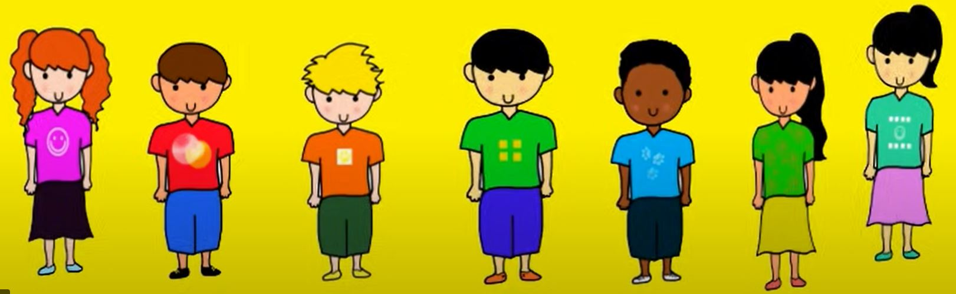
Confidentiality
What you tell me is confidential (private) unless you or someone else is in a harmful situation. Then, I want to make sure you get help.
I also ask you if you’d like me to talk to your family or your teacher about the situation you are struggling with.

Slide 6
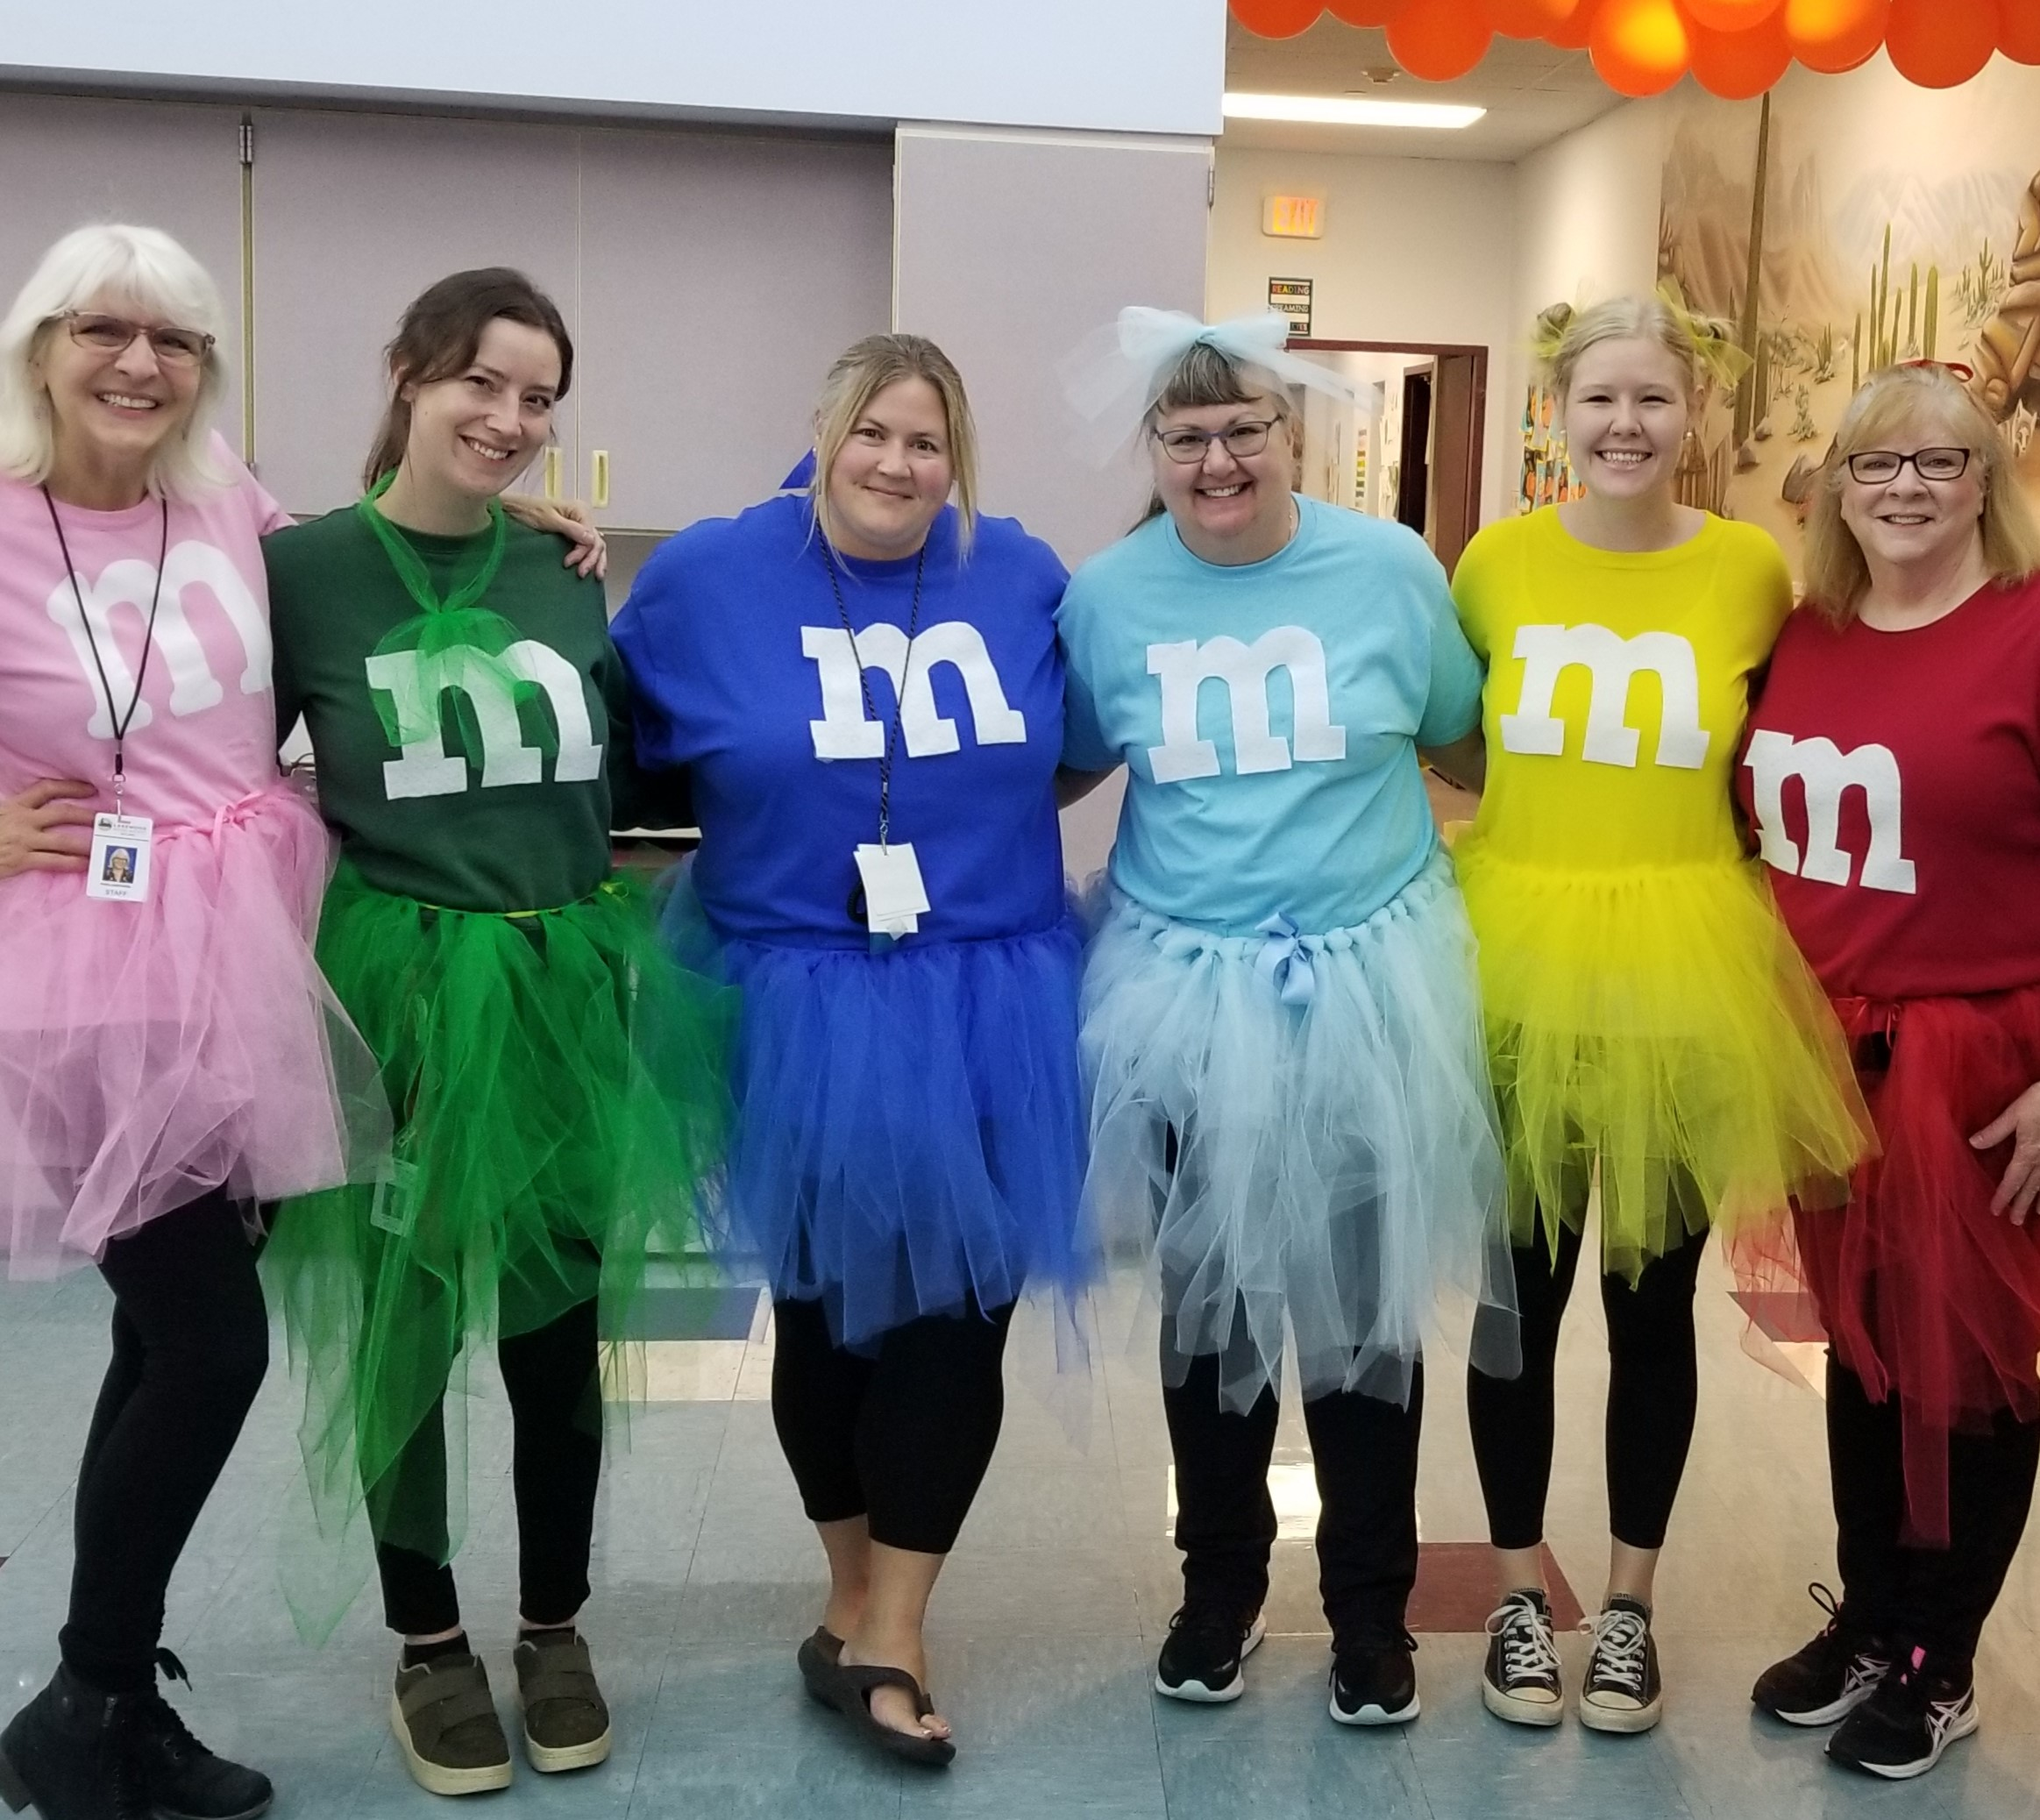
Trusted Adults
Someone you feel comfortable talking to!
They listen to you
They support and care about you
They will try to help you
It’s great to have more than one trusted adult to help you when needed

Slide 7
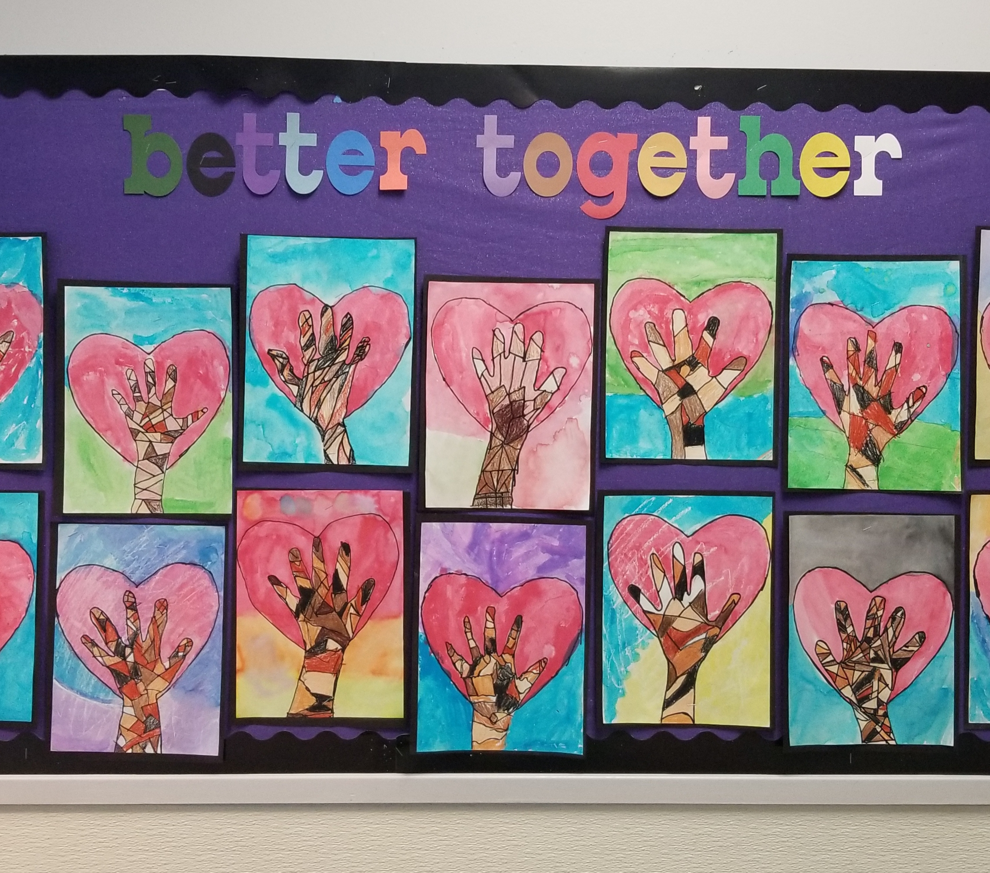
We All Belong!
And…
Remember
The Big 3!

