Slide 1
C & L McDougle Middle School
Indistar Link
Guest Login: GuestS17002
Password: GuestS17002
11/18/22; Principal Horne, Erin Rodriguez & Vickie Fornville

Slide 2
Mission and Vision
Mission
The McDougle Middle School community will work together to help every child realize their potential and prepare students for a global environment.
Vision
The vision of McDougle Middle School is to work together with parents and community members to inspire learners through relationships, engagement and rigor in order to empower students to positively impact their community and the world.

Slide 3
Goal Area 1: Student Success - Reading
Strategic Plan Priority: Instructional Excellence
Reading SMART Goal: By June 2023 C & L McDougle Middle School targeted student subgroups will achieve all ESSA expected annual improvement goals by increasing proficiency by five percentage points as measured by EOG scores.
Student Groups | EOG Proficiency Baseline 2021-2022 | EOG Proficiency Target 2022-2023
Students with Disabilities | 26% | 31%
Black Students | 45% | 50%
Latinx Students | 37% | 42%
Multi Language Learners | 20% | 25%

Slide 4
Goal Area 1: Student Success - Reading
Strategic Plan Priority: Instructional Excellence
NCStar Indicator Focus
A2.17: ALL teachers establish classroom norms for personal responsibility, cooperation, and concern for others.
C1.02: The principal plans opportunities for teachers to share their strengths with other teachers.
E1.06: The school regularly communicates with parents/guardians about its expectations of them and the importance of the curriculum of the home (what parents can do at home to support their children's learning).
A2.04: Instructional Teams develop standards-aligned units of instruction for each subject and grade level.
A3.05: The school assesses each student at least 3 times each year to determine progress toward standard-based objectives.
A4.01: The school implements a tiered instructional system that allows teachers to deliver evidence-based instruction aligned with the individual needs of students across all tiers.

Slide 5
Goal Area 1: Student Success - Math
Strategic Plan Priority: Instructional Excellence
Math SMART Goal: By June 2023 C & L McDougle Middle School targeted student subgroups will achieve all ESSA expected annual improvement goals by increasing proficiency by five percentage points as measured by EOG scores.
Student Groups | EOG Proficiency Baseline 2021-2022 | EOG Proficiency Target 2022-2023
Students with Disabilities | 32% | 37%
Black Students | 29% | 34%
Latinx Students | 42% | 47%
Multi Language Learners | 23% | 28%

Slide 6
NCStar Indicator Focus
Goal Area 1: Student Success - Math
Strategic Plan Priority: Instructional Excellence
B2.03: Effective planning/schedule times
A2.16: Units of instruction and activities are aligned with AIG goals, ELL student progress, IEP goals and objectives for all students
A3.01: Instructional Teams use student learning data to identify students in need of instructional support or enhancement.
E1.06: The school regularly communicates with parents/guardians about its expectations of them and the importance of the curriculum of the home (what parents can do at home to support their children's learning).
A4.01: The school implements a tiered instructional system that allows teachers to deliver evidence-based instruction aligned with the individual needs of students across all tiers.

Slide 7
Goal Area 1: Student Success -Multi-Language Student
Strategic Plan Priority: Instructional Excellence
Multi-Language Student Acquisition SMART Goal: By June 2023 C & L McDougle Middle School Multi-language students (MLS) will graduate 10% of students out of direct services to being monitored and 80% of students will increase by .5 points in their overall composite ACCESS Score.

Slide 8
Goal Area 1: Student Success
Strategic Plan Priority: Instructional Excellence
Reduction of Discipline Disproportionality Goal: By June 2023 C & L McDougle Middle School will decrease office referrals for Black, Latinx and students with disabilities by 10%.
A1.07: ALL teachers employ effective classroom management and reinforce classroom rules and procedures by positively teaching them.
A4.06: ALL teachers are attentive to students' emotional states, guide students in managing their emotions, and arrange for supports and interventions when necessary.
Student Culture Goal: By June 2023 C & L McDougle Middle School will increase its school climate panorama score to 45 and school safety panorama score to 60.
D2.05: The environment of the school (physical, social, emotional, and behavioral) is safe, welcoming, and conducive to learning.

Slide 9
Goal Area 1: Student Success
Strategic Plan Priority: Instructional Excellence
Key Action Items:
Safeguarding PLC times
Advisory period focusing on AVID organization/SEL
Frequent data analysis to ensure data driven instruction
Regular communication with families (Student Led Data chats, Talking Points, phone calls)
Continuous improvement of school programming.
Data Sources/REIA Use:
STAR/Freckle
CFAs
Tier 2 weekly data
Tier 3 weekly data
Progress Monitoring
StudySync
EC Goal Progress Monitoring
ESSA Data
Student Surveys
Panorama
EdHandbook

Slide 10
Goal Area 2: Family and Community Engagement
Strategic Plan Priority: Strengthening Family and Community Engagement
Indicators:
E1.01: ALL teachers maintain a file of communication with parents/guardians.
E1.11: ALL teachers meet with family members (parents or guardians) formally at least two times a year to engage in two-way communication regarding students' cognitive, socio-emotional, and physical development outside the classroom.
E1.06:The school regularly communicates with parents/guardians about its expectations of them and the importance of the curriculum of the home (what parents can do at home to support their children's learning).
Key Action Items:
McDougle Middle Family and Community Engagement committee members plan, schedule and host 4 family events for the 2022-23 school year
Annual Fundraiser - Partnership with PTSA for staff and students to have equitable opportunities throughout the 2022-23 school year
Host at least 2 Data Chat events (Fall Semester & Spring Semester)
Data Sources/REIA Use:
Tracking Attendance (Google Forms, Sign In)
Feedback Forms (Google Forms, Paper/Pencil, Verbal)
Talking Points, Remind App, Weekly Principal Message to Family & Community

Slide 11
Goal Area 3: Employee Experience
Strategic Plan Priority: Empowering, Engaging and Investing in Our People
Indicators:
B2.01: School culture promotes and supports the physical, social, emotional, and behavioral health of all school personnel.
B2.03: The school has established a team structure among teachers with specific duties and time for instructional planning.
C3.04: The LEA/School has established a system of procedures and protocols for recruiting,
evaluating, rewarding, and replacing staff.
Key Action Items:
School Wide Genius Bars allow teachers to choose PD that is best applicable to their needs.
Counselors promote education and activities promoting good self-care habits for staff.
Staff are provided time for duty-free lunch, at least an hour of individual instructional planning time each day, and common PLC planning time throughout each week.
Administration provide positive and meaningful feedback based on informal observations.
Administration give staff opportunities to share feedback openly and to make grade-level and school-wide decisions.
Data Sources/REIA Use:
Monthly Genius Bars
Teacher Working Conditions Survey
Duty Schedule
MMS Surveys (Google Forms)
Counselor links
Oral and written feedback from administration

Slide 12
Goal Area 4: Organization Effectiveness
Strategic Plan Priority: Equitable and Transparent Fiscal Stewardship and Operations
Indicators:
D1.02: The LEA has aligned resource allocation (money, time, human resources) within each school's instructional priorities.
Key Action Items:
Monthly Genius Bars that provide personalized PD for staff.
Weekly Leadership Team Meetings
Staff proposals for instructional needs
Coordination of extra duty contracts to help fill the gaps
Data Sources/REIA Use:
School Budget/Monthly Expenditures
Leadership Team Meeting Agendas and Minutes
Genius Bar Agendas and Professional Development Presentations
Extra Duty Contract Spreadsheet

Slide 13
Goal Area 4: Organization Effectiveness
Strategic Plan Priority: Creating a Culture of Safety and Wellness
Indicators:
D2.05: The environment of the school (physical, social, emotional, and behavioral) is safe, welcoming, and conducive to learning.
Key Action Items:
Partnership with PTSA (student events, staff recognition and appreciation)
Creation of a Sunshine Committee (support SEL needs of staff)
Frequent Grade Level Kids’ Days
Restorative Practice Center and creation of PBIS/SEL Committee
House system and Advisory Lessons
Data Sources/REIA Use:
Panorama Survey
Meeting Agendas and Minutes
Restorative Practice Center Artifacts
Discipline Data
Event Attendance
Advisory Plans
Quarterly House Celebrations
Community Events with PTSA

Slide 14
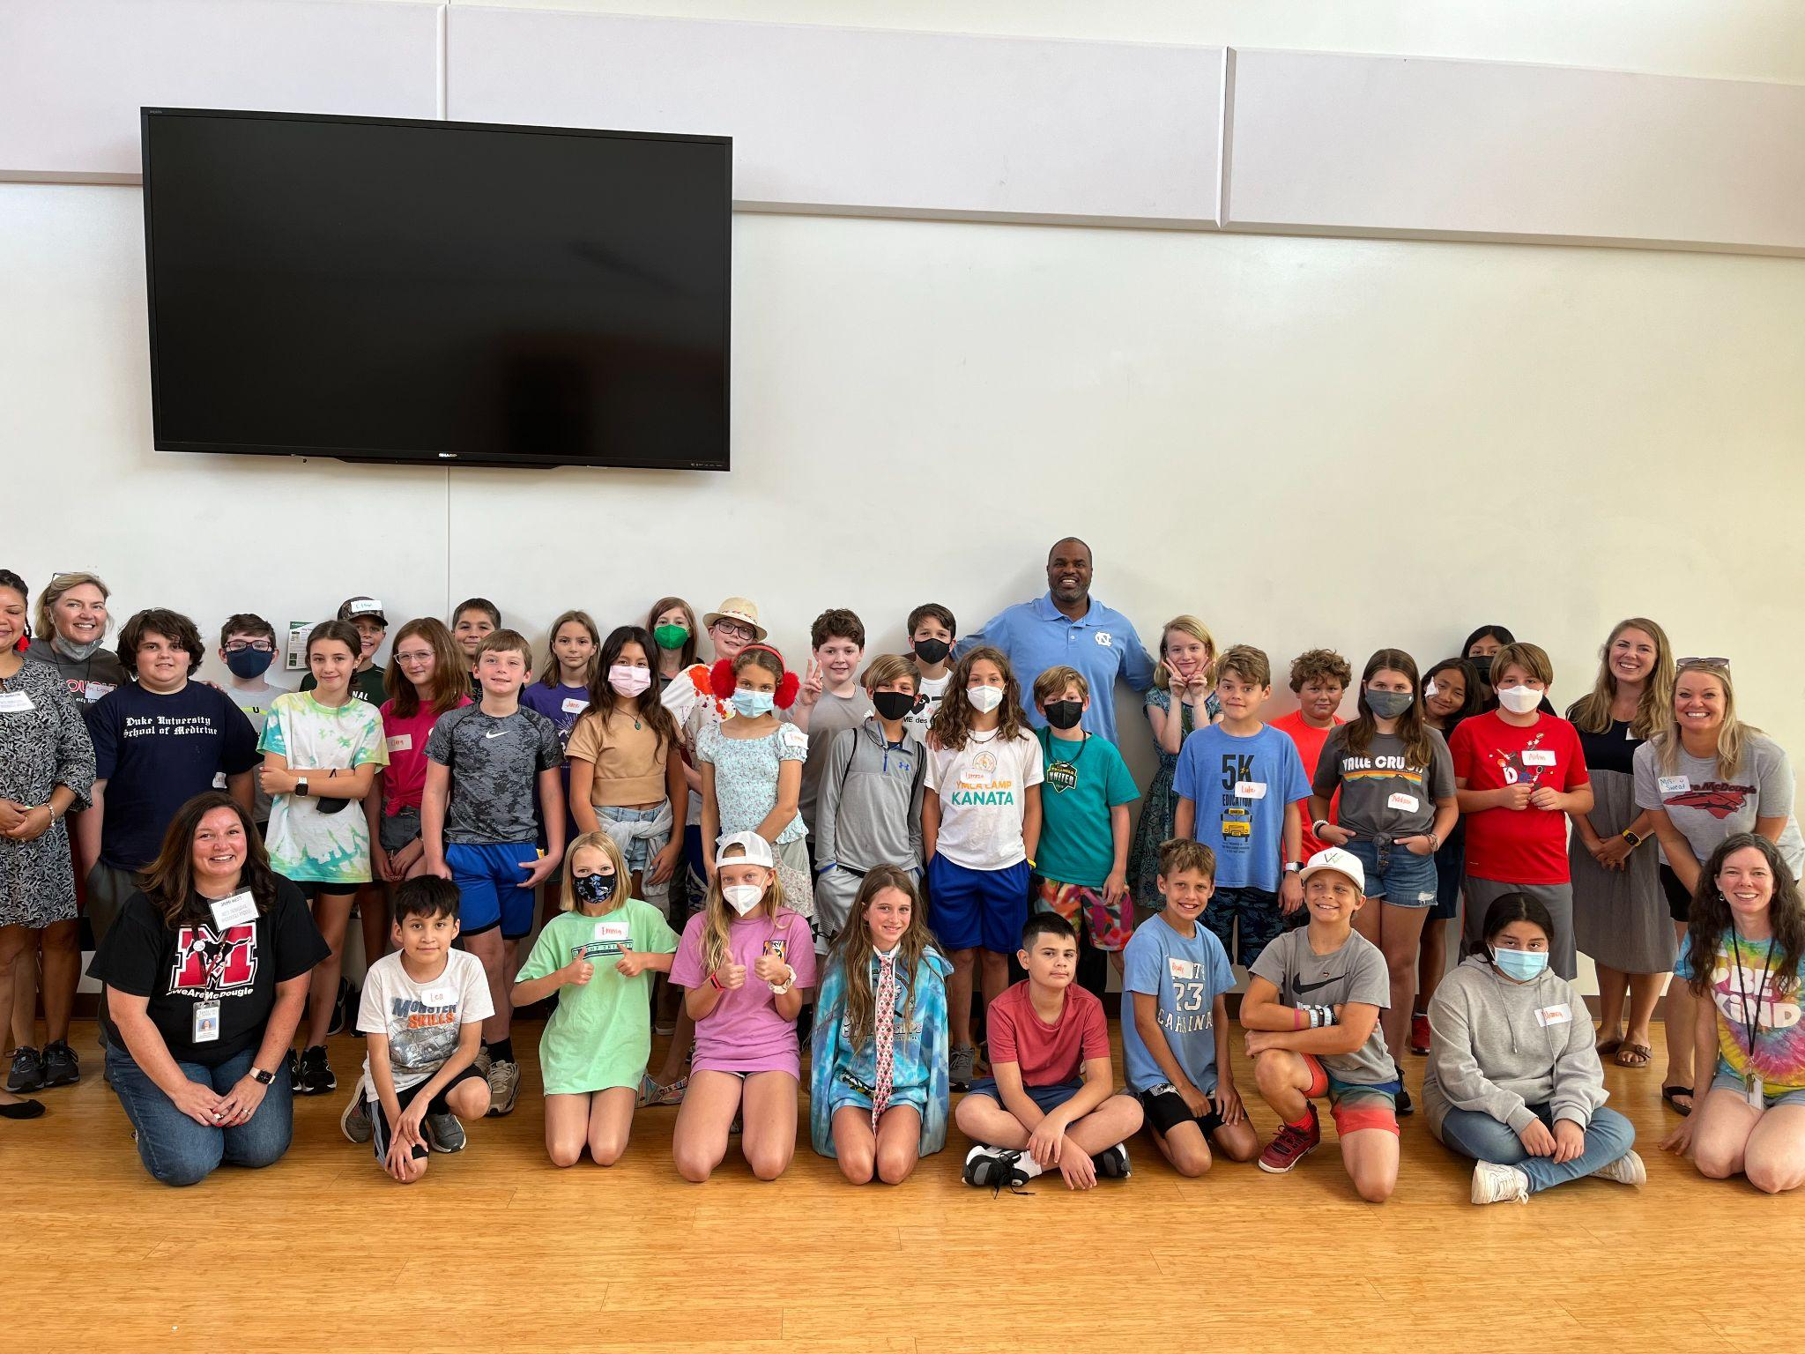
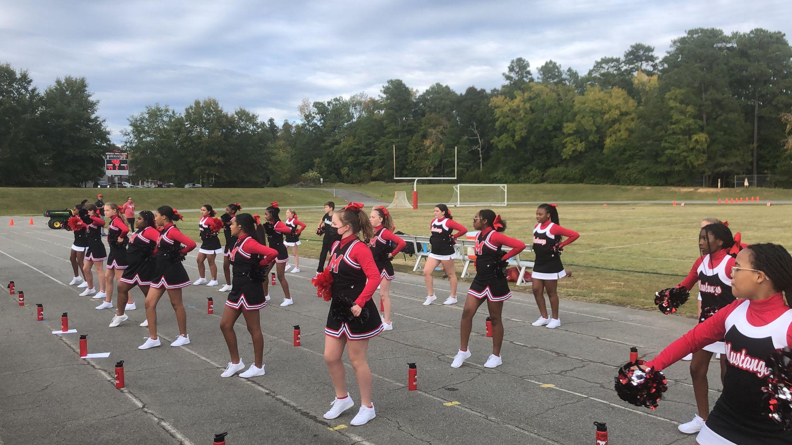
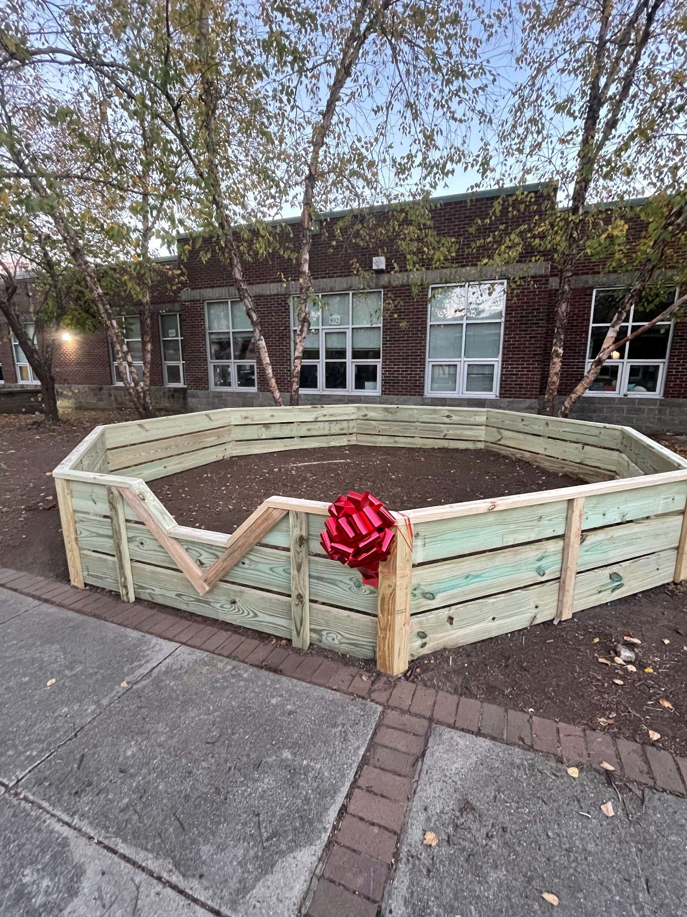
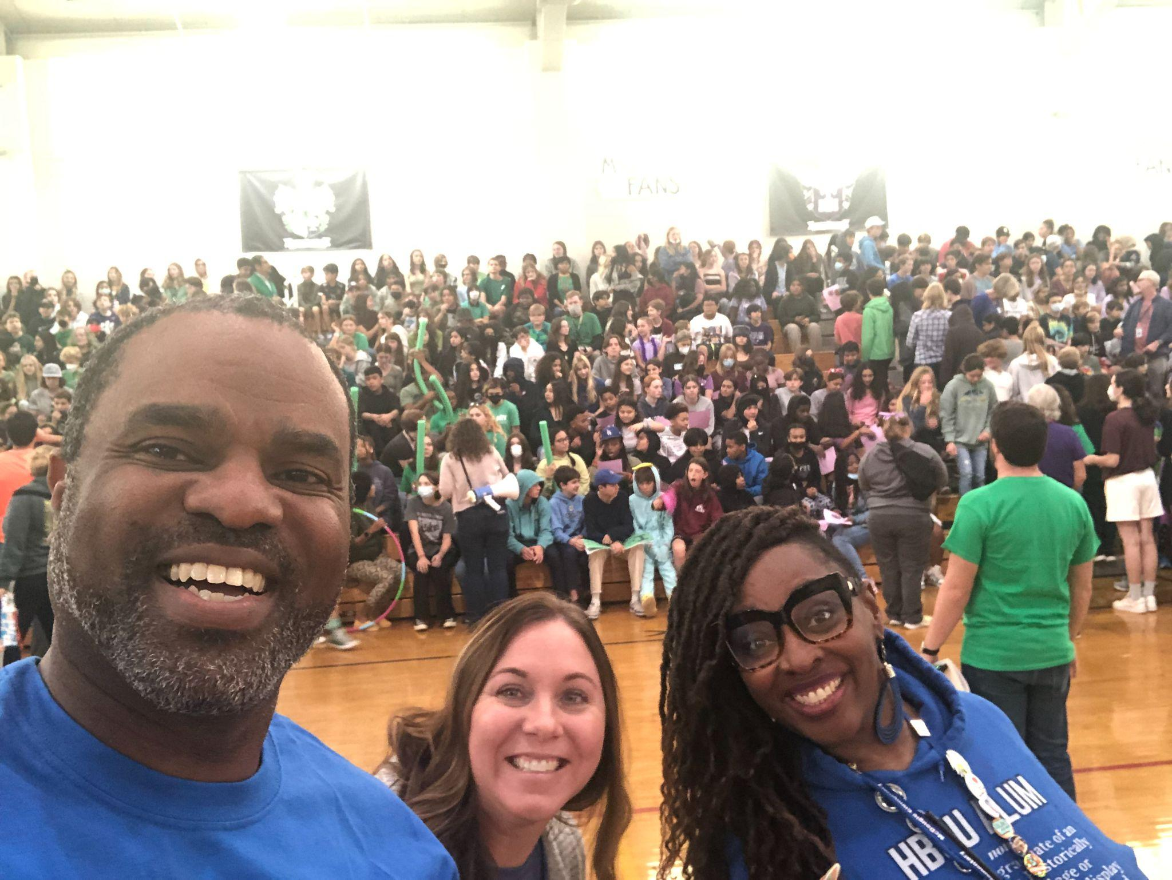
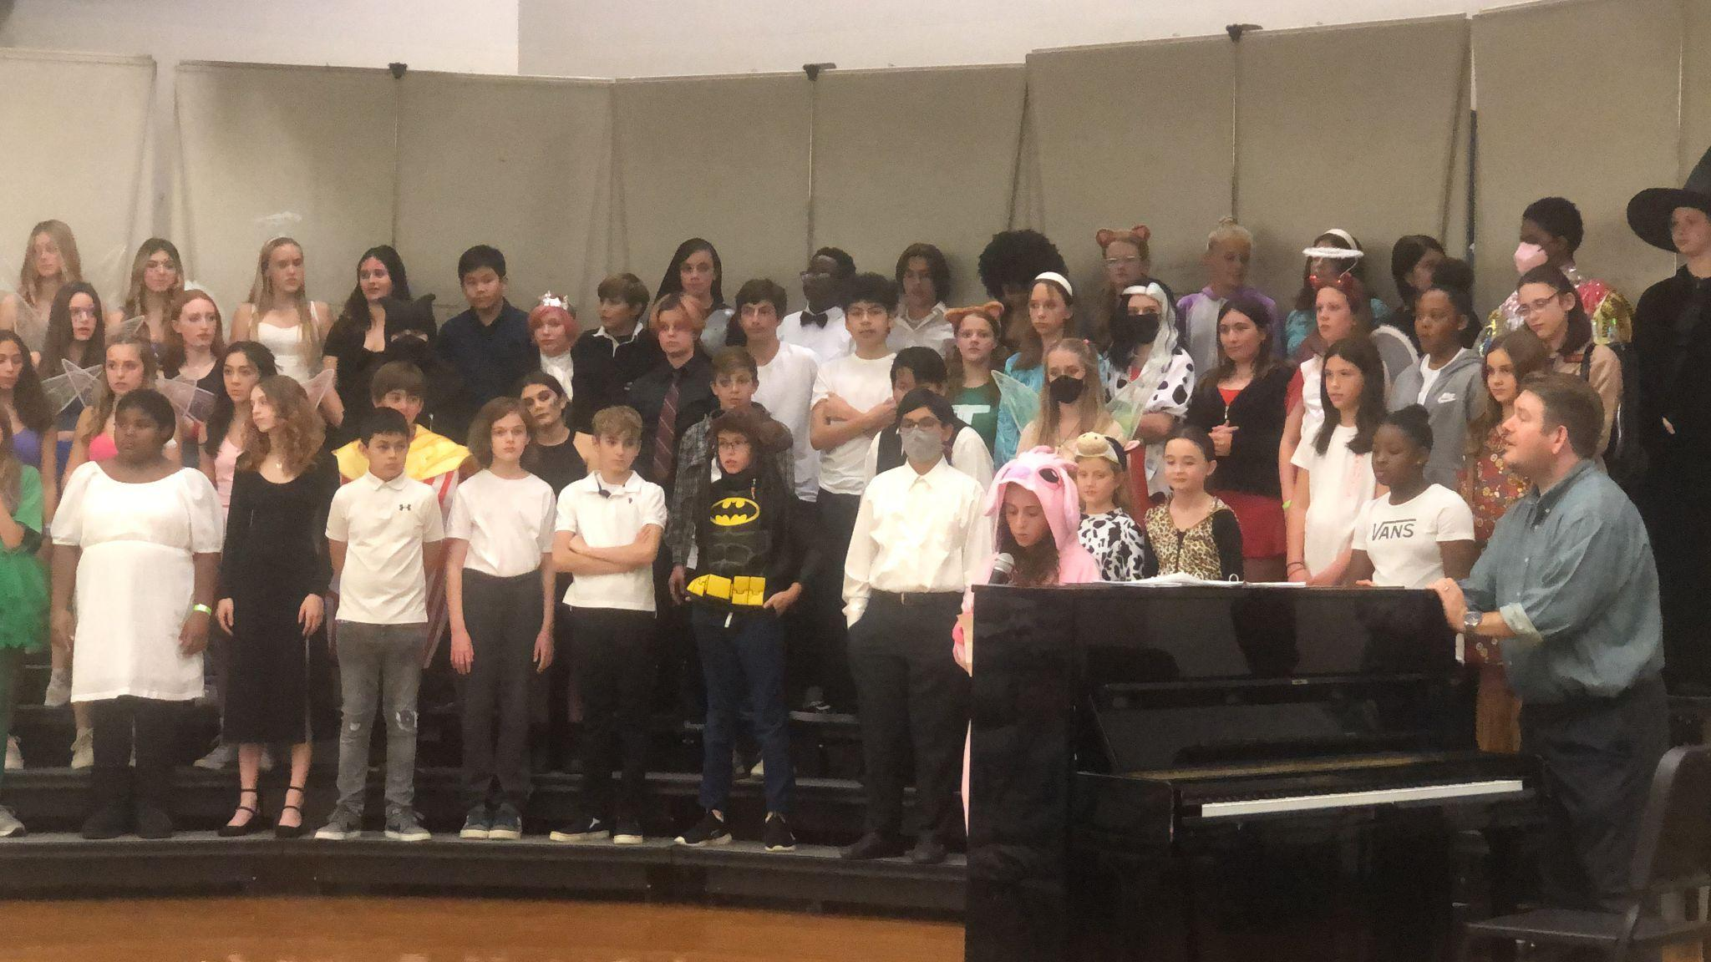
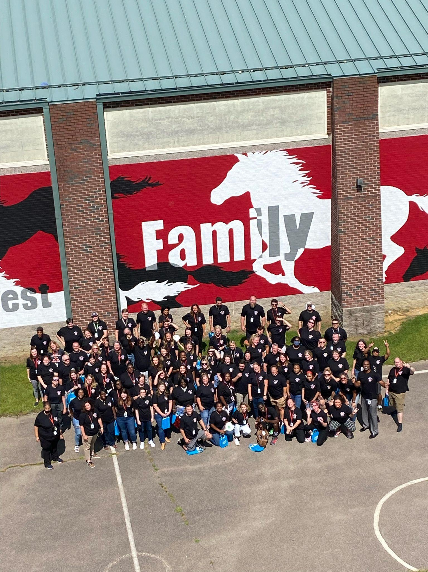
Great Things are Happening at C&L MMS!
Notes:
Create your own title and use this slide for any additional information you want to share.
Delete slide if not used.

