Slide 1
2024-25 Budget Update
March 26, 2024

Slide 2
Budget Update on THE state level
-One House Budget Bills from the Assembly and Senate have been introduced
-Now Leaders of both begin the negotiation process to formulate a final budget
-Both Budget Proposals :
Provide continuing Hold Harmless on the Foundation Aid
Provide a minimum of 3% increase in Foundation Aid
-We are not expecting an on time budget with Easter being April 1st
One thing to keep in mind at our April 9th meeting you are approving the Expenditure total for the 2024-25 budget so we can still move things around on the revenue side prior to the Public Vote May 21, 2024

Slide 3
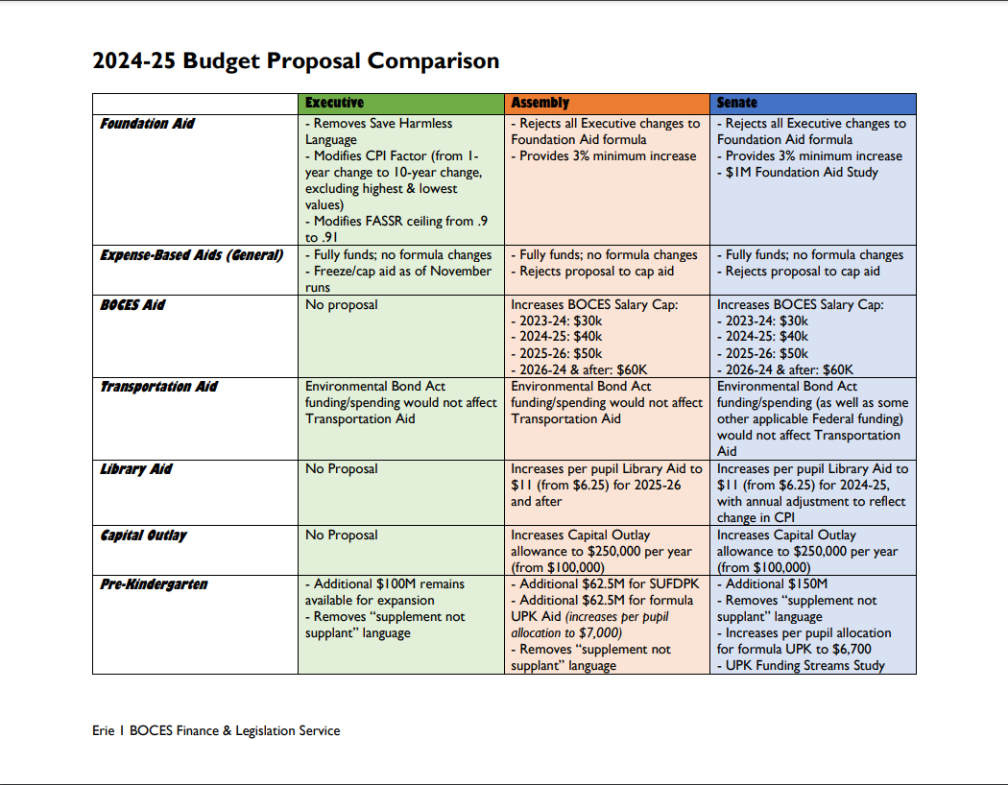

Slide 4
2024-25 MARCH Budget Highlights
Revenue $28,810,815 (up $99,470 from Jan. report)
Expenses $29,407,840 (down $85,290 from last month’s report)
Shortfall $ 597,025 (had a shortfall of $681,785 previously)
Revenue Assumptions:
In figures I am using a 2.54% increase in taxes, at our legal levy limit prior to carry over. Our legal limit is 4.08%
$500,000 is Appropriated Fund Balance.
Expense Changes:
Total expenditures is a .68% increase over last year.
Principal and Interest payments are $1,214,963.
Health insurance-3% increase in costs for 2024-25
Two Teacher retirements calculated in.
Final Budget Approval- April 9th Meeting

Slide 5
Revenue changes since last update
Interest Earnings $100,000 Felt with rates we could afford to increase
Tax Levy $ 530 I had the wrong number down
Net Change $ 99,470
Potential Reserve Use: Include $597, 025 from the Debt Service Reserve to cover shortfall? If State Budget includes more Foundation Aid then the Governor's Budget, we can adjust the revenue side prior to the Budget Hearing.

Slide 6
Expenditure changes since last update
Special Education Teacher/Aides $ 87,299
Special Education Placements $(254,634)
Benefit adjustments $ 58,000
Increase a staff line that had no sub $ 2,000
Athletics changes $ 4,045
Copy Paper line short $ 9,000
Increase TRS line $ 50,000
Increase tech M&S-Toner $ 15,000
E-rate funds $ (56,000)
Total decrease $ (85,290)

Slide 7
Capital Outlay Project 2024-25
We are working with LaBella to look at modifications to the Elementary school office and conference room.
Mr. Wilkie has some ideas to help improve the functionality of the main office space by creating a private student work zone, adding storage, increasing mailbox capacity, and adjusting the placement of secretary work station to increase security. Built in storage will also be added to the conference room.
We are working to develop the drawings and estimate the cost of the improvements.
Capital Outlay Projects can be done each year with funds allocated from the General Fund for up to $100,000 and then the District receives building aid back the next year on the project. We receive aid back at the rate of $.82 cents on every $1 spent.

Slide 8
federal funds
Funds must be spent by September 30, 2024
We will run a summer program again this summer in all buildings
We currently are purchasing our finally round of technology approved in the ARP ESSER 3 grant.
ARP Learning Loss has funds available that we are working on an Amendment on how we would like to use these funds. A new reading series has been selected by a committee at the Elementary school and we would like to use some of the funds to purchase that and do some training for the staff.
ARP Before/After School Grant- Has some funds available. Admin team is looking at the best way to use.

Slide 9
Multi-Year Plan 2024-2027
Multi-Year Plan will be placed on the District website under Budget tab once approved by the BOE in April.
Many assumptions in the plan, the foundation aid being lower is dramatically effecting the years covered by this plan. If changes occur for 2024-25 will help the outlook. Also as I said in the plan no retirements were factored in which can help the total expenses from year to year.
The Plan was in your News and Notes last week and the Finance Committee reviewed it today at their meeting prior to this workshop. I am happy to take any questions you may have about the Plan.

