Slide 1
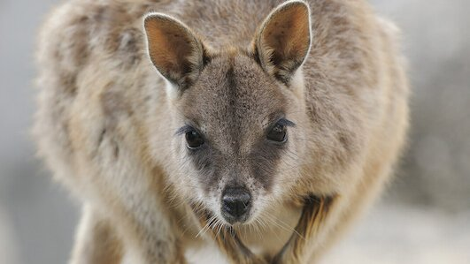
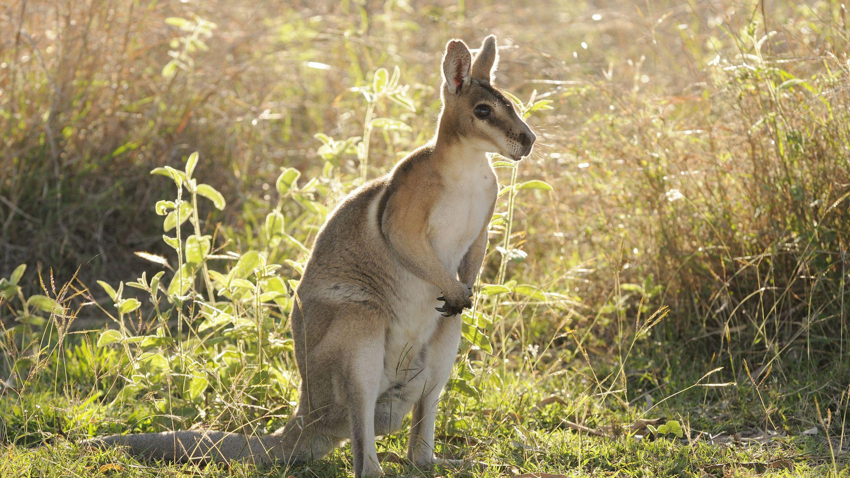
Wallaby
Scientific name: Macropus
Mammal & Marsupial

Slide 2
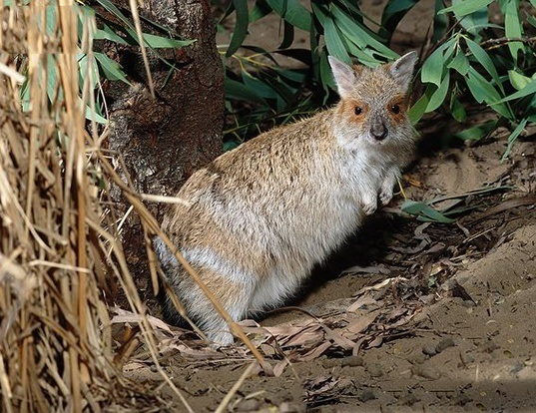
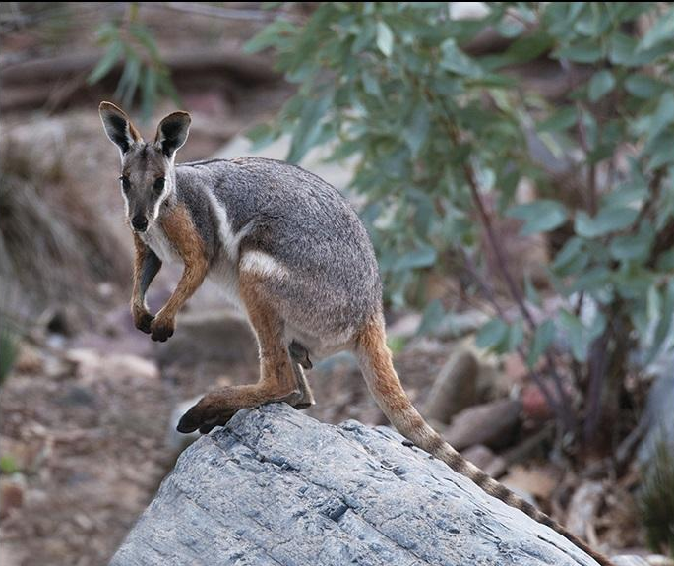
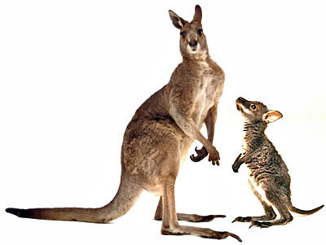
Yellow-Footed
Rock Wallaby Distinct color and
patterns
Hare Wallaby Small like a rabbit
Wallabies resemble a kangaroo. The biggest difference between the two animals is their size. On average, kangaroos are much bigger, sometimes growing to 8 feet. Most wallabies range in size from 1 to 4 feet and weigh between 4-50 pounds.
There are over 30 different species of wallabies, that are grouped mostly by their habitat, including brush, swamp, shrub and rock.
The smaller kinds (hare wallabies) resemble rabbits, while the larger kinds look more like kangaroos. Recently, smaller species have become popular pets. Although they are not domesticated and cannot be housetrained,
they can be quite friendly.
Kangaroo vs. Wallaby Height

Slide 3
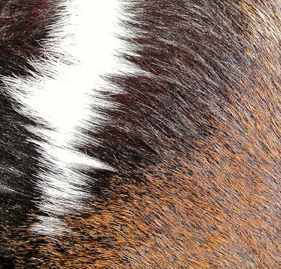
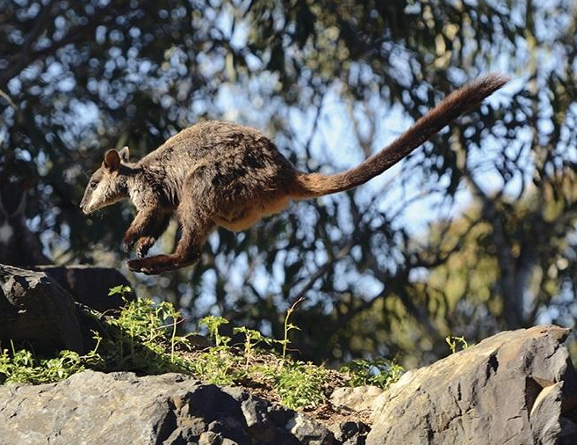
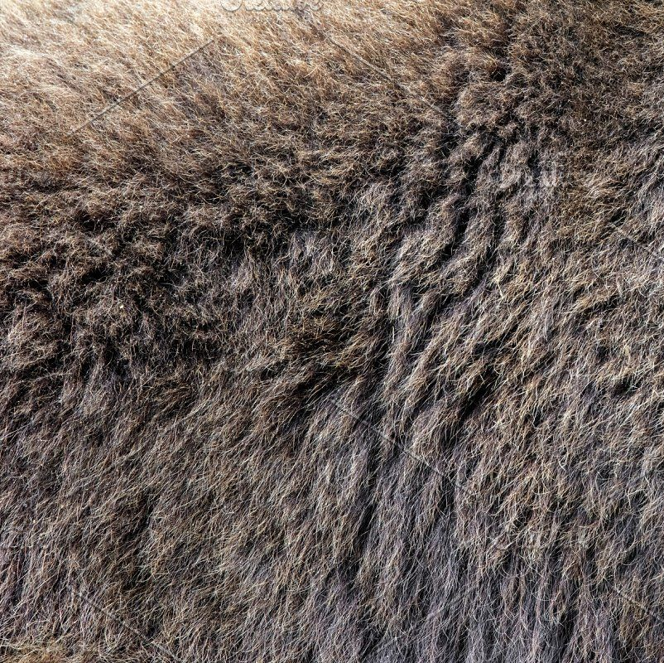
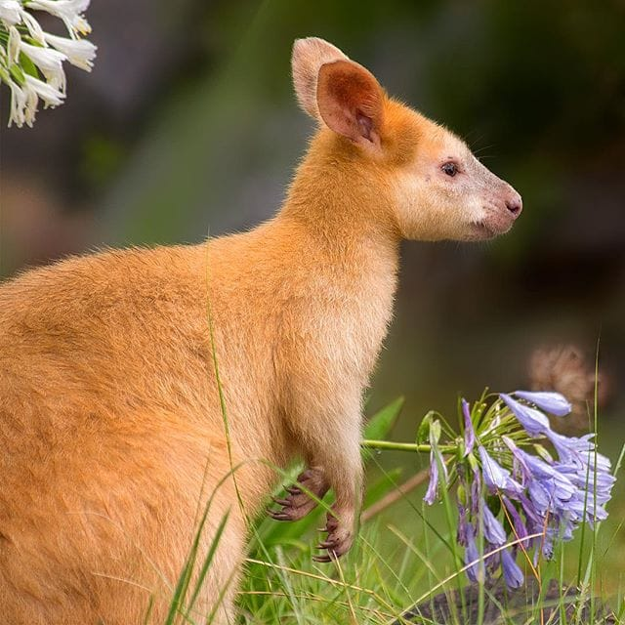
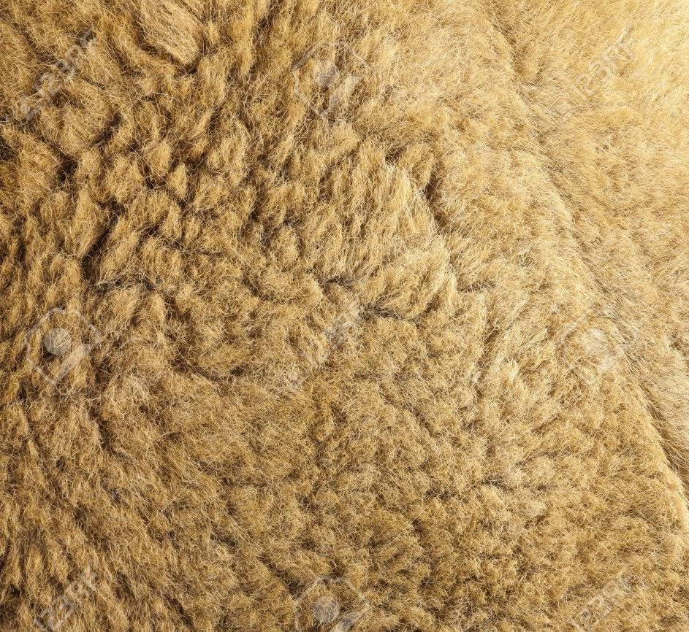
Wallabies look very similar to kangaroos, but smaller. They have
long tails, and short forearms, which they use for feeding. Their powerful legs allow them to hop very far and very fast.
Their fur is often different shades of brown or grey, with a few species having red or golden fur.

Slide 4
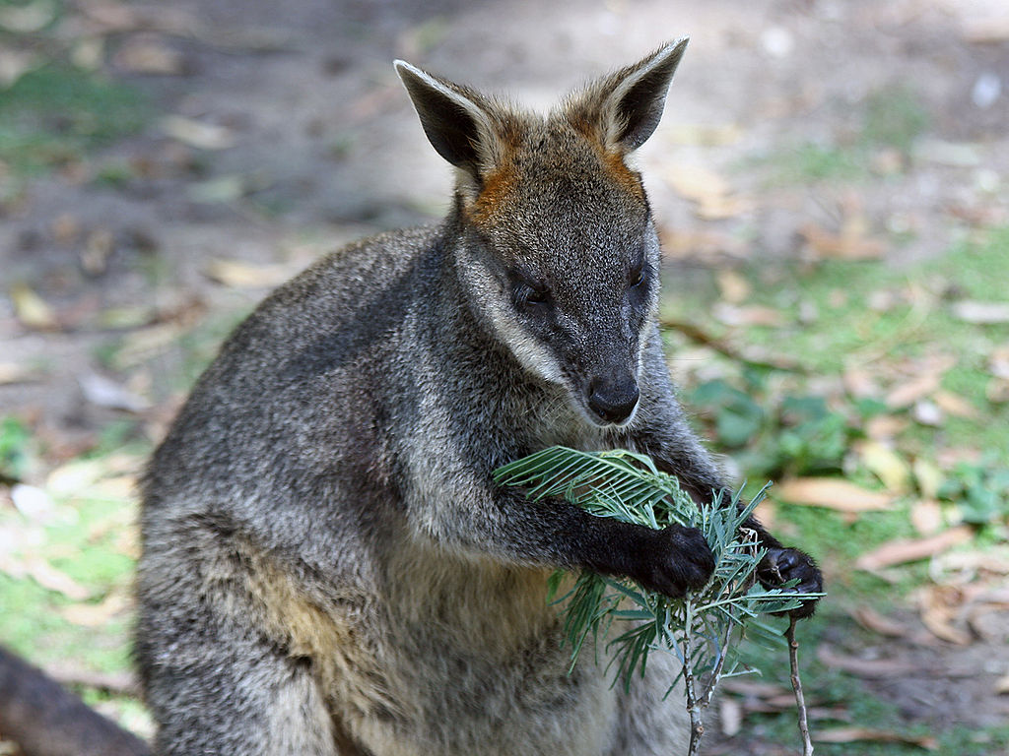
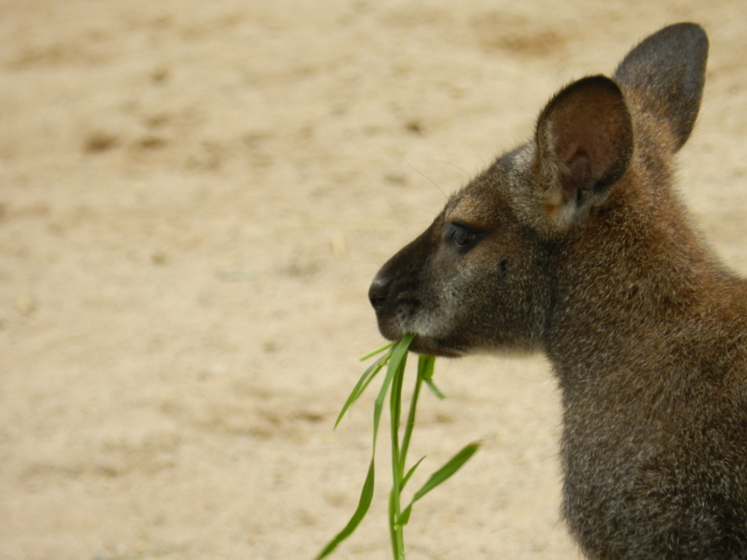
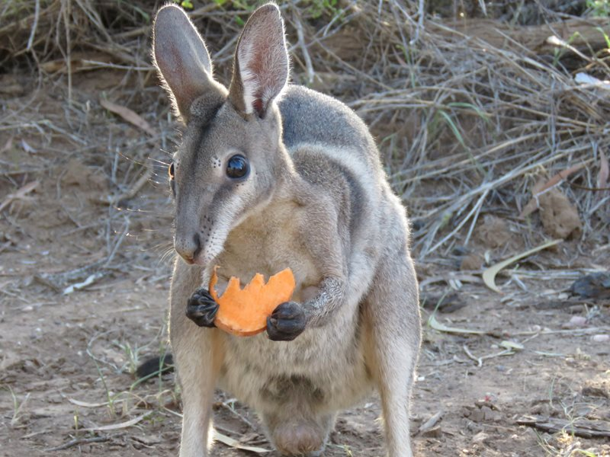
Wallabies may be considered to be nocturnal, since they tend to hide during the day and go out at night to find food. They feed mostly on grasses, fruits and plants.
In general, wallabies are not very social animals, and prefer to live alone. Some species
(like the red-necked wallaby) do gather together to forage for food, however.

Slide 5

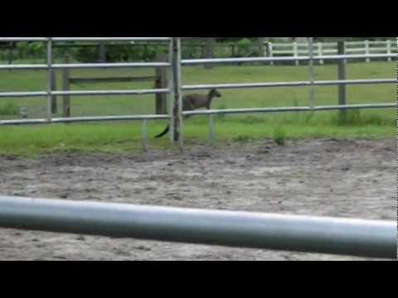
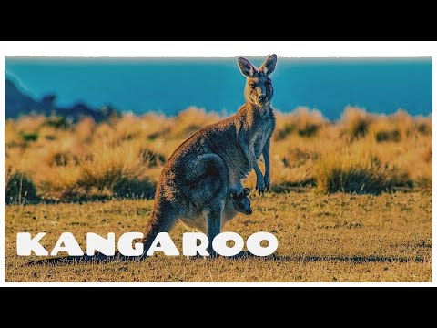
Wallabies
are
FAST!
3
0 M P H
All wallabies have very large hind legs that they use to hop from place to place. If necessary, they can hop very fast, reaching top speeds of 30 miles per hour. Swamp wallabies are also good swimmers.
If they sense danger, they may thump their feet to warn others. Sometimes, they communicate with grunts and hisses.
Click the above to hear
wallaby sounds!

Slide 6
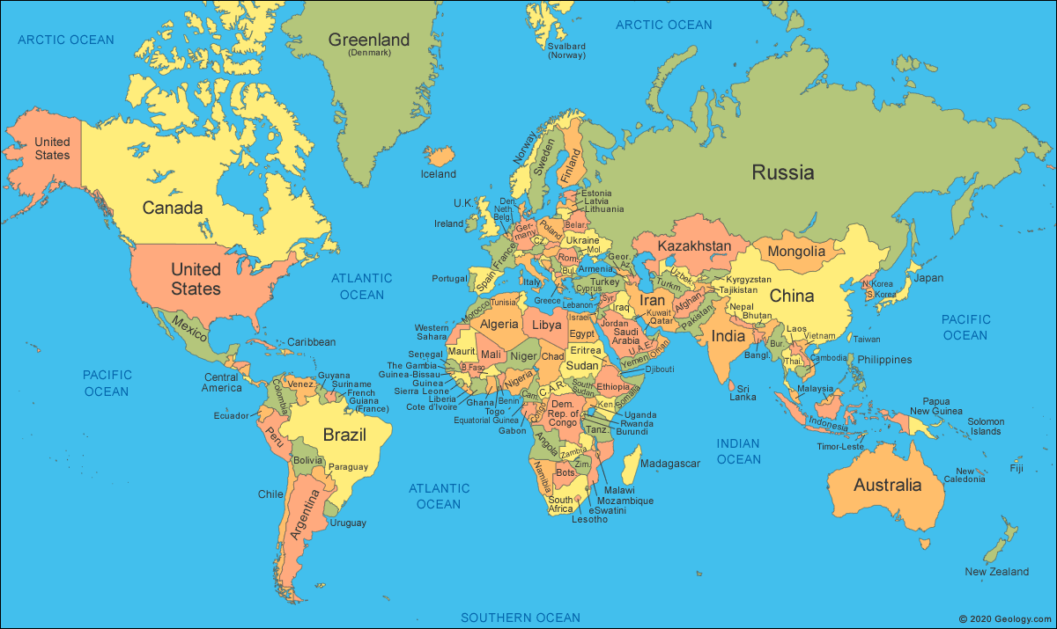
Although wallabies were originally only found in Australia and New Guinea, they now live in other parts of the world, where humans have introduced them.

Slide 7
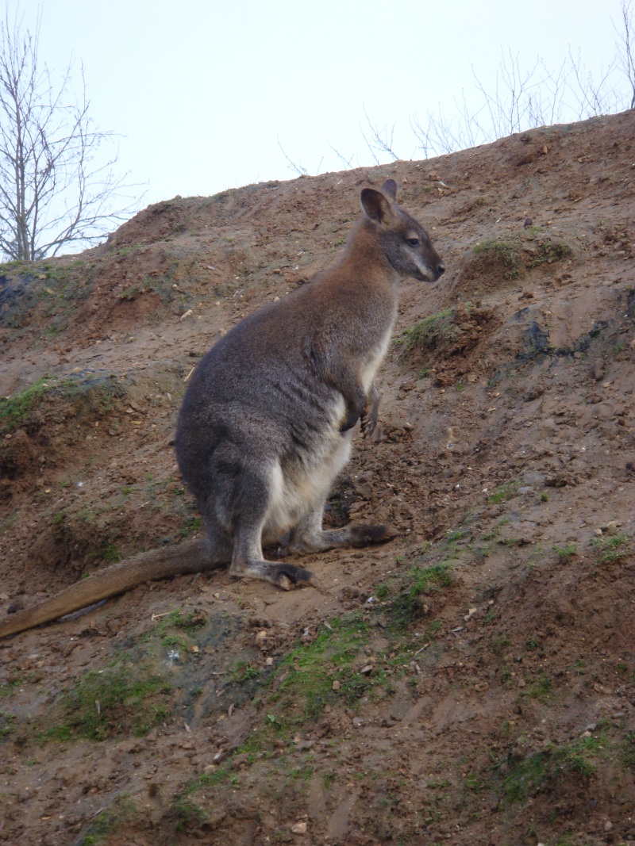
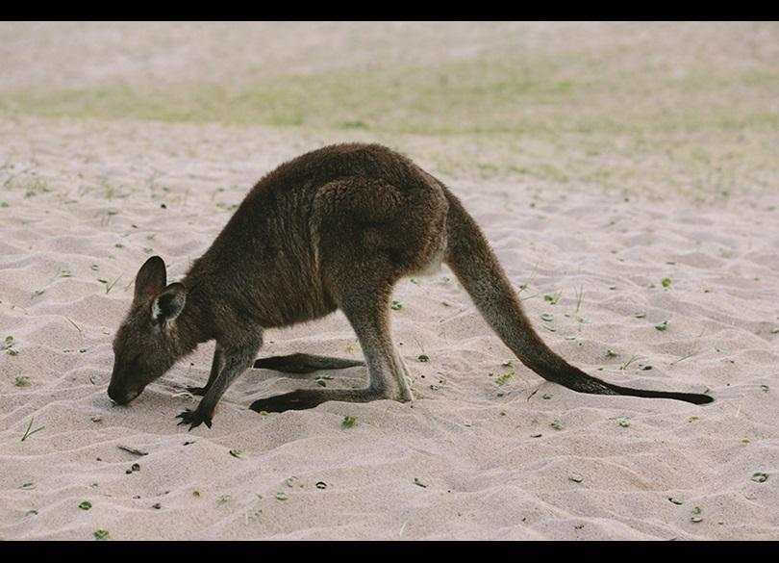
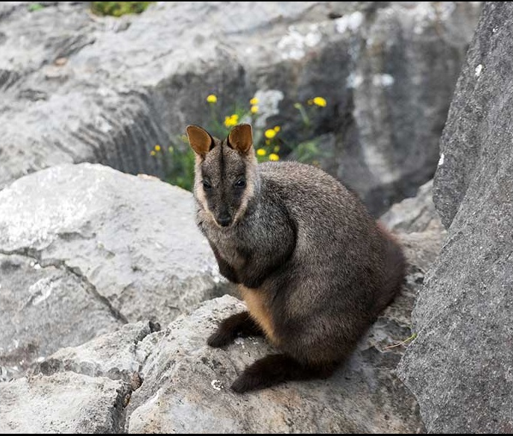
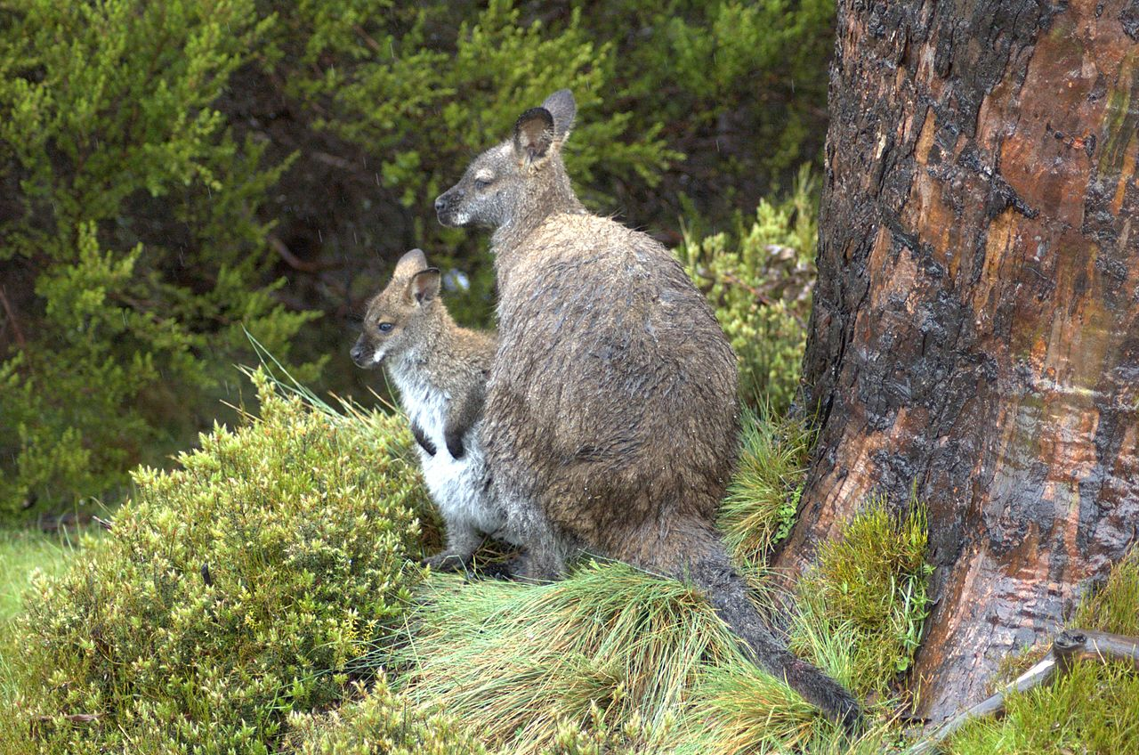
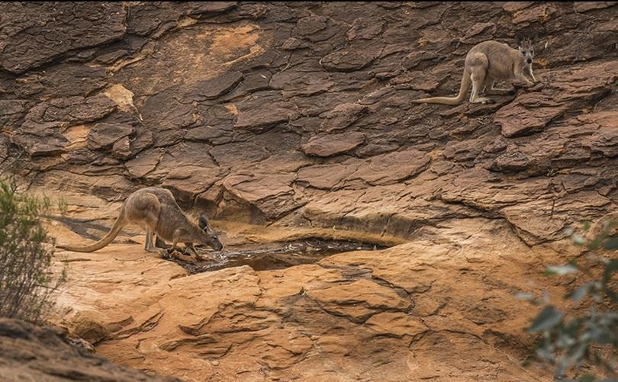
Depending on where they live, different species have adapted physically. The rock wallaby has developed grooves on the bottom of its feet, to help grip the rocks.
A wallaby may be found in many different kinds of habitats, ranging from tropical rainforests to rocky hills to open plains. Because their habitats are so diverse, they are often named after them. For example, the rock wallaby is found in the rocky terrain of northern Australia, while the western brush wallaby is found in the open forests on the southwest coast

Slide 8
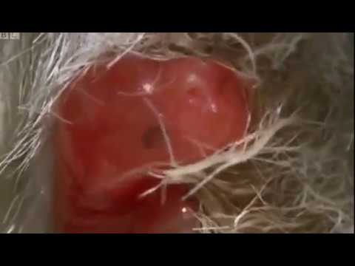
A young joey, about the size of a lima bean, climbs up into its mother’s pouch. It is blind, and led only by instinct!
Mother wallabies are pregnant for a very short time… about 28 days. They give birth to a young joey, that is born hairless and blind. Once born, the joey will climb up the mother’s body, finding her pouch. The joey will then latch on to a teat, to nurse. Joeys will stay in the mother’s pouch until they are 8 or 9 months old.
Did you know?
Mama wallabies may become pregnant while carrying a joey, but can suspend or pause their pregnancy until the current joey vacates the pouch!

Slide 9
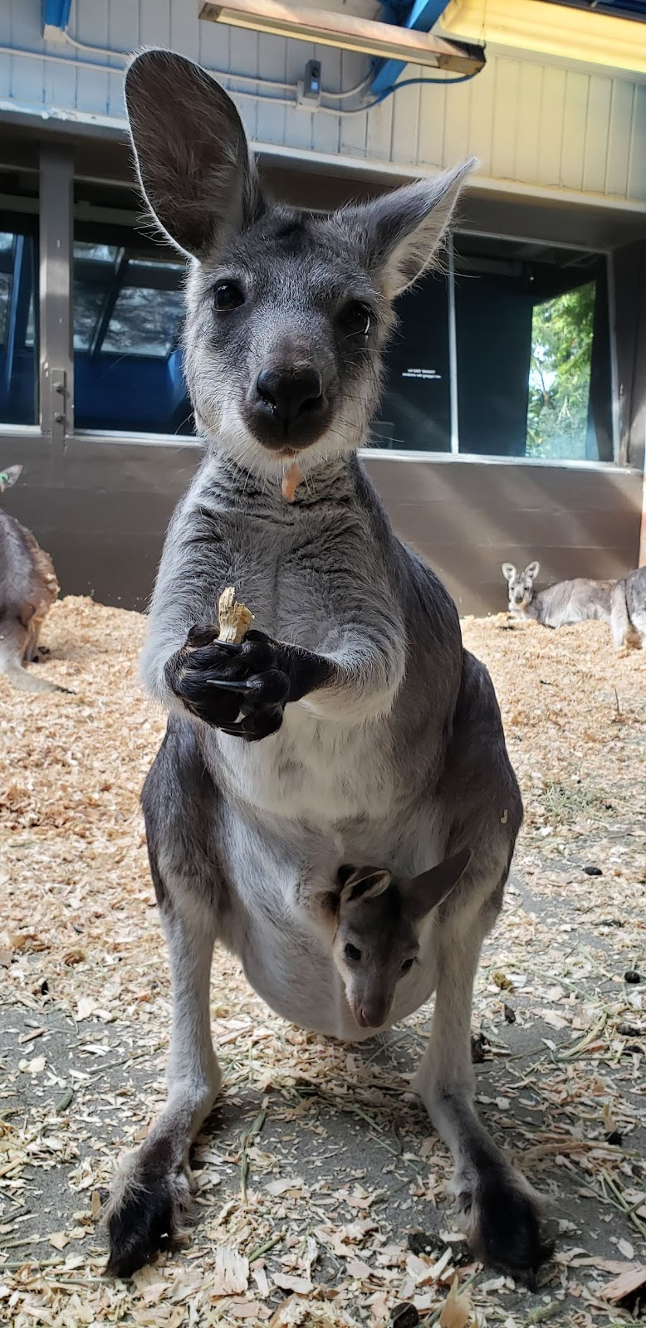
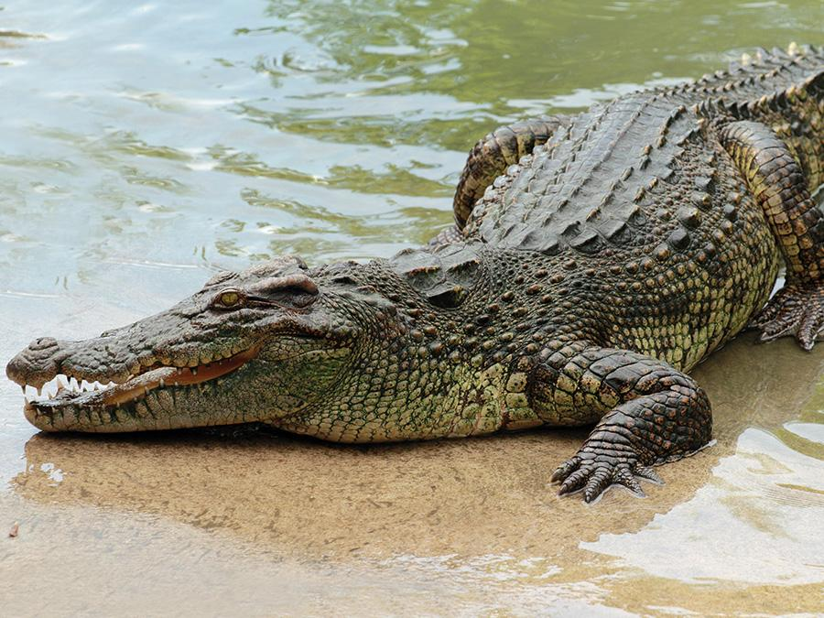
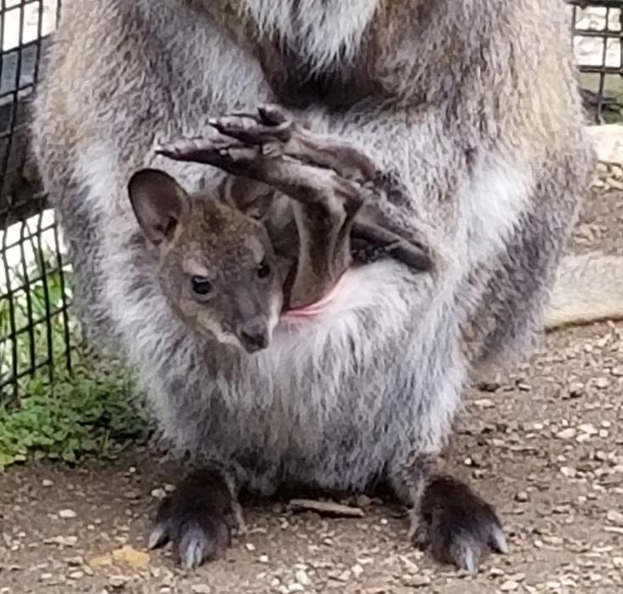
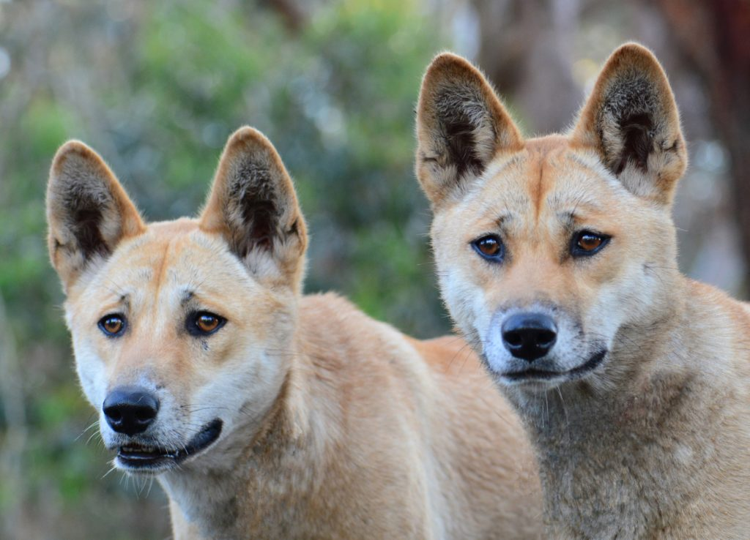
After leaving its mother’s pouch, young joeys will still stay nearby. Their life span is between 7-10 years in the wild, and up to 15 years in captivity.
Wallabies serve as prey for many predators, including coyotes, dingoes, fox, large eagles, crocodiles and snakes.

Slide 10
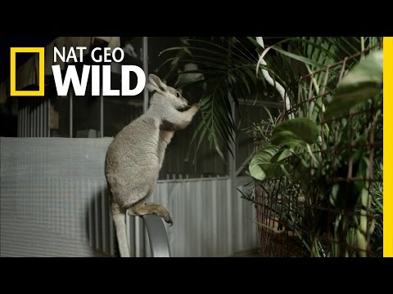
Because wallabies eat a lot of plants and fruits, they are actually helpful to the ecosystem because seeds from their food pass through their digestive tract and get deposited in the environment. Although they are plentiful and not endangered, humans have infringed on the their habitat, resulting in infrequent attacks (wallabies will use their powerful legs to kick and defend themselves). They have also become popular as pets, in areas of the world where owning one is legal.
“We have a nugget”

Slide 11
Bibliography
Augee, Michael L. "Wallaby." World Book Advanced, World Book, 2019, worldbookonline.com/advanced/article?id=ar725283. Accessed 24 Jan. 2019.
Ballenger, Liz. Macropus rufogriseusred-necked wallaby. 2014. 8 Feb. 2019 < https://animaldiversity.org/accounts/Macropus_rufogriseus >.
Brust, Beth Wagner. Kangaroos. Poway: Wildlife Education, 1993.

