Slide 1




Fostering Personalized Learning Through the Use of Educational Technology
Olean City Schools
Presenters: Jennifer Mahar, Coordinator of State and Federal Aid Programs, McKenzie Forrest, Student Advocate- Liberty Partnerships, Scott Waterman, Learning Technology Specialist
Olean City Schools
Learning Technology
https://www.oleanschools.org/Page/6509

Slide 2

Welcome
Discussion Time
Please tell us your name?
What organization you are with?
What role/position?

Slide 3

Introduction
Purpose of the grant
  How did we get to where we are today?
Target participants
  Special Education
  Title I
  Liberty Partnerships
Objectives/ Major goals
Websites:
  LTG- https://www.oleanschools.org/Page/6509
  LPP- https://www.oleanschools.org/domain/21

Slide 4

Personal Learning Plans (PLP)
What is a PLP?
  Focus
    Academic
    Personal
  Goals
    Actionable Steps
    Suggested Activities
Varied Time Frames
Who is using them?

Slide 5

Discussion Time
What does a Professional Learning Plan mean to you?
Do you implement anything like this already?

Slide 6
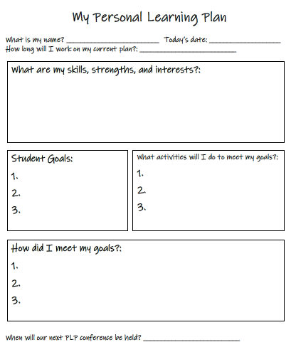
PLP Examples
Special Education

Slide 7
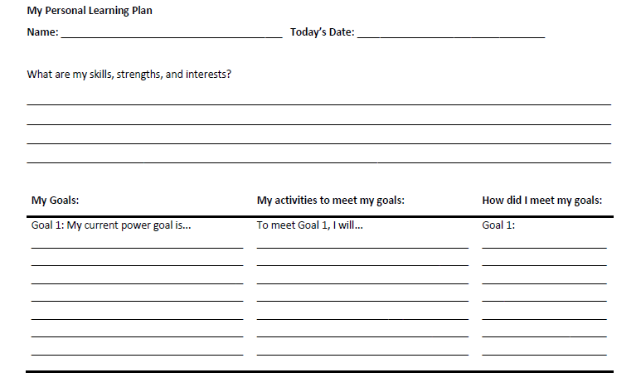
Other PLP Examples
Title I

Slide 8
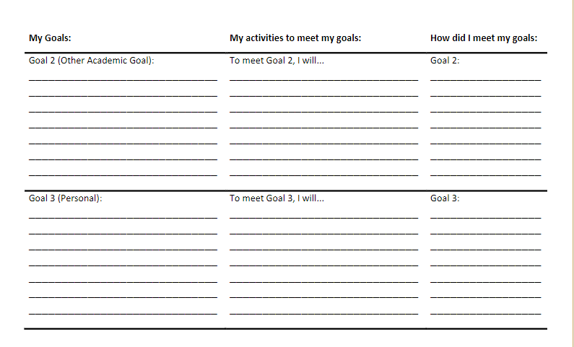
Other PLP Examples
Title I

Slide 9
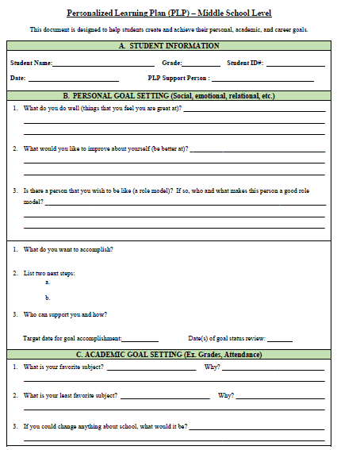
Other PLP Examples
Liberty Partnerships

Slide 10
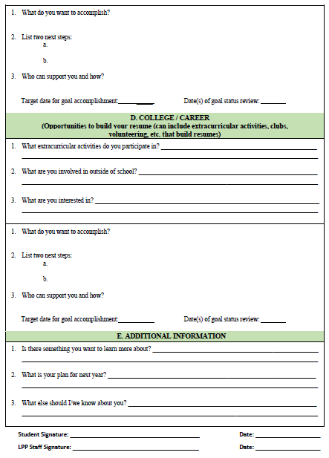
Other PLP Examples
Liberty Partnerships

Slide 11
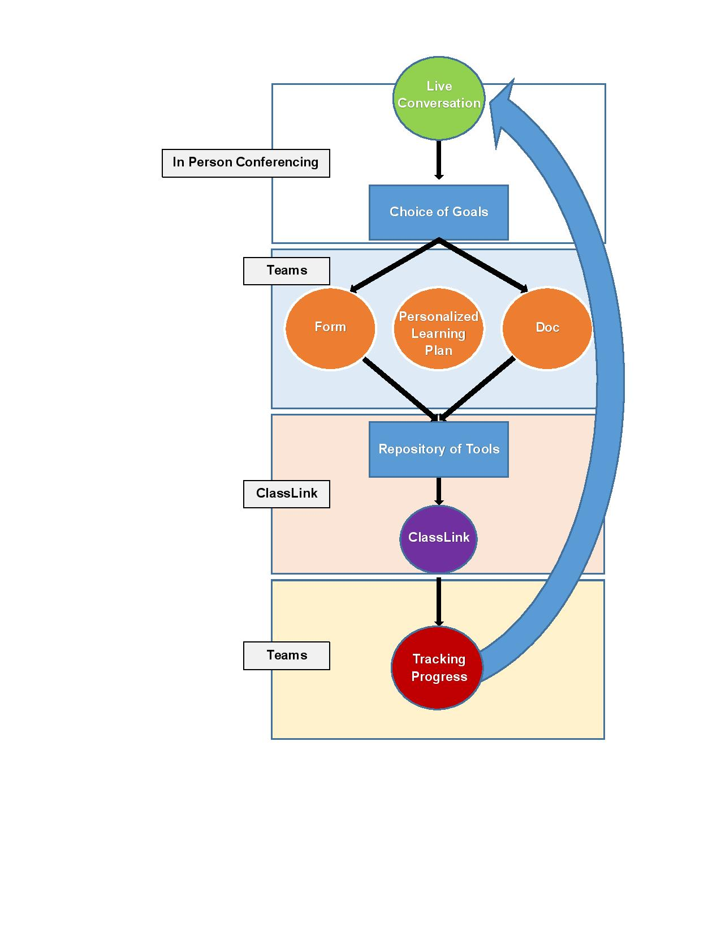

The PLP Process
Where does it start?
  Student/ Teacher Conferencing
Interactions on Student Plans
Platform for Collaboration
  Microsoft Teams
  Other Connected Adults
Reviewing student needs/ interests
Ongoing Check-ins

Slide 12


How Does This Fit in?
Already existing practice
What do other students do during conferencing?
Teaching students to become self guided

Slide 13

Discussion Time
Is all technology electronic?
Provide examples?

Slide 14
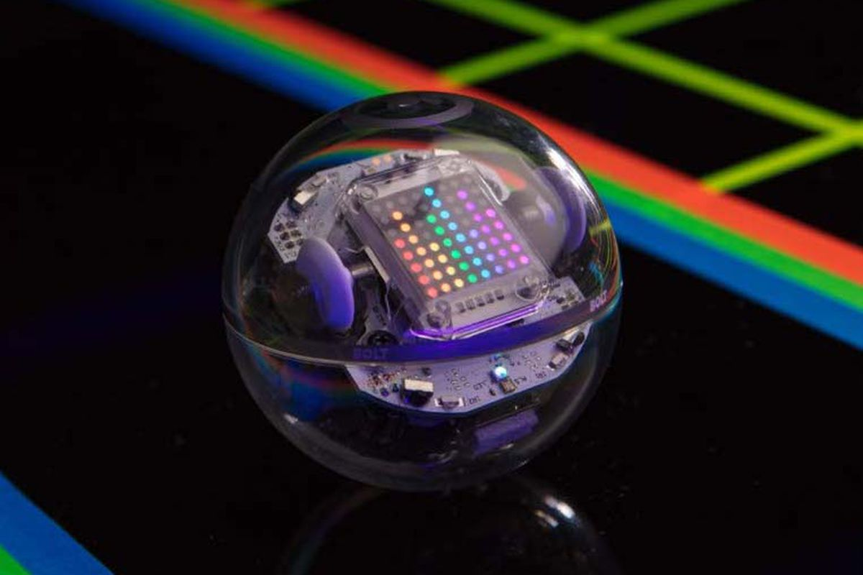
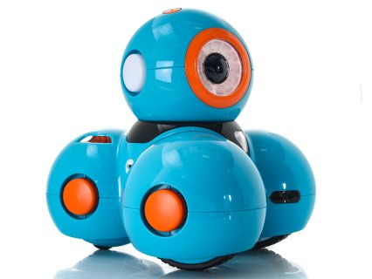
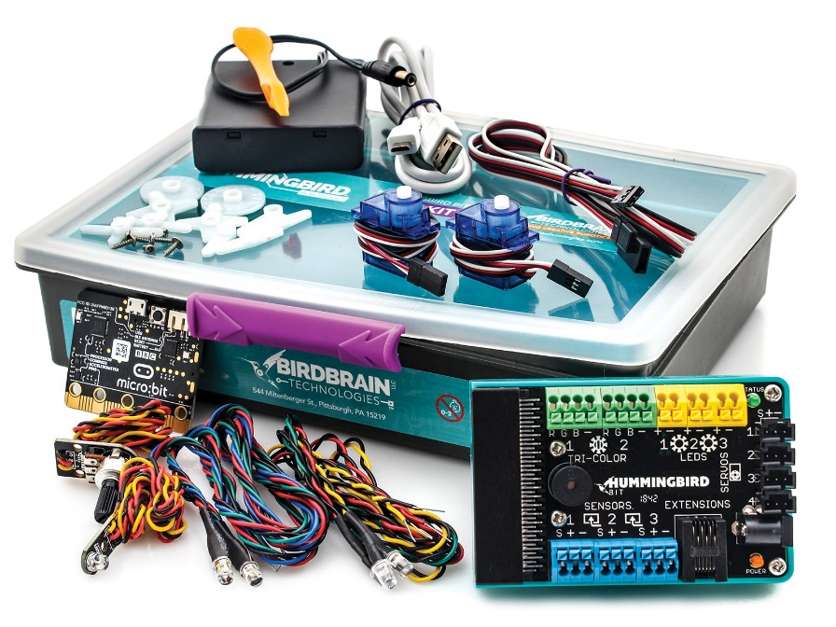
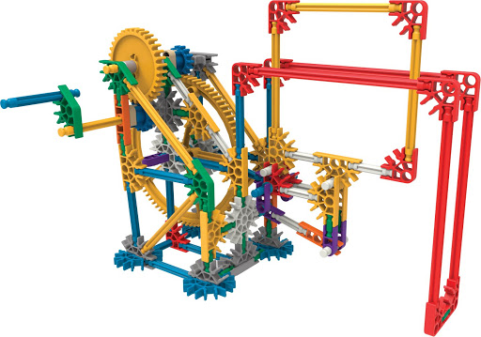
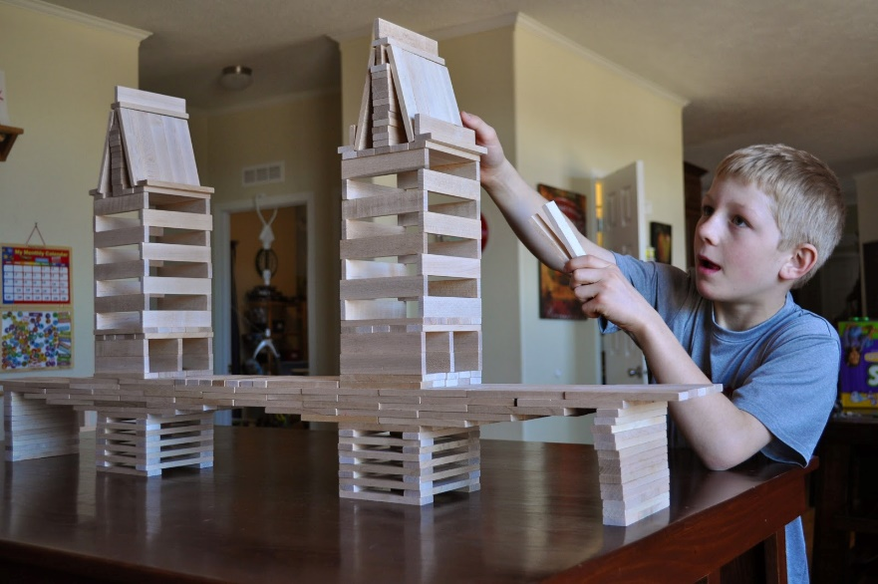
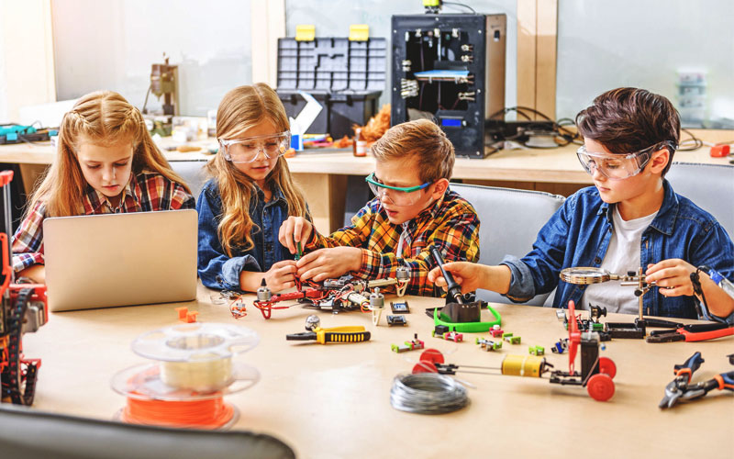
Use of Educational Technology
Design Technology
  PLP and Interactions/ Check-ins
Learning Tool Technology
  Robotics
  Coding Kits
  Engineering Manipulatives
  MakerSpace
  SiLAS Solutions

Slide 15
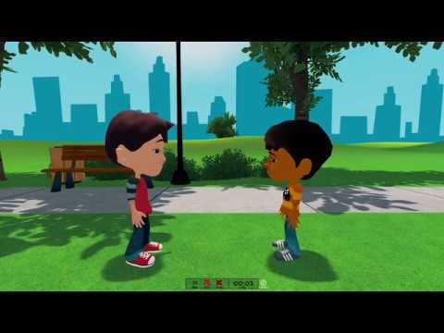
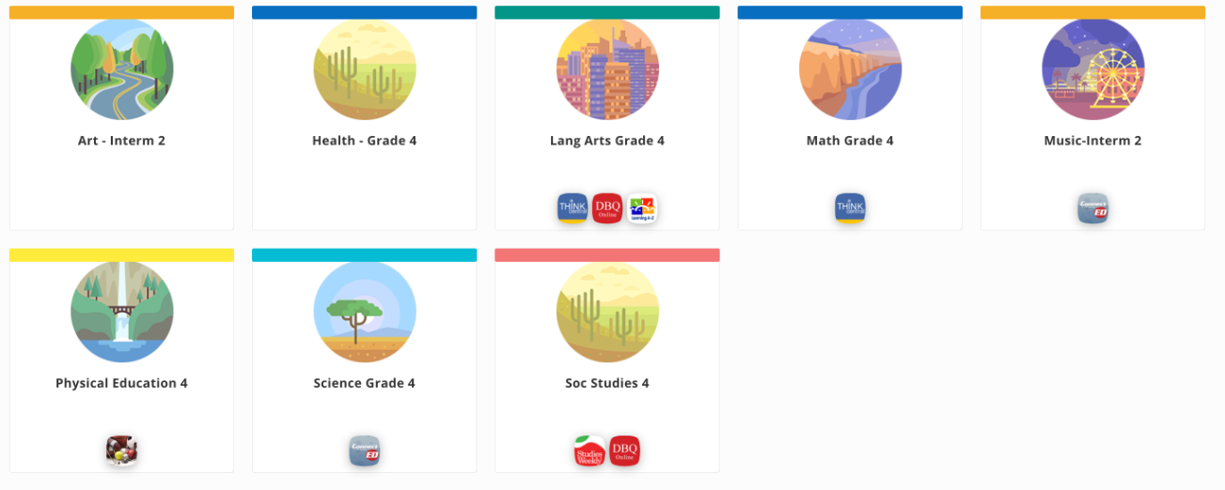
Use of Educational Technology
SiLAS Solutions
  New Jersey Based Company
  Social-Emotional Virtual Reality
  www.silassolutions.com
  SiLAS Video
Classlink
  One stop place for website links and apps
    Menu of Supports
    Teachers can narrow choices down
    through the My Backpack feature
  Single Sign on compliant with Ed Law 2D

Slide 16


Discussion Time
How might you imagine
utilizing this with students?

Slide 17
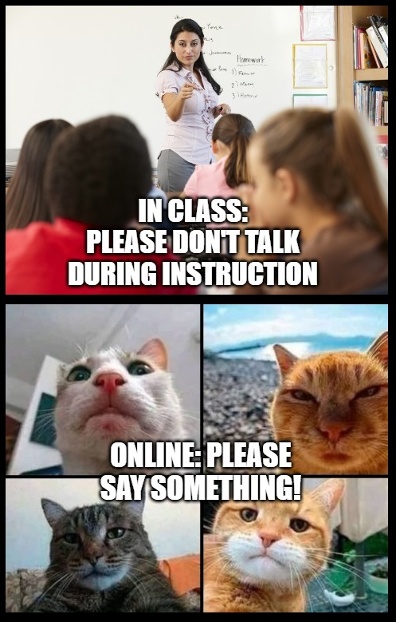
Implications of
Remote Learning

Slide 18

Thank you for attending
Thoughts
Questions
Ideas
Concerns

Slide 19
Contact Information
Jennifer Mahar
(OCSD Coordinator of State and Federal Aid Programs)
jmahar@oleanschools.org
McKenzie Forrest
(OIMS Liberty Partnerships Student Advocate)
mforrest@oleanschools.org
Scott Waterman
(OCSD Learning Technology Specialist)
swaterman@oleanschools.org

