Slide 1
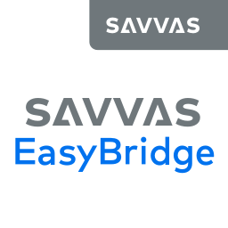
Adding SuccessMaker to EasyBridge - Planning

Slide 2
Introductions
Name
Title
email@savvas.com
Support: 800-848-9500

Slide 3
Agenda
Requirements
Considerations
Teacher Login Process
Student Login Process

Slide 4
Requirements
Version: Latest version of SuccessMaker is required (version 12)
Hosted: SuccessMaker MUST be hosted by Savvas
Section Data: SuccessMaker sections MUST be in your SIS and in the data file upload
Teachers: All teachers need to originate in the SIS data
Section Names: For each teacher, each SuccessMaker class must have a unique name
Student Data: Grade levels for students MUST be provided in data files:
Text File Format (TFF): add ENROLLMENT.txt file to nightly data uploads
OneRoster (OR): add grade values to the users.csv file
Licensing: District provides list of school locations that will need access to SuccessMaker in EasyBridge

Slide 5
Considerations
New SuccessMaker instance will be created for integration
Any existing SuccessMaker work for the current school year will be lost
Teachers MUST assign the SuccessMaker product to classes in EasyBridge
SuccessMaker is the source for license availability and usage
SuccessMaker now supports these special staff accounts
Curriculum Specialists
The EasyBridge admin account can now be used for direct SM login for SM admin tasks

Slide 6
SuccessMaker Integration: Teacher Login Process

Slide 7
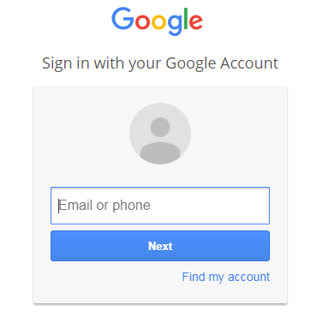
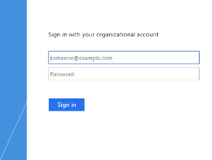
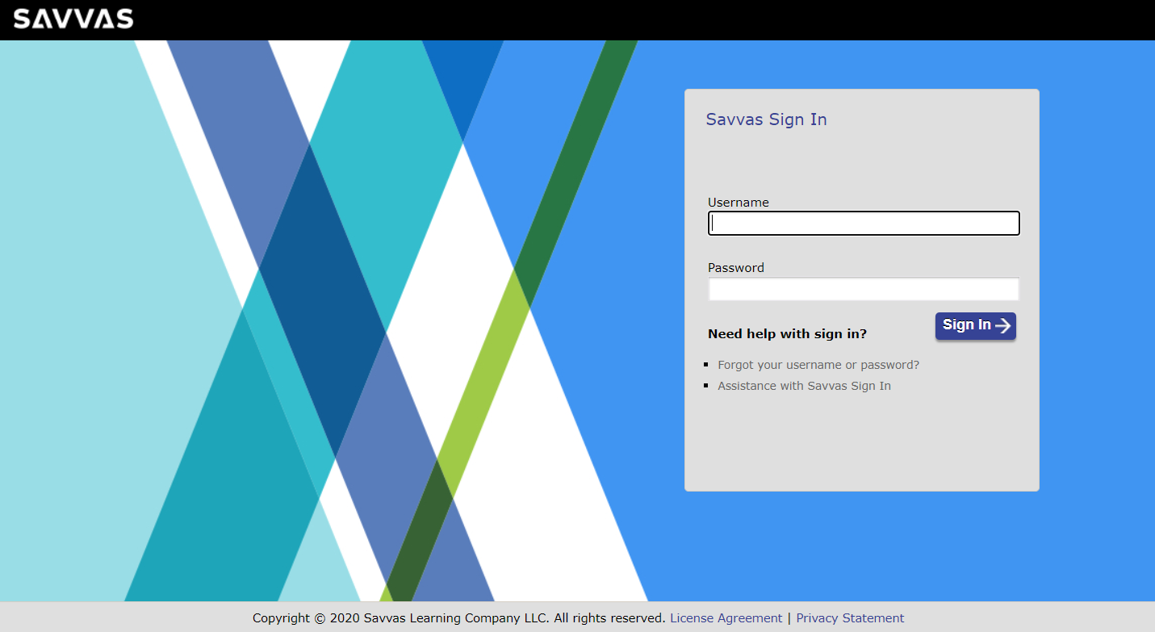
Teacher Login Process – Plus or Auto

Slide 8
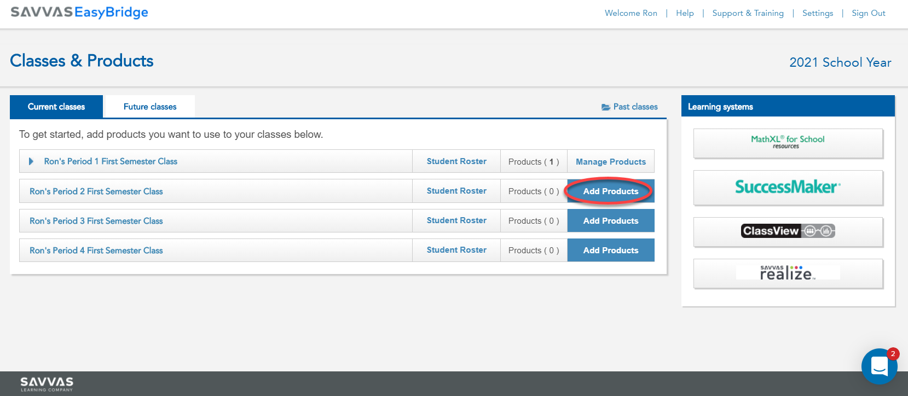
Teacher Login Process
From the EasyBridge portal, select “Add Products”

Slide 9
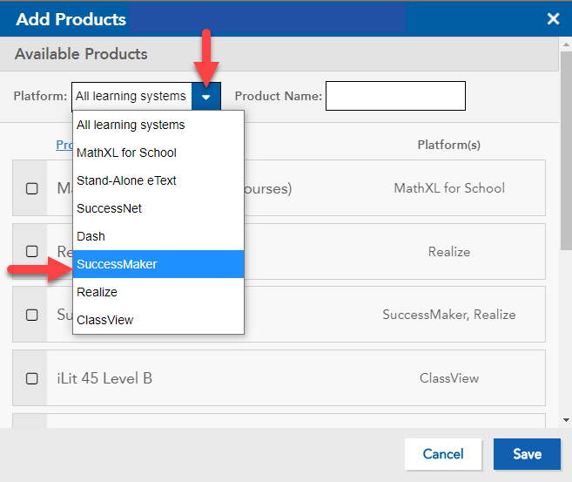
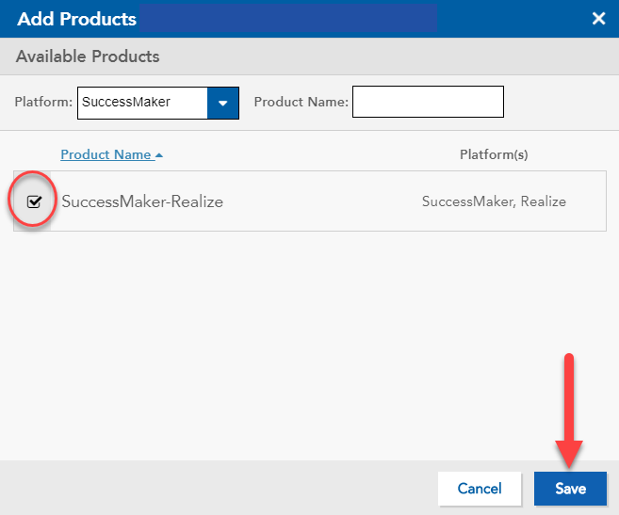
Teacher Login Process
SuccessMaker is added to a class just like any other Savvas product

Slide 10
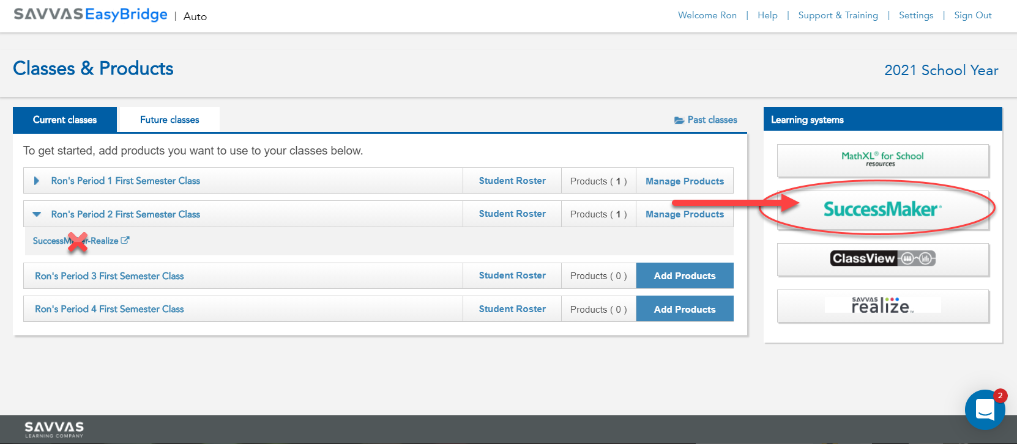
Teacher Login Process
To launch SuccessMaker, click “SuccessMaker” in the Learning systems menu.

Slide 11
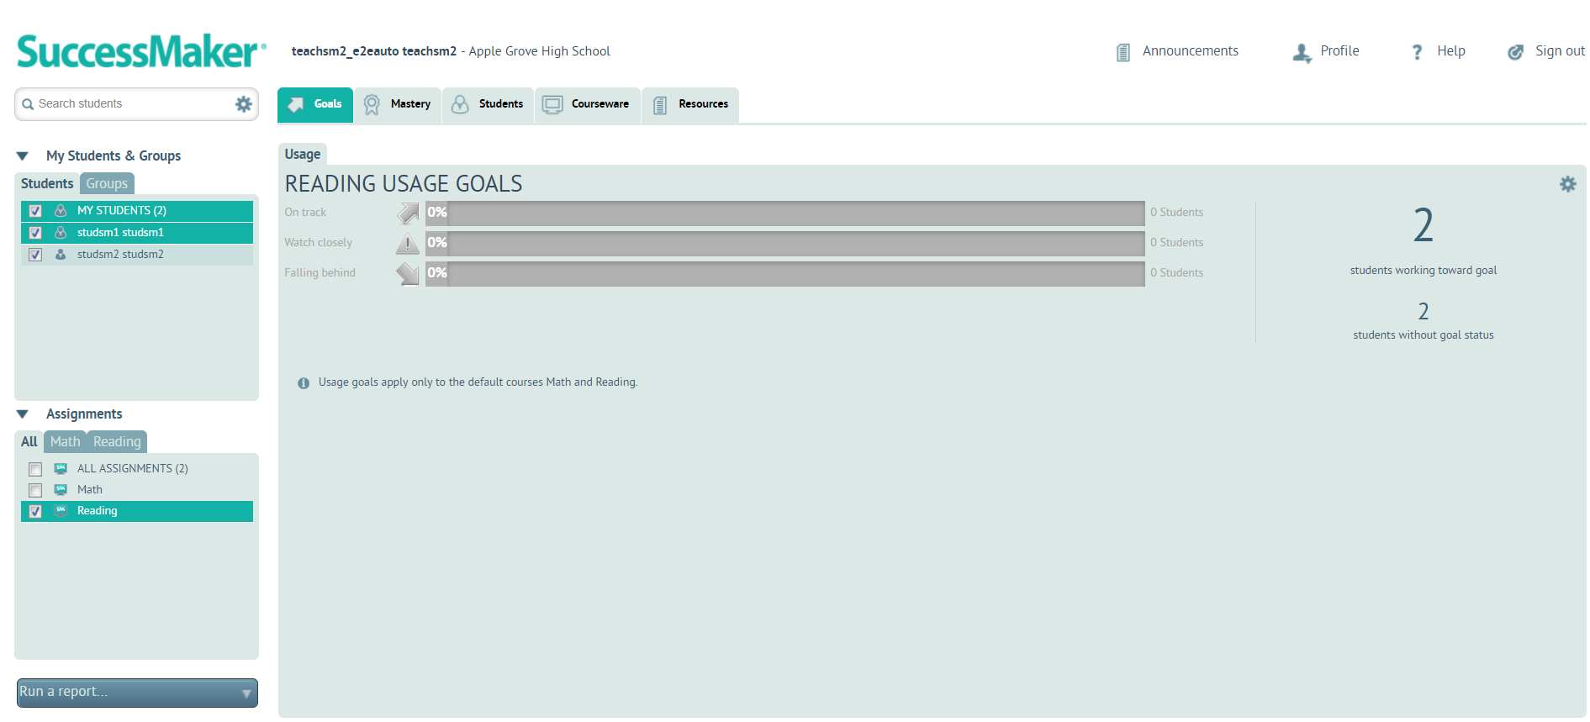
Teacher Login Process
You will be taken to the SuccessMaker teacher dashboard:

Slide 12
Teacher Login Process
Links to teacher SuccessMaker resources on mySavvasTraining.com
On this page you will find resources for:
SuccessMaker 12: Teacher Dashboard Guide
SuccessMaker 12: How to create groups and add students to groups
SuccessMaker 12: How to assign courses to students
All SuccessMaker 12 Online Resources Page

Slide 13
SuccessMaker Integration: Student Login Process

Slide 14
Student Login Process – Plus or Auto

Slide 15
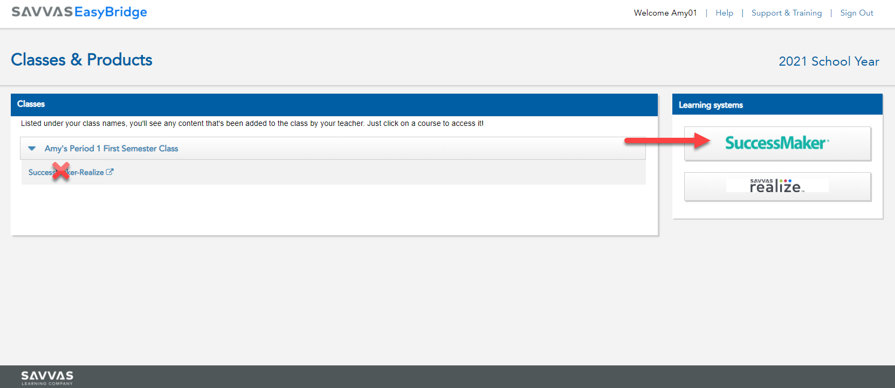
Student Login Process
To launch SuccessMaker, click “SuccessMaker” in the Learning systems menu.

Slide 16
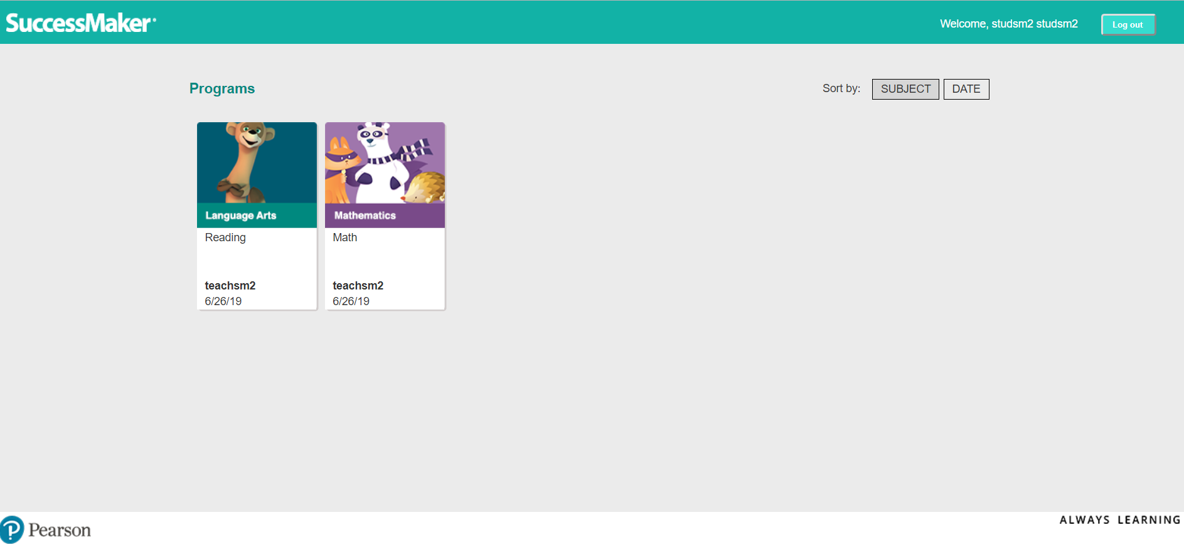
Student Login Process
You will be taken to the SuccessMaker student programs:

Slide 17
SuccessMaker Integration: Curriculum Specialist Login Process

Slide 18
Curriculum Specialist Login Process – Plus/Auto

Slide 19
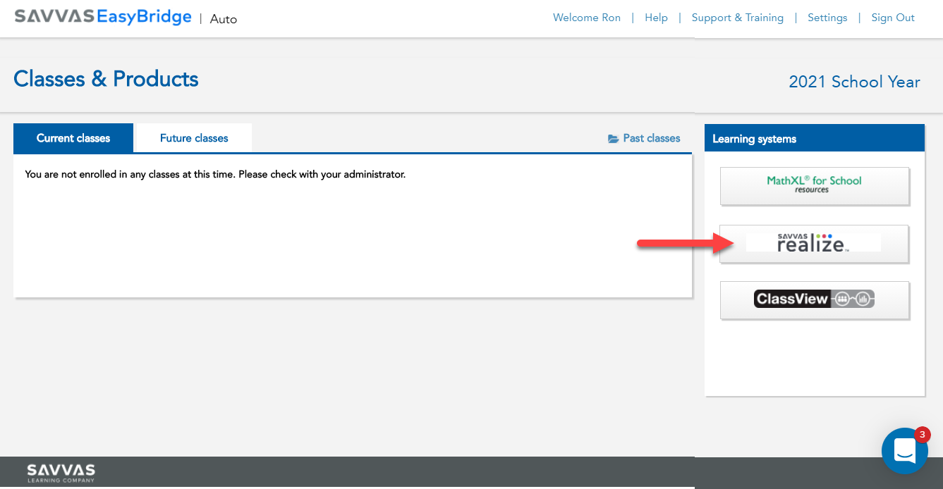
Curriculum Specialist Login Process
From the EasyBridge portal, select “Add Products”

Slide 20
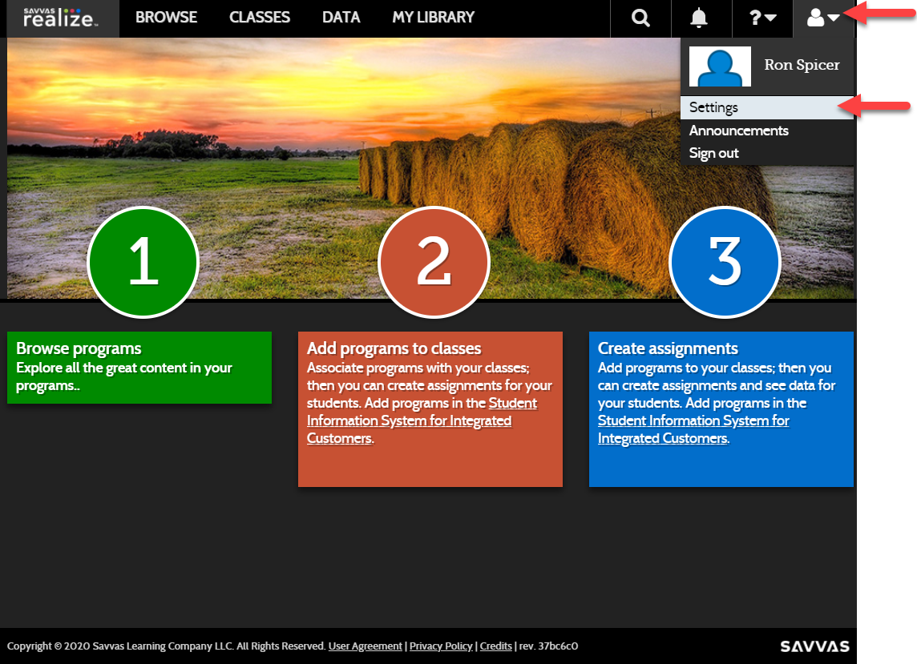
Curriculum Specialist: Manually Activate SM

Slide 21
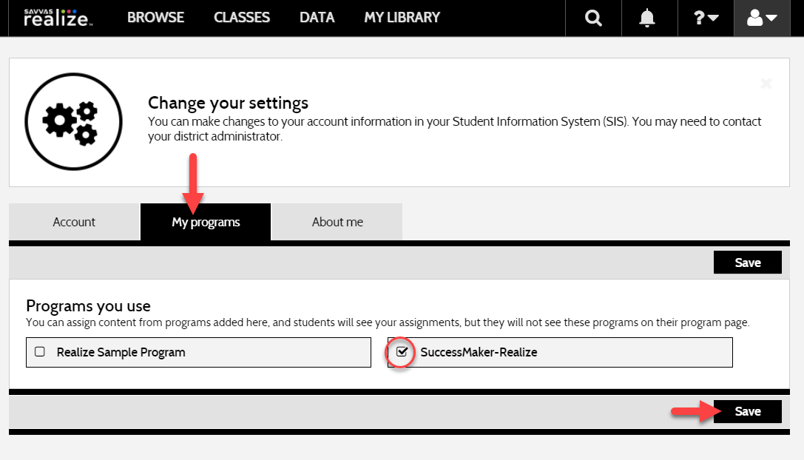
Curriculum Specialist: Manually Activate SM

Slide 22
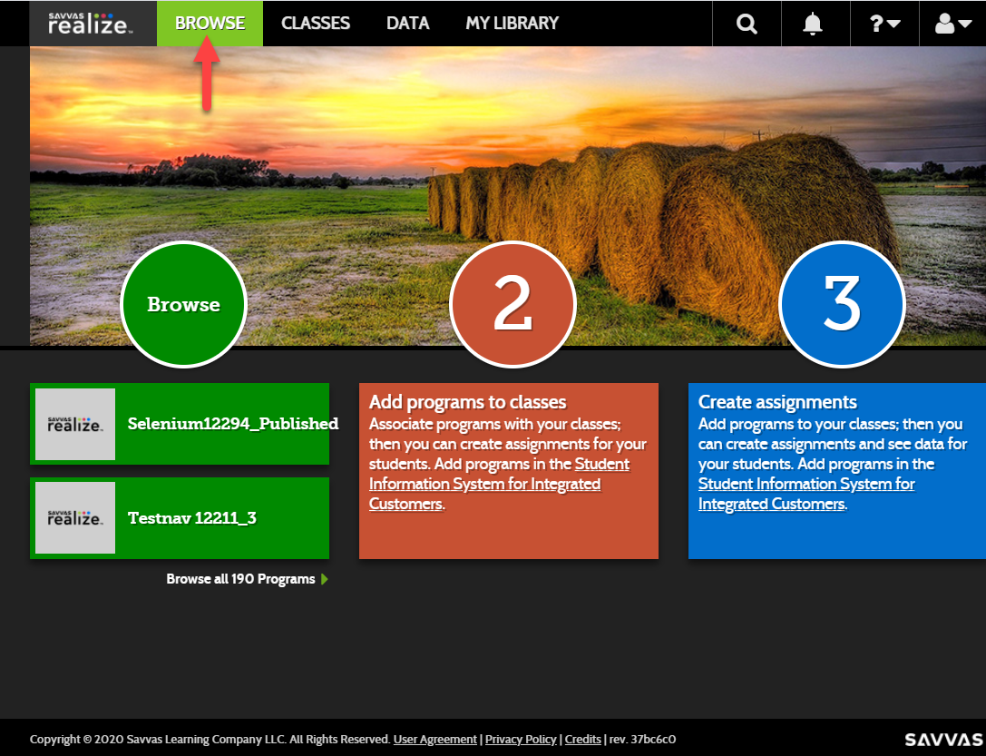
Curriculum Specialist: Open SM from Realize

Slide 23
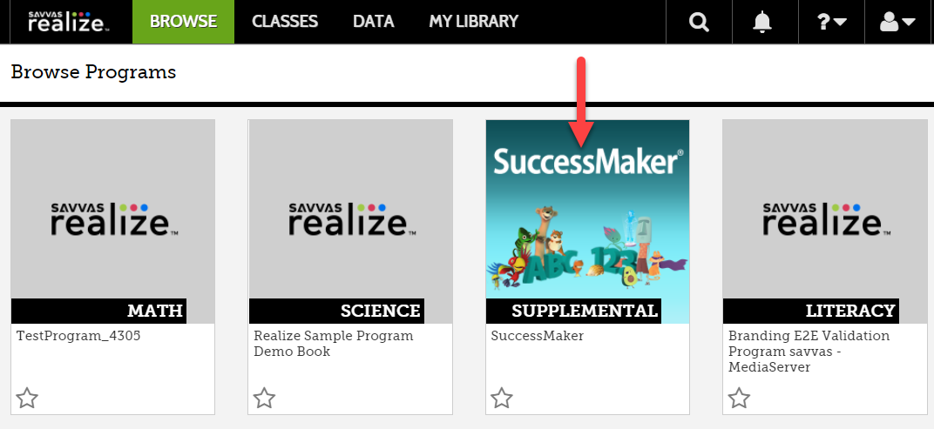
Curriculum Specialist: Open SM from Realize

Slide 24
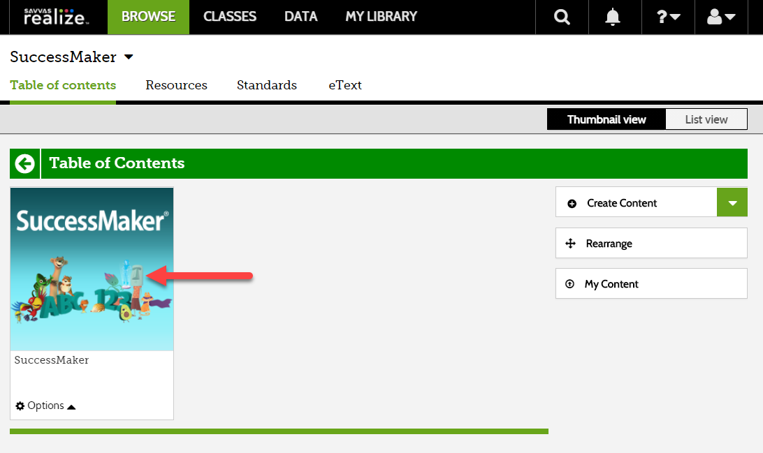
Curriculum Specialist: Open SM from Realize

Slide 25
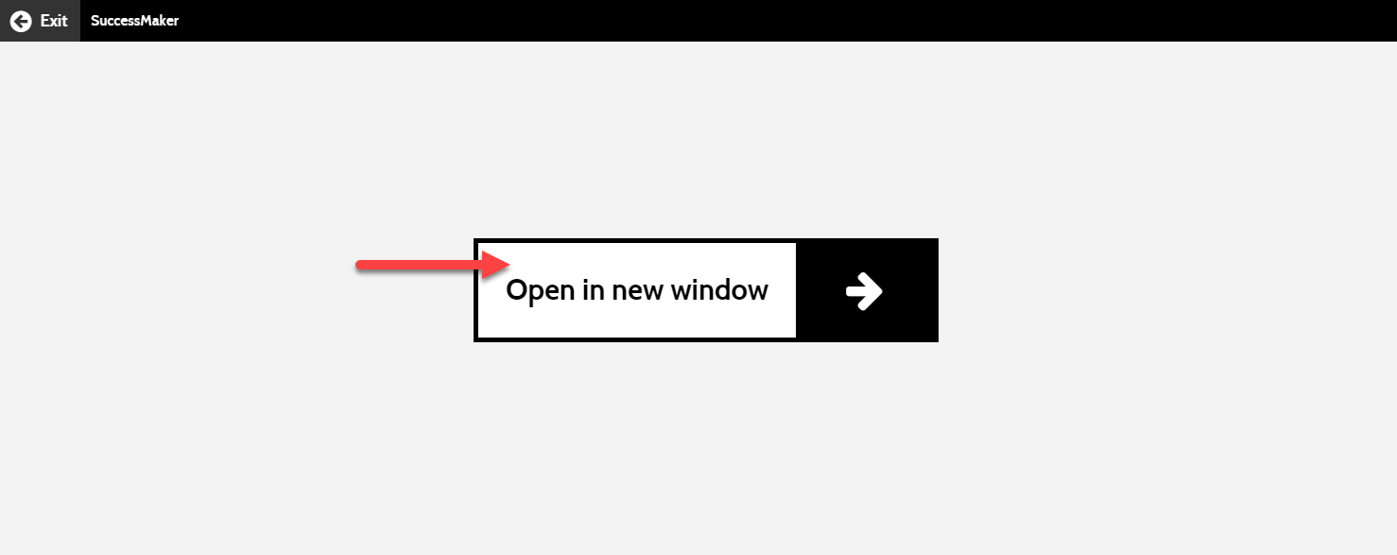
Curriculum Specialist: Open SM from Realize

Slide 26
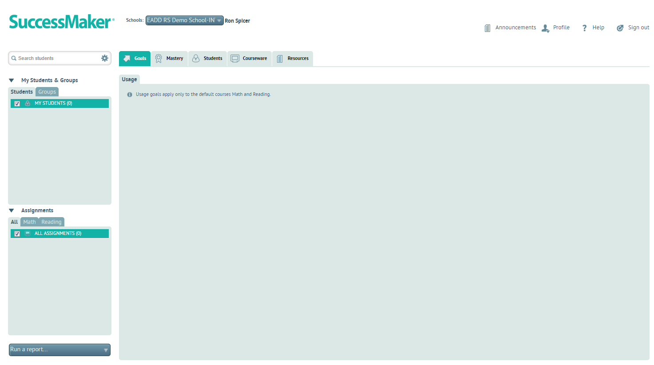
Curriculum Specialist: Open SM from Realize

Slide 27
Q & A

Slide 28
Thank you
Name email@savvas.com

