Slide 1
Infinite Campus Parent Portal Overview

Slide 2
How parent/guardian logs in
https://campus.gsl.k12.mn.us/campus/portal/gsl.jsp
Or go to the district website,
www.gsl.k12.mn.us, and click Parent Portal in the Parents section
User name and password will be sent to you when you request a portal account

Slide 3
Hover your cursor on Parents
Then click Parent Portal

Slide 4
If you have a portal account, click
Parent Portal link
If you have not requested a portal account yet, you must complete all four steps. You will then receive an e-mail with your login information
Be sure to select Parent Portal

Slide 5
Enter your user name
Enter your password
Click Sign In

Slide 6
Select a student

Slide 7
What can you do?
Check schedule and assignments
Check attendance
Check grades
Print schedules and report cards

Slide 8
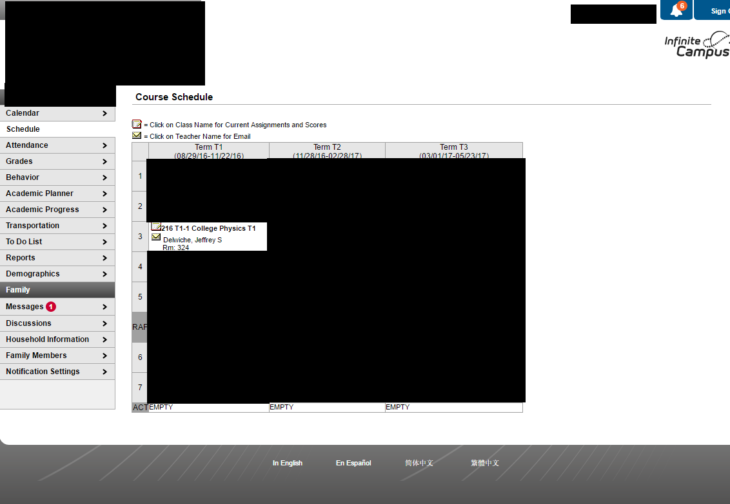
This screen displays teachers and the time your student has each class
Click on a course next to the Notepad icon to view assignments.

Slide 9
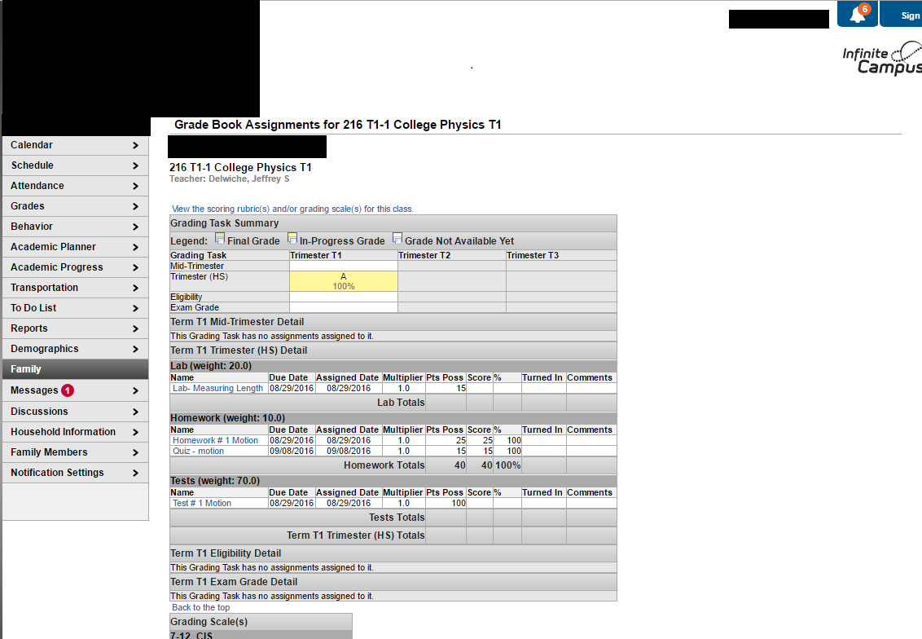
Course and teacher name
Earned grade
Click an assignment to see more details

