Slide 1
CONGRATULATIONS GRADUATES!!

Slide 2
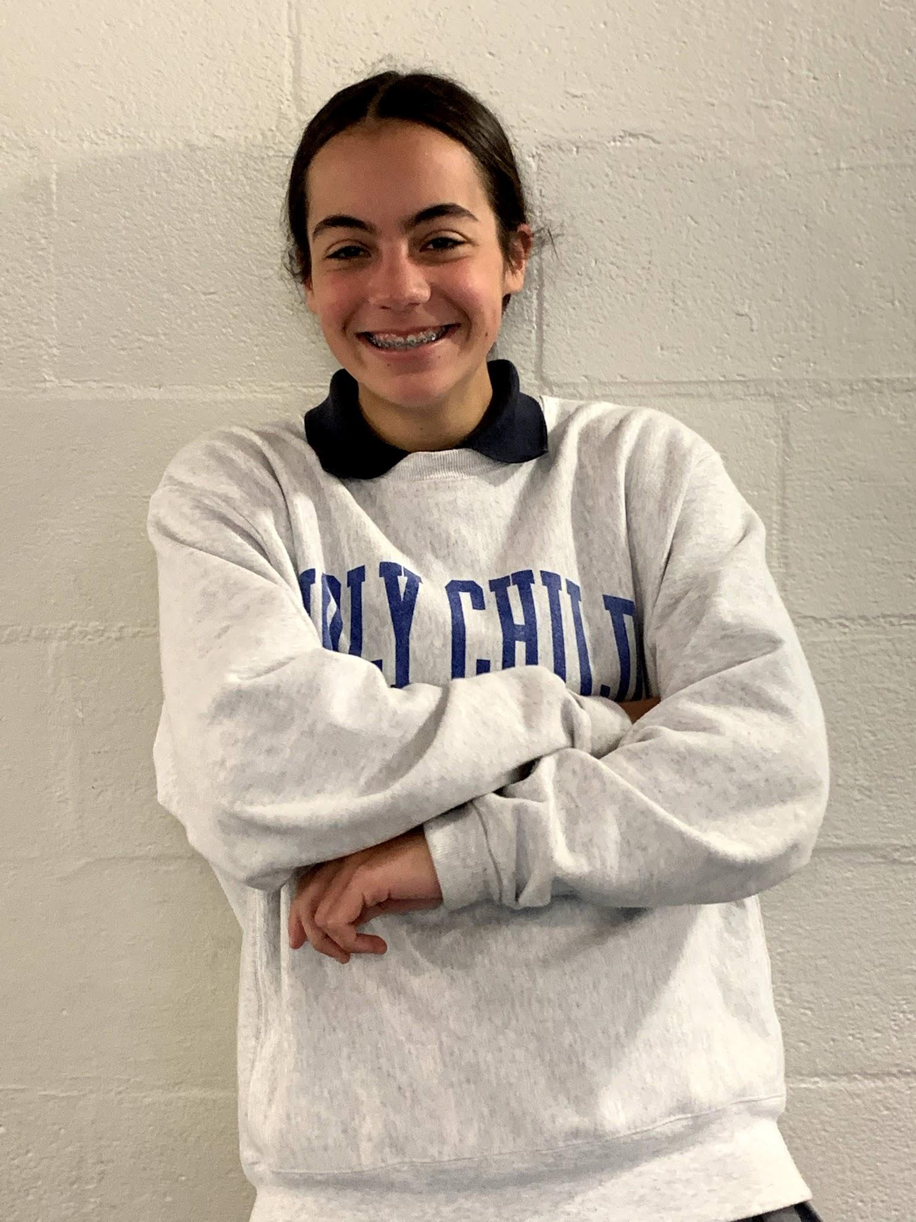
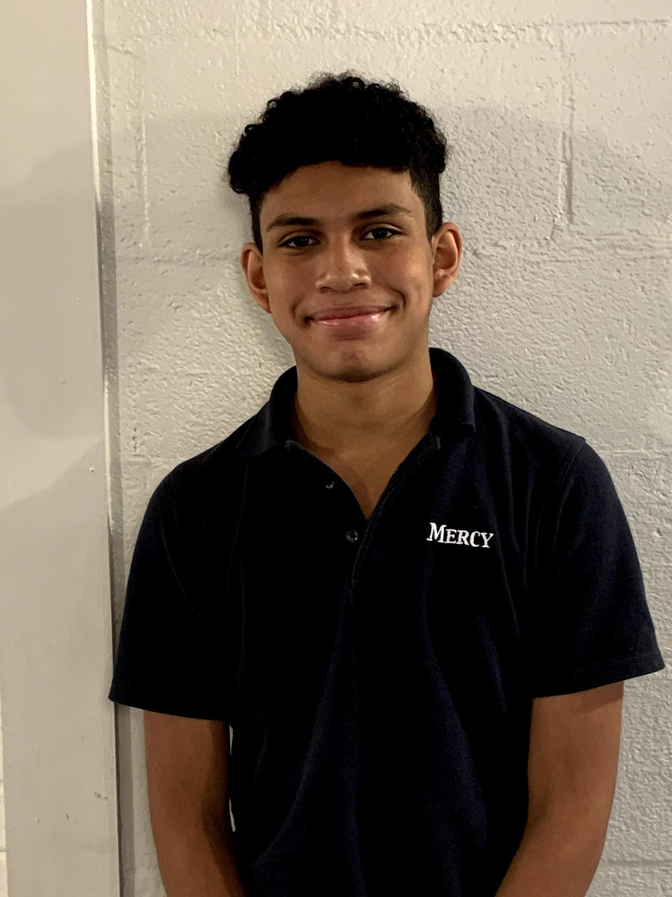
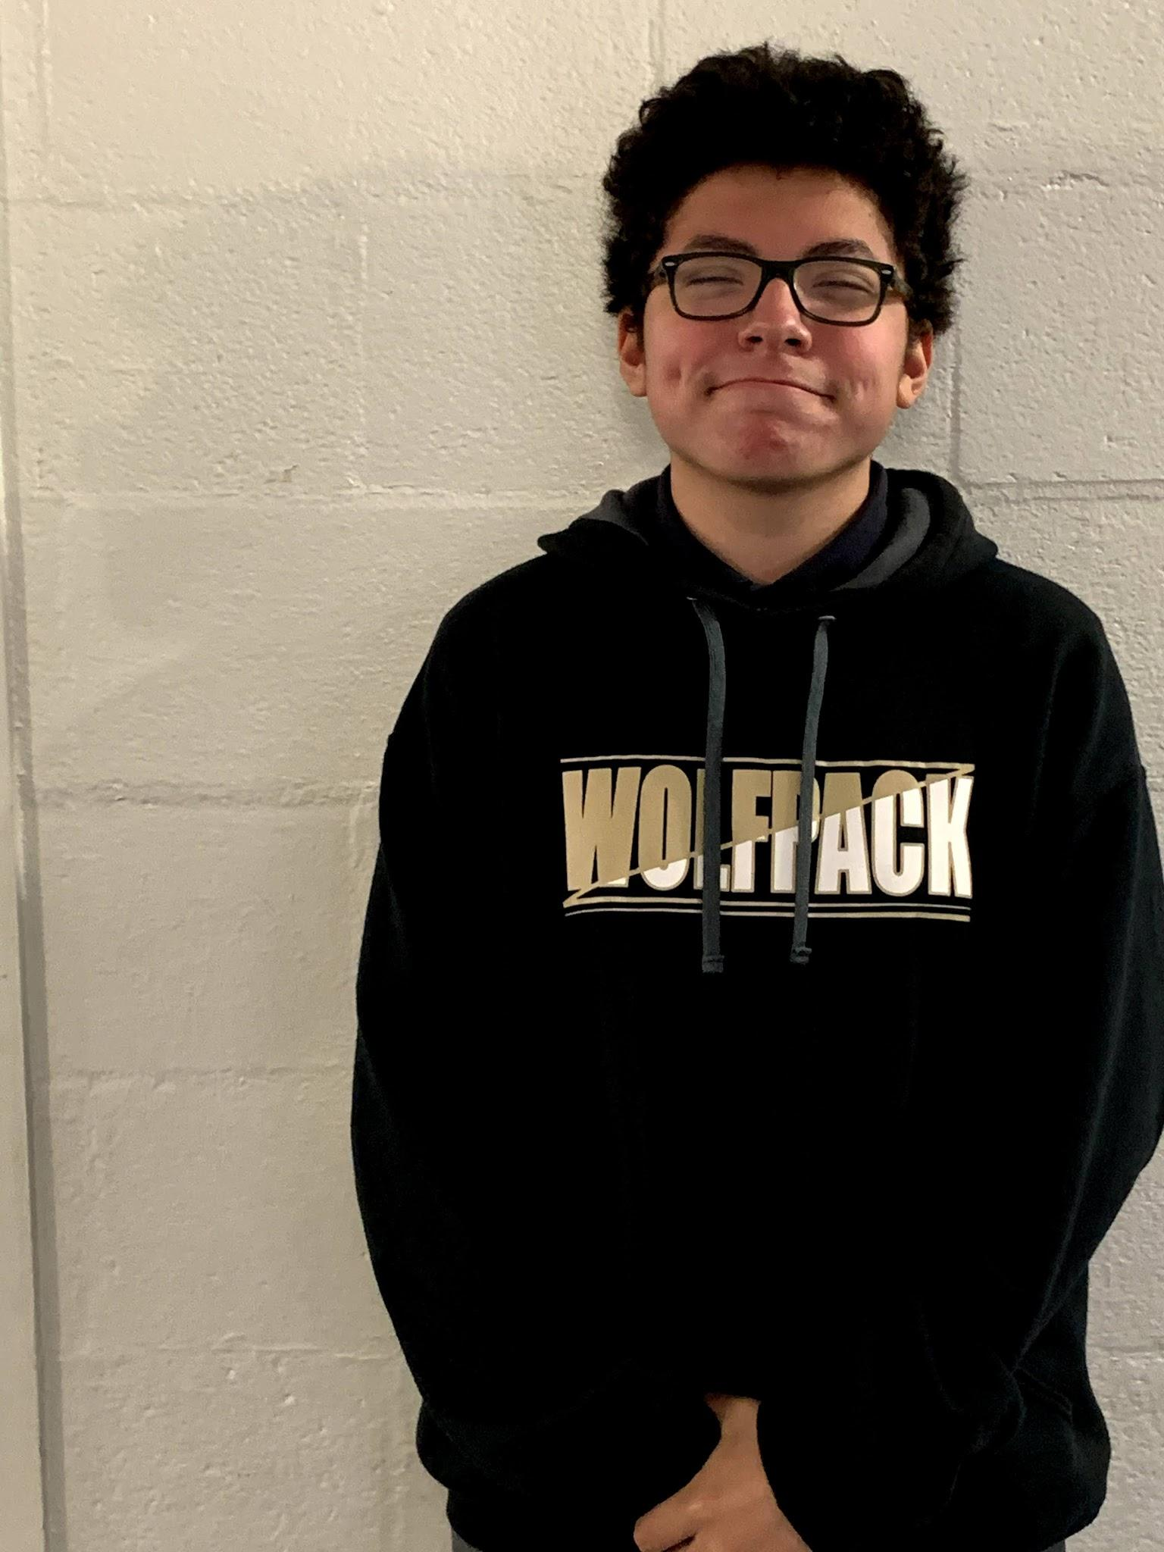
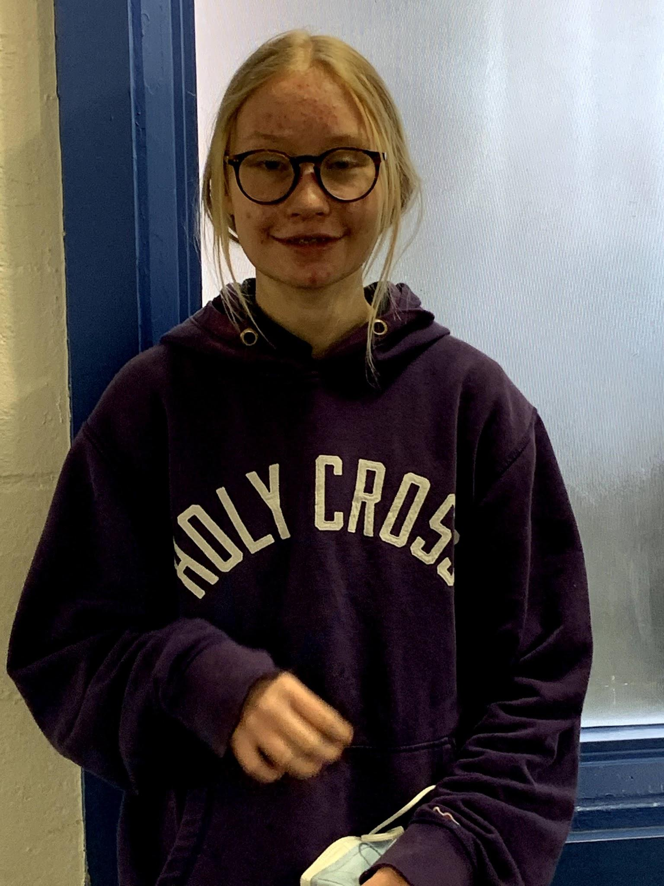
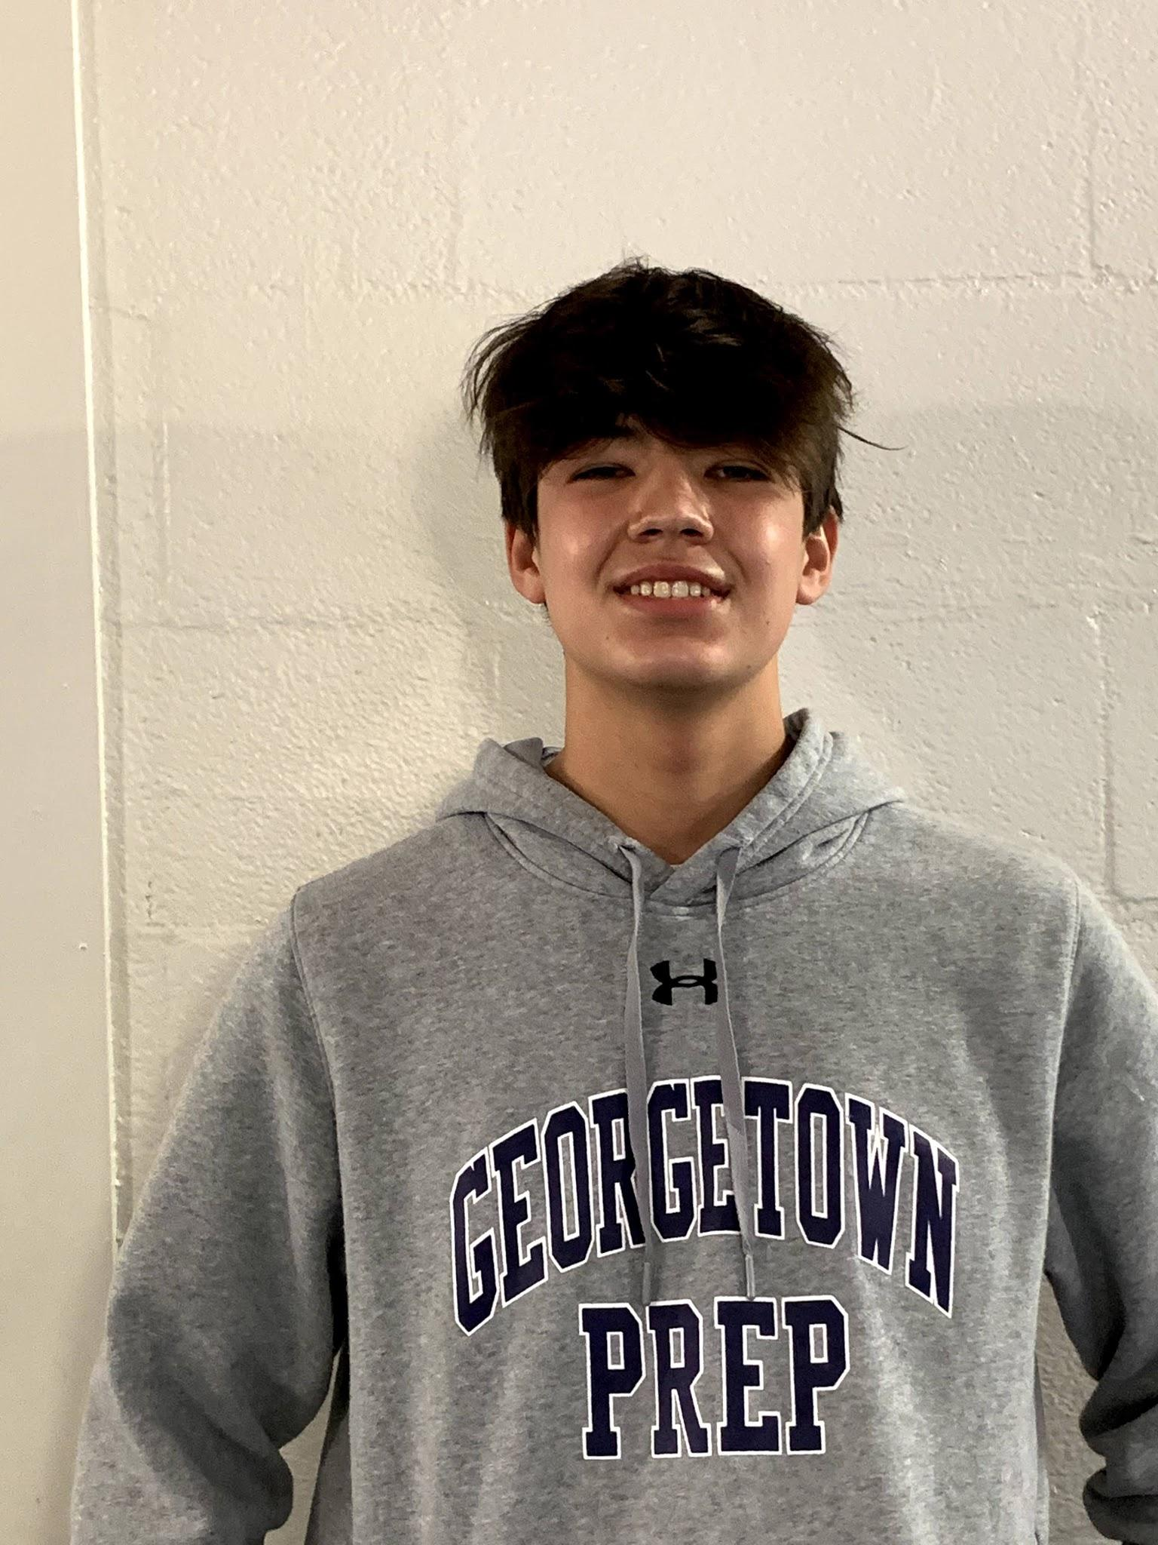
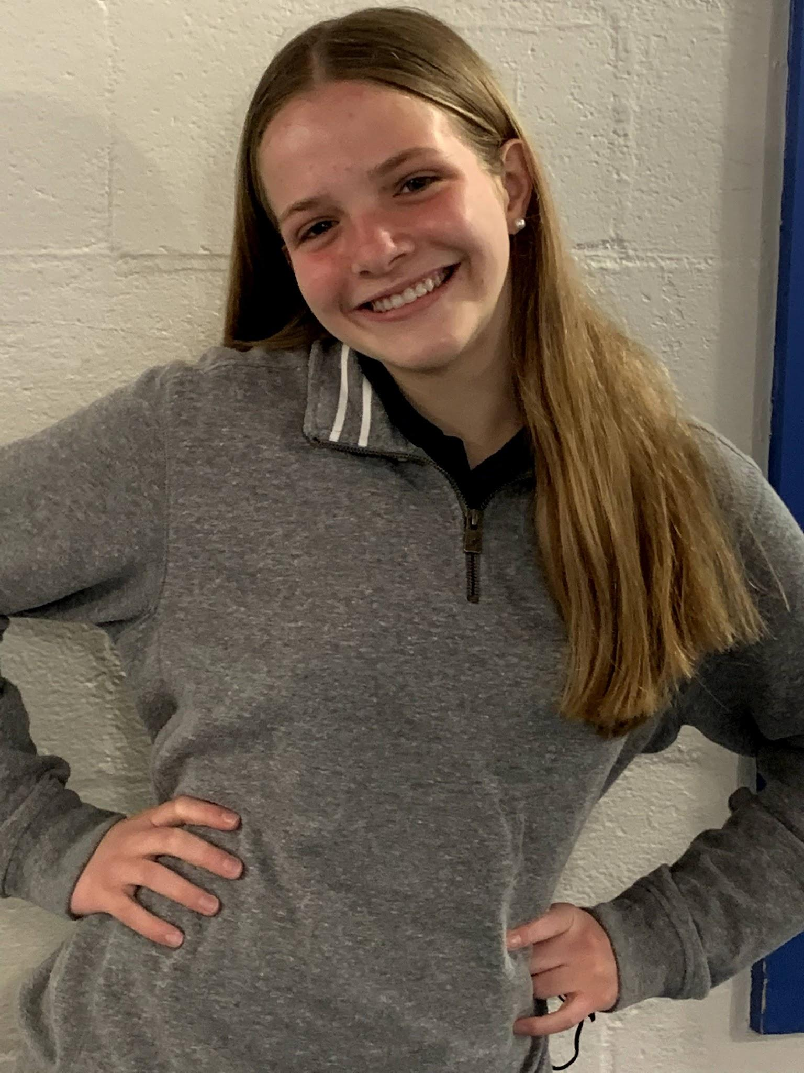
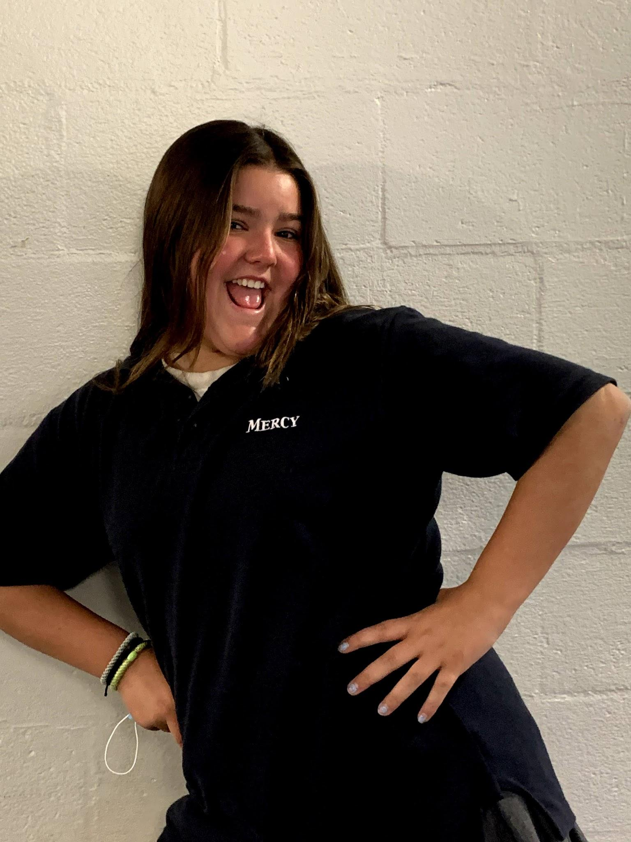
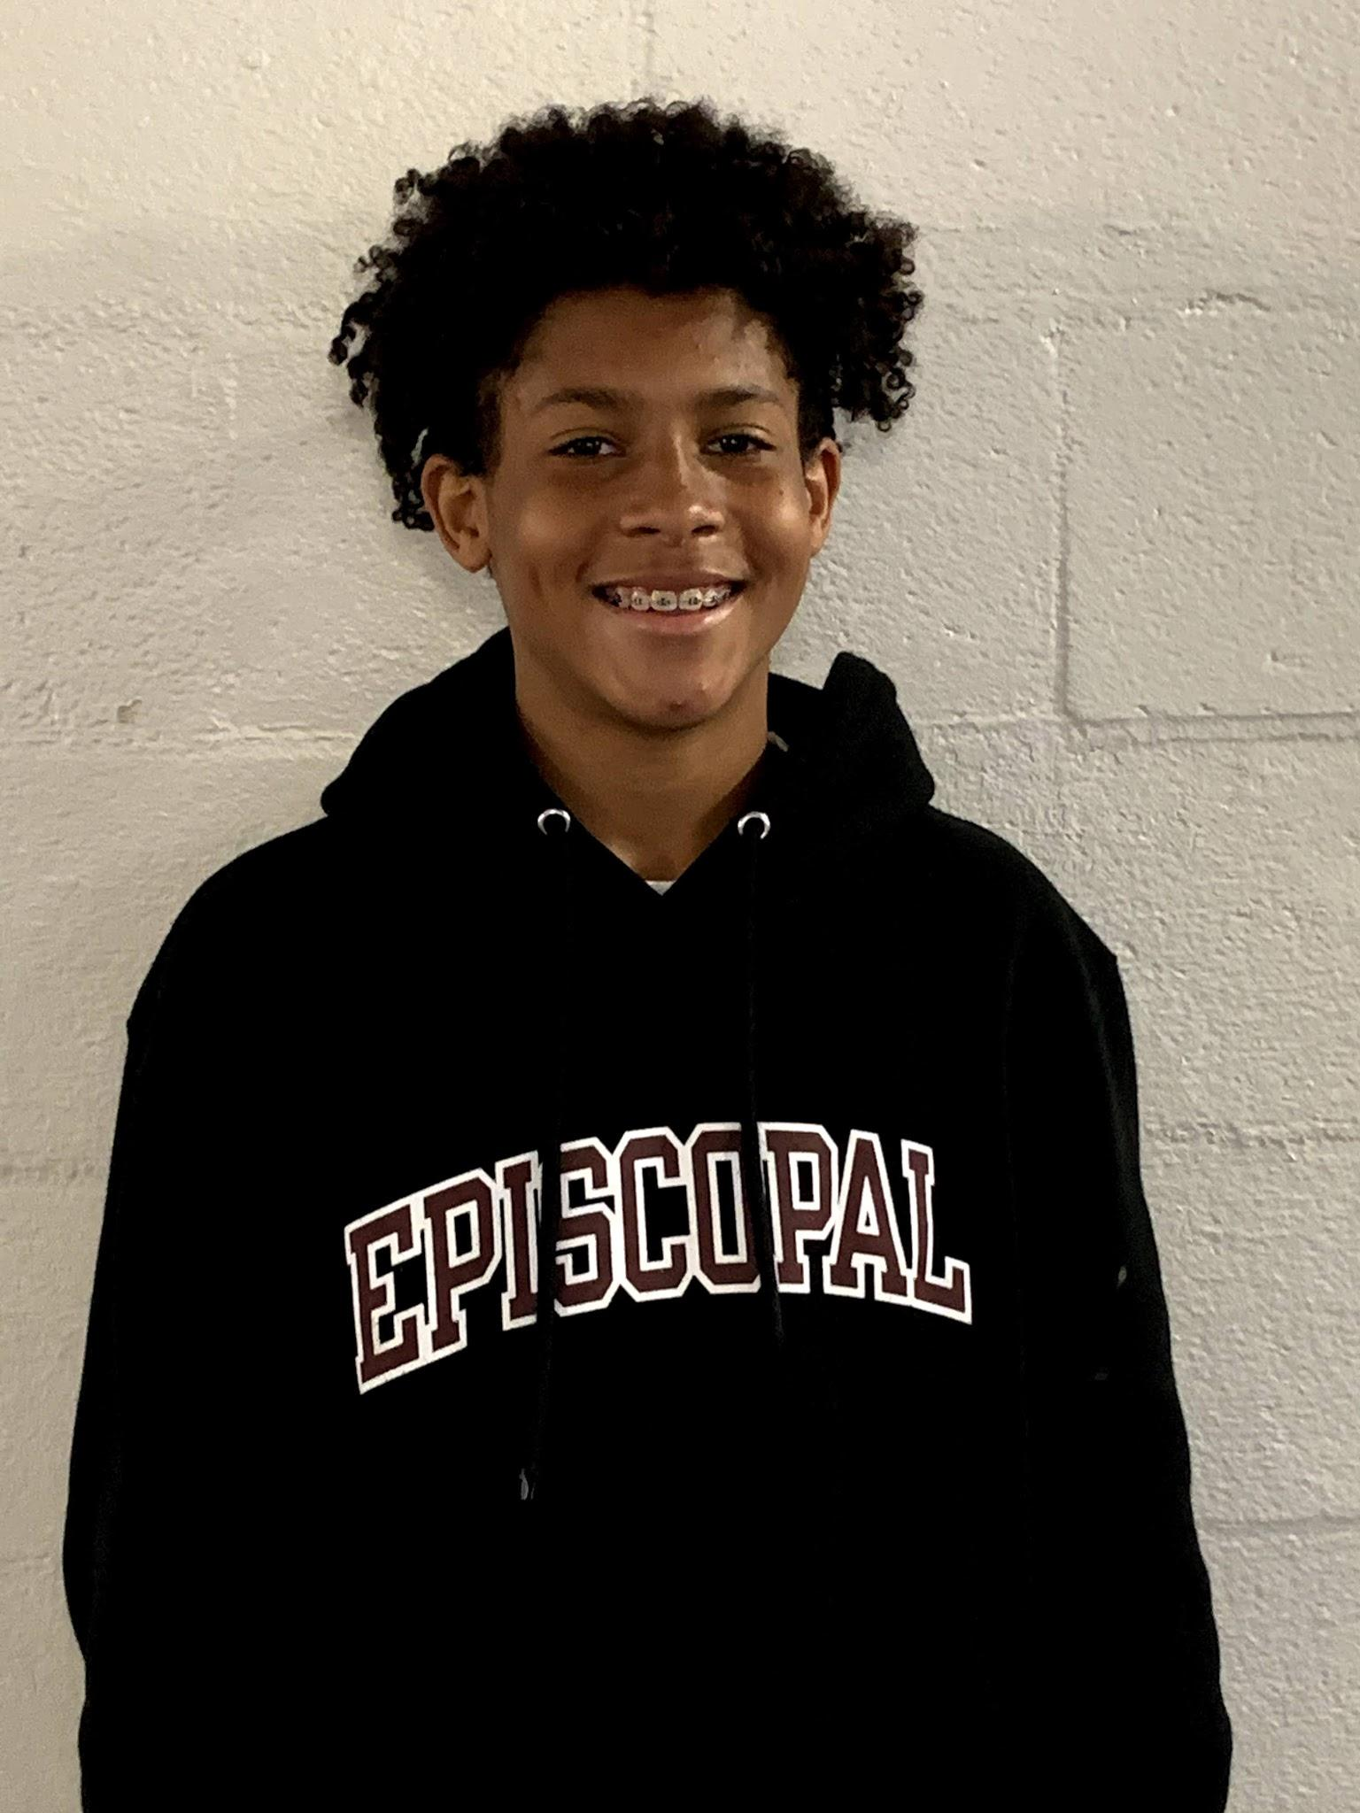
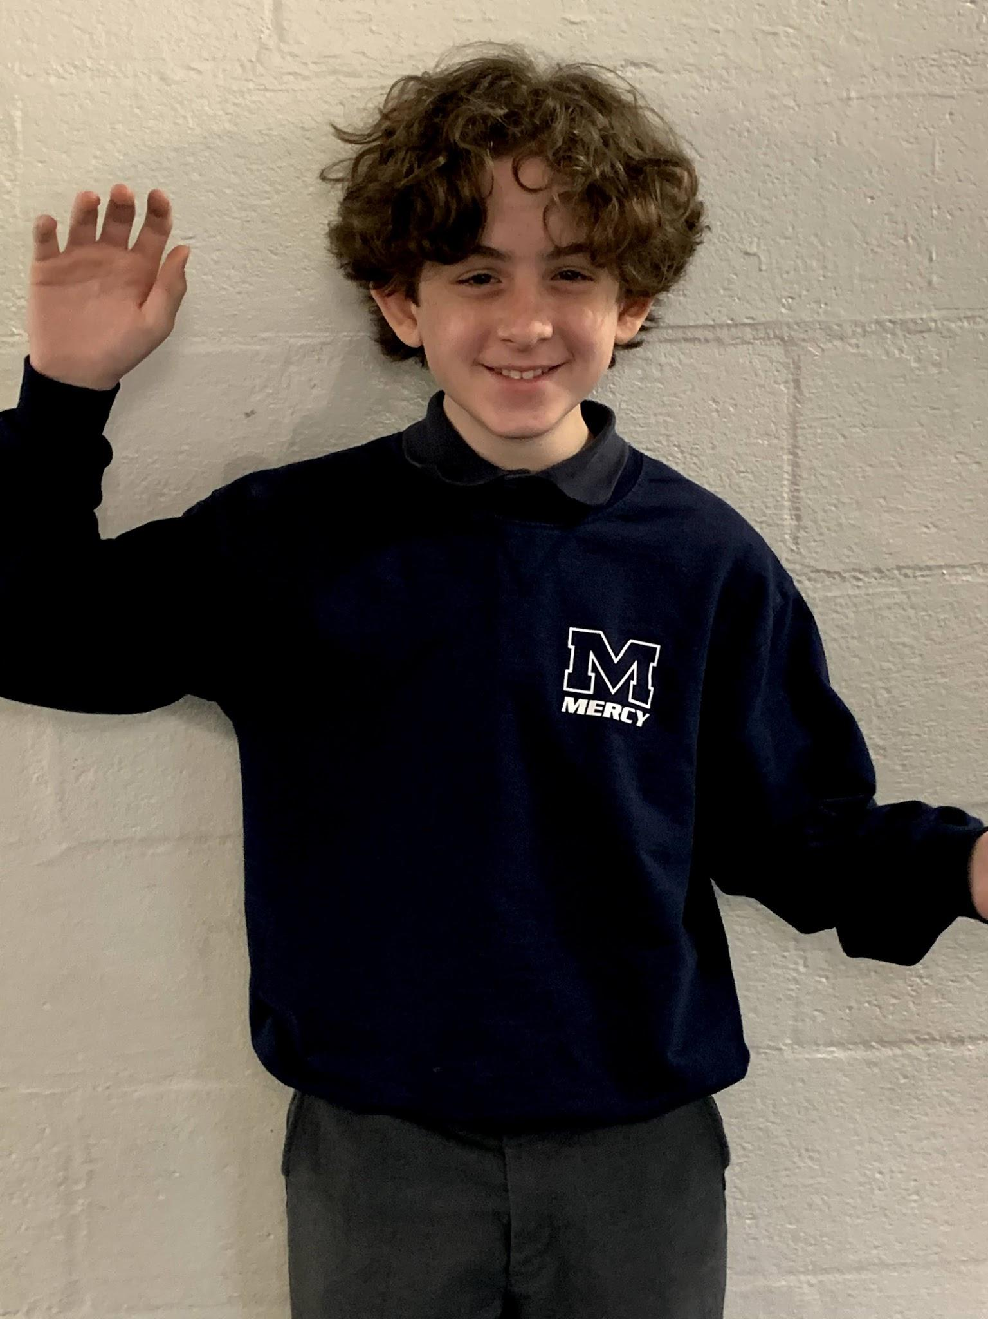
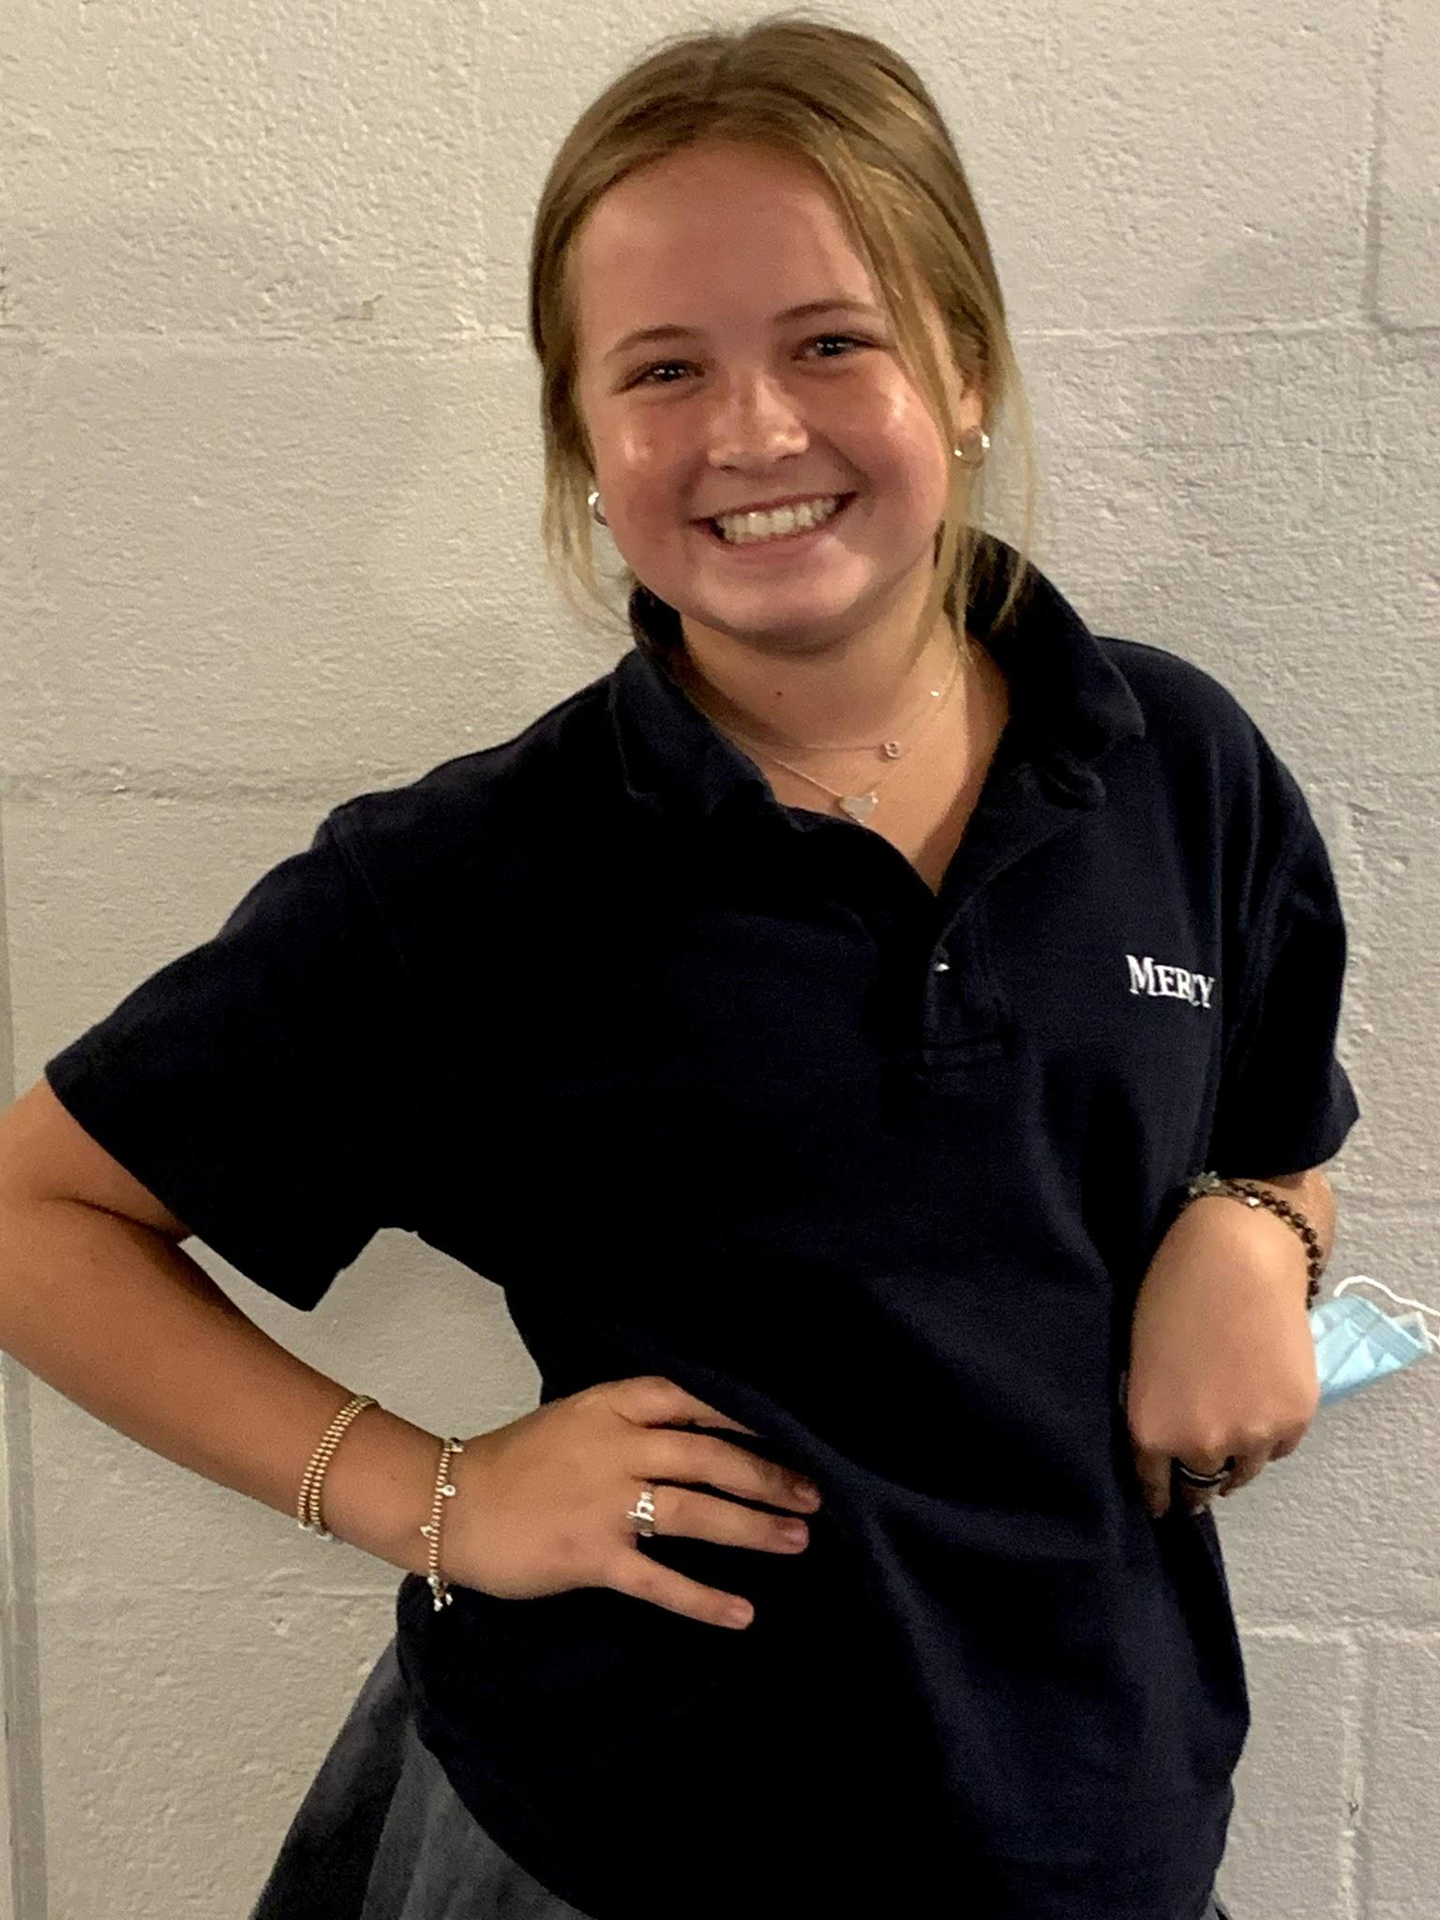
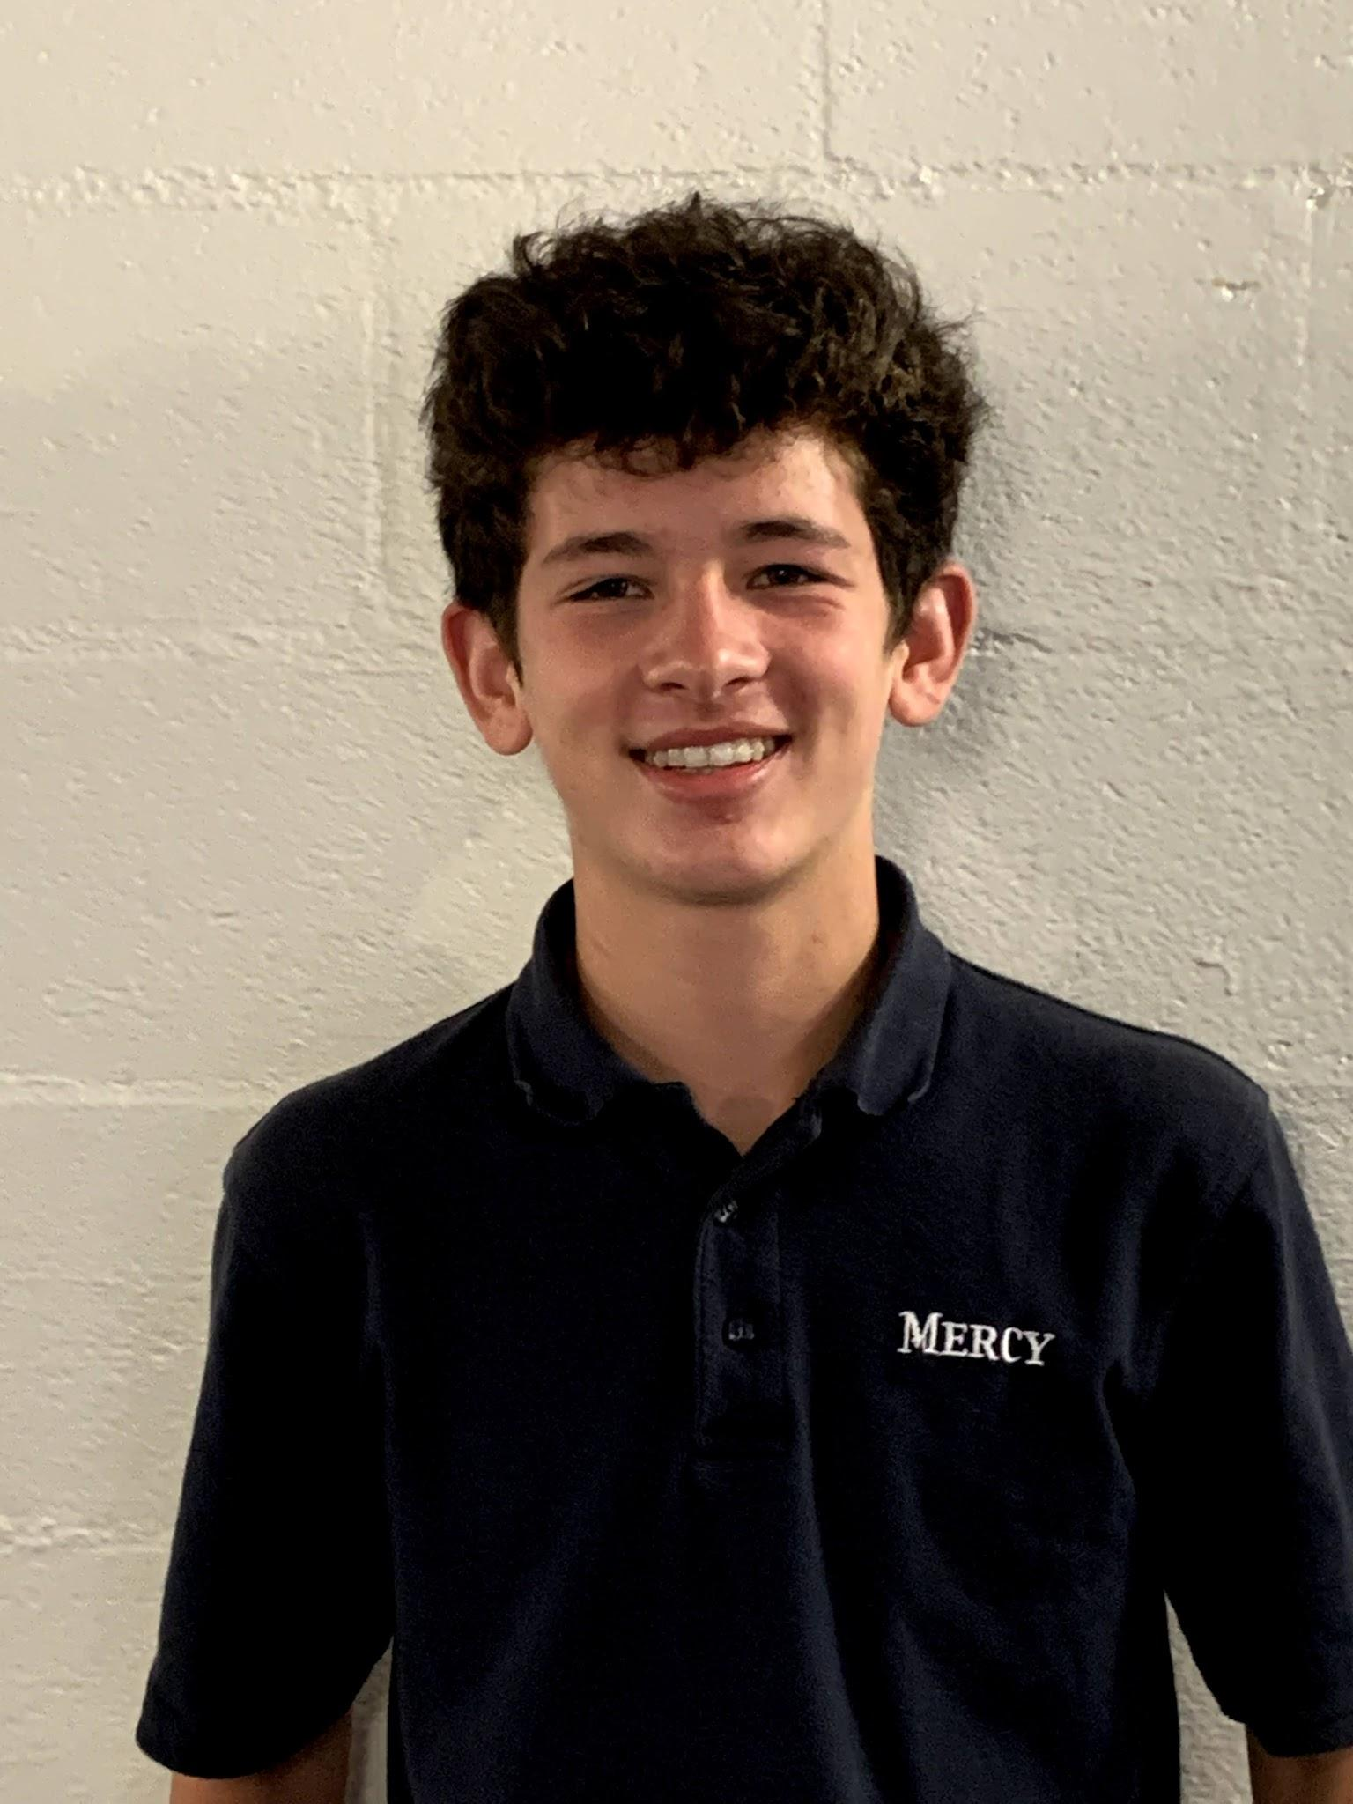
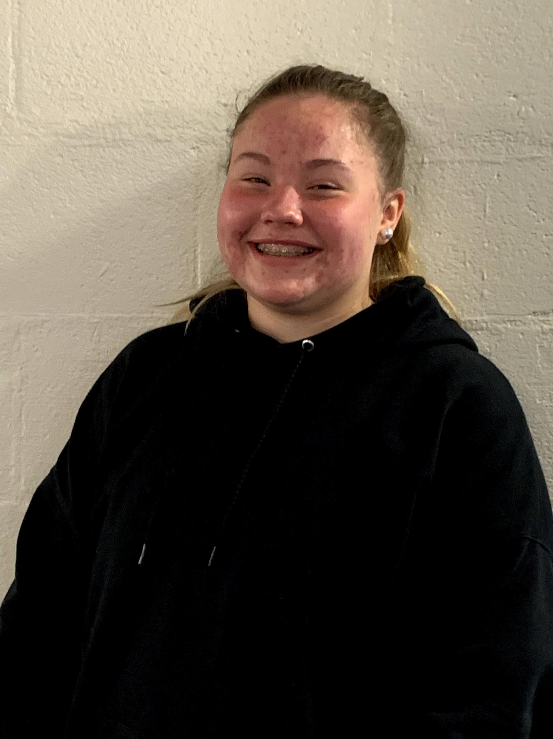
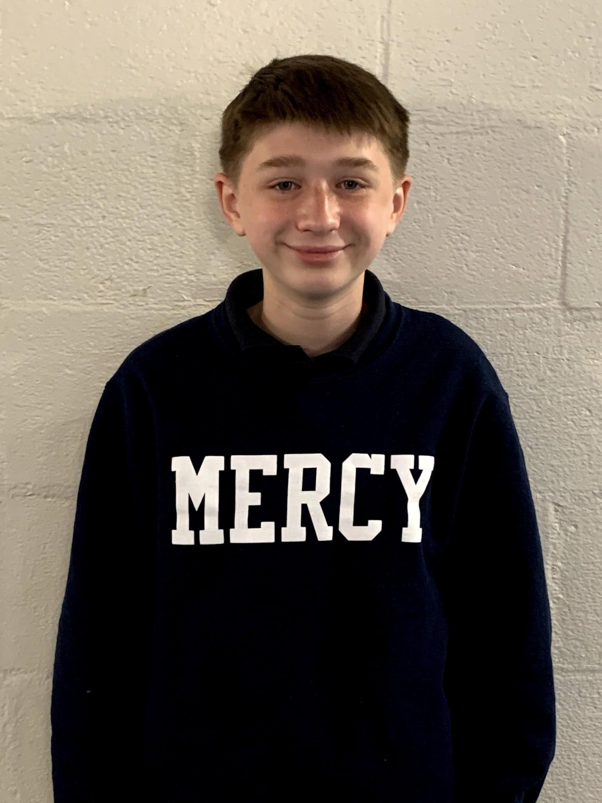
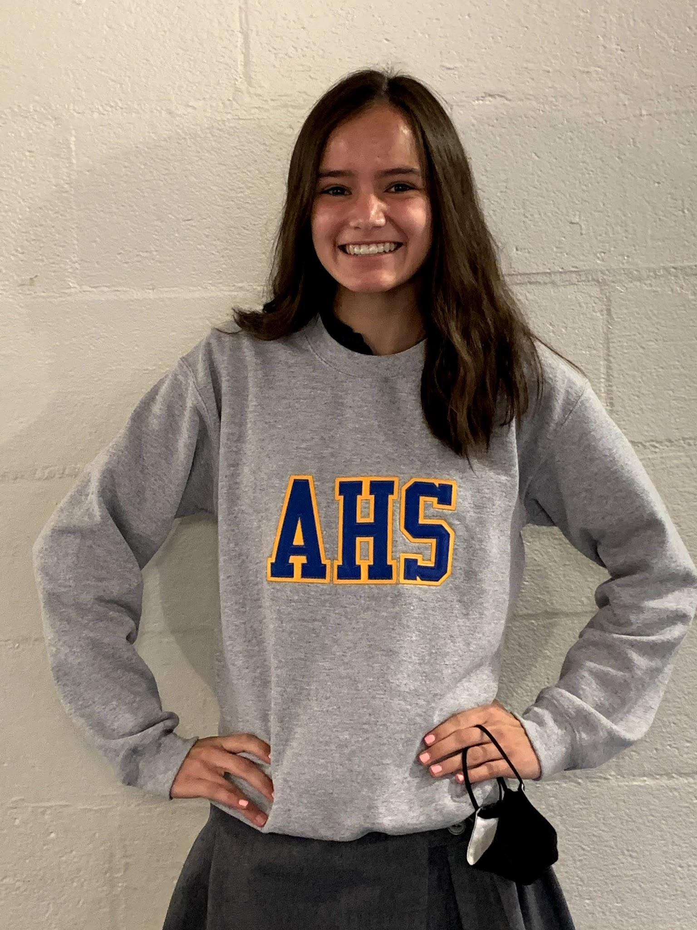
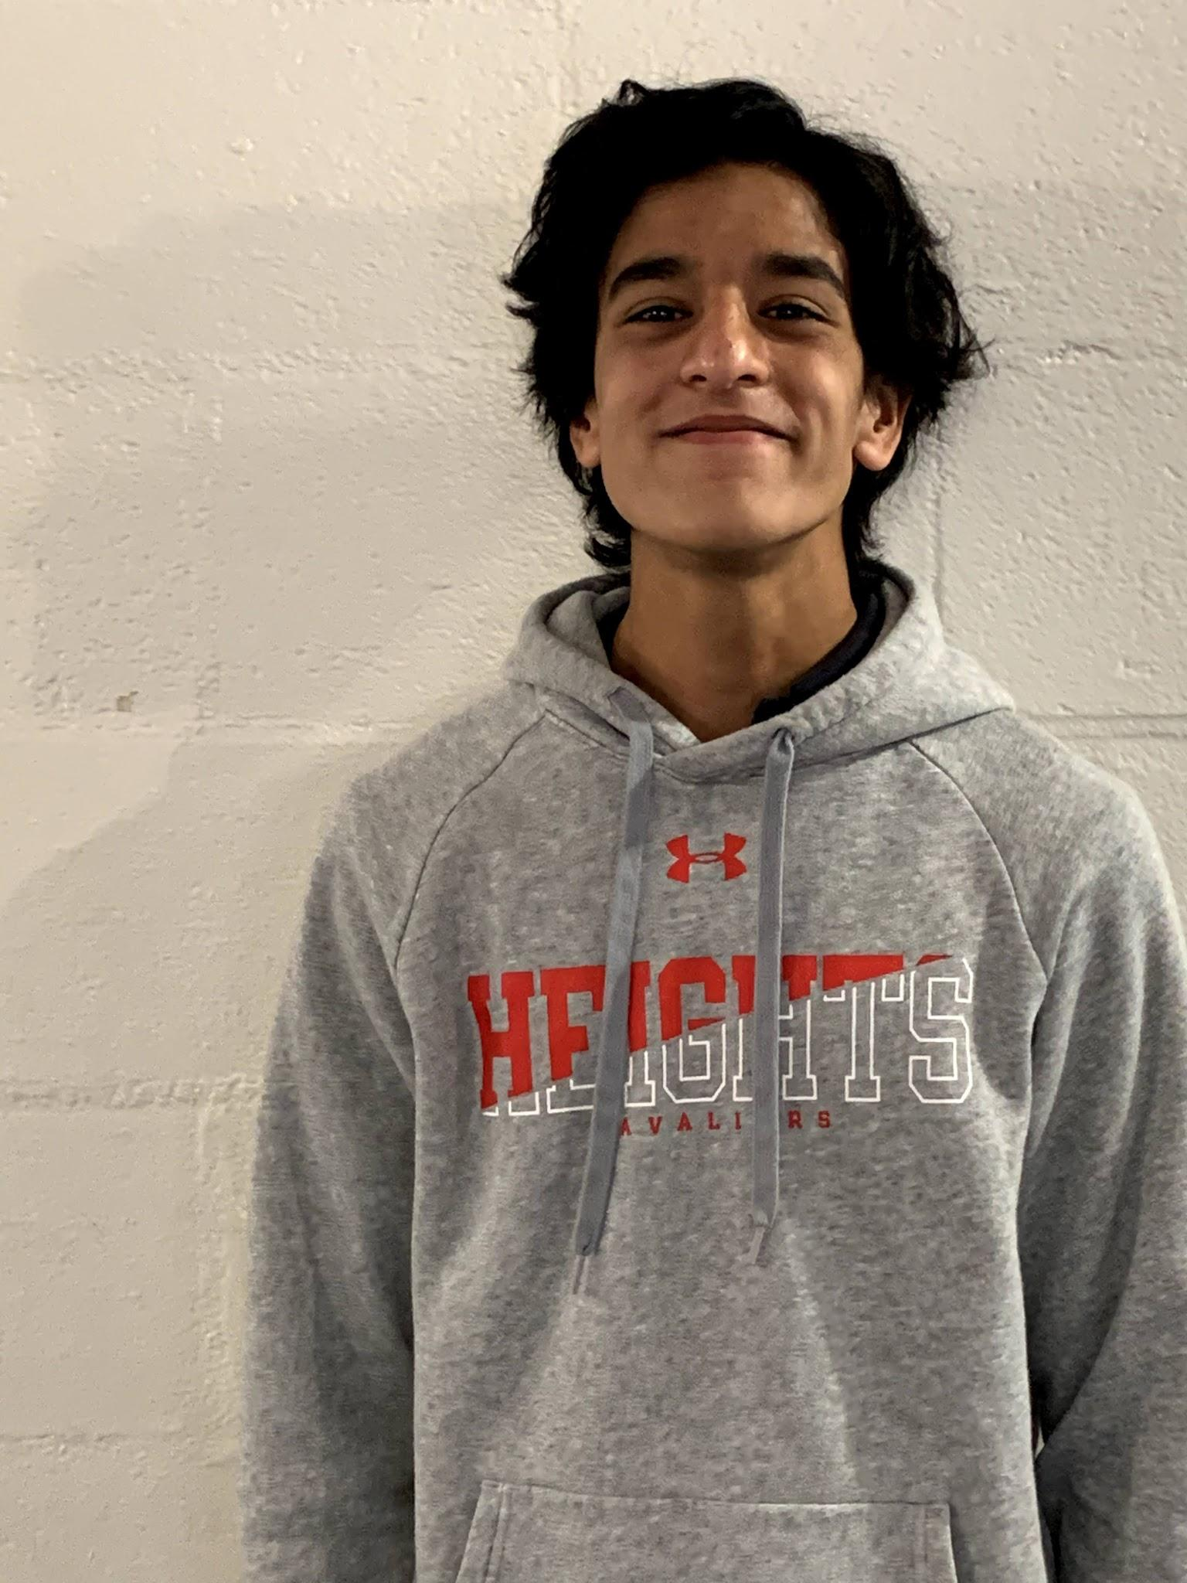
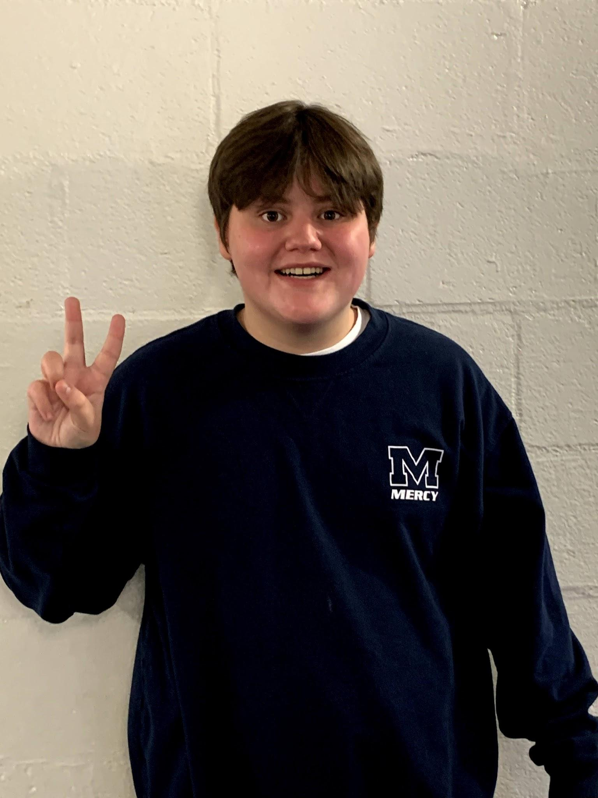
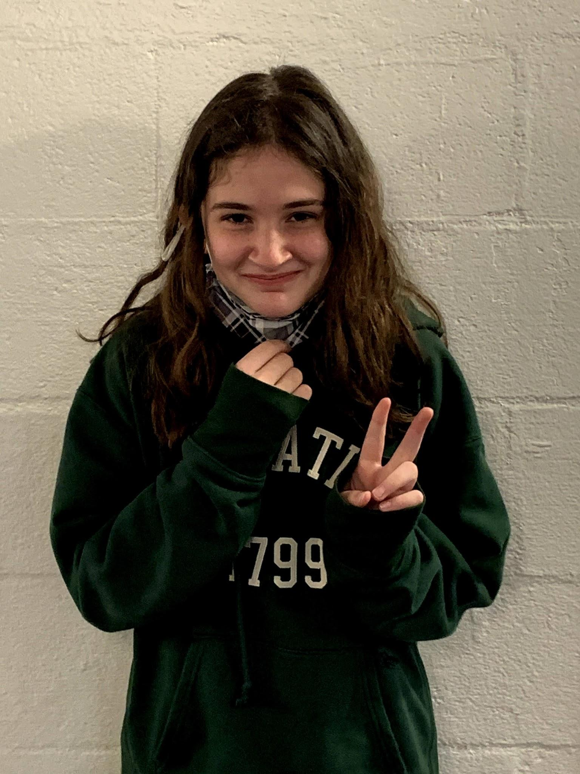

Slide 3
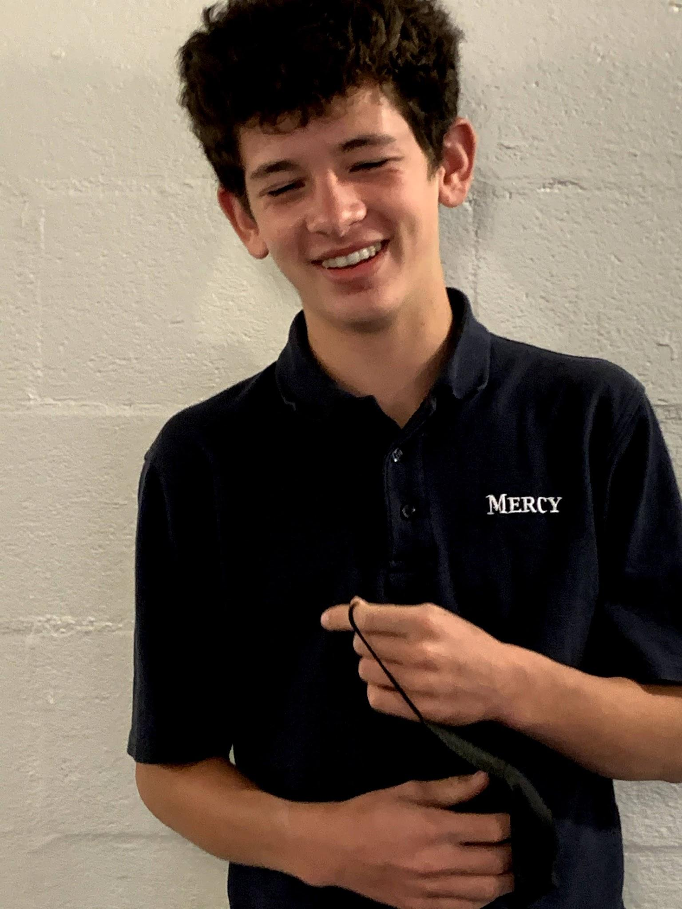
Big Mati B
My main man mati he makes me happy
When he's on the field he never lackeys!
His lushes skin and his beautiful hair cut by tang
It makes me wanna stand up and say hey hey
But i cannot sing so this poem is dedicated to him
The man. The myth the legend mati B man
He gets all the women and that's no doubt
The girls go to him like magnets
Whenever we go out
he so cool and has a special place in my heart
Have fun a prep man i loved you from the start!
By Tate

Slide 4
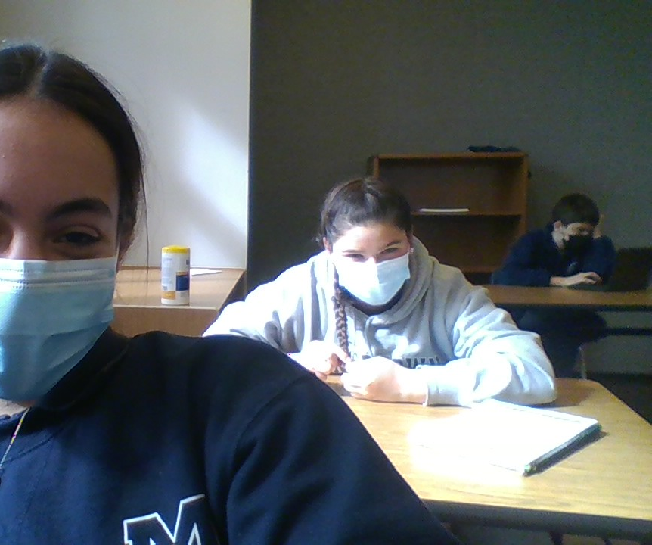
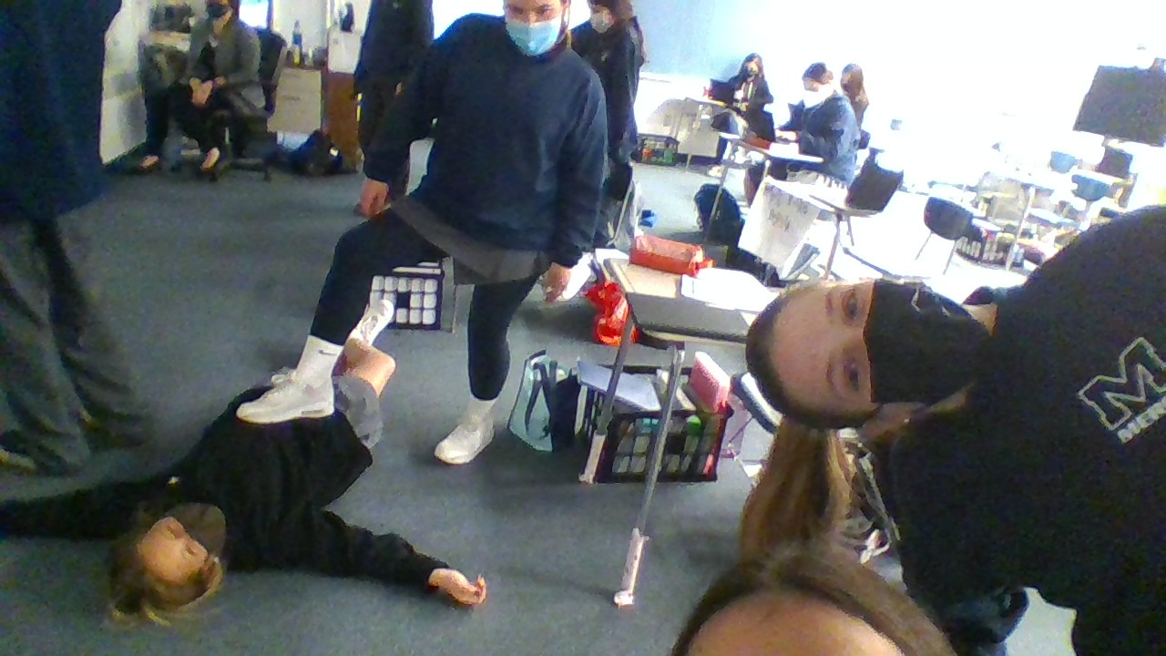
WHITNEY
Whitney is unique
She is very kind as well
Whitney is athletic, too
By: Evie Stamos

Slide 5
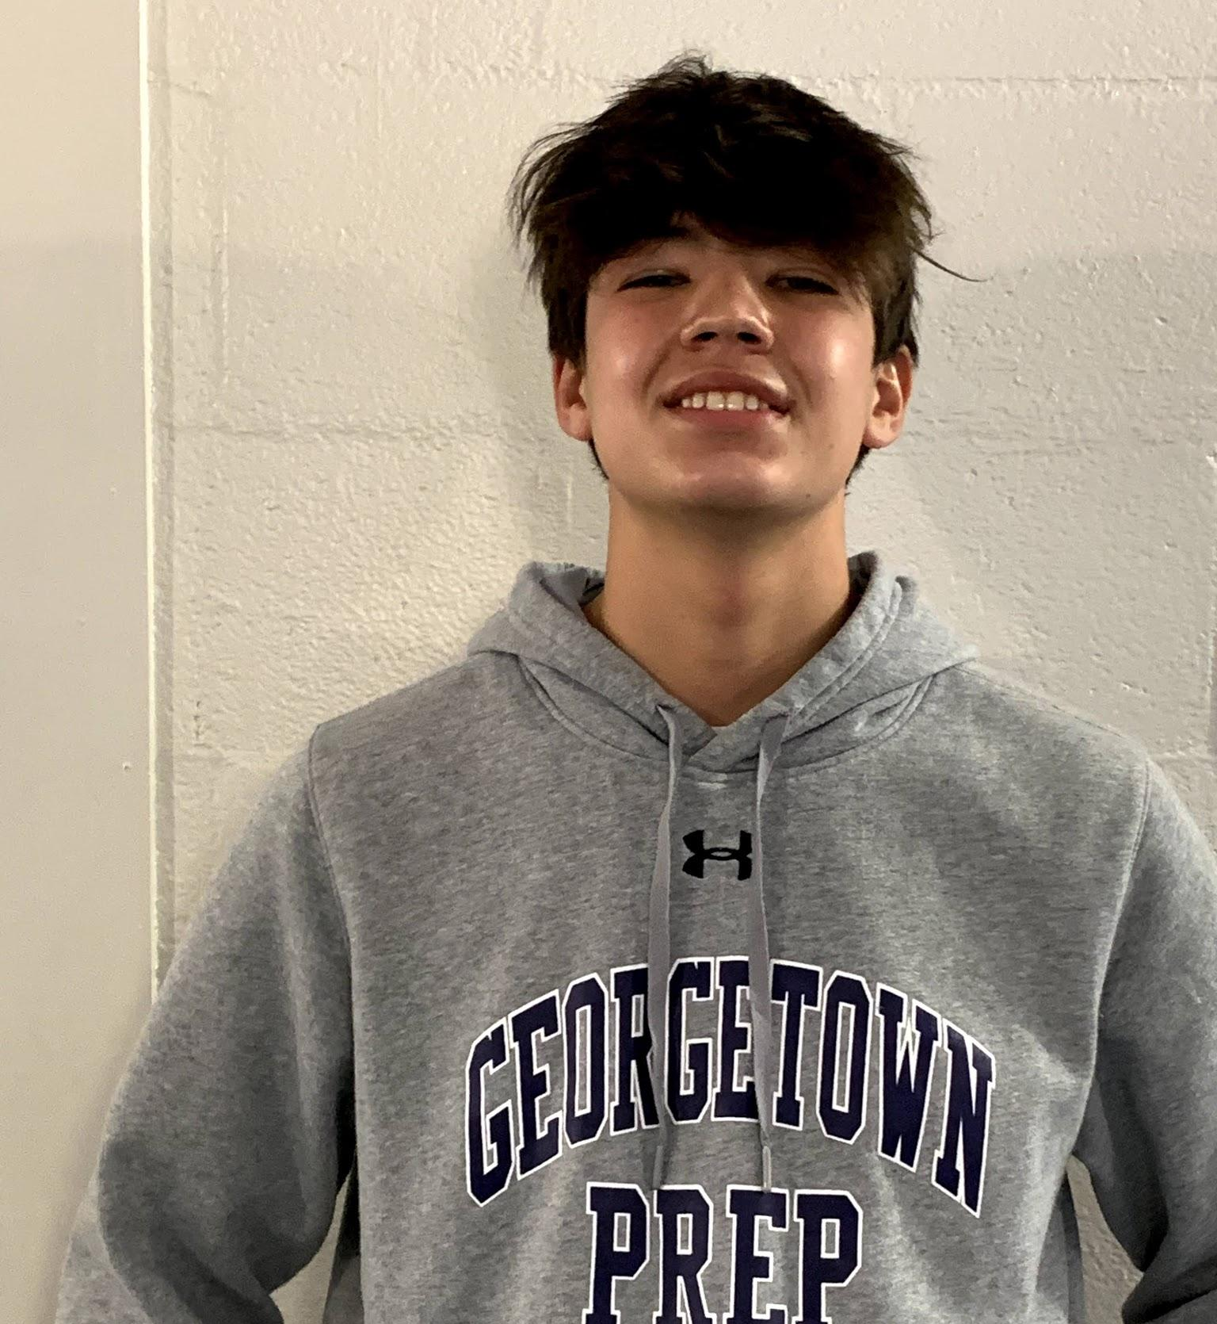
ALEX
He puts a smile on our faces
And he helps others with their work
He is empathetic, and helps those who are sad
He can even make teachers laugh when they are mad
He can talk to anyone and make them glad
That they met Alex, and they know that he is a good friend
By Sam

Slide 6
SAM
Sam is a very good at minecraft
He's a very good skater
He is no hater
With his fast fingers he can play the piano
And is good at other instruments
He is a very good friend
By Luis

Slide 7
Everyone calls you daddy
And you really come in handy
You’re always there to give me some candy
It’s always fun to play games with you and
Jamie
You’re so great at math, you’re super brainy
It’s gonna stink to leave you next year ‘cause I think you’re so dandy
Andrew
By Gabe

Slide 8
Gabe
Gabe, you’re always there
No matter what or where
You never turn your back on me
And you’re always nice guaranteed
You’re a kind friend
And someone to depend on
You’re also very good at soccer
And you always seem to look proper
I’m really going to miss you next year
Especially because you are dear
By Andrew

Slide 9
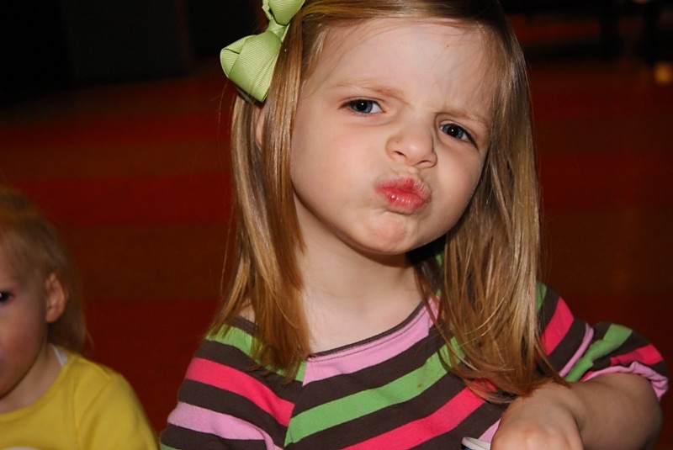
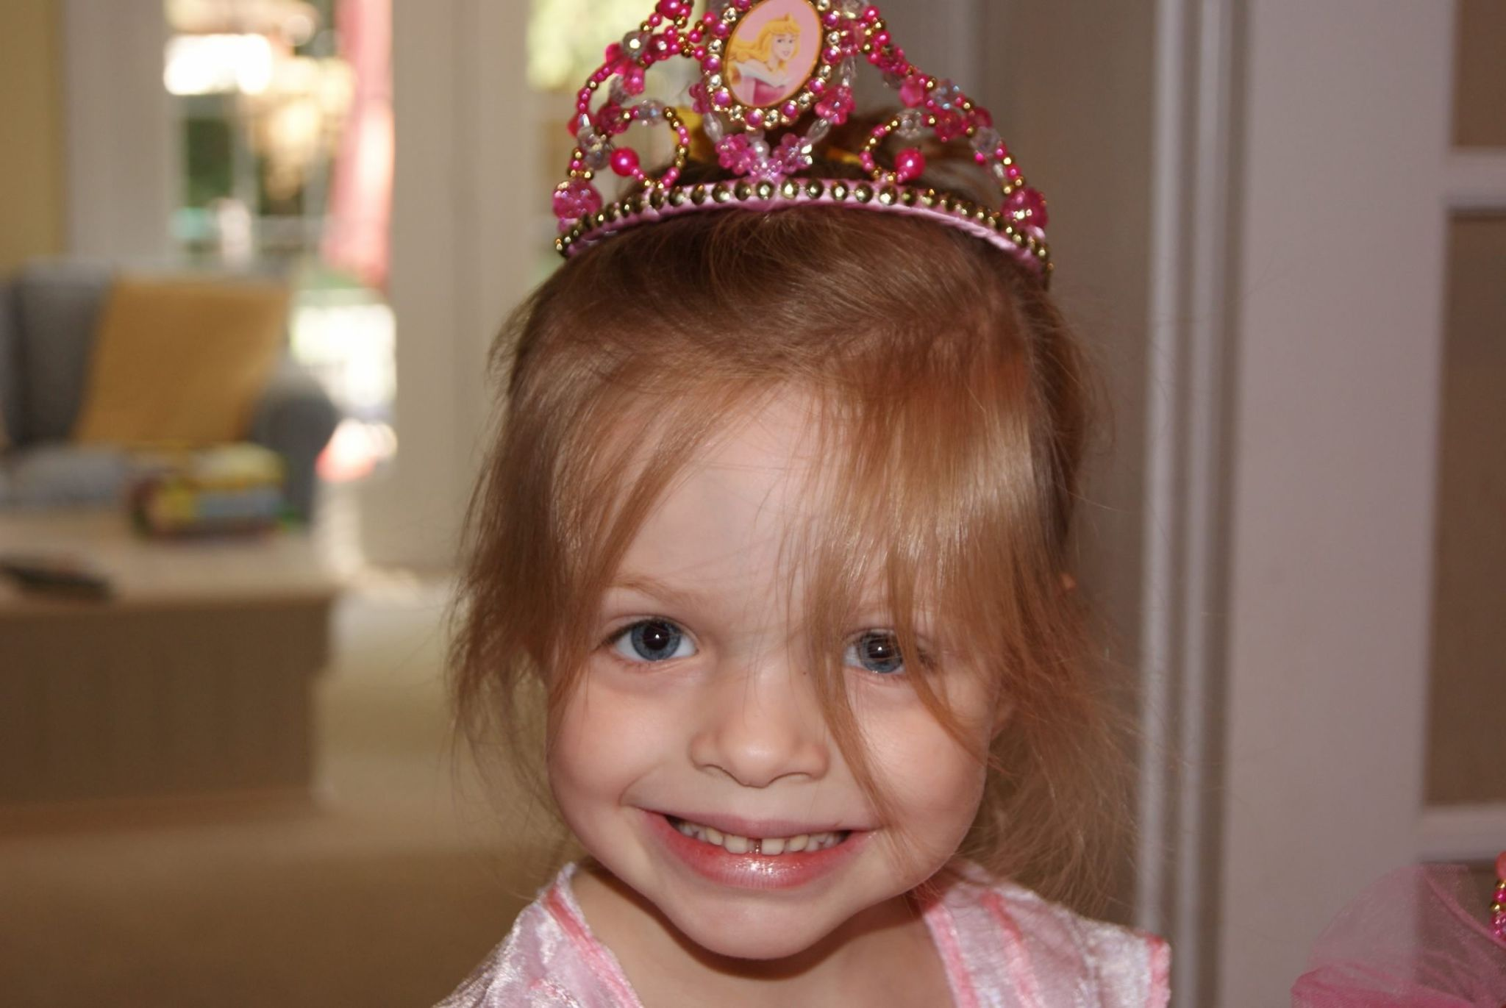
Sophia Beahn
my bean, my light, my world, my Sophia
although she cannot digest lactose, she consumes ice cream every night -
she is brave for that
sophia is intelligent and acts like she isn’t, that’s okay though
my wish for her is that she eats chick fil a one day
she becomes a cub next year, wow, moving on from a lion- that is so angelic
By Eloise
^^^a queen^^^

Slide 10
Carly
Where do I even start; to someone who I have known from the start
I have known you for nine years, and each one you have filled me with cheer
You often have a point to make; and when you do, you do not hesitate
You don’t treat anyone with hate; instead you spread love with haste
You never let anything go to waste; and you make the world a better place
By Jake

Slide 11
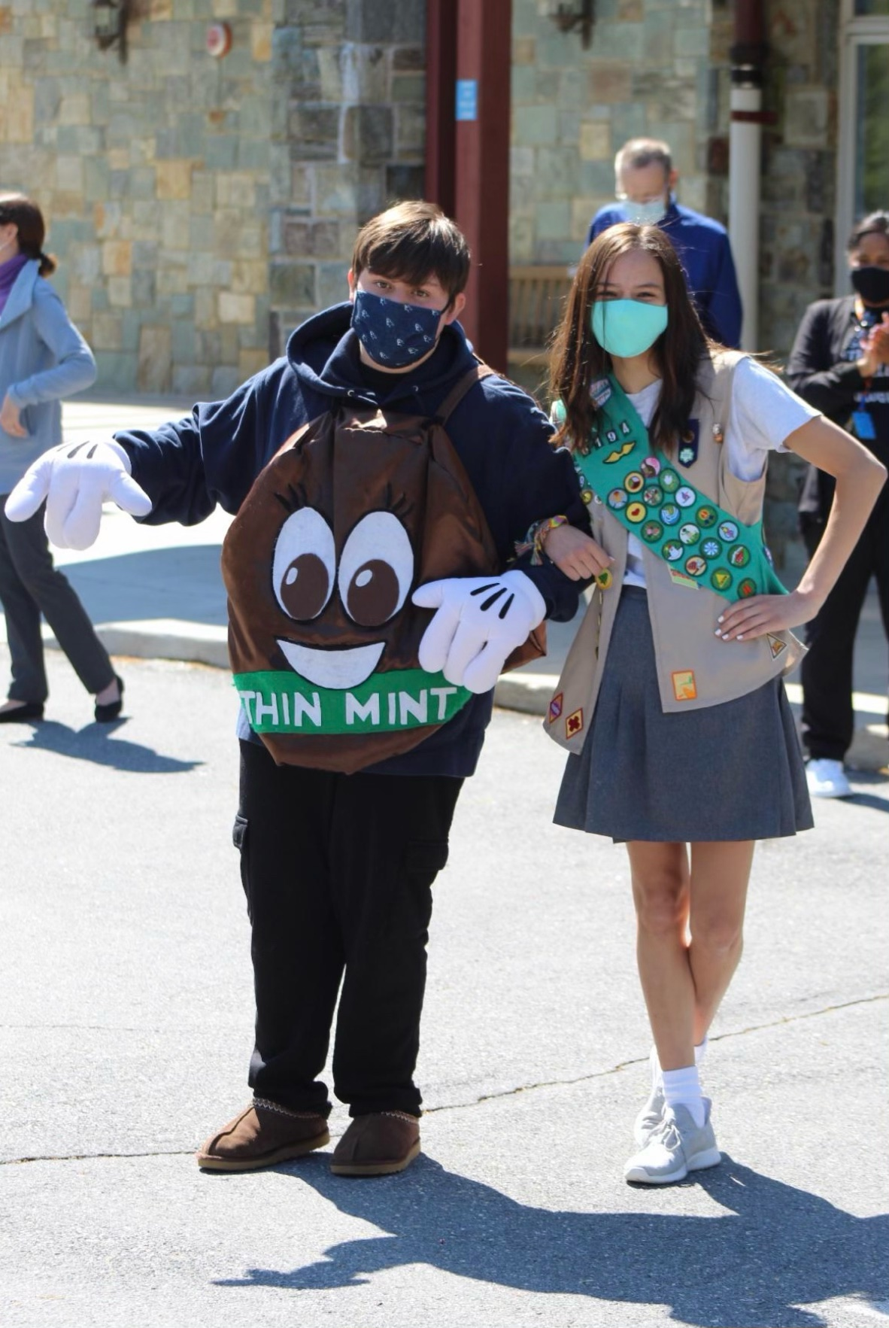
Drew Kelly
Drew is my very best friend, he is never a bore,
We’re alike in many ways, but there are some differences that I adore.
He is never afraid to speak his mind,
Doodles inside his notebooks you’ll find.
A bunch of homework will make him pout.
A tough cookie he is, he’ll knock you out.
He makes my days better with his comedy,
He is the best in both quality and quantity.
When it comes to cookies, he’s thinner than I,
He is such a super cool guy.
In a year he’ll be at Good Counsel, enjoyment galore,
Drew Kelly is truly never a bore.
By
Anna
Bartow Kelly IV, don’t ever change!

Slide 12
A Guy Named Sky
To that friendly distance-learning guy,
The one I’ve named “Gamer Sky,”
It’s been a pleasure knowing you;
You’re smart and nice and funny, too!
We’re about to exit Mercy’s door;
Middle schoolers we’ll be no more.
You’ll go your way, and I’ll go my own;
And if you should ever feel alone,
I hope you’ll know with certainty,
You’ll always have a friend in me!
By Levi

Slide 13
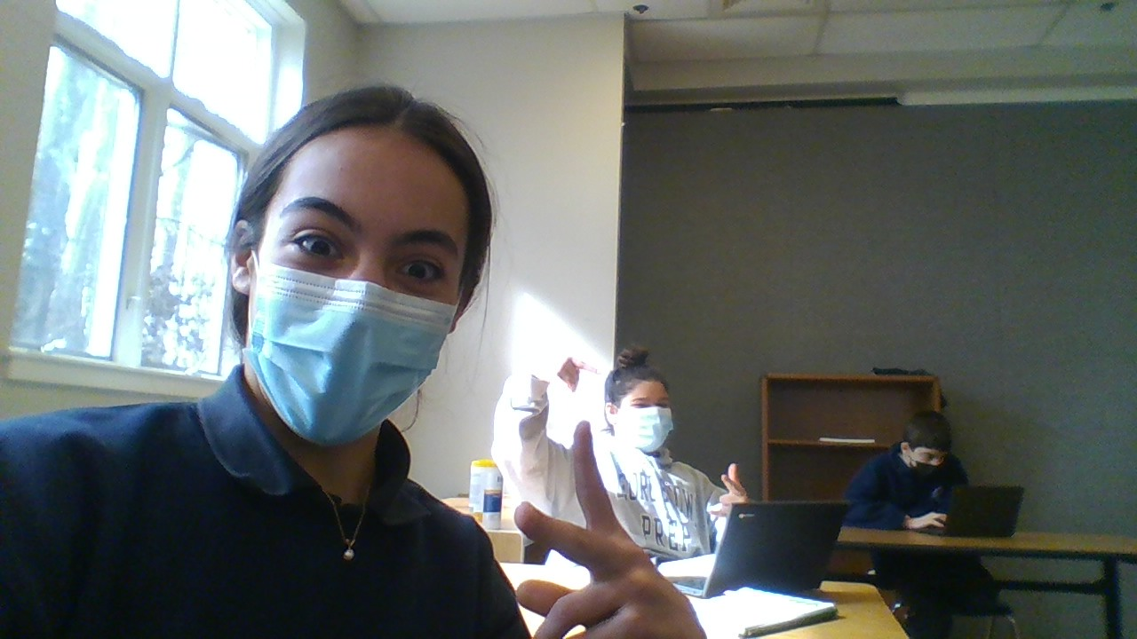
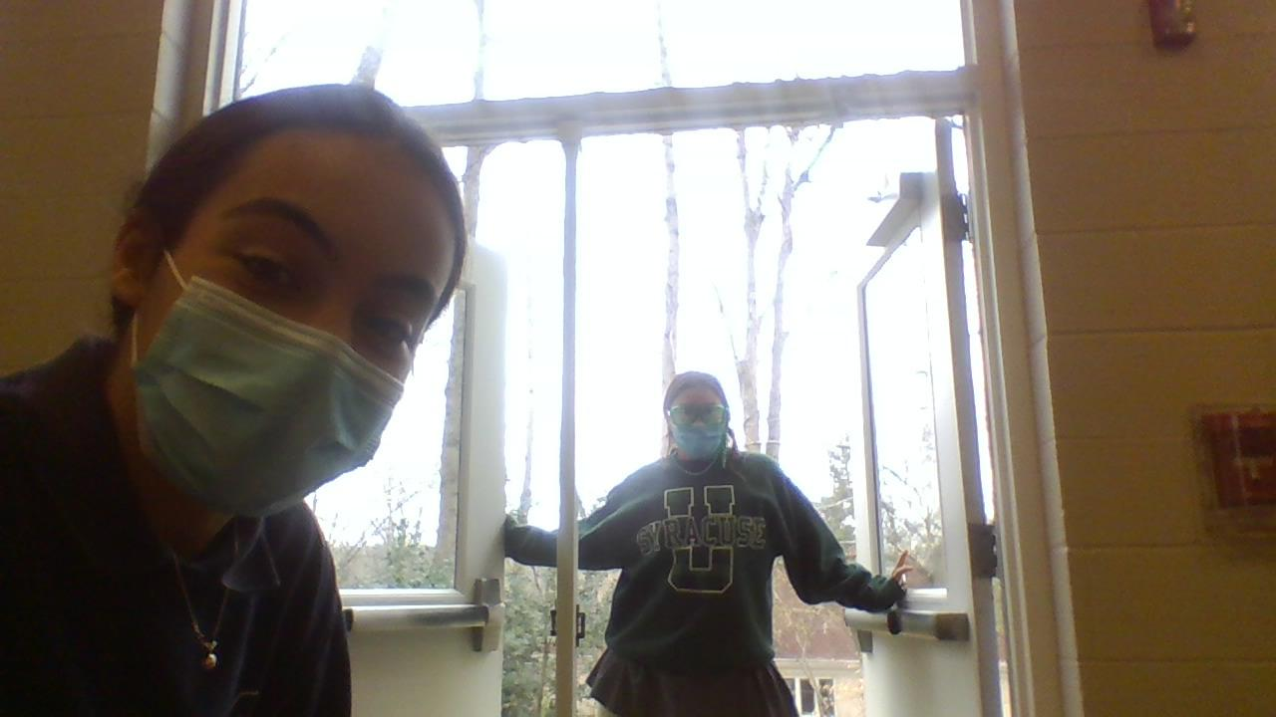
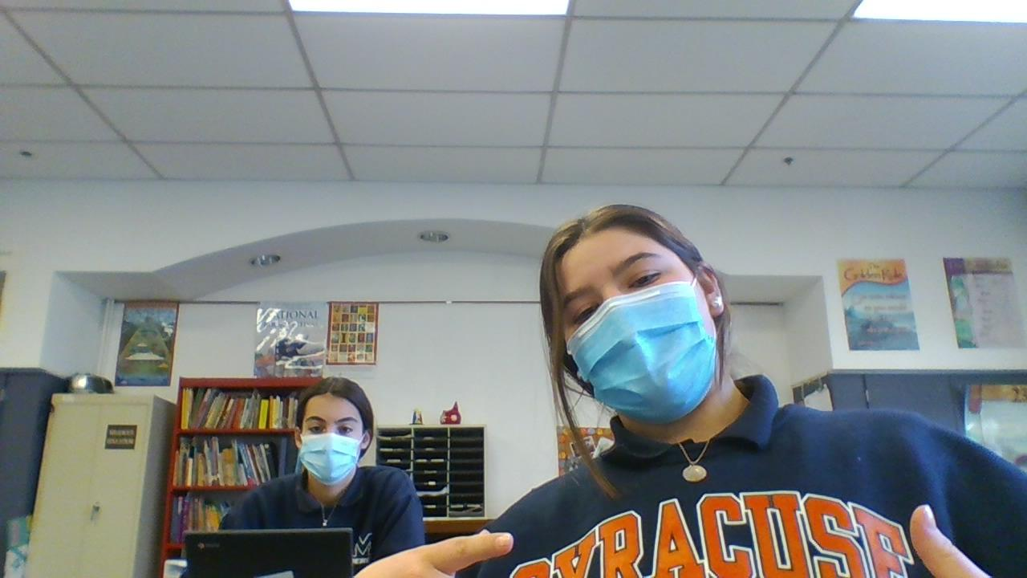
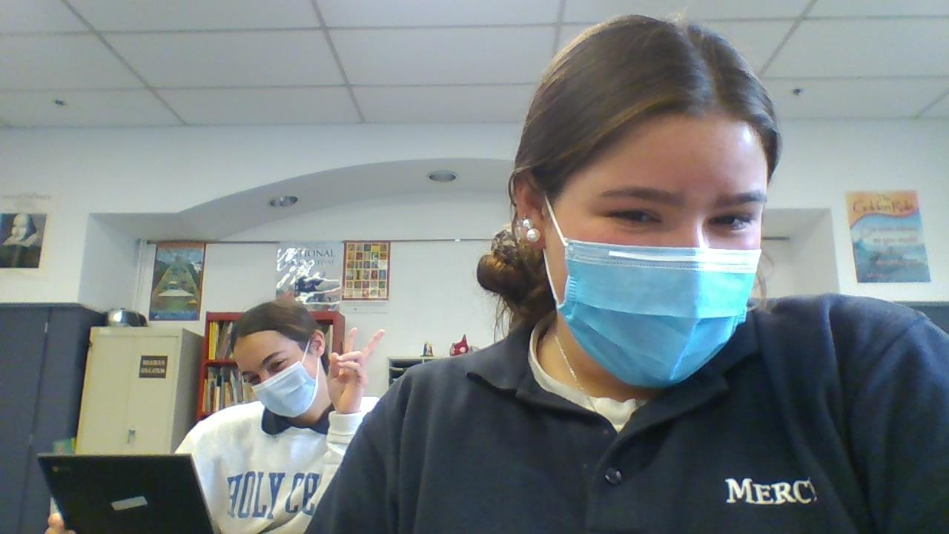
EVangELINE stamos
♡
♡
Evie is cool
She's a goddess
She is fun and funny

Slide 14
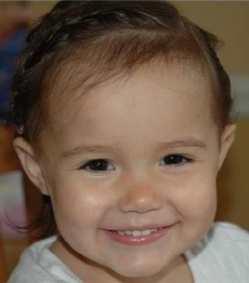
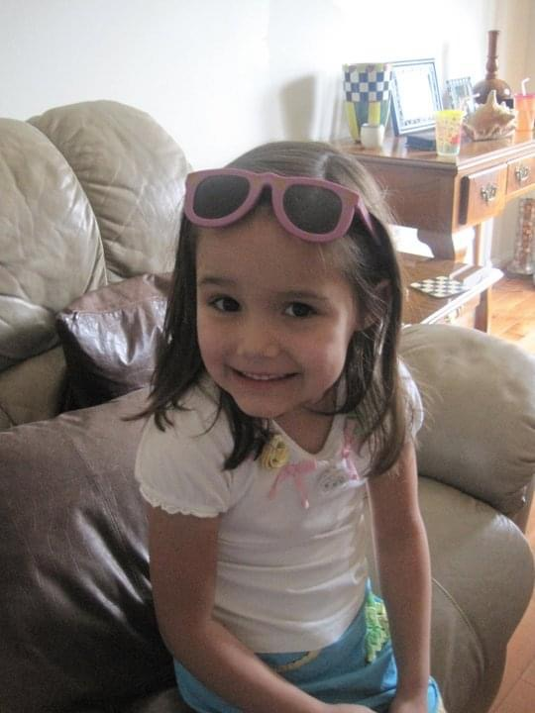
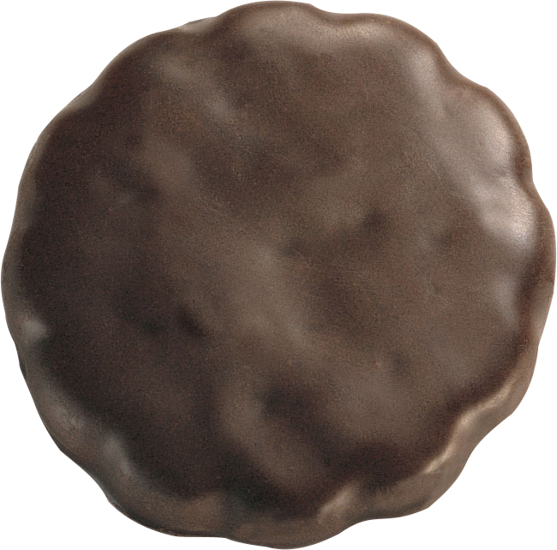
Anna Luther
Anna is my very best friend,
Our minutes on facetime have no end.
When it comes to math Anna needs no hint,
She’s the girl scout to my thin mint.
Skirt just above her knees, she’s very modest,
When I call her my phone overheats, Anna’s the hottest.
Proofreading her essays are sometimes a task,
She’ll give you her math answers if you just ask.
Just like me, she’s a grade repeater,
Anna can run very fast, in her Costco sneakers.
The Office is a show she never stops watching,
And if you bring up k-pop she never stops talking.
Watch out California, she’s on her way!
She can always brighten up your day.
My source of happiness, yeah, Anna is my essence,
I don’t know, I just like her presence.
By Drew
*This is an inside joke*

Slide 15
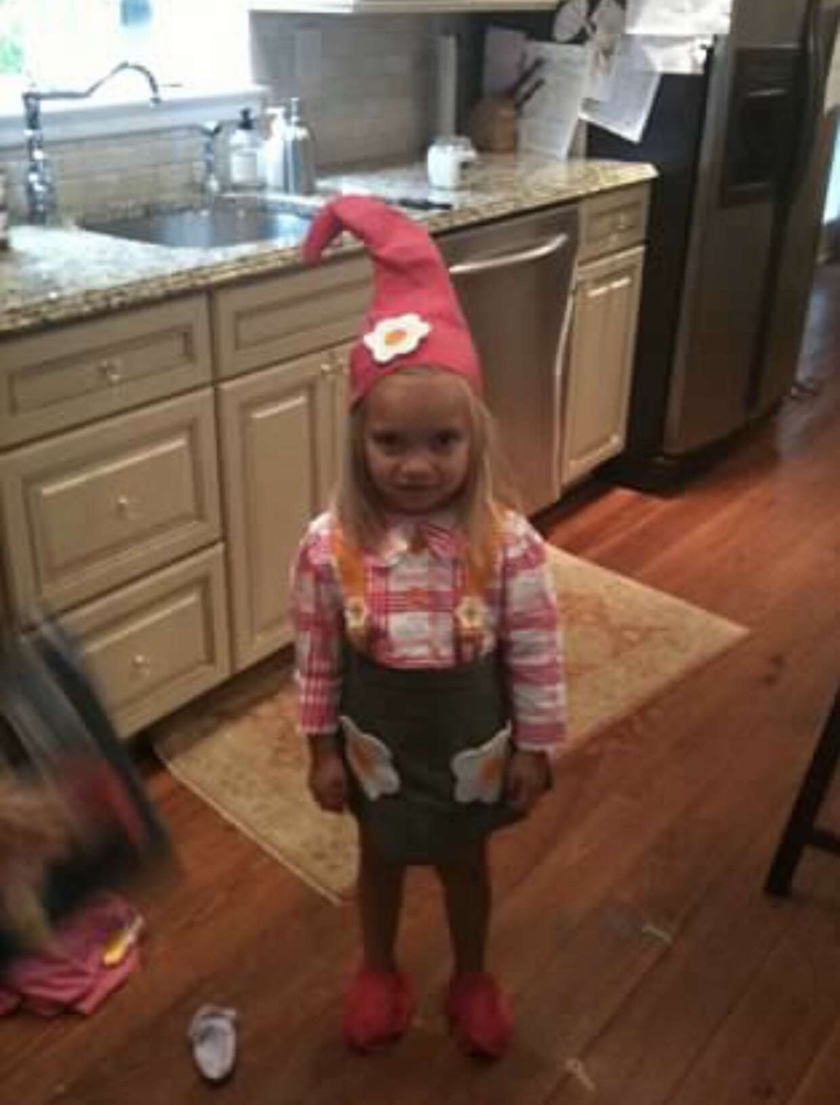
My Lila
Where do I begin,
Your smile is like a rainbow
That overflows the sky with it’s glow
Red, for taylor swift's album, that you listen to all the time.
Orange,for all the carrots you eat, so your eyesight gets better. But, it is obviously not working.
Yellow, your favorite color and the sun because of the way you shine as a friend, at mercy, and the future to come.
Green,for the color of what you fear the most.
Blue,for the tears you cry, but you overcome.
and Purple,for all the.. Well there is not much purple, but for all the flowers that bloom, like you. You have bloomed into a woman these nine years I have known you, and I’m proud of you and for all your future success at Visitation and beyond.
Always remember the rainbow, the beautiful rainbow, you have formed throughout your life.
yours truly, caroline humiston

Slide 16
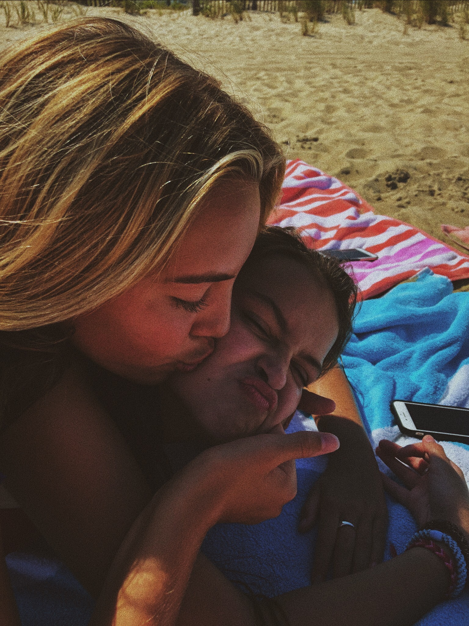
Sweet Caroline
By: lila horrigan
My sweet caroline
Plain Cheerios and buttered noodles
Your dirt colored eyes are like jewels
Meet me at noodles & co
Where we used to go
Years ago
Your dark luscious hair
Your long legs that take you nowhere
You hate running
But it's okay because you are stunning
I’m sorry for hitting you with a straw
It really must’ve hurt your jaw
You really cannot read
But you can still succeed
Because that is guaranteed
You have been my best friend
For years on end
We will be split
And i can admit
I will miss you so much
My sweet caroline

Slide 17
Luis is a soccer goalie extraordinaire,
His comedy lightens a room
He is a gifted artist.
LUIS
By: Alex Gutierrez

Slide 18
LEVI
You are kind and nice
Fun to be around and joke with
And you’re a good friend
BY Sky

Slide 19
Jake:
I don’t talk to Jake very much
But he’s a nice guy, just a hunch
He is kind and never fights
He always tries to do what is right
I know he gets good grades
But he’s more than just big brains
Now he’s a bulldog, so watch out prep he’s on his way
By Carly

Slide 20
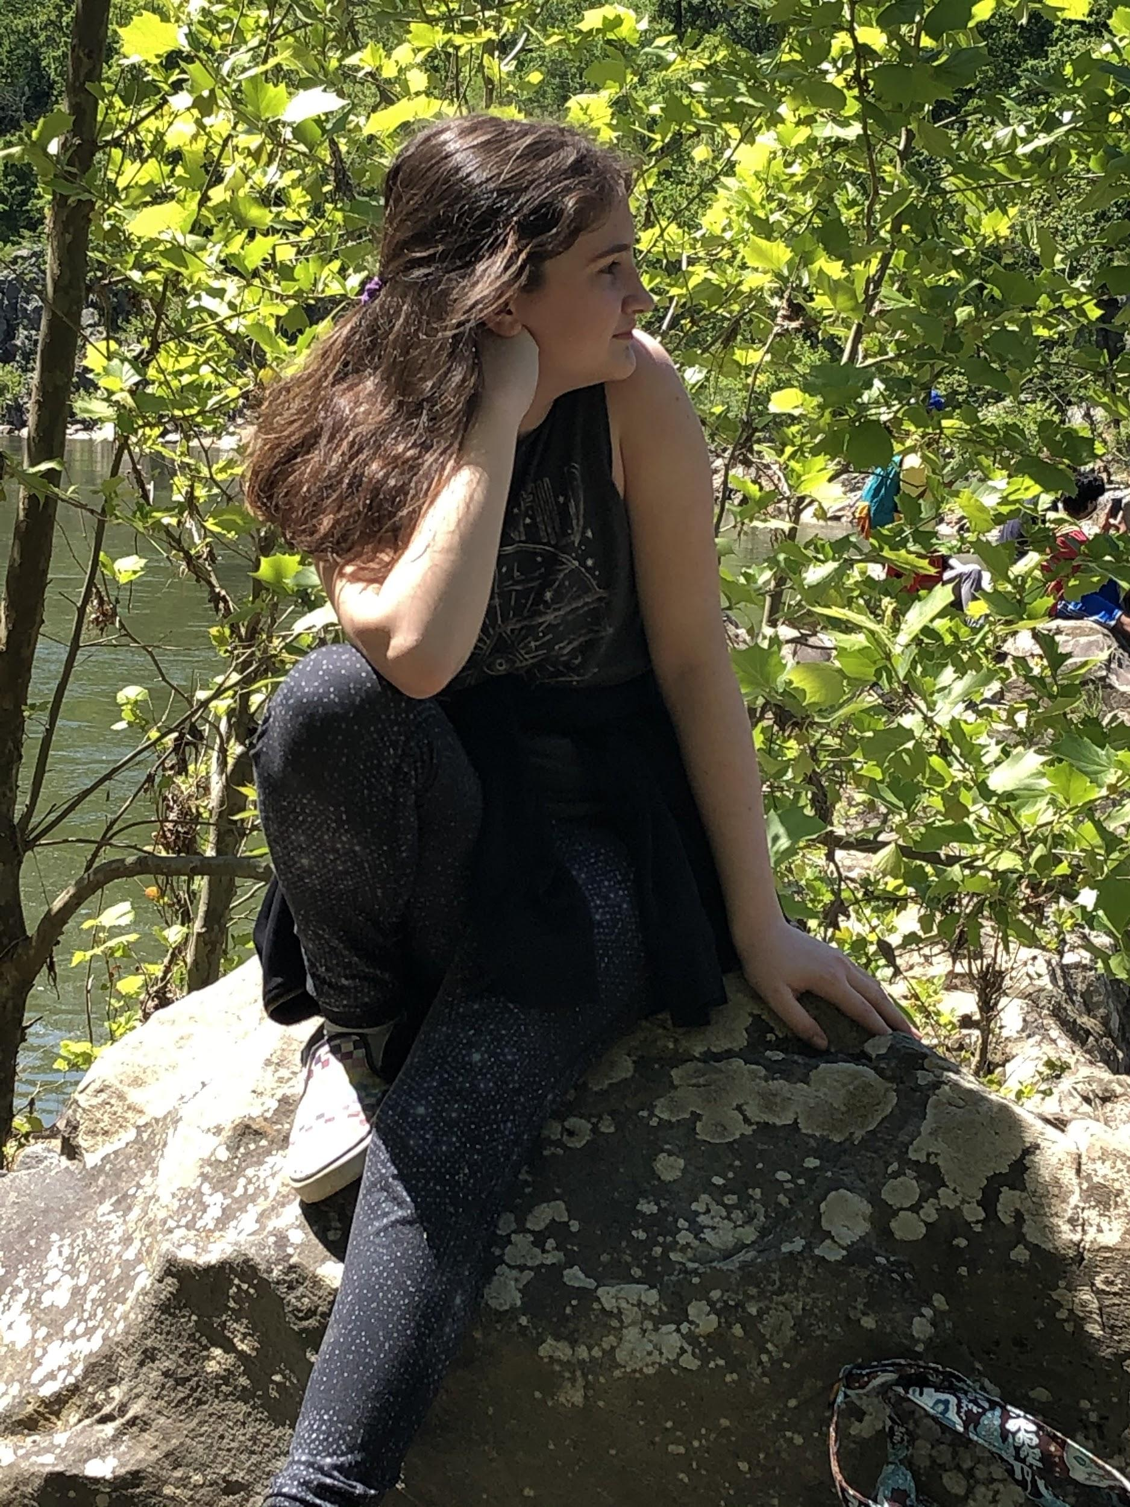
Poem for Mary Clancy by Caitlin Dougherty
Miraculous
Amazing
Radiant
Youthful
Charming
Leader
Admirable
Nice
Cool
Young

Slide 21
Caitlin
Working hard, every day.
Trying and trying to find the best way.
Though I know you will succeed,
You own mind tends to mislead.
Even when put to the test,
You outshine all of the rest.
Reading books tell the end of days,
You help your friends in marvelous ways.
Even if your best qualities you tend to ignore,
You are incredible, and so much more.
By Mary

Slide 22
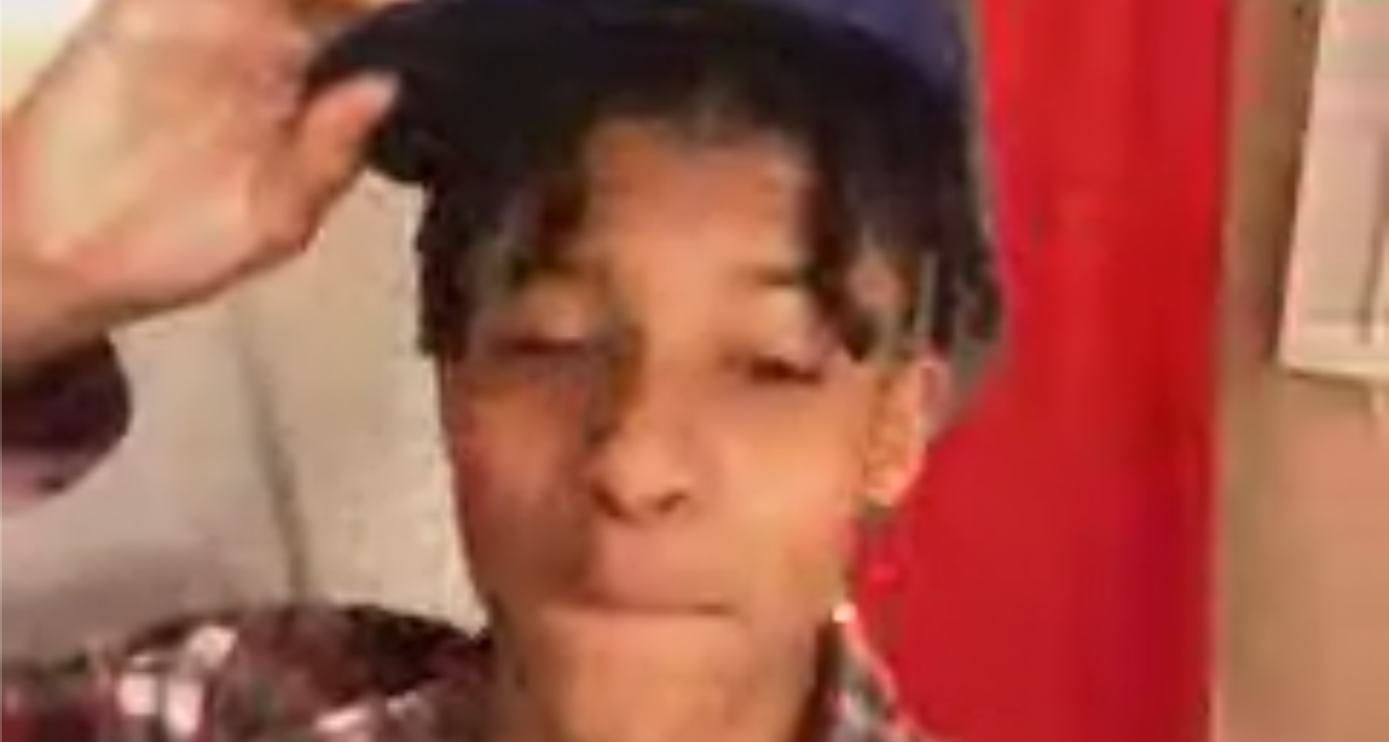
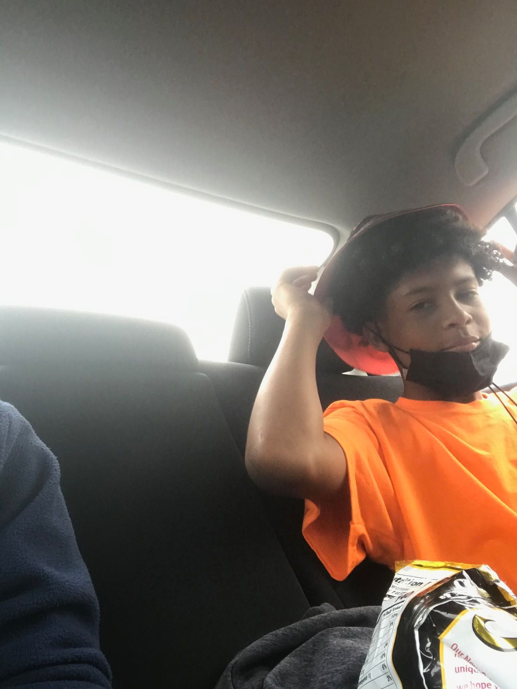
Tateyboo
Oh my guy Tate where do I begin
All he gotta is do keep on ballin’
Man is hot as (you know what)l
Always looking as clean as the sound of a bell
Athleticism is insane y’all
Any sport he plays he makes the other team fall
Even if he’ll go D1
He’s getting A’s just for fun
Ye bro is a G.O.A.T.
To me he’s like a Rolex in gold
Hey Episcopal,
With man like this you're gonna have your hands full
Oh my guy I’m gonna miss you my guy
It's hard to say bye bye
Tate just looking fine -------------->
By Mattias

Slide 23
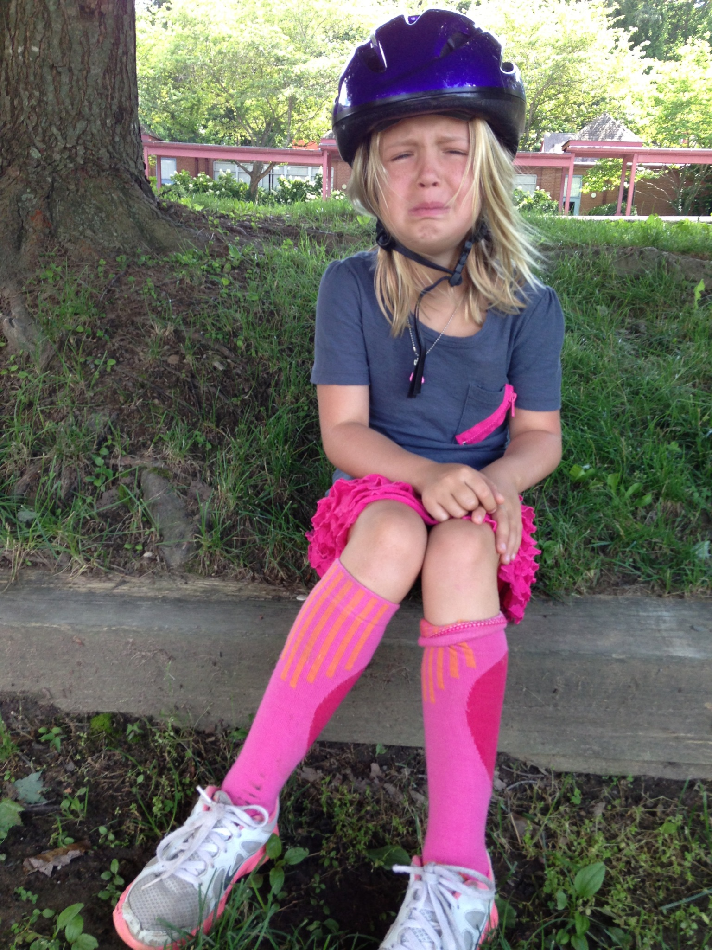
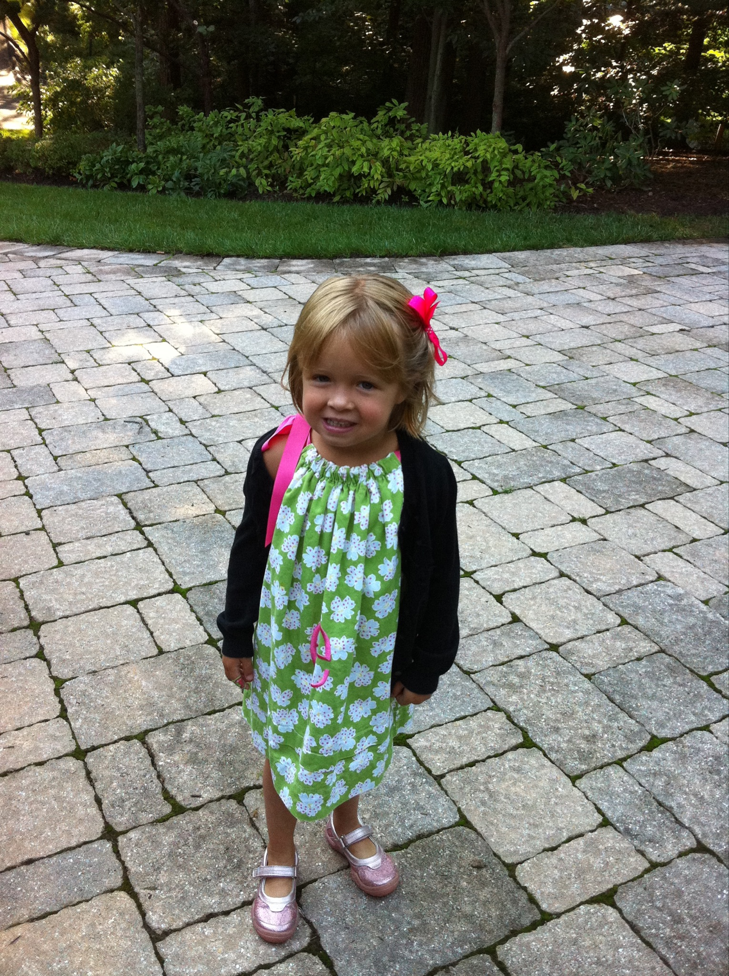
✰ELOISE✰
Eloise is the one with the contagious smile. She’s always honest with you, her confidence and wit are greatly admired.
A strawberry açai lemonade from Starbucks always in her hand, lol remember that time we played the violin in band.
She never fails to make me laugh, especially in the middle of science class.
Soccer, basketball, softball, I remember those good times with Weezer. Watch out Stone Ridge, here comes your next favorite gator!
I really am so lucky to say I’ve been friends with a girl who is the most energetic, jolly, and determined person I know, named Eloise James Quinn.
By: Sophia Beahn

Slide 24
GOOD LUCK
CLASS OF 2021!!

