Slide 1
7th Grade
Lenten Poems 2021
Father, bless us
with the gift of Love--
our Savior, Jesus.
By Mrs. Francis

Slide 2
Elijah Almas Mrs. Francis Lune Poem
For Jesus’ Sacrifices
I gave up junk foods
The smallest sacrifice

Slide 3
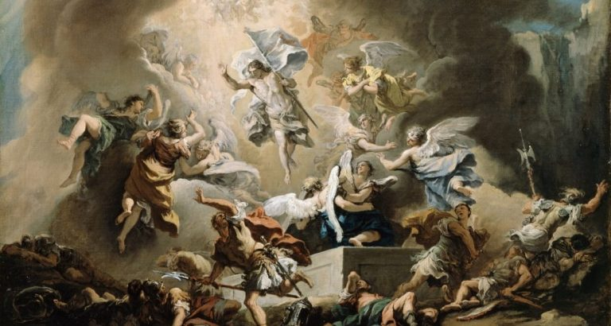
Jesus is back
Everyone, Jesus has risen
Come with us
By Michael Anderson

Slide 4
Lent is a time for
sacrificing little things,
while waiting for Him.
By Anna Gilbert

Slide 5
Lenten Poem (Haiku)
By Jack Jenkins
Hope
For better resolutions
To do better in life

Slide 6
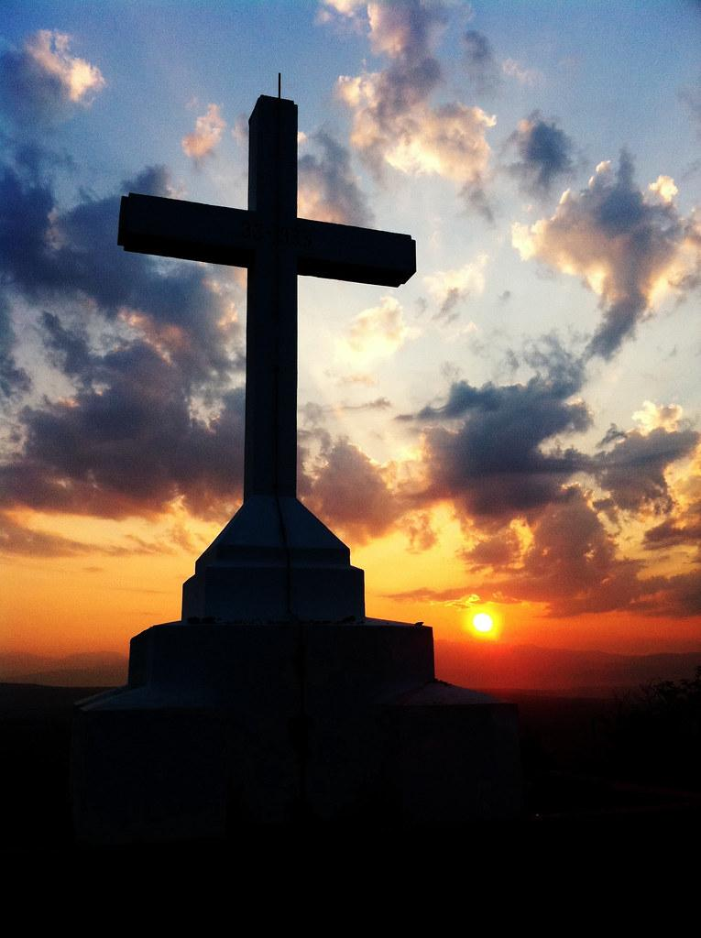
As Lent begins
We turn to God in sadness
Till the Messiah comes
By Blaise Joubert

Slide 7
Forty days praying,
Fasting and almsgiving. We
will Repent on lent.
By:Bobby Lannan

Slide 8
Haiku
By Robert Luther
Lent is about God
Sacrificing for him
Giving up objects

Slide 9
Lent is a time of
Sacrifice and giving to
God and everyone else
Christian Moore

Slide 10
As we await
For the coming of Jesus
We offer ourselves
By Annie Ondeck

Slide 11
Just forty days
Until Jesus died and resurrected
Ends Easter day
By Sophia-Marie Provenzano

Slide 12
By Andrew Forrester
Jesus’ goal; clear
All await, He is near
Thou has RISEN

Slide 13
Lenten Poem
By Kaylah Tchoufa
L is for the Life he gave
E is for the Eternal grace for us
N is for the Nurture he gave to us and has for us
T is for the Trust that he will rise again

Slide 14
My Lenten Poem
Time to grieve
He suffered just to die
He is alive!
By Katherine Treacy

Slide 15
A Lenten Poem
By Ryan VanHuysen
We wait for
The return of the Lord
Through Prayer, Fasting

