Slide 1
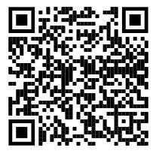
WGSD New Faculty
Tim Brown Director of Student Assessment, Data, and Learning Technologies
Technology Training
http://goo.gl/RSQZ5K

Slide 2
Director of Student Assessment, Data, and Learning Technologies Connecting the Webster Groves staff with professional development opportunities to enhance their understanding of assessment, data management, and teaching with technology in the classroom.

Slide 3
What this looks like . . .
Modeling lessons for teachers and with teachers on current technologies being utilized in the classroom.
1-on-1 PD for teachers, small group PD, building level PD, online support, and whole district PD opportunities.

Slide 4
Technology Support Specialists
If something is broken or is not working properly make sure you fill out a tech. request and the technology support specialists will come to solve your problems.

Slide 5
In the classroom . . .

Slide 6
and in the cloud

Slide 7
Why the Cloud?
Student collaboration
Access to documents anywhere and at anytime
Less printing - students can share their work with you and you can comment or edit.
Staff collaboration and professional development
More storage space for digital files

Slide 8
Google and WGSD
www.google.com www.wgcloud.org (students domain)
Teacher Login: lastname.firstname@wgmail.org
Password: Should be the same password that was put on your AUP form. If not, should have been emailed to you when we created your accounts.
After you log in the program will have you change your password

Slide 9
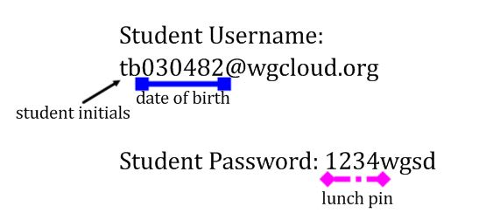
Wgcloud Accounts

Slide 10
Clever
Single sign on platform for our various products.
clever.com/in/wgsd Click login with Google Wgcloud login information

Slide 11
Canvas - Learning Management System
The Webster Groves School District uses Canvas as our learning management system.
Resources:
Getting Started with Canvas Canvas Tutorials and Do Now Activities LMS in the WGSD YouTube Channel

Slide 12
Infinite Campus
https://webstermo.infinitecampus.org/campus/webstergroves.jsp
We use SIS for grade reporting K-12, gradebook (6-12), and student data of all kinds.
K-6 Progress Report Online for Parents (printouts only when parent requests a copy)
We are in the process of moving from Tyler SIS to Infinite Campus and trainings will come in August

Slide 13
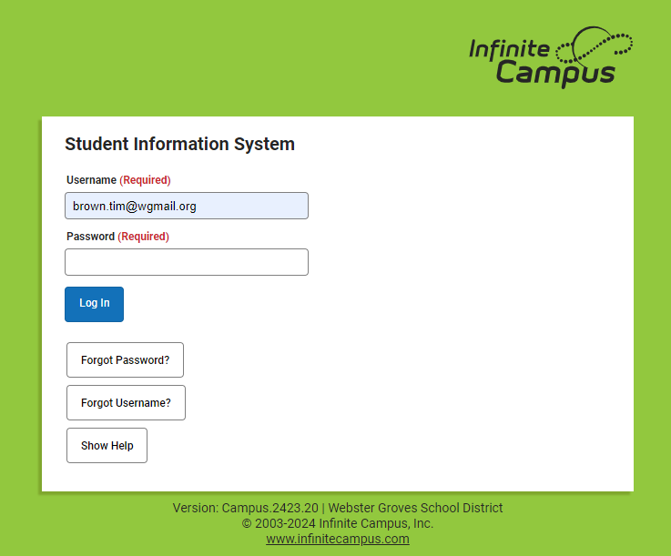

Slide 14
Wireless
Wireless is available district-wide - Webster.
You will need to put in your login credentials.
All BYOD and single user devices (tablets) use Webster. You will need to put in your login credentials and password and then trust the certificate.

Slide 15
Technology Requests
Use them always to create a formal trail of your requisitions and technical issues, even if you have already spoken to your building tech staff.
(handout) https://qware.app/#/login/WEBSTERMO
When to place a tech request?

Slide 16
Setting Voicemail

Slide 18
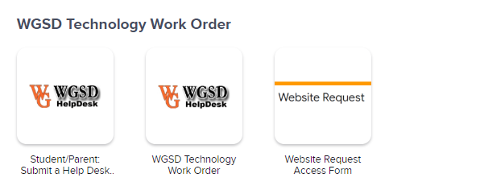
Staff Tech. Req.
Can be found through About US, and then Staff Links and in Clever

Slide 20
Questions?
Please complete the quick survey by clicking the link below.
Welcome Survey
Director for Learning Technologies http://goo.gl/YjleWx

