Slide 1
WCSD Elementary
Reading Instruction
Antoniette Barbosa and Barbara Curiale

Slide 2
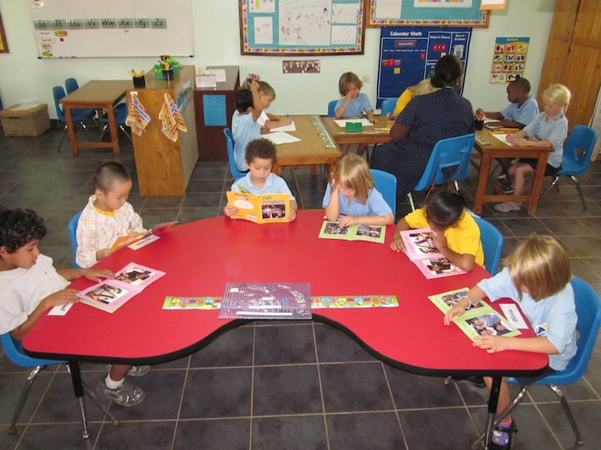
Reading Instruction Continuum at School
Reading Instruction in the classroom
Small group reinforcement in the classroom
Consult with reading specialists as needed
Reading Lab/AIS
State Assessments *Benchmark Scores
STAR *Individual assessments
RtI – goals and strategies

Slide 3
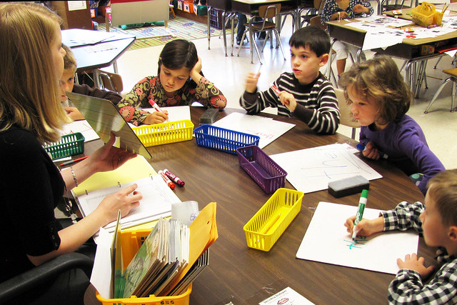
Reading Instruction Continuum at School (slide 2)
Inclusion setting (ICT)
General education curriculum, as well as work on specific IEP goals
Resource Room (RR)
Work on IEP goals
Can be a mix of students with IEPs, 504 plans and without IEPs (if room)
Students’ primary reading instruction is still in the general education classroom
Special Class Reading (SC-Reading)
Work on IEP reading goals
Only classified students
More intensive program
Students grouped based on complexity of reading needs

Slide 4
Reading Training
Previous Training
October 2019 – Reading teachers attended conference at Manhattanville College. Keynote speaker presented an Orton Gillingham lesson.
Summer 2019 – two reading teachers received beginning OG training
June 2019 – a teacher attended Lindamood Bell Visualizing Verbalizing
October 2018 – PESCI Dyslexia training
Upcoming Training
Winter/Spring 2020 – all elementary reading teachers and ICT teachers will receive 30 hours of Orton Gillingham training with Dawn Nieman, a Fellow of the Academy of Orton Gillingham.
Fall 2020 – this group will continue with additional OG training.

Slide 5
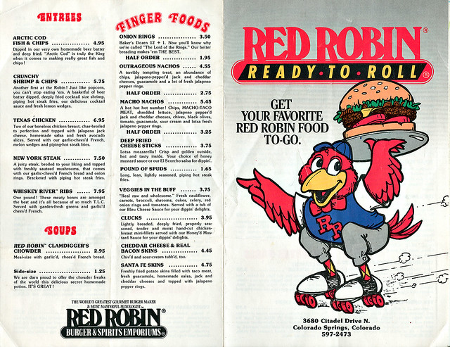
Strategies to help at home
Keep reading relaxed and fun
These are ideas, not requirements. Students who struggle expend a lot of effort and energy to get through their day. They are tired when they get home. Feel free to read homework questions, passages, etc. to them. This can separate reading issues from learning science, social studies or math concepts.
Read road signs, billboards, any environmental print.
Let them choose from the take-out menu and write down everyone’s orders.
Leave a short note for your child. Encourage them to write back.
Holidays are approaching. Fill a stocking or box with office supplies. (post its, highlighter tape, highlighters, pens markers, magnetic letters for the fridge, index cards, …)
Hang up index cards with words they need to learn. Say the word each time you pass it or see it. Keep a tally. Set a goal (Can you read were 50 times?)

Slide 6
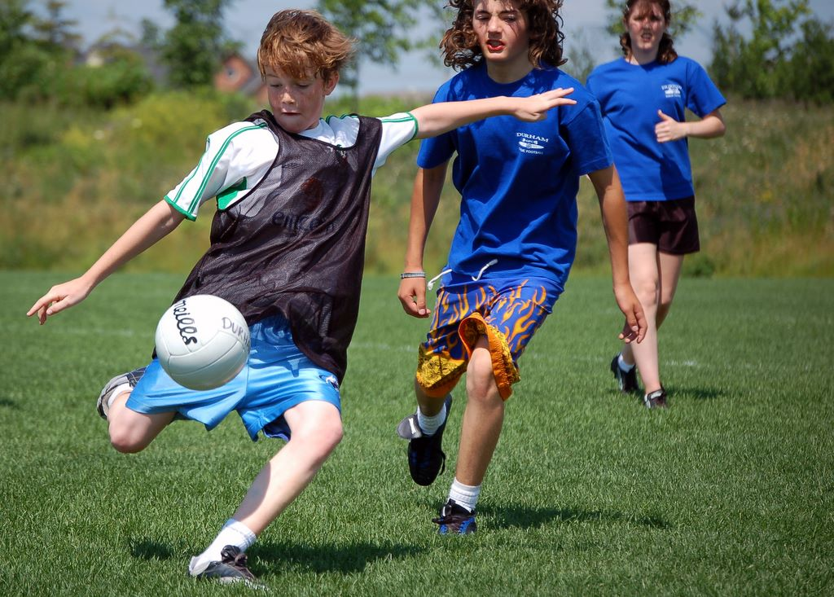
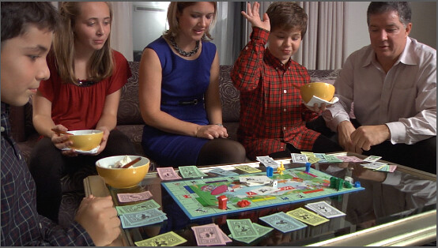
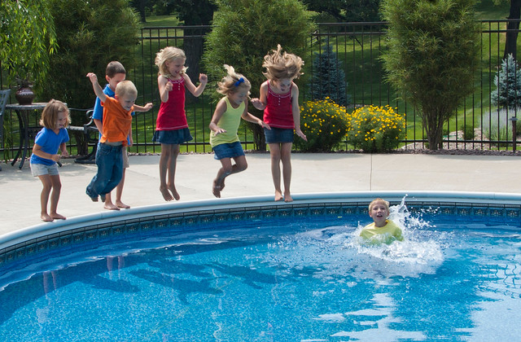
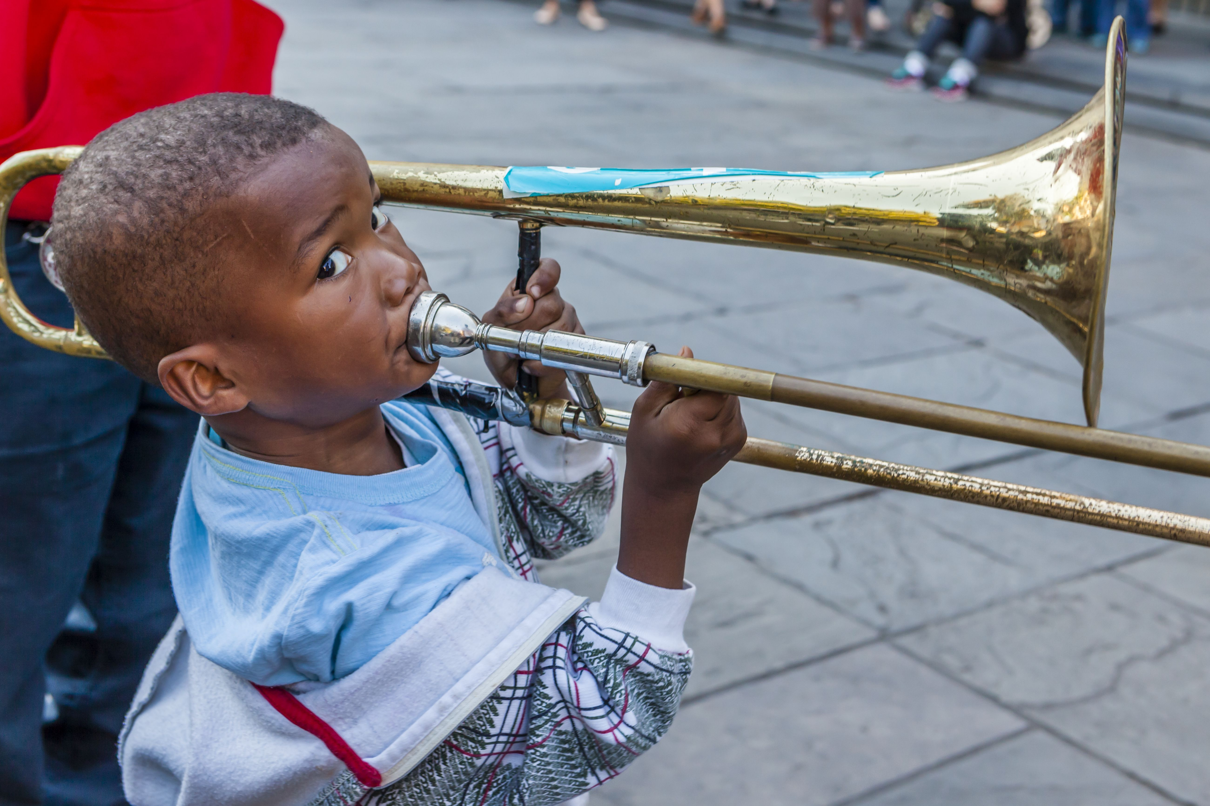
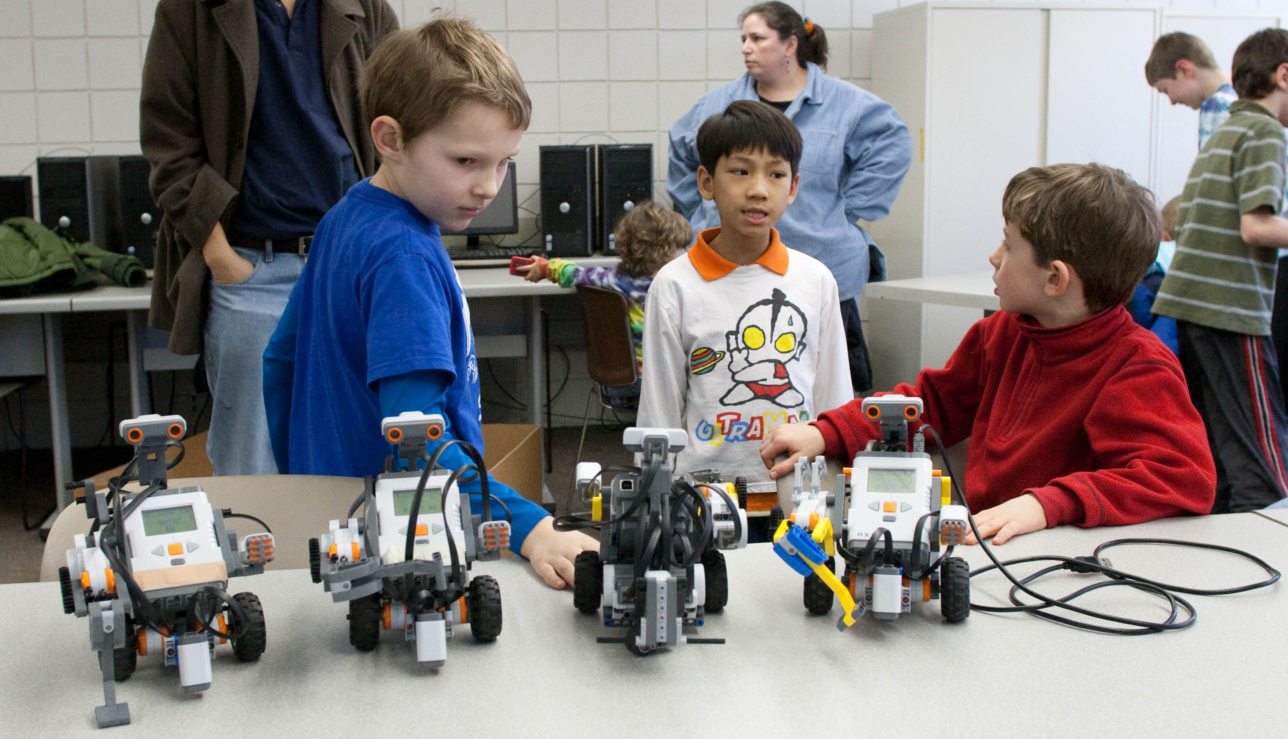
Children are more than their reading problems. Celebrate their strengths, talents, interests and childhood.

