Slide 1
Strategic Planning Determination, Dreams and Destiny
Pitman Public Schools
A Tradition of Excellence
Facilitated by NJSBA Field Services Department
Terri Lewis and Jesse Adams Jr.

Slide 2
Agenda
Welcome
Recap
Small Group Work
Strengths and Challenges
Report Out
Common themes
Common Themes
Next Steps
Mission Statement
Building on our unique traditions, the mission of the Pitman School District, in partnership with families and our community, is to educate all students through exceptional learning experiences to be discerning, ethical, confident citizens. It is the expectation of this school district that all pupils achieve the New Jersey Student Learning Standards at all grade levels.

Slide 3
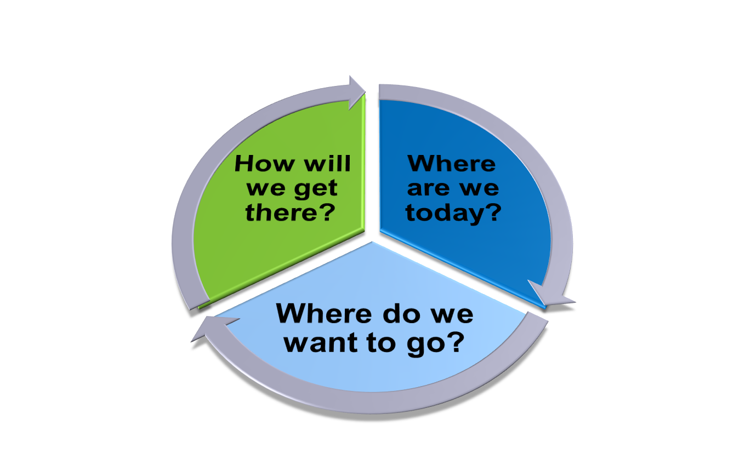
Strategic Planning Process

Slide 4
“Vision is the art of seeing things invisible.” - Jonathan Swift

Slide 5
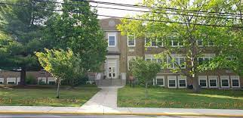
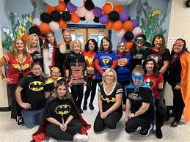
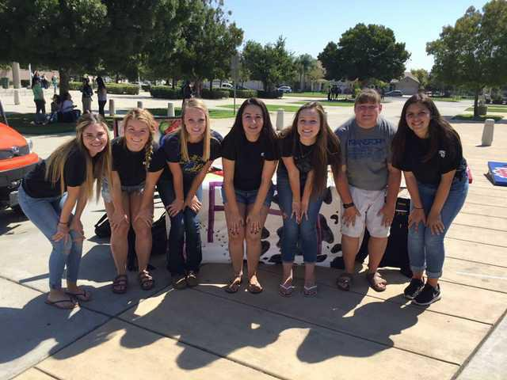
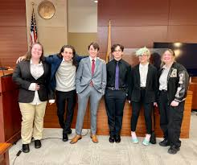
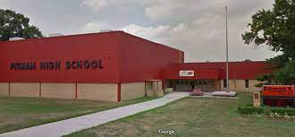
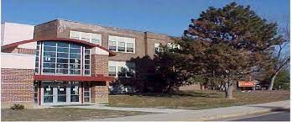
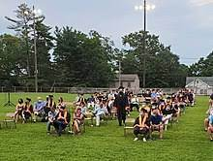
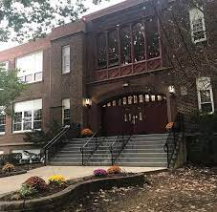
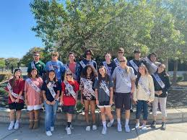
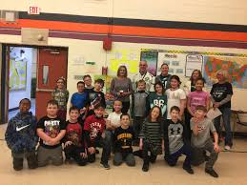
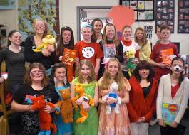
Visioning Exercise

Slide 6
Visioning Exercise
PITMAN
is being
recognized
as the model
district in New Jersey for success in advancing
student achievement.
Student Achievement for All
Pitman School District
2028

Slide 7
Visioning Exercise
All the top educators and dignitaries in the state are at the awards ceremony, which is taking place in Pitman!
Your group are the guest speakers,
sharing the Pitman School District story.
What will you say in your speech about what has taken place in the Pitman schools over the past several years to earn this award?
Pitman
2028

Slide 8
Small Group Work
Outline your speech…
What did we look like in 2023?
What do we look like in 2028?
What did we do to get there?
Give your speech a title.
Brainstorm key highlights
contributing to the district’s future success.

Slide 9
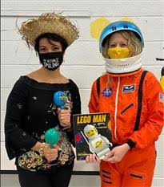
Student Focus
Our students…
Skills
Knowledge
Experiences
What are they receiving?
What are they leaving Pitman with?

Slide 10
Visioning Exercise Example
Title: Leading for the Future
Speech highlights:
Service learning
School is community hub
Cross-disciplinary projects
Flexible spaces
Community partnerships
through 10 ….

Slide 11
Next Steps
Develop survey based on your work this evening and the next meeting.
How will we get there?
Review data and begin development of goals and objectives– March 6, 2023
Finalize goals and objectives – March 27, 2023
Plan presented and adopted by BOE.
Survey disseminated February 15 through 28

Slide 13
Strengths
Challenges
Vision

