Slide 1
ACC Dual Credit Cohort Program
Earn High School AND College Credit
Pflugerville ISD and Austin Community College Partnership

Slide 2
What is Dual Credit?
Opportunity to earn college credit BEFORE graduating from high school
Experience college enrollment process and college course
Credit for high school course AND college course
NO course fee for courses taken on PFISD campus
May have minimum textbook / supply fees
Partnership with Austin Community College
ACC Dual Credit Information

Slide 3
ACC vs. AP
ACC Classes
Tier 2 (5.0) weighted course (Class of 2023 and beyond)
Academically challenging - College Course
Free (up to 12 credits); pay for textbook
Pass for college credit
Transfers to TX public universities; not guaranteed for others
Results may impact college GPA
Seats are limited/First come, first served
Professors have office hours
No summer assignments
AP Classes
Tier 1 (6.0) weighted course
Academically challenging - High School course
High school course prep free; pay for AP exam
Earn qualifying score (3+) for potential college credit
Each university has AP credit policy - research those you plan to attend
Results do not impact college GPA
Open enrollment
Teachers have tutorials
May have summer assignments
BOTH proven to promote student success in college.

Slide 4
How is grade credit awarded?
The transfer of letter grades from other accredited high schools or institutions for District approved courses will be recorded as follows: Conversion Scale A+ = 98 A = 95 A- = 90 B+ = 88 B = 85 B- = 80 C+ = 78 C = 75 C- = 70
F = 65
A student must pass a dual credit class with a C or higher to earn both high school and college credit. A credit of D will earn college credit through ACC, but a grade of D will not earn high school credit.

Slide 5
How do ACC courses fit in high school schedule?
Classroom courses at your high school (No fee for class on PFISD campus)
Only select courses offered based on Dual Credit Cohort plan
PFISD provides ACC the space to hold on PFISD HS campus (can be ACC or PFISD ACC instructor)
Online courses (if available)
Self-motivated students
Good at time management
Tight schedule or lack of transportation
Look to see if course requires you to take exams at ACC
Classroom courses at ACC campus (students may encounter fees on ACC campus)
Be careful about which campus you select
Courses offered at various time throughout the day and weekends
Must be taken outside of the regular school day - only cohort courses offered during regular school day

Slide 6
Which classes do students commonly take?
PfISD Approved Dual Credit List
College Course |  | High School Course |  | HS Credit
ECON 2301 | Principles of Macroeconomics* (sr. cohort) | 2211 | Economics | 0.5 credit
GOVT 2305 | United States Government* (sr. cohort) | 2201 | Government | 0.5 credit
HIST 1301 AND | U.S. History I* (jr. cohort) | 2131 | U.S. History (must complete the two ACC classes to earn PfISD credit) | 1 credit
HIST 1302 | U.S. History II* (jr. cohort)
PSYC 2301 | Introduction to Psychology* (sr. cohort) | 2411 | Psychology | 0.5 credit
ENGL 1301 | English Composition I *(ACC Eng. 3) jr. cohort AND | 1131 | English III (If ACC course taken on PfISD Campus only) | 1 Credit
ENGL 1302 | English Composition II* (ACC Eng. 3) jr. cohort
ENGL 2322 | British Literature: Anglo-Saxon Through 18th Century* (ACC Eng. 4) sr. cohort | 1141 | English IV (If ACC English III and English IV taken on PfISD Campus) | 1 Credit

Slide 7
PfISD Two-Year ACC Cohort - Junior and Senior Years
 | Fall Course | HS Credit | Spring Course | HS Credit | Credits
Summer Courses (OPTIONAL)
Junior Year | ENGL 1301: English Comp I w/ American Lit | English 3A (0.5) | ENGL 1302*: English Comp II w/ American Lit | English 3B (0.5) | Junior year earn 2 high school credits and 12 college course hours
 | HIST 1301: US History | US History A (0.5) | HIST 1302: US History | US History B (0.5)
Summer Courses (OPTIONAL)
Senior Year | ENGL 2322*: British Literature | English 4 (1.0) | PSYC 2301 | Psychology (0.5) | Senior year earn 2.5 high school credits and 12 college course hours
 | GOVT 2305 | US Government (0.5) | ECON 2301 | Economics (0.5)
Completed the Junior and Senior Year, the PFISD ACC Cohort allows students to earn 24 college credit hours during the last two years of high school. You may take an additional four courses with your dual credit contract, which is typically two credits before junior year and two before senior year. If you successfully complete all 12 courses as a dual credit student, you will have earned 36 college hours before you graduate high school. Basically, you will be able to enter college with enough credit to graduate in three years or less. Other than textbooks this cost your family nothing AND it allows you to spend less on your bachelor's degree.

Slide 8
ACC English and PFISD HS English III and IV Credits
PfISD's procedure to earn English 3 & 4 credit as part of two-year ACC cohort:
ENGL 1301 | English Composition I *(ACC Eng. 3) AND | 1131 | English III (If ACC course taken on PfISD Campus only) | 1 Credit | Courses must be taken on PfISD campus with approved faculty/curriculum. American Literature TEKS embedded in English Composition I and II for English 3 high school credit.
ENGL 1302 | English Composition II* (ACC Eng. 3)
ENGL 2322 | British Literature: Anglo-Saxon Through 18th Century* (ACC Eng. 4) | 1141 | English IV (If ACC English III and English IV taken on PfISD Campus) | 1 Credit

Slide 9
Dual Credit ACC Cohort Bonuses
Benefits
Easy to follow schedule
Freedom to take or not take summer classes
Earn required high school and college credits at the same time
24 college credits
4.5 high school credits
Classes at your HS campus = no transportation issues
Cost Savings
Dual Credit
Free* courses
ACC 3 credit hours
$255 (in-district); $1,083 (out of district)
$2,040 saving for 8 college courses; $8,664 (out of district savings)
Texas State University
$1,508.93/class
Tuition only, not including room/board, etc. savings
$12,071.44 savings for 8 college courses

Slide 10
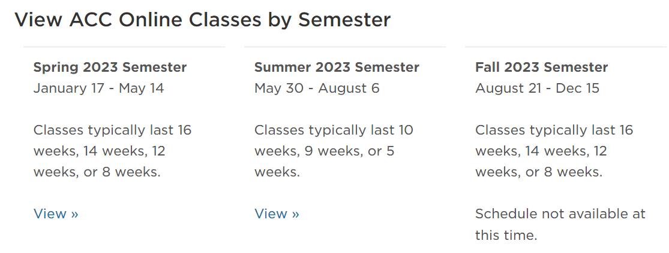
Classes this summer! Look for courses offered for PfISD students to avoid fees.
Student is responsible to pay for summer classes
ACC Summer 2023 Schedule

Slide 11
Steps To Being a Dual Credit Student
Attend / View PfISD ACC information Session / Orientation
Talk to your HS counselor to see if this is the right fit for you
Follow steps outlined in Steps to Being a Dual Credit Student

Slide 12
Questions?
ACC High School Campus Counselor

