Slide 1

Rising 8th Grader
Panthers
Class Information and Choice Sheets
PFISD MS Course Guide:
http://www.pfisd.net/Page/5144

Slide 2
Choice Sheets
Every eighth grade student will receive a blue form. On the form, you will have the opportunity to select the courses you will take for the next school year. You will have EIGHT classes total.
REQUIREMENTS
  Four core classes (English, History, Math, Science) - put a check next to option you want
  Elective choices - MUST be numbered 1-6 by PREFERENCE
    8th graders do NOT have to take a PE class if they took one in 6th & 7th grade
    Rank your choices
      Whichever class you put a 1 by is your first choice
        This will be the class you want most and we will do our best to give you that option

Slide 3
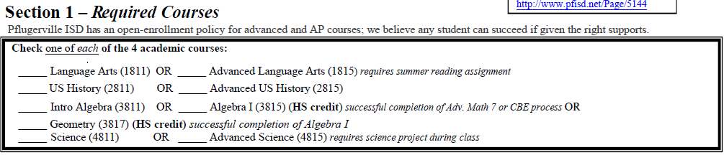
Section 1-Required Courses:
Check one of each subject,
either Regular or Advanced/Accelerated
(Continue with accelerated math if you are currently in it unless your parent or teacher has notified me that you are changing)

Slide 4
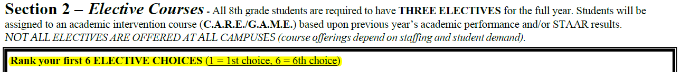
Section 2- Regular Electives:
READ THE DIRECTIONS !
Regular Electives Notes-
PE elective is optional not required (unless you did not take 2 years of a PE in 6th and 7th)
Athletics is available and requires a physical form completed
Some classes on the choice sheet are not available at all campuses
AVID - If you are currently in AVID you will be put in there again for 8th grade according to the contract.
-AVID changes- If wanting to get out of AVID, please have your parent talk with the AVID teacher about exit procedures
Fine Arts Requirement- All students must take a fine arts class in 8th grade IF you did not take one in 6th or 7th grade. Fine Arts Classes are: Art, Band, Choir, Theater, Dance-if taken along with another PE elective
High School Credit Electives Notes-
High school credits are available and will be included in your high school GPA (Grade Point Average) and transcript

Slide 5
Electives that have Prerequisites
Accelerated Spanish II, III and IV- must have been in the previous year, or passed CBE- Fluent in Spanish
PFLEX - must be in the Gifted and Talented Program
AVID - Application or in it this year
Library/Office Aide - Application required (see Ms. Guardiola)
Art II or III - Successful completion of Art I or Art II
Band - Higher bands are assigned by directors
Choir - Higher choirs are assigned by director
Theater II, III, or Musical Theater - Successful completion of Theater I

Slide 6
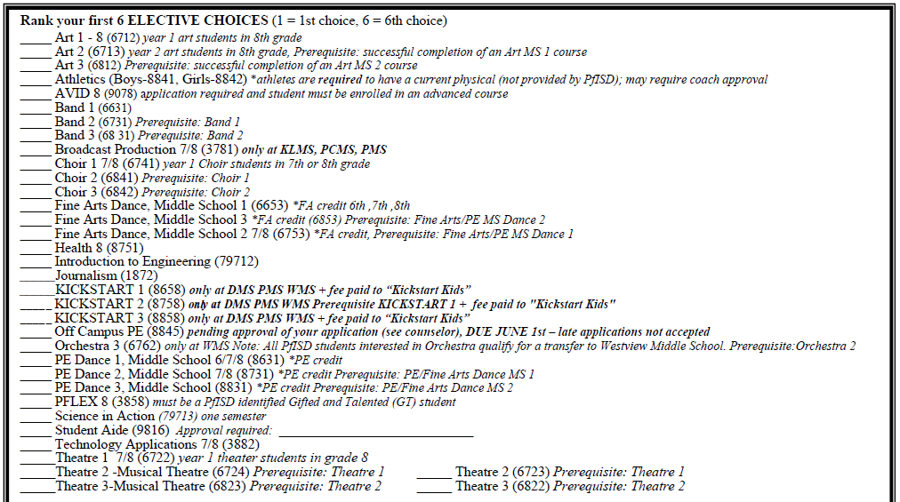
Section 2- Regular Electives:

Slide 7
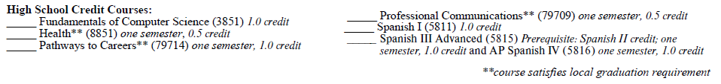

High School Credit Courses
Some electives are only one semester so you will need to pick two
Important Note: The grade that you receive in these HS credit electives will be calculated into your High School grade point average (GPA). Therefore, it is important that you do your best. These HS electives are more rigorous that regular electives.

Slide 8

Course Descriptions Website
Let’s Check Them Out!
PFISD MS Course Guide:
http://www.pfisd.net/Page/5144
Friday, March 8th
DON’T FORGET TO TURN IN YOUR CHOICE SHEET
***SIGNATURE REQUIRED ***
*** If not turned in by due date, academic and elective choices will be made by the school staff. ***

Slide 9
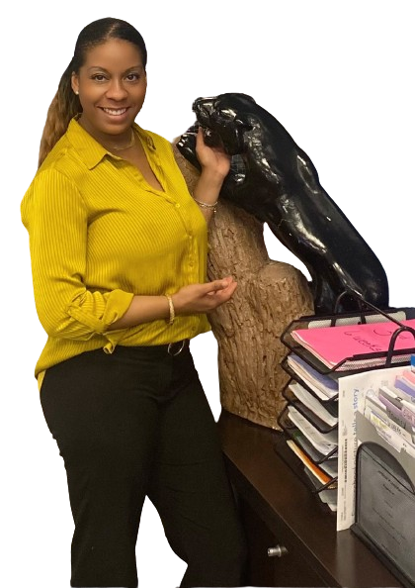
If you have ANY questions about your choice sheet
Mrs. Lane
(nikishia.lane@pfisd.net)

