Slide 2
Chapter 16
Managing the Stress in Your Life
Lesson 16.1 What Is Stress?
Lesson 16.2 Stress and Your Physical Health
Lesson 16.3 Stress and Your Intellectual and Emotional Health
Lesson 16.4 Managing Stress

Slide 3
Lesson 16.1
What Is Stress?

Slide 4
Warm-Up
What are the biggest sources of stress in your life? Consider major events and daily struggles.
Do you think these are common sources of stress? Do others respond the same way you do to these stressors?
cloki/shutterstock.com

Slide 5
Types of Stressors
Stress may be...
acute (sudden and short-lived) or chronic (lasting over a long time period)
caused by major events or daily struggles
positive as well as negative
auremar/shutterstock.com

Slide 6
Acute Versus Chronic Stress
Acute stress is temporary (example: a final exam)
Chronic stress is continual (example: stress over an unsafe neighborhood)
The body can manage acute stress, but chronic stress harms the body
Peter Nadolski/shutterstock.com

Slide 7
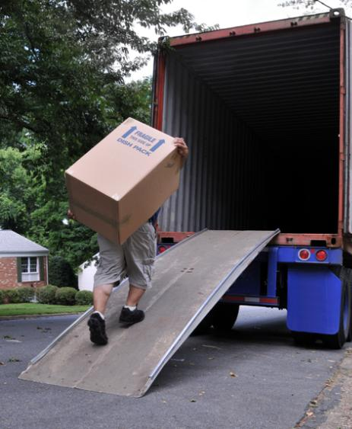
Major Events Versus Daily Hassles
Major events (moving, a parent’s death) are the most stressful in a person’s life
Daily hassles (being late, losing keys) create more overall stress since they occur frequently
Frontpage/shutterstock.com

Slide 8
How can stress be positive as well as negative?
Stress can produce positive feelings, such as excitement before a big game or motivation to do well on a test. Positive events, such as the birth of a sibling, can cause stress because they increase responsibilities.
Why is it possible for two people to have completely different responses to the same stressful event?
People may have different perceptions of an event, interpreting or thinking about it in a different way.

Slide 9
Sources of Stress for Teenagers
Relationships (conflict with family, friends, and peers)
School (academic pressure; balancing schoolwork with other activities)
Home environment (crowded, noisy, lack of privacy; lack of food or money; crime in your neighborhood)
Inner conflict (making difficult life choices)
Click here for the Unit 6 video, “Stressed Out”
threerocksimages/shutterstock.com

Slide 10
Critical Thinking
Why might people living in different countries experience different levels of stress?
How does stress level change depending on a person’s age or life stage?
Dragon Images/shutterstock.com

Slide 11
Lesson 16.2
Stress and Your
Physical Health

Slide 12
Stages of Stress
The body responds to stress in three stages:
Alarm
Resistance
Exhaustion
Hans Kim/shutterstock.com

Slide 13
The Body’s Response to Stress
Fight-or-flight response
Heart rate, blood flow, breathing, and sweat production increase
Pupils widen
Other body processes are stopped or slowed
Resisting stress over time leads to exhaustion
foto infot/shutterstock.com

Slide 14
What are some infections or diseases that could be triggered by chronic stress?
Colds and flu
Headaches
Back pain
Asthma
Eczema and hives
Hernias
Ulcers
Gastrointestinal disorders
Cardiovascular disease
Diabetes
Cancer

Slide 15
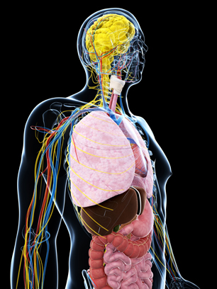
Stress and Body Systems
Nervous system
the brain, sensing a threat, sends signals to mobilize the body
Endocrine system
produces stress hormones, epinephrine and norepinephrine
Cardiovascular system
pumps blood at a faster rate
Immune system
gets fewer resources to produce disease-fighting lymphocytes
Reproductive system
stress hormones, such as cortisol, cause sex hormones to decrease, reducing fertility
Sebastian Kaulitzki/shutterstock.com

Slide 16
Critical Thinking
Procrastination and Health
Research shows that students who procrastinate, or delay, doing their schoolwork experience more symptoms of illness.
Why might procrastination be harmful to a person’s health?

Slide 17
Lesson 16.3
Stress and Your Intellectual and Emotional Health

Slide 18
Stress and Cognitive Problems
Stress affects cognitive abilities (thinking and reasoning), leading to
Trouble focusing
Risk of injury
Negative thoughts
Impulsive decisions
Forgetfulness (stress hormones disrupt the hippocampus—the brain’s memory center)
iko/shutterstock.com

Slide 19
Stress and Emotional Problems
Stress can cause many emotions: fear, anxiety, helplessness, anger, shock, or numbness
Chronic stress can lead to depression, a feeling of low self-worth and disinterest in life
Extremely stressful events can cause post-traumatic stress disorder (PTSD)
Stress from combat can lead to post-traumatic stress disorder, or PTSD.
John Gomez/shutterstock.com

Slide 20
What are some symptoms of post-traumatic stress disorder, or PTSD?
Nightmares and recurring thoughts about the event
Feeling detached, numb, uncaring, irritable, angry, or guilty
Inability to remember parts of the event
Lack of interest in normal activities
Avoidance of people associated with the event
Being easily startled
Difficulty concentrating
Difficulty sleeping

Slide 21
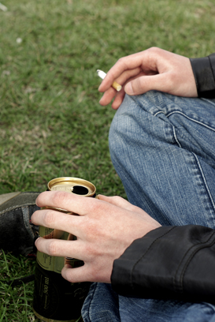
Stress and Behavioral Problems
Stress can lead to behavioral problems
Conflict (arguments and domestic violence)
Unhealthy lifestyle choices (smoking, drinking, taking drugs, bad eating habits, infrequent exercise, lack of sleep)
dwori/shutterstock.com

Slide 22
Critical Thinking
Stress and Hormones
Explain how hormones are involved in stress-related memory problems and depression.
Stress hormones disrupt the functions of the hippocampus, the part of the brain responsible for memory formation. This makes it difficult for people under stress to remember things and form new memories. Stress can also reduce the “feel-good” hormones and other chemicals in the brain, leading to depression.

Slide 23
Lesson 16.4
Managing Stress

Slide 24
Tips for Reducing or Avoiding Stress
Manage time
Set limits by saying no when too busy
Stay positive
Distract yourself
Laugh
Use relaxation techniques
Take care of yourself
Express feelings to a friend or in a journal
jcjgphotography/shutterstock.com

Slide 25
Staying Positive
Use positive reappraisal to focus on the positives of a stressful event
Distract yourself—go for a walk, read, or volunteer
Watch a funny movie or talk to a friend who makes you laugh
oliveromg/shutterstock.com

Slide 26
Relaxation Techniques
Breathe deeply to decrease heart rate and blood pressure
Visualize yourself in a peaceful environment
Progressively relax muscles by tensing and relaxing each part of your body
Meditate to clear your mind
Practice yoga, a series of postures and breathing exercises
Ditty_about_summer/shutterstock.com

Slide 27
Taking Care of Yourself
What are ways to take care of your body when you’re stressed?
Eat well
Exercise regularly
Get plenty of sleep
Avoid smoking, drinking, and drugs

Slide 28
When to Seek Professional Help
Seek the help of a counselor, social worker, therapist, or psychologist
After experiencing major stress, such as the death of a loved one or parents’ divorce
When you’ve experienced stress for more than a couple of weeks
Olimpik/shutterstock.com

Slide 29
Benefiting from Stress
A certain amount of stress is unavoidable
When stress is managed properly, it can be used for your benefit
Developing important skills for managing future stress and coping with new challenges
Increasing physiological arousal, resulting in excess energy and concentration
Pete Saloutos/shutterstock.com

