Slide 2
Chapter 7
Sleep
Lesson 7.1 Getting Enough Sleep
Lesson 7.2 The Science behind Sleep
Lesson 7.3 Common Sleeping Problems
Lesson 7.4 Strategies for Getting the Sleep You Need

Slide 3
Lesson 7.1
Getting Enough Sleep

Slide 4
Warm-Up
Your Sleep Habits
How many hours per night do you sleep on average?
Do you think you get enough sleep?
How do you think the amount of sleep you get affects your health?
Vava Vladimir Jovanovic/shutterstock.com

Slide 5
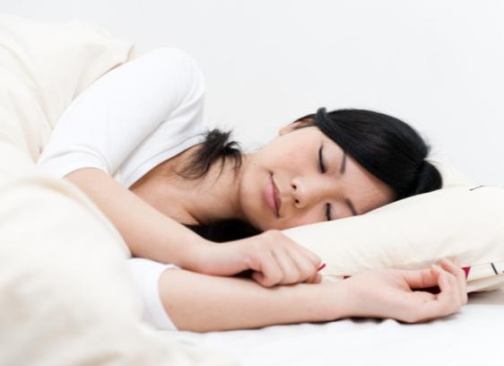
Varying Sleep Needs
The amount of sleep that people need varies at different ages
Teenagers need about nine hours of sleep per night
A shortage of sleep is called a sleep deficit
takayuki/shutterstock.com

Slide 6
The Impact of Insufficient Sleep
Lack of sleep is related to various health problems
Diabetes
Cardiovascular disease
Hypertension
Stroke
Coronary heart disease
Irregular heartbeats
Obesity
JPC-PROD/shutterstock.com

Slide 7
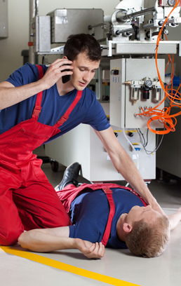
Accidents
People who are sleep deprived have impairments in their ability to pay attention, concentrate, and react quickly
Sleep deprivation can lead to accidents and injuries
Car accidents
Workplace accidents
Photographee.eu/shutterstock.com

Slide 8
Myth or Fact?
The amount of sleep you get does not affect your school performance.
MYTH
Fact: Students who have slept too little often have problems concentrating, solving problems, and retaining information.
Fact: Insufficient sleep leads to lower grades and poor academic performance.

Slide 9
Lesson 7.2
The Science behind Sleep

Slide 10
The Body’s Biological Clock
Most circadian rhythms are controlled by the body’s master biological “clock,” the suprachiasmatic nucleus (SCN)
The SCN controls…
The sleep-wake cycle
Body temperature
Hormone levels
Brain wave activity
DigitalHand Studio/shutterstock.com

Slide 11
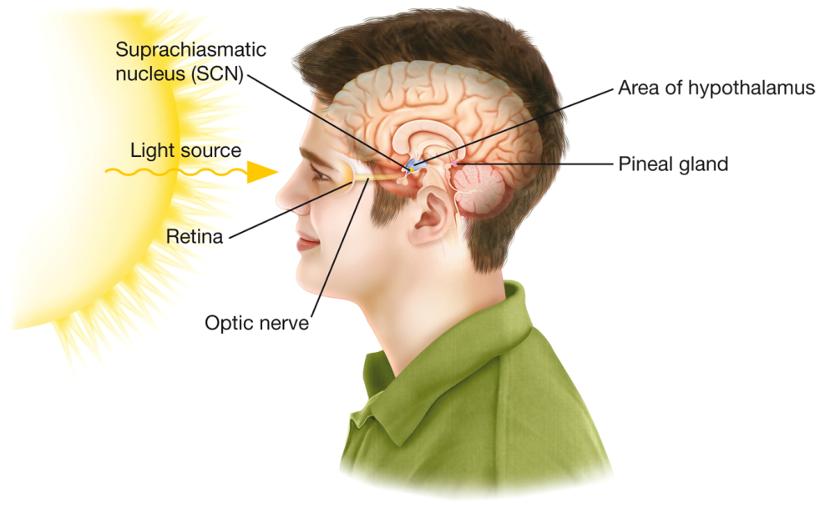
Sleep and Circadian Rhythm
Your body’s biological clock determines when you feel tired and when you feel awake.
© Body Scientific International

Slide 12
Disruptions to Circadian Rhythm
When the natural circadian rhythm is disrupted, the body’s biological clock takes a while to readjust
Jet lag is a fatigue that people feel after changing time zones when they travel
Monkey Business Images/thinkstock.com

Slide 13
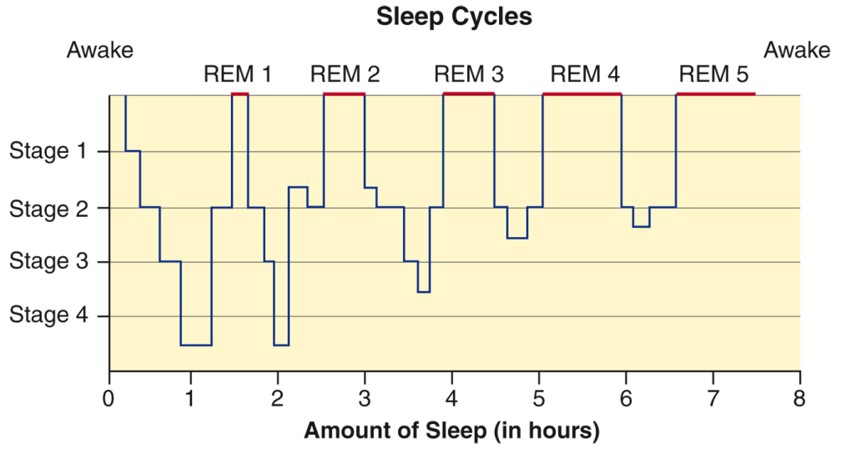
Stages of Sleep
Each night, you usually pass through five distinct stages of sleep.

Slide 14
In what sleep stage do sleep spindles occur?
Stage 2
What happens during REM sleep?
Your breathing becomes shallow and more rapid
Your heart rate and blood pressure rise
Your eyes dart about rapidly
Your muscles are temporarily paralyzed

Slide 15
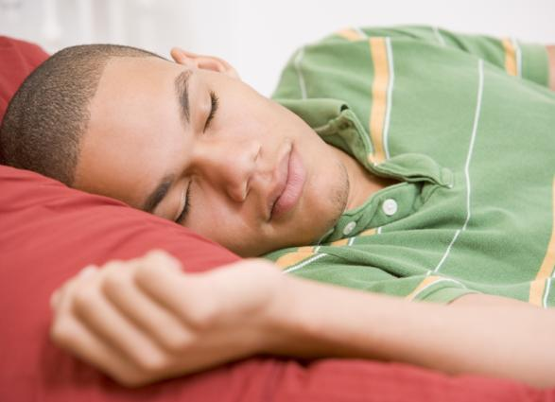
Dreaming
On most nights, you spend more than two hours dreaming
Most dreams last between 5 and 20 minutes
Dreams that occur during REM sleep are remarkably vivid
Monkey Business Images/thinkstock.com

Slide 16
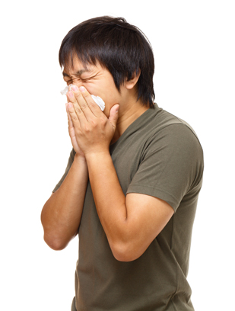
Sleep Impacts Body Systems
Researchers believe that sleep benefits the nervous, immune, and endocrine systems. It helps the body
Learn and remember new information
Fight infections
Regulate hormones
Repair damaged cells
leungchopan/shutterstock.com

Slide 17
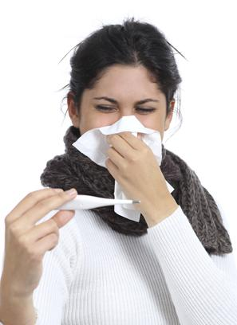
Critical Thinking
Sleep and the Immune System
Have you noticed that you are more likely to get a cold or other health problem when you don’t get enough sleep?
How does the amount of sleep you get affect your immune system?
AntonioGuillem/iStock/thinkstock.com

Slide 18
Lesson 7.3
Common Sleeping Problems

Slide 19
Insomnia
An inability to fall asleep or stay asleep
Acute (short-term) insomnia
Common condition
Caused by daily stressors
Chronic (long-term) insomnia
Lasts a month or longer
May be related to another health problem
VGstockstudio/shutterstock.com

Slide 20
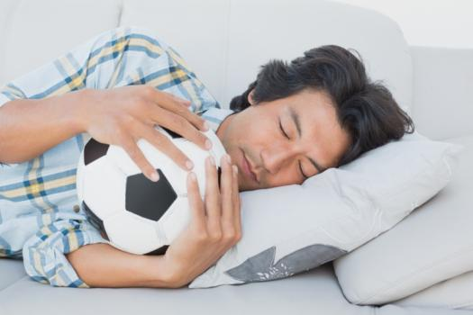
Parasomnia
Sleep disorders that occur when people are partially, but not completely, aroused from sleep
Can occur when people are
First falling asleep
Between sleep stages
Aroused from sleep
wavebreakmedia/shutterstock.com

Slide 21
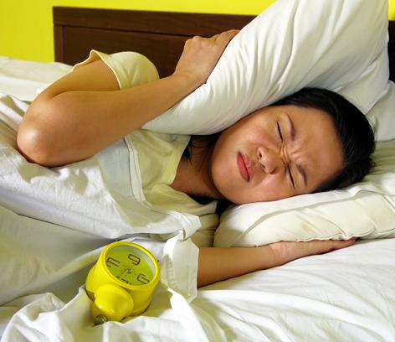
Nightmares
Highly disturbing dreams associated with negative feelings
Many possible causes
Daily life stresses or major changes
Trauma, such as an accident or injury
Exposure to books or movies right before sleep
Illness, especially if accompanied by a fever
Alcohol, illegal drugs, and some medications
beemanja/shutterstock.com

Slide 22
Sleepwalking is a sleep disorder that leads people to get out of bed and walk around while they are in a state of deep sleep.
Will a person who sleepwalks typically remember the experience?
What are some factors that may cause sleepwalking?

Slide 23
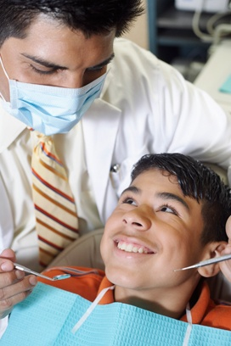
Teeth Grinding
Bruxism is a condition in which a person grinds or clenches his or her teeth while sleeping
Teeth grinding can lead to tooth damage, a sore jaw, or headaches
Reducing caffeine may be helpful
Fuse/thinkstock.com

Slide 24
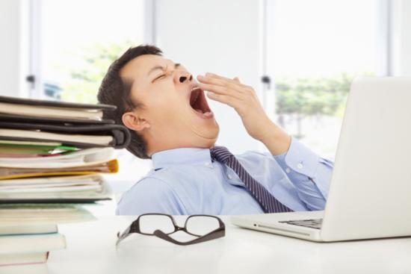
Sleep Apnea
A disorder in which a person stops breathing for short periods during sleep
Two types
Obstructive
Central
People with sleep apnea can suffer numerous side effects
Tom Wang/shutterstock.com

Slide 25
Narcolepsy
A disorder that causes people to have difficulty regulating their sleep
May cause sleep attacks at various times of the day
Can be treated with drugs that help control the symptoms
MickyWiswedel/shutterstock.com

Slide 26
Critical Thinking
Sleep Attacks
What might be some dangerous consequences of having sleep attacks?
What may sometimes trigger sleep attacks?
Rommel Canlas/shutterstock.com

Slide 27
Lesson 7.4
Strategies for Getting the Sleep You Need

Slide 28
Set (and Follow) a Schedule
To make sure you get enough sleep, use
a sleep-wake schedule that is in sync with your body’s natural circadian rhythm
the same schedule throughout the week, even on weekends
lightwavemedia/shutterstock.com

Slide 29
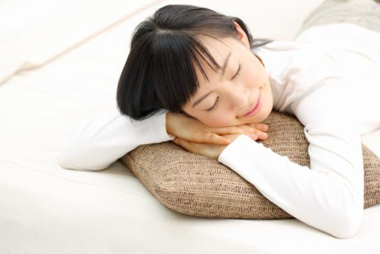
Nap Strategically
Napping can help you get extra sleep without disrupting your regular sleep schedule
Set an alarm so you don’t sleep too much
Nap in the early afternoon
Do not nap after dinner
naka-stockphoto/shutterstock.com

Slide 30
Exercise Regularly
Exercising for as little as 20 to 30 minutes a day can help you sleep better
Try to exercise at least five or six hours before you plan to go to sleep
Rob Marmion/shutterstock.com

Slide 31
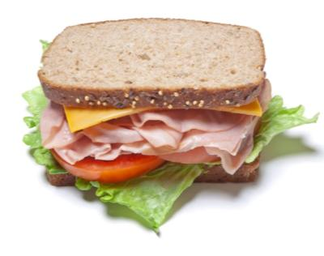
Substances That Interfere with Sleep
A stimulant is a substance that increases the body’s activity
Caffeine (soda)
Nicotine (cigarettes)
Taking stimulants makes it more difficult to sleep
Trytophan in a turkey sandwich can help you fall asleep
Karin Lau/iStock/thinkstock.com
David Koscheck/shutterstock.com
eurobanks/shutterstock.com

Slide 32
Relax before Bedtime
A peaceful bedtime routine sends a signal to your brain that it’s time to relax and sleep
If you can’t sleep, do something relaxing
Avoid stimulating activities, such as using a phone or computer
MJTH/shutterstock.com

Slide 33
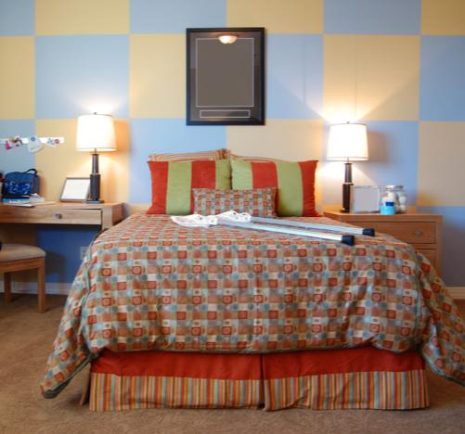
Getting to sleep is easier in an environment that you find comfortable.
What can you do to create a comfortable sleep environment?
Reduce the room’s temperature and light
Maintain quiet
Make your bed as comfortable as you can
Paul Matthew Photography/shutterstock.com

Slide 34
Control Exposure to Light
Melatonin is a naturally occurring hormone that helps regulate the sleep-wake cycle
When it is light, less melatonin is produced, making you feel awake
When it is dark, more melatonin is produced, making you sleepy
gpointstudio/shutterstock.com

Slide 35
Critical Thinking
Regulating Your Sleep Schedule
What are some natural methods you can use to regulate your sleep schedule?
racorn/shutterstock.com

