Slide 2
Chapter 17
Mental Illnesses and Disorders
Lesson 17.1 Types of Mental Illnesses and Disorders
Lesson 17.2 What Causes Mental Illnesses?
Lesson 17.3 Understanding and Preventing Suicide
Lesson 17.4 Getting Help for Mental Illnesses and Disorders

Slide 3
Lesson 17.1
Types of Mental Illnesses and Disorders

Slide 4
Warm-Up
What do you know about mental illnesses?
Do you think people with mental illnesses are treated well in our society? Why, or why not?
Africa Studio/shutterstock.com

Slide 5
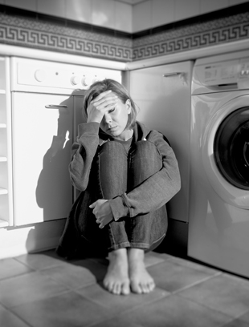
Defining Mental Illness
A mental illness, also called a mental disorder, is a medical condition in which a person’s mental or emotional problems are so severe that they interfere with daily living
Anxiety and depression are the most common types of mental illness
Marcos Mesa Sam Wordley/shutterstock.com

Slide 6
Anxiety
Symptoms of anxiety include:
Increased heart rate
Rapid breathing
Sweaty palms
Upset stomach
People who experience these symptoms on a regular basis may have an anxiety disorder
Naypong/shutterstock.com

Slide 7
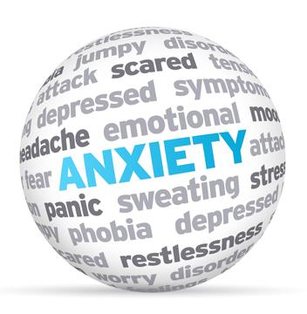
Anxiety Disorders
Panic disorder causes panic attacks (episodes of intense fear)
Generalized anxiety disorder causes extreme or unrealistic worries over daily experiences
Phobias are unrealistic fears about an object or situation (e.g., social phobia or social anxiety disorder)
Obsessive-compulsive disorder (OCD) causes obsessive thoughts and behavior
Post-traumatic stress disorder (PTSD) occurs after a terrifying event or experience
Bildagentur Zoonar GmbH/shutterstock.com

Slide 8
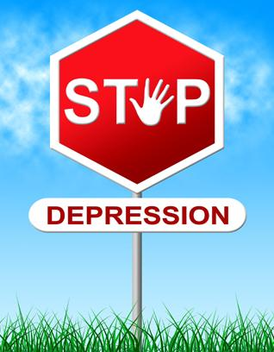
Depression
Depression is a feeling of hopelessness, loneliness, and inability to care about anything
All people experience depression at some point in their lives, but the feelings typically go away over time
Depression that lasts a long time or is especially severe is called major depression or clinical depression
Stuart Miles/shutterstock.com

Slide 9
What are the symptoms of major depression?
Decreased interest in previously enjoyed activities
Extreme tiredness and lack of energy
Difficulty sleeping
Trouble concentrating
Irritability, anger, and hostility
Recurrent thoughts of death
How is major depression different from typical feelings of loss and sadness?
Major depression is more intense and lasts longer than normal feelings of sadness. People experience changes in thinking and behavior. If left untreated, it can have serious effects.

Slide 10
Bipolar Disorder and Schizophrenia
Bipolar disorder
Recurring depression alternating with mania, a hyperactive mood with poor judgment, little need for sleep, and a lack of self-control
Schizophrenia
A mental illness characterized by delusions, hallucinations, and irregular thoughts
People in the mania phase of bipolar disorder may show lack of self-control by overspending.
file404/shutterstock.com

Slide 11
Personality Disorders
A consistent pattern of inappropriate behavior
People with antisocial personality disorder disregard rules and are indifferent to other people’s rights and feelings
People with borderline personality disorder have unstable self-esteem and relationships
People with antisocial personality disorder may disregard the law and commit crimes.
ChameleonsEye/shutterstock.com

Slide 12
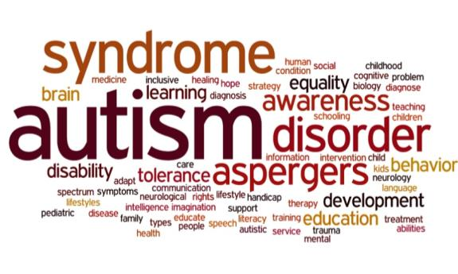
Autism Spectrum Disorders (ASD)
People with ASD have problems with normal interpersonal interactions
Symptoms include
Avoiding eye contact
Failing to respond when spoken to
Engaging in repetitive motions or unusual behaviors
Needing a familiar routine
Using gestures inappropriately
Having delayed language development
lculig/shutterstock.com

Slide 13
Attention Deficit Disorders
ADD and ADHD are the most common mental disorders in children and adolescents
Symptoms
Difficulty focusing, organizing and completing tasks, sitting still, and listening to instructions
Becoming bored quickly
Talking too much or blurting out inappropriate things
People with ADD/ADHD get bored quickly and struggle to pay attention.
Andrey_Popov/shutterstock.com

Slide 14
Critical Thinking
How might having attention deficit disorder (ADD) or attention deficit with hyperactivity disorder (ADHD) affect a person’s ability to cope with daily living?
varandah/shutterstock.com

Slide 15
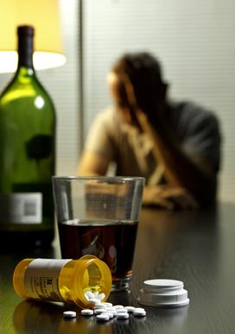
Other Mental Disorders
Eating disorders
Addiction to substances or activities
Alcohol
Nicotine
Gambling
Using social media
Self-injury
Self-mutilation or cutting
Addiction to substances increases a person’s risk of depression, anxiety, and other mental illness.
Burlingham/shutterstock.com

Slide 16
Myth or Fact?
Eating disorders and self-injury are not real disorders, but ways for people to get attention.
MYTH
Fact: Eating disorders are serious mental illnesses.
Fact: While not technically a mental disorder, self-injury is often addictive and can be linked to other mental disorders such as depression or borderline personality. People self-injure because they cannot effectively manage or control their emotions.

Slide 17
Lesson 17.2
What Causes Mental Illnesses?

Slide 18
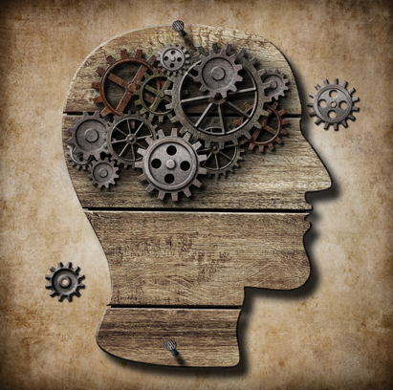
Causes of Mental Illness
The causes of most mental illnesses and disorders are unknown
They may be caused by a combination of
Biological factors
Environmental factors
Psychological factors
Andrey_Kuzmin/shutterstock.com

Slide 19
Biological Factors: Genetics
Certain inherited genes can give a genetic predisposition for mental illness
Genes influence the levels of chemicals in the brain
Low serotonin can cause depression
People with high levels of dopamine may have schizophrenia
Kamira/shutterstock.com

Slide 20
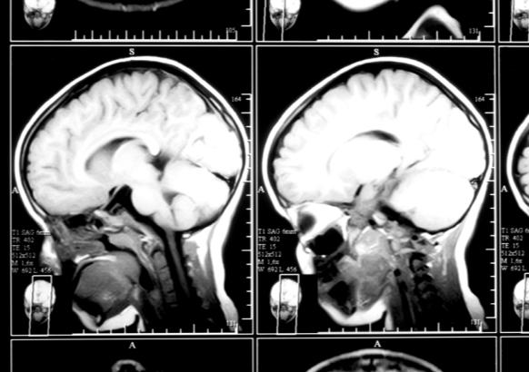
Biological Factors: Brain Injury
Traumatic brain injury (TBI) such as a concussion results from a severe blow or jolt to the head that damages the brain
Brain injuries can lead to temporary or permanent changes in the brain, including
Depression
Anxiety
Personality changes
Aggression
Substance abuse to control mood and pain
Nata-Lia/shutterstock.com

Slide 21
What are some symptoms of a concussion?
Disorientation and confusion
Nausea
Weakness
Memory loss
Unconsciousness
Why should a concussion be treated by a doctor?
Concussions can lead to serious complications.

Slide 22
Critical Thinking
Brain Injury and Sports
Research shows that repeated concussions can lead to mental disorders including epilepsy and dementia. Concussion is a common injury in many sports, including football and soccer.
Do you think the rules of sports should be changed to reduce the risk of concussion? If so, how? What can schools do to keep student athletes safe from brain injury?

Slide 23
Biological Factors: Environment during Pregnancy
Developing babies risk mental illness if the mother:
Uses alcohol or drugs
Does not get proper nutrition
Experiences stress or trauma
Is exposed to a virus, toxins, or certain chemicals
Babies may also experience brain damage during a difficult birth
A healthy environment during pregnancy may decrease a child’s risk of mental illness.
morrowlight/shutterstock.com

Slide 24
Environmental Factors
Mental disorders can be triggered by stressful events and experiences in a person’s environment
Death of a loved one
Divorce
Family conflict
Financial pressures
Moving or changing jobs or schools
Abuse or neglect
Substance abuse
Sean Locke Photography/shutterstock.com

Slide 25
Psychological Factors
Unhealthy thinking patterns, or cognitive distortions, can lead to mental disorders
Examples include black-and-white thinking and catastrophizing
Changing these ways of thinking can improve mental health
Therapy can help people change unhealthy thinking patterns, leading to improved mental health.
Photographee.eu/shutterstock.com

Slide 26
Explain and give examples of each of the following types of distorted thinking.
Black-and-white thinking
Jumping to conclusions
Catastrophizing
Control fallacies
Emotional reasoning
Fallacy of change
Always being right

Slide 27
Lesson 17.3
Understanding and Preventing Suicide

Slide 28
Why Do People Commit Suicide?
People consider suicide because they believe their life can never get better
A mental illness such as depression is often the cause of these feelings
It is important for people to get help if they are contemplating suicide
PathDoc/shutterstock.com

Slide 29
Risk Factors for Suicide
Past suicide attempts
A history of mental illness or substance abuse
Troubled home environment
Crisis such as financial hardship
Experience of abuse, neglect, or bullying
Hearing about someone else who has committed suicide (this can lead to a suicide contagion or suicide clusters, in which others copy the behavior)

Slide 30
Myth or Fact?
Hearing about other people’s suicides may increase the risk for certain people to commit suicide.
FACT
Fact: Hearing about another person, even a stranger, who has committed suicide can lead certain people to copy the behavior. Copying of suicide attempts is known as suicide contagion.
Fact: When a community or group experiences a series of suicides in a relatively short period of time, it is known as a suicide cluster.

Slide 31
Impact of Suicide on Others
Survivors who have lost a loved one to suicide may feel
Guilt for not being able to prevent the death
Abandonment and rejection
Embarrassment or shame
Unprepared for the loss
Since others feel uncomfortable with the topic of suicide, survivors may not get the support they need
wavebreakmedia/shutterstock.com

Slide 32
Critical Thinking
Preventing Suicide
How can you help prevent suicide? What warning signs can you look for?
Take any mention of suicide seriously.
Look for warning signs such as
Changes in eating and sleeping habits
Withdrawal from friends, family, and regular activities
Disregard for personal appearance
Giving away possessions
Loss of interest in activities previously enjoyed
When someone threatens suicide, or if you are thinking of suicide, get help immediately. Find a trusted adult, call 911, or phone a suicide hotline to reach a counselor.

Slide 33
Lesson 17.4
Getting Help for Mental Illnesses and Disorders

Slide 34
Barriers to Seeking Help
Social stigma
Negative and unfair beliefs about mental illness that can make people ashamed to seek help
Cost of treatment
Health insurance may cover part of the expense; some clinics offer reduced rates or no cost
Dragon Images/shutterstock.com

Slide 35
Treatments for Mental Health
Individual therapy
Family therapy
Support groups
Medication, often used in combination with therapy
Inpatient treatment received around-the-clock in a hospital
g-stockstudio/shutterstock.com

Slide 36
Medications for Mental Health
Antidepressants treat depression by making chemicals such as serotonin more available
Stimulants for ADD/ADHD help increase norepinephrine and dopamine in the brain, improving memory and attention span
Medication for anxiety helps slow down the central nervous system
Antipsychotics help manage schizophrenia
Lithium helps control the highs and lows of bipolar disorder
Medications may help people manage withdrawal from addictions and substance abuse
auremar/shutterstock.com

Slide 37
What are ways you can help a loved one with a mental illness or disorder?
Express concern and offer help
Offer to find a mental health professional who can help
Accompany your loved one to see the professional
Accept that it is not your responsibility to solve the problem, and the person may not want your help or may need time to realize he or she needs help
Do not protect someone from the consequences of their disorder or enable them to avoid treatment
Take immediate action if someone talks about suicide by calling 911 or taking the person to the hospital

