Slide 2
Chapter 15
Achieving Mental and Emotional Health
Lesson 15.1 Making Sense of Your Emotions
Lesson 15.2 Establishing Your Identity
Lesson 15.3 Understanding Self-Esteem
Lesson 15.4 Improving Your Mental and Emotional Health

Slide 3
Lesson 15.1
Making Sense of Your Emotions

Slide 4
Warm-Up
Emotional Health
What does it mean to have high emotional intelligence?
Is high emotional intelligence the same as high self-esteem?
Digital Vision/thinkstock.com

Slide 5
Understanding Emotions
Emotions are the moods or feelings you experience
Figuring out which emotions you feel and why can be difficult
Both pleasant and unpleasant emotions are part of daily life
miya227/shutterstock.com

Slide 6
Managing Emotions
First, identify the emotions you are feeling
Second, try to acknowledge and accept the emotions
Third, express your emotions
Finally, find a way to make yourself feel better
Aleksandr Markin/shutterstock.com

Slide 7
Critical Thinking
Expressing Emotions
You should remember not to hurt someone, or yourself, when expressing emotions.
What are some guidelines you can follow to help you express your feelings without hurting others?

Slide 8
Develop Resilience and Coping Skills
Disappointments, rejections, and mistakes are a normal part of life
Feeling sad, anxious, and frustrated during these times is normal
Developing coping skills can help you get through the more difficult times
Andi Berger/shutterstock.com

Slide 9
What are some characteristics of people who cope well with emotional difficulties?
Optimism
Positive outlook
Flexibility and the ability to adapt, change, and grow
Resilience

Slide 10
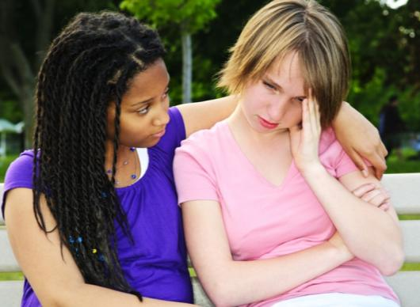
Emotional Intelligence
People with high emotional intelligence can identify the emotions they are feeling
They also understand the emotions of others
They have high levels of empathy
They are able to express their emotions in healthy, positive ways
Elena Elisseeva/shutterstock.com

Slide 11
Lesson 15.2
Establishing Your Identity

Slide 12
Forming an Identity
Your identity includes
Physical identity
Active identity
Social identity
Psychological identity
People often focus on different parts of their identities at different ages
Rob Byron/shutterstock.com

Slide 13
How does a child typically define her or his identity?
How does identity focus shift as children enter adolescence?
How does identity focus shift again during high school?

Slide 14
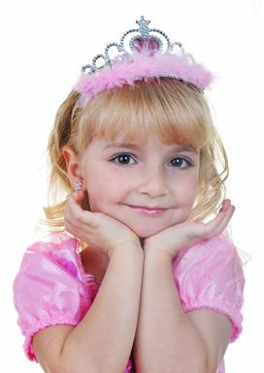
Gender Identity
Gender identity is a person’s biological makeup—male or female—and how a person experiences or expresses that makeup
Young children learn gender roles around three years of age
Gender identity is influenced in part by a person’s culture
Denis Tabler/shutterstock.com

Slide 15
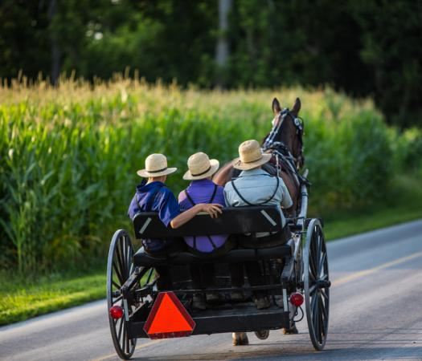
Ethnic Identity
Ethnicity is a person’s connection to a social group that shares similar cultural or national ties
People may define their ethnicity through
Traditions
Language
Religious practices
Cultural values
hutch photography/shutterstock.com

Slide 16
Critical Thinking
Ethnic Groups
Can a person belong to more than one ethnic group?
To what ethnic group or groups do you belong?

Slide 17
Identity Changes in Life Stages
A famous psychologist, Erik Erikson, believed that people go through eight stages in life
In each stage, people focus on accomplishing different goals
According to Erikson, the primary task for adolescents is to form a sense of unique identity
Condor 36/shutterstock.com

Slide 18
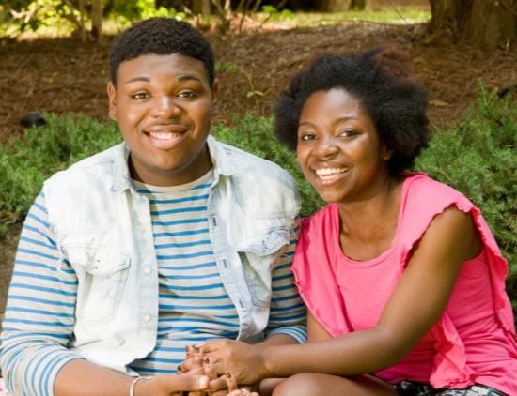
Emotional and Social Changes
Many teenagers experience changes in their emotions and social relationships
Having more interest in dating
Showing more independence from parents
Feeling more intense emotions
threerocksimages/shutterstock.com

Slide 19
Moral Development
Adolescents show changes in how they think about moral decisions
By the time they reach high school, teenagers have typically formed their own moral code
They can use this code to decide how to act in situations
milias1987/shutterstock.com

Slide 20
Critical Thinking
Moral Code
What are some ideas or beliefs that might be part of a person’s moral code?
What is an example of how a person’s moral code might affect his or her behavior?

Slide 21
Lesson 15.3
Understanding Self-Esteem

Slide 22
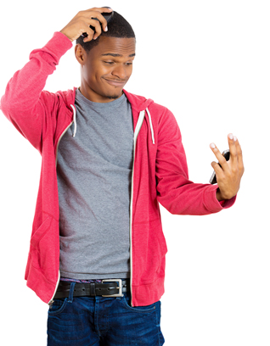
Self-Image
Your self-image is your mental picture of yourself
Your appearance
Your skills and abilities
Your weaknesses
Your self-image forms gradually over time
It is influenced by your life experiences
PathDoc/shutterstock.com

Slide 23
Self-Esteem
Self-esteem describes how you feel about yourself
People who like themselves have high self-esteem
People who have low self-esteem doubt their own self-worth and may feel negatively about their traits, skills, and abilities
Antonio Guillem/shutterstock.com

Slide 24
Why Self-Esteem Matters
Your self-esteem has a major impact on different aspects of your life
How well you do in school
How easily you make friends
How you manage disappointments and frustrations
Mike Flippo/shutterstock.com

Slide 25
Critical Thinking
Self-Esteem
What are some characteristics that people with high self-esteem have?
What are some characteristics that people with low self-esteem have?

Slide 26
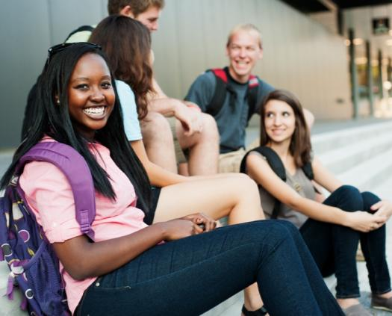
Factors that Affect Self-Esteem
Many factors can affect self-esteem
Social interactions
Home, school, community, and cultural environments
Life events
Media (books, movies, or social media)
Body image
Personal perceptions
RyFlip/shutterstock.com

Slide 27
Self-Actualization
Self-Actualization
Esteem
Love and Acceptance
Security
Basic Needs
Self-actualization is the feeling that you are becoming the best person you can be
According to psychologist Abraham Maslow, self-actualization occurs only after you meet your basic needs

Slide 28
What are some characteristics that people who are achieving self-actualization share?
Accepting themselves and others for who they are
Feeling self-motivated
Working actively to solve problems
Viewing the world with a sense of appreciation
Enjoying spending time with other people as well as alone
Feeling at peace with themselves and the world

Slide 29
Lesson 15.4
Improving Your Mental and Emotional Health

Slide 30
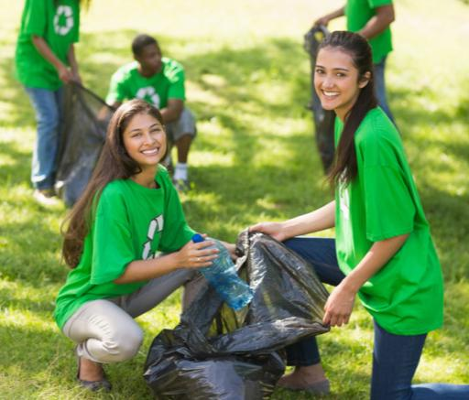
Good Mental and Emotional Health
People with good mental and emotional health share certain traits
Having a zest for life
Being responsible
Keeping a sense of balance
Being trustworthy, respectful, kind, and compassionate
Demonstrating good citizenship
wavebreakmedia/shutterstock.com

Slide 31
Improving Mental Health
Strategies you can use to help improve your mental and emotional health
Spend time in nature
Develop strategies for reducing stress
Set and work toward goals
Have fun
Focus on the good, not the bad
Maintain close relationships
auremar/shutterstock.com

Slide 32
Critical Thinking
Relationships
Why do you think maintaining close relationships with other people is important for good mental and emotional health?
Kirill Linnik/iStock/thinkstock.com

Slide 33
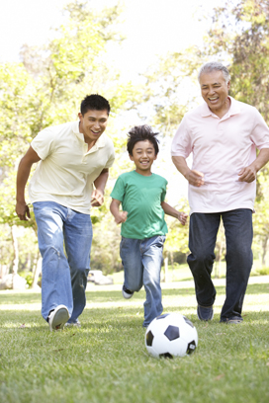
Improving Physical Health
Improving your physical health will lead to better mental and emotional well-being
Follow these strategies
Get adequate sleep
Practice good nutrition
Get plenty of physical activity
Avoid risky behaviors
Monkey Business Images/shutterstock.com

Slide 34
Improving Intellectual Health
There are many ways you can work on improving your intellectual health
Make good decisions
Develop new skills and interests
Play games
Read a book for pleasure
Lucky Business/shutterstock.com

Slide 35
Why is developing new skills and interests important for good mental and emotional health?
What are some activities you can do to explore new talents or interests?
Design Pics/thinkstock.com

Slide 36
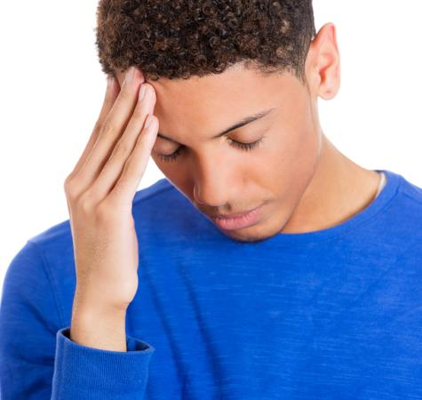
Get Help When You Need It
Some people may make a real effort to improve their mental and emotional health and still do not feel better
These people should consider getting help from a counselor or other mental health professional
PathDoc/shutterstock.com

