Slide 2
Chapter 4
Body Weight and Composition
Lesson 4.1 What Is a Healthy Weight?
Lesson 4.2 Factors that Influence Weight
Lesson 4.3 Treatment and Prevention of Weight Problems

Slide 3
Lesson 4.1
What Is a Healthy Weight?

Slide 4
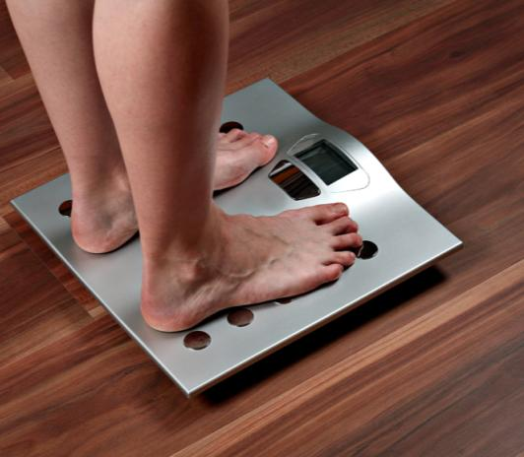
Warm-Up
Healthy Weight
Approximately 36% of adults and 17% of children and adolescents in the United States are obese.
Why do you think so many Americans are overweight?
What can you do to maintain a healthy weight?
Bine Å edivy/iStock/thinkstock.com

Slide 5
Weight and Body Composition
Factors that determine what you should weigh
Age
Gender
Height
Body composition
Body composition is the ratio of the various components—fat, bone, and muscle—that make up your body
Kzenon/shutterstock.com

Slide 6
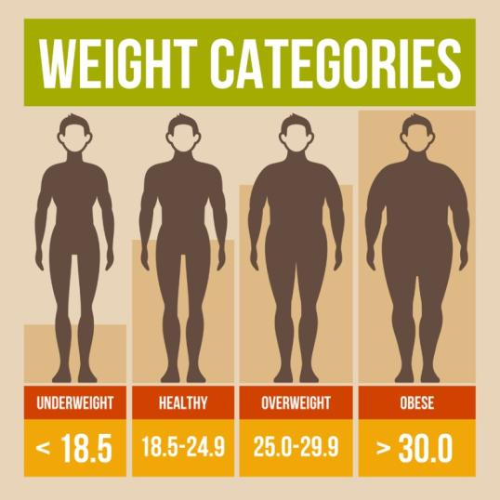
Determining a Healthy Weight
Traditionally, height-weight tables have been used to determine healthy weight
Body mass index (BMI) and other measures provide more accurate readings than tables
In-Finity/shutterstock.com

Slide 7
Body Mass Index (BMI)
BMI is calculated to determine whether a person is a healthy weight for his or her height
The resulting BMI number is interpreted differently for different age groups
Adults with a BMI between 25 and 29.9 are considered overweight
BMI = Weight (lbs.) × 703
Height (in.) ²

Slide 8
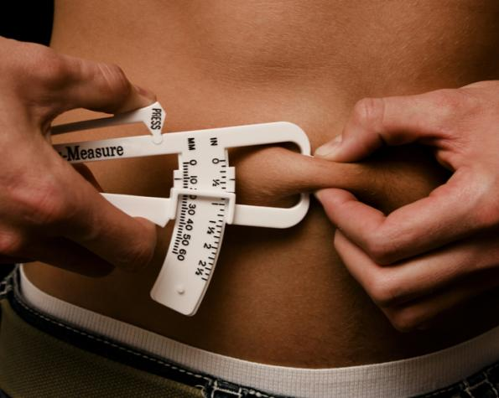
Other Body Composition Measures
The skinfold test is a reliable measure of body composition
Additional methods for measuring body composition include
DXA scans
Underwater weighing
Air displacement
Bioelectrical impedance
airet/iStock/thinkstock.com

Slide 9
Myth or Fact?
The distribution or location of body fat has no impact on your health.
MYTH
Fact: The location of the fat deposits on your body can be as important, if not more important, to your health as how much fat you have.
Fact: Waist circumference and waist-to-hip ratio are two methods used to assess body fat distribution.

Slide 10
Underweight and Your Health
Causes for underweight
Cancer or other disease
Alcohol or drug abuse
Genetics
Psychological problems
Lack of access to food (most common)
Deficiency diseases are caused by inadequate intake of various nutrients
Photographee.eu/shutterstock.com

Slide 11
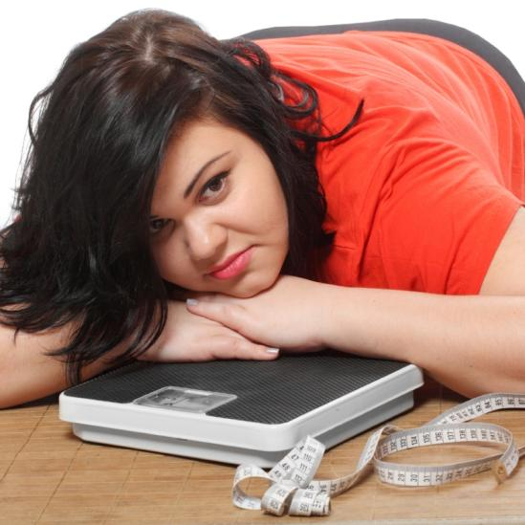
Overweight and Your Health
Being overweight contributes to a range of health issues
Heart disease
Hypertension
Liver and gallbladder disease
Many types of cancer
Diabetes
Kletr/shutterstock.com

Slide 12
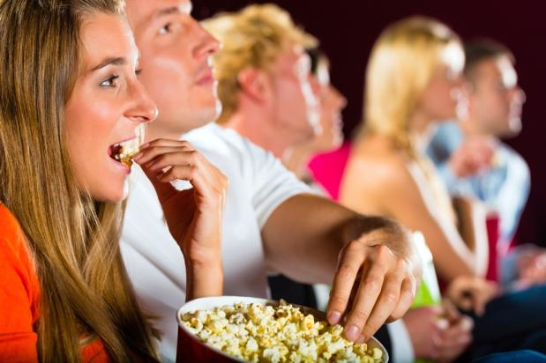
Critical Thinking
Malnutrition
Is malnutrition unique to underweight individuals?
Can a person who is overweight or obese also experience malnutrition? Explain your answer.
kzenon/iStock/thinkstock.com

Slide 13
Lesson 4.2
Factors that
Influence Weight

Slide 14
The Influence of Genetics
Genetic factors influence how much people weigh
Genetic factors alone do not cause obesity
Studies suggest that genes have a stronger influence on weight than environment
Lisa F. Young/shutterstock.com

Slide 15
How Genes Impact Weight
Researchers have found 32 different genes that may influence weight
Genes may influence
Food preferences
Hormone levels that affect how hungry a person feels
Metabolism
Monkey Business Images/shutterstock.com

Slide 16
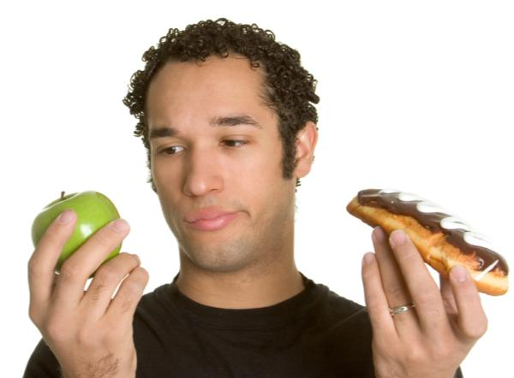
While genes do not control your food choices, they may influence your food preferences.
What sorts of foods do the members of your family prefer?
Do you also prefer these foods?
What foods do you like that your family members do not like?
Jason Stitt/shutterstock.com

Slide 17
Social and Psychological Factors
Eating can be triggered by a psychological desire for food rather than a physiological need for food
Eating can be part of celebrating happy occasions
Some people tend to eat more when feeling nervous or sad
Click here for the Unit 2 video, “Dining Dilemma”
Dan Kosmayer/shutterstock.com

Slide 18
Myth or Fact?
Your environment influences your eating in a number of ways.
FACT
Fact: People eat more when dining with others than when they are alone.
Fact: People eat more when a variety of foods is available.

Slide 19
Portion Size
The amount of food served for a single person is called portion size
Portion sizes in the United States have become much larger over time
This contributes to overeating
cobraphotography/shutterstock.com

Slide 20
Cultural Factors
People in different cultures prefer different types of foods and tastes
Culture also influences how, where, and how much you eat
Different groups have different values and preferences regarding ideal weight
Sean Locke Photography/shutterstock.com

Slide 21
Socioeconomic Status
Socioeconomic status plays a role in the prevalence of obesity
Low-income families may have less to spend on healthful foods
Low-income areas may offer fewer opportunities for physical activity
Rick Becker-Leckrone/shutterstock.com

Slide 22
Lesson 4.3
Treatment and Prevention of Weight Problems

Slide 23
Critical Thinking
Healthy Eating Habits
Adults who are overweight were often overweight as
children.
What can you do to help the children in your life develop healthy eating habits?
MIXA next/thinkstock.com

Slide 24
Strategies for Healthy Weight Loss
To maintain your current weight, you must balance calories consumed with calories used
Weight loss occurs when you eat fewer calories than are needed for physical activity
stockyimages/shutterstock.com

Slide 25
Realistic Goals
Set realistic, short-term goals regarding eating and exercise
Focus on gradual weight loss of one to two pounds a week
Monitor exactly when and what you eat to help reach your goals
Ivan1981Roo/shutterstock.com

Slide 26
A food diary is a record of what a person eats each day.
Why do you think keeping track of what you eat is so important to weight management?
How might keeping track of where you eat also be helpful?
bevangoldswain/iStock/thinkstock.com

Slide 27
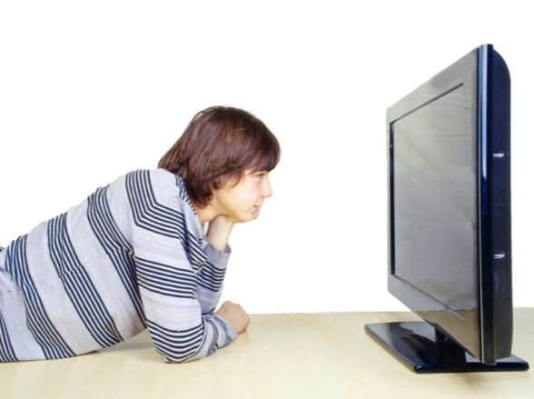
Limit Screen Time
People who spend many hours watching TV or playing video games are more likely to be overweight or obese
Watching TV also increases exposure to commercials for unhealthy foods and beverages
papa1266/shutterstock.com

Slide 28
Change Your Thoughts
Try to change your negative thoughts about eating and weight
An “all-or-nothing” mindset about eating can undermine weight-loss efforts
Forgive brief lapses and return to your new healthy habits
Rob Byron/shutterstock.com

Slide 29
Changing eating and exercise behaviors is difficult, so it is helpful to have support from those around you.
What are some ways that your family or friends can support your weight loss or healthy eating efforts?
michaeljung/shutterstock.com

Slide 30
Unhealthy Weight-Loss Strategies
Weight-loss programs are generally unsuccessful
Most people who participate in these programs regain about one-third of any weight lost within one year
They return to their initial weight within three to five years
forestpath/shutterstock.com

Slide 31
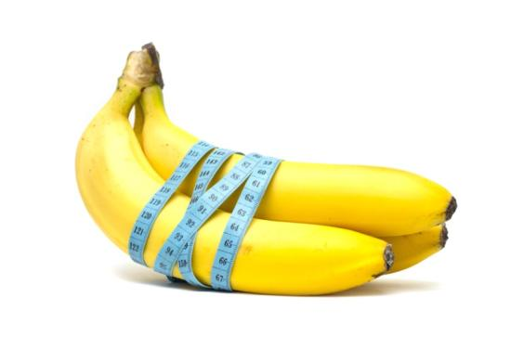
Fad Diets
Weight-loss methods that are extremely popular for a certain time period
May focus on one food
Often unhealthy
Typically do not produce lasting weight-loss results
Zhax/shutterstock.com

Slide 32
Drugs
Appetite suppressants and diuretics may lead to short-term weight loss
Dietary and herbal supplements can have serious side effects
Lisa S. /shutterstock.com

Slide 33
Healthy Strategies for Gaining Weight
Healthy weight-gain strategies should focus on nutrient-dense foods
People who are underweight need to monitor their eating
They can also benefit from the social support of others
Pressmaster/shutterstock.com

