Slide 2
Chapter 5
Body Image
Lesson 5.1 Factors that Influence Body Image
Lesson 5.2 What Are Eating Disorders?
Lesson 5.3 Treating and Preventing Body Image Issues

Slide 3
Lesson 5.1
Factors that Influence Body Image

Slide 4
Warm-Up
Body Image
Your thoughts and feelings about how you look make up your body image.
What are three things that you like about your body?
Name two things you can do to improve your body image.
monkeybusinessimages/iStock/thinkstock.com

Slide 5
Body Image
Your body image doesn’t describe what your body actually looks like—but how you think it looks
People with a positive body image appreciate and value their bodies
Tiplyashina Evgeniya/shutterstock.com

Slide 6
Family and Peers
A child’s body image is influenced by his or her parents
A teenager’s body image is also influenced by his or her friends
All teenagers feel self-conscious about their bodies at some time
Samuel Borges Photography/shutterstock.com

Slide 7
Critical Thinking
Body Image
Teenagers sometimes make unhealthy choices when attempting to change their body shape or size.
What are some unhealthy choices you have seen your friends or classmates make?
Andreas Rodriguez/iStock/thinkstock.com

Slide 8
In the Media
Advertisements convey messages about what is regarded as attractive and desirable
Images of celebrities can also set standards for attractiveness
These images are often unrealistic or misleading
John Warner/shutterstock.com

Slide 9
Female Body Image
Popular media employs images of women who are consistently young and thin
This promotes an unrealistic standard of attractiveness against which women are measured
Sheftsoff/shutterstock.com

Slide 10
Male Body Image
Males are feeling increased pressure to conform to an unrealistic body image
Media images of men have become increasingly muscular
This has led some boys and men to take extreme measures to change their body shape and size
Maridav/shutterstock.com

Slide 11
Men also feel pressured to change their body to match unrealistic ideals.
What are some examples of ways boys or men make try to change their body image?
Which of these ways are healthy choices? Which ones are not?
Steve Pepple/iStock/thinkstock.com

Slide 12
Ethnicity and Body Image
Media ideals for body image are not embraced to the same extent by everyone
Different groups have different values and preferences when it comes to ideal weight and appearance
Flashon Studio/shutterstock.com

Slide 13
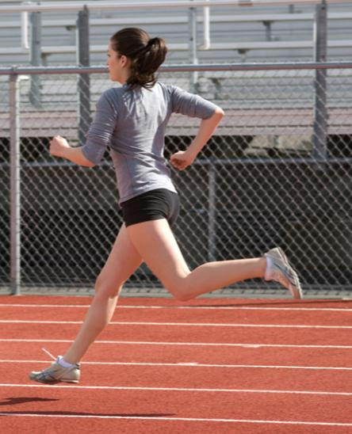
Sports and Body Image
Involvement in sports can influence a person’s body image
Athletes may feel pressure from coaches or parents to maintain a thin body
Teenagers in sports that do not emphasize thinness feel less pressure to be thin
Brian Chase/shutterstock.com

Slide 14
Lesson 5.2
What Are Eating Disorders?

Slide 15
Eating Disorder
A serious illness that causes major disturbances in a person’s daily diet
There are three main types
Anorexia nervosa
Bulimia nervosa
Binge-eating disorder
Elenathewise/iStock/thinkstock.com

Slide 16
Anorexia Nervosa
An eating disorder in which a person has an intense fear of gaining weight
The person eats too little and loses far more weight than is healthy
Often marked by lack of menstruation among females
Julija Sapic/shutterstock.com

Slide 17
Bulimia Nervosa
An eating disorder in which a person has recurrent episodes of binge eating followed by purging
Binge-purge episodes are often triggered by some type of negative emotion
Twin Design/shutterstock.com

Slide 18
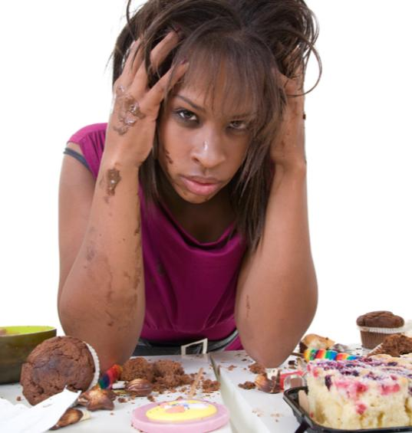
Binge-Eating Disorder
An eating disorder in which a person consumes a huge amount of food in a short period of time
Accompanied by feelings of extreme distress during or after bingeing
Simone van den Berg/shutterstock.com

Slide 19
Do people with eating disorders typically have a healthy body image?
How does a person’s body image relate to his or her eating behaviors?
Piotr Marcinski/shutterstock.com

Slide 20
Problems Caused by Eating Disorders
Anorexia nervosa
Decreased bone density
Brittle hair and nails
Mild anemia
Muscle wasting and weakness
Severe constipation
Low blood pressure
Heart and brain damage
Organ failure
Infertility
Bulimia nervosa and binge-eating disorder
Inflamed and sore throat
Swollen salivary glands
Sensitive and decaying teeth
Severe dehydration
Electrolyte imbalance
Damage to the stomach and intestines
Hypoglycemia

Slide 21
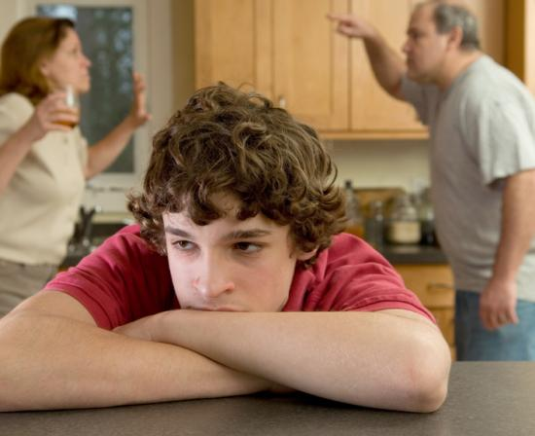
Contributing Factors
Experts believe biological and genetic factors may trigger the development of eating disorders
Family dynamics can also play a role
Some children learn unhealthy eating patterns from watching their parents
ejwhite/shutterstock.com

Slide 22
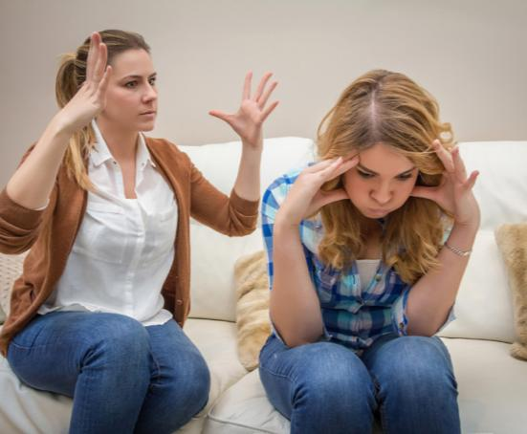
Critical Thinking
Family Dynamics
Negative interaction patterns within a family may trigger disordered eating.
What are some negative patterns or behaviors that may lead to stress and eating disorders for a family member?
David Pereiras/shutterstock.com

Slide 23
Lesson 5.3
Treating and Preventing Body Image Issues

Slide 24
Treating Eating Disorders
People who have eating disorders are often reluctant to seek treatment
They may be embarrassed to admit their behavior
Some people are afraid that treating their disorder will cause them to gain weight
Alexsokolov/iStock/thinkstock.com

Slide 25
Myth or Fact?
Most people are able to overcome disordered eating behaviors on their own.
MYTH
Fact: Eating disorders rarely go away without proper treatment.
Fact: Eating disorders are mental disorders and should be treated by mental health professionals.

Slide 26
Individual Therapy
Many people find that talking with a therapist is very helpful in managing eating disorders
Cognitive-behavioral therapy helps patients create more normal eating patterns
wavebreakmedia/shutterstock.com

Slide 27
Family Therapy
Involves parents or guardians and siblings of patients in treatment
Many therapists recommend some combination of individual and family therapy
Creativa Images/shutterstock.com

Slide 28
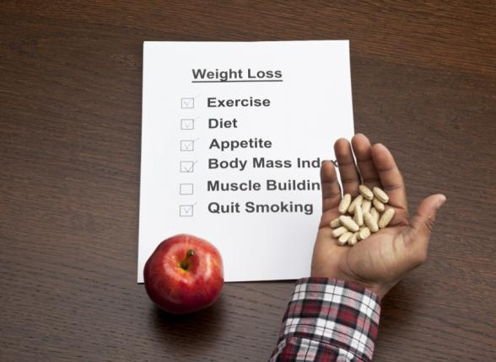
Challenges of Treatment
People with eating disorders have a relatively high rate of relapse
Their bodies may be unable to repair the damage caused by years of disordered eating
Dan Kosmayer/shutterstock.com

Slide 29
Critical Thinking
Recovery
Recovery from an eating disorder does not always yield instant results.
Why is recovery from eating disorders best viewed as a process?
Maridav/iStock/thinkstock.com

Slide 30
Preventing Body Image Issues
Strategies for developing a healthy body image
Remember that images of people in the media are manipulated to create an idealized image
Be aware of the nature and origins of the thin ideal
Realize the negative effects of believing in this ideal
Focus on positive thoughts about your body
MJTH/shutterstock.com

Slide 31
What Businesses Are Doing
Some companies are using more realistic images of people in their advertising
Some magazines have banned the use of underweight models in advertising
Ryan McVay/Photodisc/thinkstock.com

Slide 32
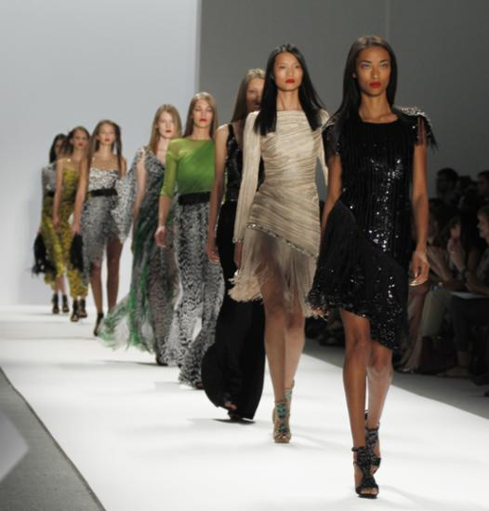
What Governments Are Doing
Spain and Italy require that models have a BMI of at least 18.5 to be in some fashion-week shows
Israel became the first country to pass laws banning the use of extremely thin models in ads
Nata Sha/shutterstock.com

Slide 33
Do you think the US government should pass legislation banning certain types of advertising related to body image? Why or why not?
AndreyKrav/iStock/thinkstock.com

