Slide 1
Preventing Overtraining
MCST PE Dept.

Slide 2
Are you overtraining?
Too much exercise may lead to OVERTRAINING, which can make you susceptible to illness and injury
Conditioning requires a balance between overload and recovery. Too much overload and/or too little recovery may result in both physical and psychological symptoms of overtraining syndrome

Slide 3
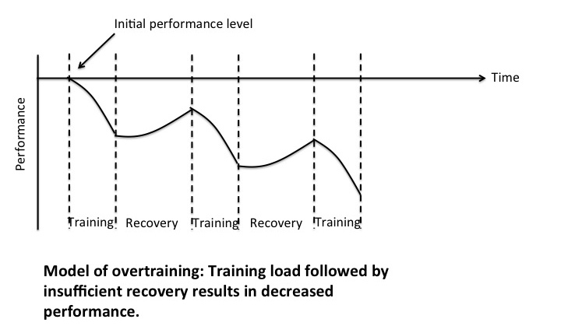
Overtraining is hard to predict since we are all different
It is important to vary training throughout the year and schedule significant rest periods

Slide 4
Common Warning signs
Achiness or pain in the muscle and/or joint
Fatigue
Headaches
Elevated morning pulse
Sudden inability to complete workouts
Feeling unmotivated and lacking energy
Increased susceptibility to colds, sore throats and other illnesses
Loss in appetite
Decrease in performance
A compulsive need to exercise

Slide 6
Measuring Overtraining
Take 3 days off from all training
Each morning take your resting HR prior to getting out of bed
Average your 3 day resting HR. This becomes your baseline resting HR average
After you being training, repeat the above steps
If your resting HR begins to increase 3-5 beats you need to take some time off

Slide 7
Preventing Overtraining Syndrome
Allow one day of rest before working the same muscle group again
Do not do intense and difficult workouts everyday of the week
Warm up prior to each workout
Fuel-up after exercise
Stretch
Schedule recovery days into your weekly routine
Get adequate sleep

Slide 9
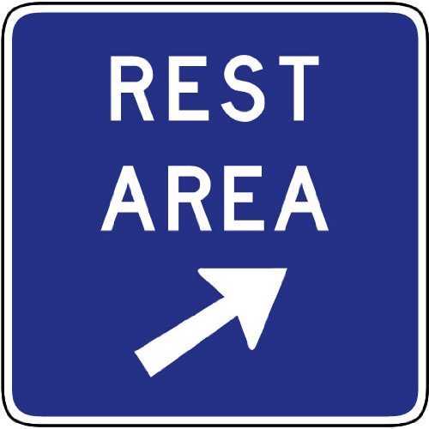
Treating overtraining syndrome
Reduce or stop your exercise and allow for a few days of rest
Drink plenty of fluids
Alter your diet if necessary
Total recovery can take up to several weeks and includes proper nutrition and stress reduction

