Slide 1
Sins of weightlifting
MCST P.E. DEPT.

Slide 2
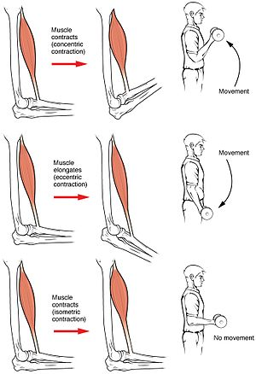
Phases of a muscle contraction
Isokinetic – Pertaining to a concentric or eccentric contraction of a muscle, in which the speed and tension are constant throughout the range of lengthening or contracting
Produce movements of a constant speed

Slide 3
Muscle Contractions

Slide 4
Sin: Skipping the warm up & cool down
If your lifting significant weight and you don’t warm up, it will be harder for you to lift. Your muscles will not be ready and your change of injury significantly increases
DO A GENERAL WARM UP: Use a cardio machine at a moderate level for at least 5 minutes
THEN, DO A SPECIFIC WARM UP for each of the exercises.. 10 reps @ 25% of the weight you intend to lift moving to 50% before you do your full workout.
COOL DOWN

Slide 5
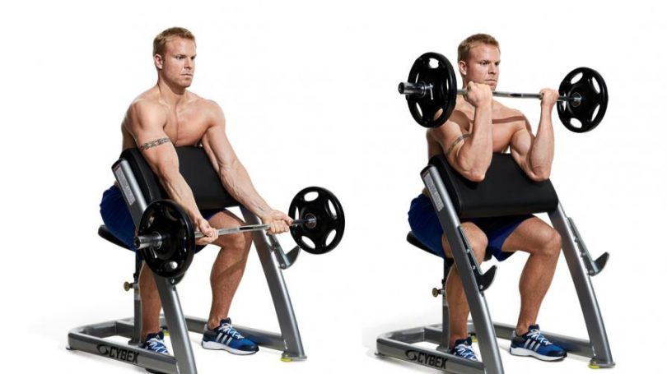
Sin: Rocking Hips & Pelvis while doing a bicep curl
Moving your pelvis back and fourth during curls is using momentum to help rather than isolating the muscle and progressing through the phases of a muscle contraction
This isn't allowing an effective workout and can cause injury or harm to your back
Solution:
Perform the motion allowing only the biceps to
contribute to
Try it seated with your legs spread, resting your
elbow against the inside of your leg
Use a preacher bench
Stand up with your butt and back firm against the
wall
Have a 25 degree hip angle with your legs straight

Slide 6
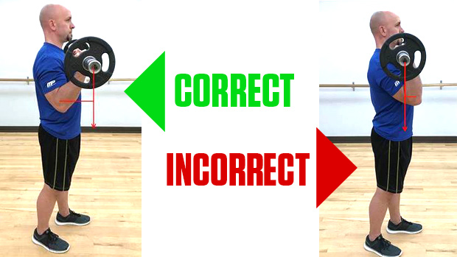
Sin: Stopping Short
Not exercising through a full range of motion is a common mistake
Ex. (Bicep Curl)
Many people stop before they’ve extended their arm all the way down. This only strengthens the upper bicep
Solution: - The exercise should be done in a slow, controlled manner through the complete range of motion with emphasis on the completely contracted position. - Using full range contracts and strengthens the muscle your working and stretches the opposite muscle.

Slide 7
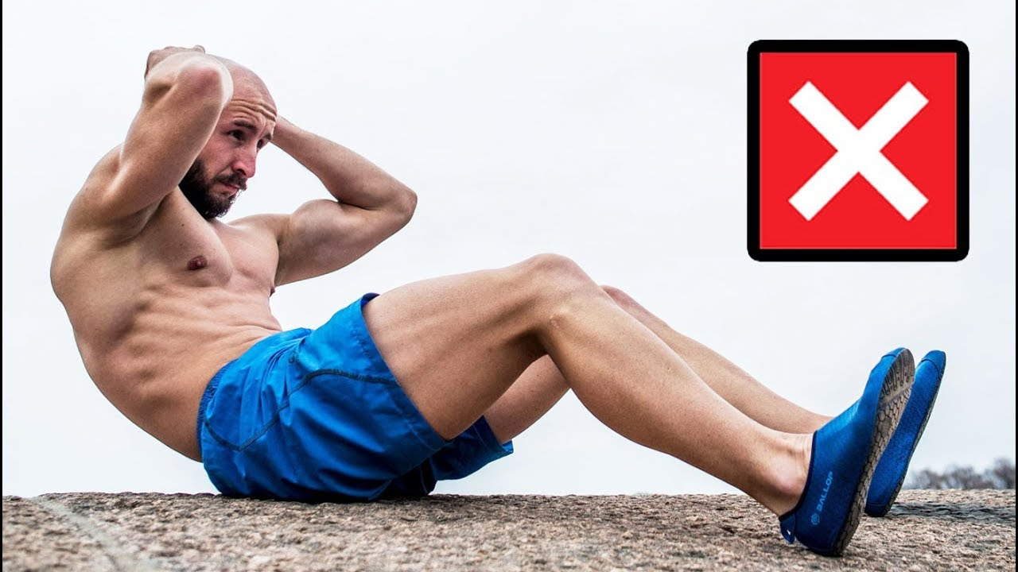
Sin: Straining the neck when doing crunches
Wildly common mistakes
– People place their hands behind their neck and often yank on their neck with their arms to bring their head up, rather than using their core
- People lift with their legs rather than with their core resulting in feeling sore in the quadriceps or hip flexor region
Solution:
- Cross your arms in front of your chest and hold your torso, neck and head in a straight alignment. Your back will elevate to the lumbar spine region
Lifting your torso and NOT just your shoulders off of the floor will give you a lower abdomen workout as well

Slide 8
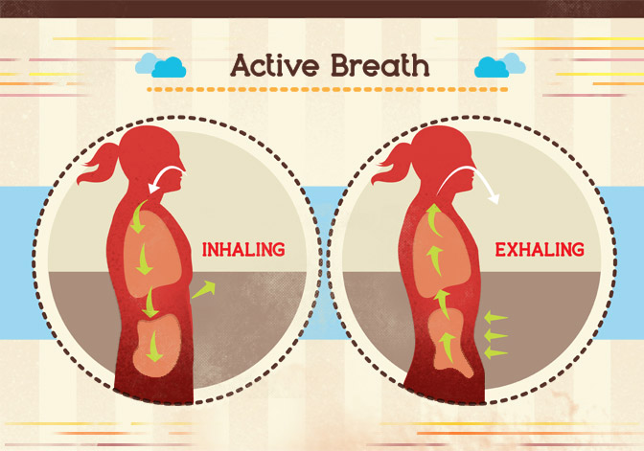
SIN: Holding your breath during a rep
It’s easy to forget to breathe, but its very important
Lifting weights causes your blood pressure to increase temporarily. Holding your breath makes it soar even more then suddenly drop.
This dramatic fluctuation in BP can make you pass out or if you have a heart condition could even cause a stroke.
Solution:
Develop a breathing pattern while you’re lifting. Take a breath with each repetition to make sure your not holding your breath
Some inhale at the beginning of a repetition and expire at the end, while other inhale on the upstroke and exhale on the down stroke

Slide 9
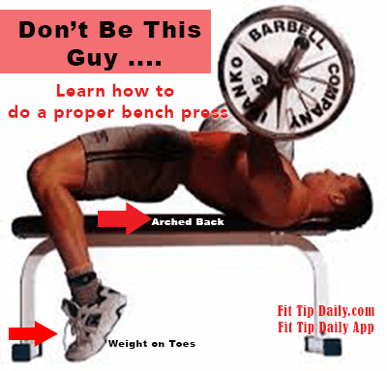
Sin: Lifting your hips off the bench when doing a bench press
When you lift your hips, you change the angle of your shoulders as you lift the bar
This means your only using your lower pectoral muscles instead of the entire pectoral muscle
Your feet are also contributing = not working as hard
Solution:
- Place your legs on the bench with your knees bent and your feet down. If you’re tempted to push with your feet, you’ll find very quickly that you’ll lose your balance and fall

Slide 11
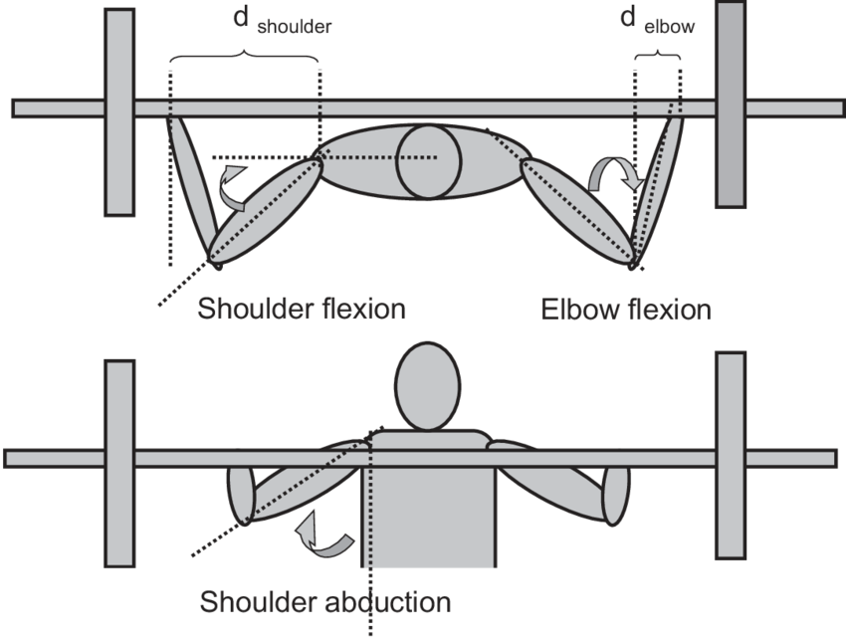
Sin: allowing your elbows to go too far behind your back in a bench or chest press
There is a fine line between a full range of motion and hyperextension
In the bench or chest press, the further you bring your elbows down, the more you increase your chances of injuring your shoulders
Solution
As a general guideline, lower the weight onto your chest until your forearms are perpendicular to the floor
Elbows drop slightly below your chest. In a bench press, your shoulders should depress to 45 degree angles
The bar should be coming down straight to the sternum and press upward evenly

Slide 13
Sin: Squatting with the bar on your neck
No matter what type of squat you do, the basic setup will be the same
Set the height of the bar to be about the same height as your collarbone
Always warm up with just the bar weight
Start by stepping up to the bar facing it and step under the bar.
Feet slightly wider than hip width apart, toes slightly pointing outward, butt back, squat down slowly, drop so the tops of your legs are parallel or lower, and stand back up
The width of your grip depends on your flexibility, but generally a narrower (closer to your shoulders0 grip will help to create a meaty shelf for you to place the bar on out of the muscles in your upper back (the bar will sit on your read deltoids
Once the bar is on your back, stand step back, stabilize and tighten your core (tighten your glutes, flex your stomach) and squat down

Slide 14
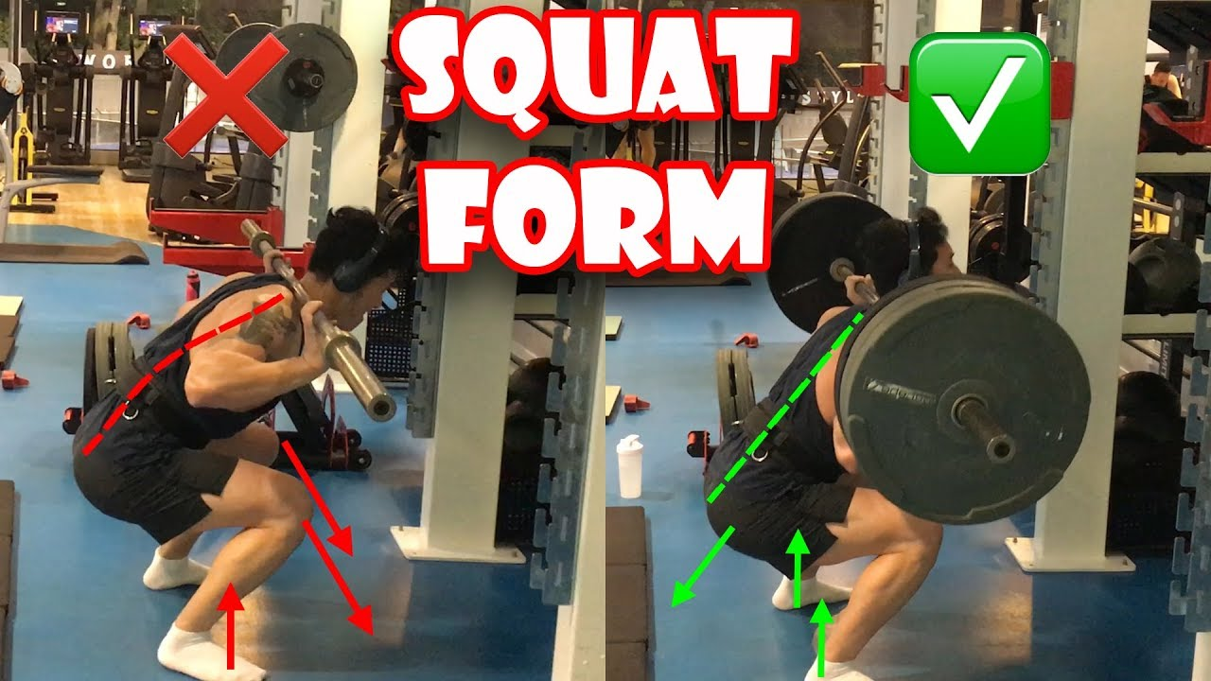

Slide 15
