Slide 1
Components of Fitness
Physical Education Dept. Morris County School of Technology

Slide 2
5 Components of Fitness
Cardiovascular Endurance
What is Cardiovascular Endurance ?
Cardiovascular, which is synonymous with cardiopulmonary exercise or "Cardio" is aerobic physical activities lasting > 90 seconds.
Understand terminology
cardio = heart,
vascular = related to blood vessels
pulmonary = related to the lungs.
Cardiovascular or cardiopulmonary endurance is your physical ability to maintain aerobic exercise for prolonged periods of time.
Physiologically, cardiovascular endurance deals with the efficiency of your body's (heart, lungs and vascular system) ability to transfer oxygen rich blood to your working muscles during activities that last longer than 90 seconds.

Slide 3
Why is Cardiovascular Endurance Important ?
The more cardiovascularly fit you are, the healthier your lungs, heart and vascular system are.
If you demonstrate high levels of cardiovascular endurance during exercise you also have more efficient heart, lungs and vascular system while at rest which takes up the bulk of your time. (This means less stress is put on your heart and lungs around the clock which enables you to avoid illness and live a long healthy life.)

Slide 4
Muscular Strength
What is Muscular Strength ?
The amount of force your muscle can exert against resistance for short duration, anaerobic (without oxygen) activities. Resistance includes external objects such as free weights or household objects as well as your own body weight.
Physiologically, Muscular Strength is the body’s ability to supply ATP (Adenosine Tri-Phosphate or muscle energy) to your muscle fibers for concentric, eccentric and isometric contractions for a duration of 0 to around 15 seconds.

Slide 5
Why is Muscular Strength Important ?
The primary reason why muscular strength is important is your efficiency at Activities of Daily Living (ADLs).
To be physically fit in the muscular strength department, you should demonstrate at least the basic muscular strength needed to efficiently perform your ADLs
ADLs vary from person to person, you can also consider activities such as push-ups, pull-ups and carrying heavy objects as ADLs.
Poor muscular strength can effect aerobic fitness and muscular endurance negatively.
Bathing | Dressing | Grooming
Walking | Cooking | Climbing stairs

Slide 6
Muscular Endurance
What is Muscular Endurance ?
Muscle endurance deals with sustained muscle contractions and other anaerobic activities lasting less than about 90 seconds.
Why is Muscular Endurance Important ?
Muscular endurance is the bridge between muscular strength and cardiovascular endurance. In order to be cardiovascularly fit, you must demonstrate muscular endurance.
Physiologically, while muscle strength deals primarily with type II, fast twitch muscle fibers, muscular endurance deals with primarily type I, slow twitch muscle fibers. Your body contains both but only anaerobic exercises which last longer than around 15 seconds and less than 90 seconds strengthen your type I muscle fibers.

Slide 7
Flexibility
What is Flexibility?
Flexibility is the range of motion (ROM) possible for each of your joints or groups of joints.
Why is Flexibility Important ?
To some degree, your flexibility determines how efficient your muscles are. Increased flexibility has also been associated with a decreased risk of acute and chronic (overuse) injuries.
Poor flexibility can directly effect cardiovascular endurance, muscle strength, and muscle endurance.
Physiologically, flexibility can include extra-muscular (range of motion at a joint) and intramuscular factors such as hypertonicity (knots) within the muscles themselves.

Slide 8
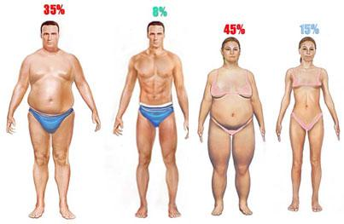
Body Composition
What is Body Composition?
Body composition is the percentage of your body’s tissues which you exhibit.
Simplest way to look at body composition is with a 2 compartment analysis. Estimating the amount of body fat you have with lean body mass (muscle, bone, water, and organs).
It takes expensive equipment for a 3 compartment analysis which isolates bone mass (Also considered an important part of body composition.

Slide 9
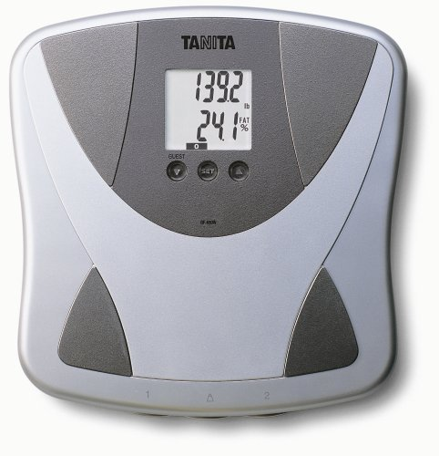
Why is Body Composition important?
Body composition depends on the other components of physical fitness.
Having poor body composition has many negative physical and psychological effects such as a increased chance of a host of chronic diseases and depression.
Improper exercise habits and choices can not only
lead to being overweight and obesity, but decreased
bone mass which is associated with osteoporosis.
Body Fat Scale →

Slide 10
Which of the 5 Basic Components of Fitness is the MOST Important?
You are Only as Physically Fit as Your Weakest Link!!!
If you haven’t gotten the point of this presentation…you CANNOT rank one of the health related components of physical fitness over the other. All 5 components of physical fitness are interdependent upon each other. If you are very strong but can’t jog a mile without getting out of breath, you need to focus more on your aerobic exercise. If you are very lean and cardiovasularly fit but you can’t touch your toes, you need to work on your flexibility….and so on.
Physical Fitness
Cardiovascular Endurance
Muscular Strength
Muscular Endurance
Flexibility
Body Composition

