Slide 1
Soccer
Morris Tech Physical Education Dept.

Slide 2
History of Soccer
Soccer is the most popular game in the world and is the most popular youth sport in the United States. Soccer is known throughout the world as “football”.
Modern football was born in 1863 when the English Football Association was founded. The roots of the game stretch back centuries. Evidence shows they were kicking a rudimentary ball more than 2,000 years ago in China. Other countries have their own claims to have played the first football game (ancient Greece and Rome included), but it was in England where the village contests of medieval times evolved into popular ball games in the public schools of the 19th century.
1863: the first basic rules were established. Tripping opponents was forbidden and handling the ball was soon to follow. The new sport did not look back.
1882: The associations in Great Britain unified their rules and formed the International Football Association Board (IFAB) to control the laws of the game.
1913: FIFA becomes a member of the IFAB.
1970: The system of red and yellow cards was introduced for the 1970 FIFA World Cup ™ finals.

Slide 3
Field Dimensions/Line Markings

Slide 4
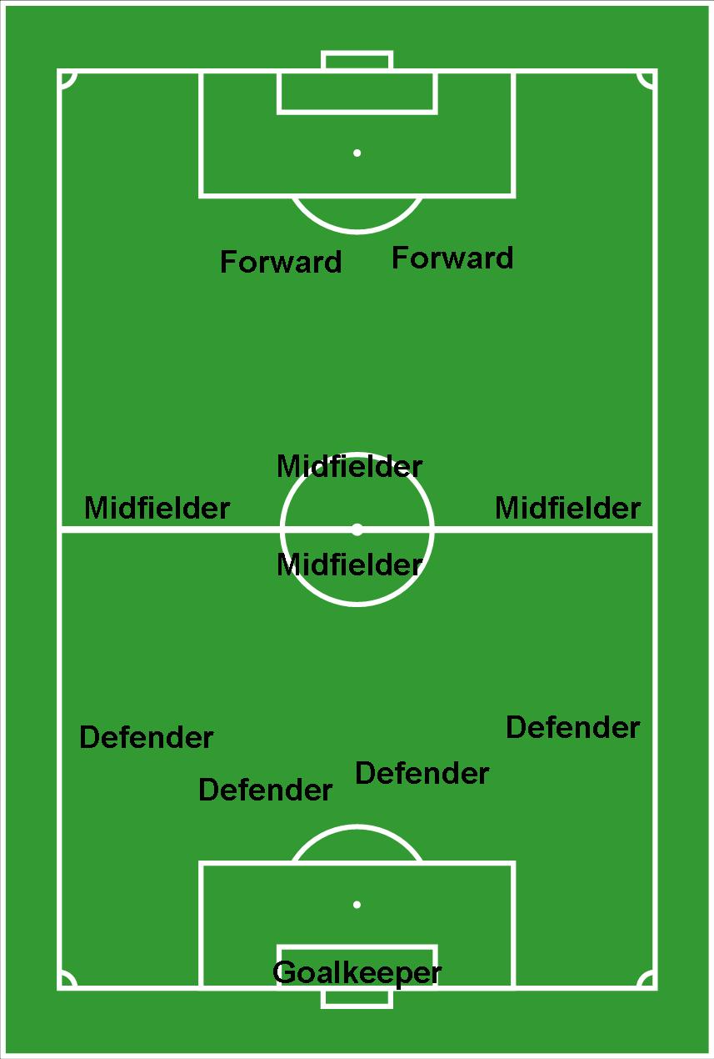
Player Positions
The object of the game is to move the ball down the field by foot, head, or body contact (no hands/arms) to score goals and to prevent the opposing team from scoring.
In a normal outdoor game of soccer there are 11 players from each team on the field at one time.
The 11 positions are labeled in the diagram to your right (these represent one team).

Slide 5
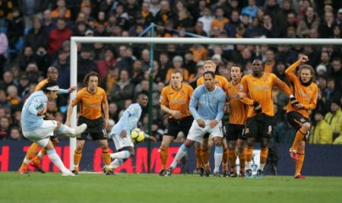
Soccer Fouls - Direct Free Kick
Direct Free Kick - A direct free kick will be taken from the place where the offence occurred with a pass or a shot at goal. Any members of the opposing team must be at least 10 yards away when the ball is struck.
A direct free kick is awarded to the opposing team if a player commits the following offenses in a “careless, reckless or excessive manner”
Kicks or attempts to kick an opponent
Trips or attempts to trip an opponent
Jumps at an opponent
Charges into an opponent
Strikes or attempts to strike an opponent
Pushes an opponent
Tackles and opponent
Holds or spits at an opponent
Handball (ball touches players hand or arm)

Slide 6
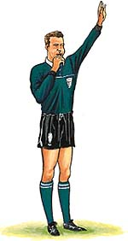
Soccer Fouls - Indirect
Indirect Free Kick - is awarded for less serious fouls. An indirect kick will be taken from the place where the offence occurred with a pass. The ball must touch another player before a goal is scored. Any members of the opposing team must be at least 10 yards away when the ball is struck
An indirect free kick is awarded to the opposing team if a player plays in a dangerous manner (tripping, high kick) or impedes the progress of an opponent (using his/her body to impede another players movements). It is also awarded if the opposing goalkeeper commits the following offences…
Touches the ball again w/ hands after they released it from possession (or a hold of 6 seconds or more). Once released, it is “live”.
Touches ball w/ hands after it’s deliberately kicked to them by a teammate (may pick up a “mis-kick”
Touches the ball w/ hands after receiving it directly from a throw-in by teammate (cannot pick up a throw-in from a teammate)

Slide 7
Indirect Free Kick
*A high kick when an opponent is nearby * If a player tried to had a low ball that an opponent is trying to kick - the player putting him/herself in danger would be guilty of dangerous play
* Any action that may endanger the goal keeper if there is a collision - (e.g. slide tackling with spikes high would be dangerous play, even if the opponent isn’t contacted) whereas a dangerous act, such as a high kick isn’t “dangerous play” unless an opponent is nearby.

Slide 8
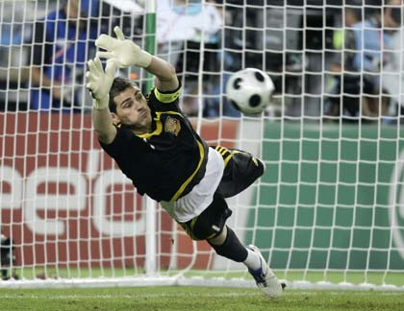
More Soccer Fouls - “PK”
Penalty Kick : is awarded if any of the offences are committed by a player inside his own penalty area. One player may then take a free shot at goal (defended only by the goalkeeper standing on the goal line) from the penalty spot, located 12 yards away.

Slide 9
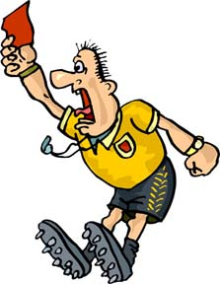
Even MORE Soccer Fouls
Yellow
Red
and
A Yellow Card means that you have been “cautioned” because of unsportsmanlike behavior. These can include hard fouls, harassment, faking an injury, inappropriate words or actions, deliberately disobeying a referee, and more.
A player who receives 2 Yellow cards is given a Red Card and ejected from the game.
If a player is shown a Red Card they are sent off the field and may not be replaced for that game. A Red Card can result from serious foul play, violent conduct, spitting at someone, deliberately touching the ball with your hand, using offensive, insulting or threatening language, or receiving two yellow cards in one game.
***Anytime a yellow or red card is shown & a direct kick isn't awarded (e.g. for “unsportsmanlike behaviour”, breaking the rules, offensive or threatening language, a dangerous act such as a high kick, or slide tackling with spikes), an indirect kick will take place.

Slide 10
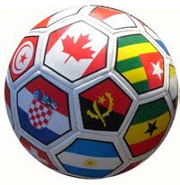
Game Basics
Kickoff – The kickoff is used to begin play at the start of a game, second half, each new period, and after a goal has been scored.
Dribbling – To maintain control of the ball and advance it before passing off to a teammate or shooting on goal. The ball is advanced by pushing with the instep of the foot.
Trapping – The purpose of a trap is to deflect a moving ball and bring it under control so that it may be advanced or passed. A trap should result in the ball dropping near your feet so that you have control of the ball. Most traps are with the feet although other body parts are often used.
Clearing - An attempt to get the ball out of a opponents scoring position.
Heading – To properly head the ball a player should keep his/her eyes up, position yourself under the ball, and allow the ball to meet your hairline. Using this technique the player can see the ball and direct it either into the goal or to a teammate in the form of a pass.
Throw-in – When a ball is kicked out of bounds the opposing team is awarded the ball in the form of a throw–in. A player from the opposing team must throw the ball back into play from out of bounds using a two-handed overhead throw while keeping both feet in contact with the ground.

