Slide 1
Speedball
Morris County Tech

Slide 2
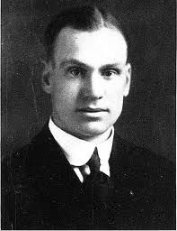
History
Speedball was created in 1921 by Elmer Mitchell (Football and Basketball coach, and Director of Intramural Athletics) @ the University of Michigan
He created a game that meshed all of the best parts of popular sports and did away with the undesired parts.
Speedball combines elements of soccer, football and basketball to create a vigorous team game played by many.

Slide 3
Rules
Play begins with a jump ball
Any time the ball touches the ground, players are forbidden to touch the ball using their hands/arms. Play must resume by kicking with the feet (soccer)
Transition from feet to hands must be made by catching a ball in the air. You may not catch from a bounce off the floor

Slide 4
Rules Continued…
4. A player may never run with the ball. Upon catching the ball a player must stop as soon as possible and establish a pivot foot. Any further movement is considered traveling.
5. Once stopped, a player has a maximum of ten seconds to pass, drop or punt the ball.
6. Any time an aerial pass is incomplete or knocked down inbounds, play continues as a grounded ball.

Slide 5
RULE INFRACTIONS
Traveling with the ball - Receivers are given a reasonable distance to stop once they catch a thrown ball. Intentional juggling or fumbling a thrown ball will result in a traveling violation.
Illegal use of the hands - Touching a ground ball with the hands or arms. A ground ball must be lifted entirely above the receiver's waist to be played with the hands or arms.
Interference - Interfering with a penalty kick or throw-in.
Dangerous play – All high kicks above the waist in a dangerous manner will be prohibited.

Slide 6
RULE INFRACTIONS
Obstruction - Obstruction is the intentional act by a player, not in possession of the ball or not attempting to play the ball, of running between an opponent and the ball or using the body as an obstacle.
Stalling - When a player in possession of an aerial throw retains possession while marked by a defender and the defender has completed the verbal 10-second count.
Closely guarded - When a defensive player marking an offensive player with the ball is closer than 18 inches to that player. Violation Penalty: The penalty for a violation is that the opponents are awarded possession of the ball for an aerial throw at the spot of the foul. The defense must take a position at least 3 yards (9 feet) from the thrower, or at the goal line if within 3 yards of the goal line.

Slide 7
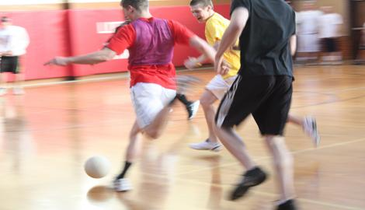
Scoring
Touchdown (1 point) is scored when the ball thrown by a player, outside of the end zone, and legally caught by a teammate in the end zone.
Field goal (2 points) is scored when the ball is kicked from outside the end zone so that the whole of the ball completely crosses the goal line into the goal.

