Slide 1
School Website Training

Slide 2
Goal of the Websites
The website will serve as a tool to proactively and positively communicate with families resulting in higher family involvement, improved relationships, and increases in student achievement.
The website will also serve as a tool to communicate to prospective families and the community the great things our schools are accomplishing.

Slide 3
Training Objectives
Directors will have a strong understanding of site manager and the tools they can use to add, edit, or change their school websites.
Information that is relevant for the 2016-2017 school year is uploaded to the site.

Slide 4
Team Introductions
Name
School
Role
What are your hopes for the new websites?

Slide 5
Your Role
Expectations
  Homepage
    Pictures
    Announcements
    News
    Principal Message
  Teacher Pages
    Bios and Pictures
    Homework/ Assignments
    ELA- Book Lists
  Clubs
    General Information Added
    Meeting Times Added
    Appropriate and Professional
  Athletics
    Practice Times
    Game Schedule
  Calendar
    Updated Monthly

Slide 6
Your Role
Monthly Meetings

Slide 7
Timeline
Optional Support PD- June 29
School Websites go Live- July 15
Teacher Sections- Back to School Night
Clubs and Athletics- August 12

Slide 8
Manual Pages 1-3
What is a channel? Which part of the school website image do you think is a channel?
Where do sections belong?
What is the difference between a section and a page?

Slide 9

Basic Overview

Slide 10


Slide 11
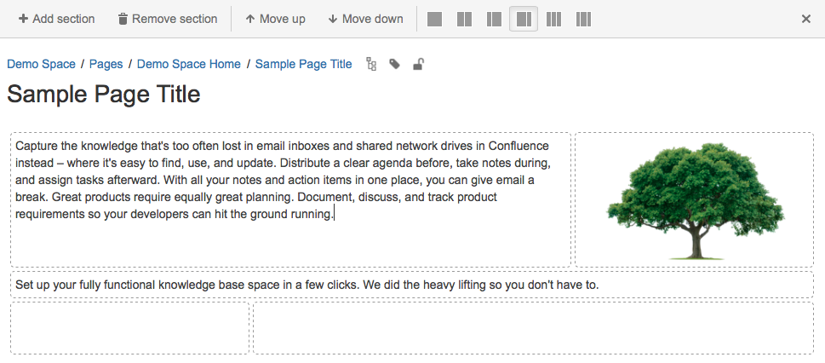

Slide 12
APPs Showroom
Which app would you use if you wanted a single document to be visible on a page?
What app would you use to add basic content? Why might you want to use this as opposed to the Document Viewer App?
Which app would you use to display several documents or files?
What is the difference between the Announcements App and the Headlines and Features App?
Which app do you think was used at the bottom left of the district website?

Slide 13
Channels

Slide 14
Check-In Before Lunch
On a scale of 1-5, how comfortable are you with the information we have reviewed this morning?
What questions do you have regarding the information we have reviewed?

Slide 15
Closing
What impact do you think the websites will have on our community and schools? What part of the websites do you think is going to be the most meaningful?
What are your next steps to meeting the deadlines discussed at the beginning of the day?

