Slide 1
Financial Aid
…Let’s Talk Money
Presented By:
Shannon Amundson, MBA
Director of Financial Aid
Colorado College

Slide 2
Agenda
What Is Financial Aid?
The Financial Aid Equation
Cost of Attendance & EFC
Applying for Financial Aid
Types of Financial Aid
Useful Online Tools
Little Known Money Savers
Q&A
Financial Aid
Inside FA:
Little Known Financial Aid Facts
…Let’s Talk Money

Slide 3
What Is Financial Aid?
Financial Aid
…Let’s Talk Money

Slide 4
What Is Financial Aid?
Financial aid is funding used to cover costs associated with earning a college degree. The primary responsibility for paying for college falls to the family and student with financial aid helping fill the gap.
Merit-based aid is awarded by the Admissions Office and is based on a student’s admission application materials including GPA and test score information.
Need-based aid is awarded by the Financial Aid Office and is based on a family’s EFC calculations and the school’s cost of attendance. Funding sources include the federal government, state government, and the college itself.
Financial Aid
Schools emphasize merit vs. need-based aid differently in their financial aid philosophies. For example, schools with lower admission rates (highly selective) may focus on funding need-based institutional awards instead of merit awards.
Inside FA:
…Let’s Talk Money

Slide 5
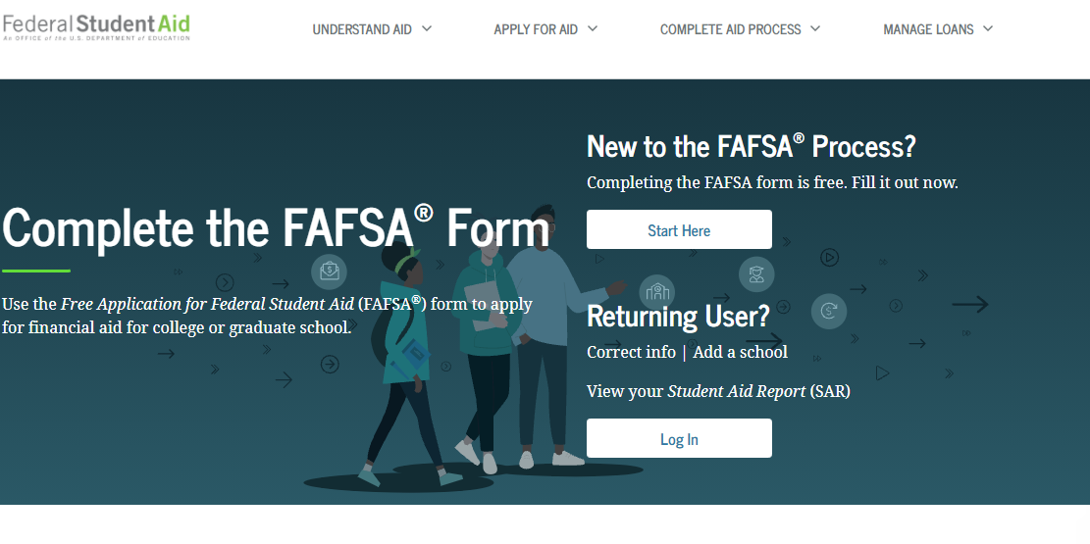
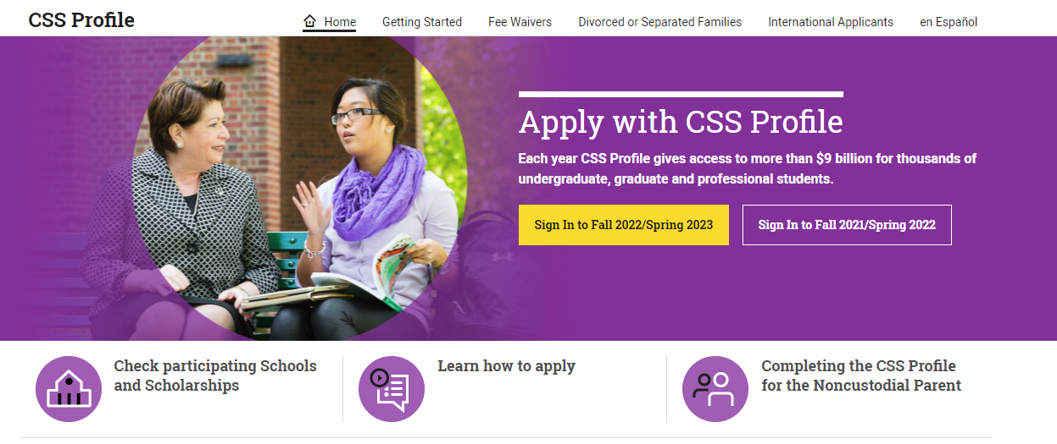
How Is An EFC Calculated?
FAFSA
CSS Profile

Slide 6
FAFSA
FAFSA = Free Application for Federal Financial Aid
Proprietor – Federal Government
www.FAFSA.ed.gov
Fill out using federal income tax information (23-24 uses 2021 taxes)
Can be completed manually or IRS tax information can be directly imported into the application using the IRS Data Retrieval Tool
FAFSA EFC is generally used in the Financial Aid Equation to award federal and state financial aid based on a student’s need level. Some schools may use it to award need-based institutional financial aid as well.
Must reapply for federal financial aid every year using the FAFSA
For dependent students, both student and a parent must digitally sign the FAFSA using FSA ID you create.
One student per FAFSA
Financial Aid
…Let’s Talk Money

Slide 7
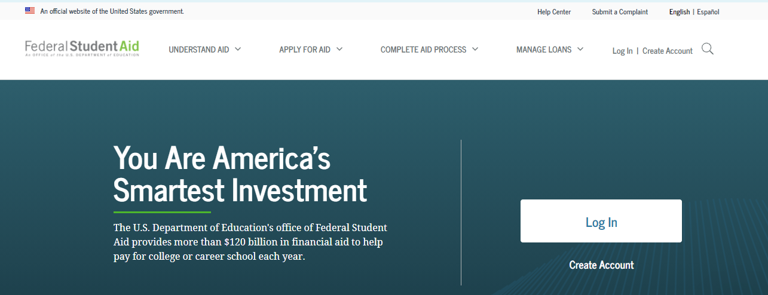
FAFSA
FAFSA = Free Application for Federal Financial Aid
Proprietor – Federal Government
https://studentaid.gov/fafsa or there is a mobile app now
Open every October 1 for the following year
Need your FSAID To sign the form https://studentaid.gov/
Financial Aid
…Let’s Talk Money

Slide 8
FAFSA
Data Collection Breakdown
Dependent Student’s Parents’ Household Comprised Of: | Data from 1 or 2 Parents Collected?
Single legal parent | 1 Parent
Two legal parents who are married | 2 Parents
Legal parent and step parent | 2 Parents
Two legal parents who are unmarried (regardless of gender), or who are of the same sex and are married, as recognized by a State or foreign country. | 2 Parents
Financial Aid
Inside FA:
Be as accurate as possible with your application answers. You may be selected for an audit process called verification and required to submit supporting documentation for your answers.
…Let’s Talk Money

Slide 9
Potential FAFSA Errors
Wrong “year’s version”
Using wrong tax year’s information (23-24 must use 2021)
For certain items on the FAFSA, you must report “as of today.” For most of these items, that’s quite simple. (Example: The balance of your savings and checking accounts “as of today” is easy to look up and report.)
Wrong Social Security Numbers or Driver License number
Incorrect marital status
The FAFSA asks for marital status “as of today” (the day it’s filled out). So if the student or parent is married now but wasn’t in 2021 (and therefore didn’t file taxes as married), the spouse’s income will need to be added to the FAFSA. Similarly, if the student or parent filed 2021 taxes as married but is no longer married when filling out the FAFSA, the spouse’s income will need to be subtracted.
Not reporting untaxed income
Incorrect number in household and dependent students in college
Including small business value (<100 employees)
Forgetting to list the college
Forgetting to electronically “sign” and submit FAFSA
Financial Aid
…Let’s Talk Money

Slide 10
CSS Profile
CSS Profile = College Scholarship Service Profile
Proprietor – College Board
Not free for all applicants. https://cssprofile.org
Available October 1st of each year
Profile EFC is generally used in the Financial Aid Equation by private universities (and a few public) to award institutional financial aid based on a student’s need level.
May have to reapply for institutional aid every year using the CSS Profile
One student per Profile
Each parent completes their own Profile for the student
Financial Aid
Inside FA:
Certain schools only require a family to fill out the Profile once and then guarantee to award their student financial aid based on that one EFC calculation all four years.
…Let’s Talk Money

Slide 11
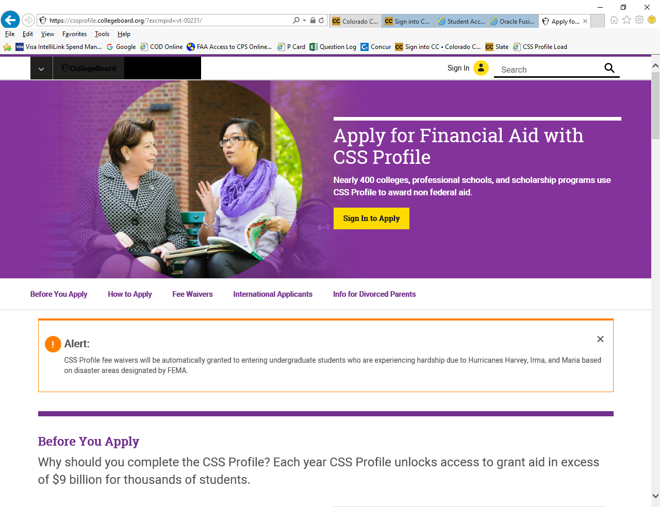
Financial Aid
…Let’s Talk Money

Slide 12
CSS Profile
Components of EFC Calculation are customizable for schools
EFC calculation often based off of:
AGI
Taxes Paid
Number in Household
Number in College
Untaxed Income (tax deferred pensions, etc.)
Investment Information (non-retirement investment holdings)
Business Income & Deductions
Supplementary Investment information (home equity, other real estate holdings, business value, family cars, etc.)
If student’s parents are divorced, non-custodial parent’s information may be required for EFC calculation.
Because school’s can customize not only the components that make up a family’s institutional EFC but also how they account for them in the calculation,
a family’s institutional EFC can vary from school to school
Also on FAFSA
Financial Aid
Inside FA:
Garbage In Garbage Out
…Let’s Talk Money

Slide 13
Types of Financial Aid
Financial Aid
…Let’s Talk Money

Slide 14
Types of Financial Aid
Work-Study
Grants
Scholarships
Student & Parent Education Loans
Financial Aid
…Let’s Talk Money

Slide 15
Grants
Federal
Award | Amount (22-23) | Criteria | Guaranteed | Application
Pell Grant | $650 - $6895 | EFC < $6207 | Yes | FAFSA
SEOG Grant | $100 - $4,000 | Financial Need | No | FAFSA
State
Award | Amount (22-23) | Criteria | Guaranteed | Application
CSG | $500 - $5000 | Financial Need & CO Resident | No | FAFSA
COF | $104-$52 per Credit Hour | CO Resident | *No* | FAFSA
Institutional
Award | Amount (22-23) | Criteria | Guaranteed | Application
Inst. Grant | Varies | Financial Need | No | FAFSA or CSS Profile

Slide 16
Student & Parent Education Loans
Federal
Award | Amount (22-23) | Criteria | Interest Rate (1718) | Guaranteed | Application
Direct Sub | $3500 – Freshmen $4500 – Sophomore $5500 – Junior & Senior | Financial Need | 3.73% (Fixed) | No | FAFSA
Direct Unsub | $2000 | None | 3.73% (Fixed) | Yes | FAFSA
Direct Parent Plus | COA – Other Aid = amount | Approved Credit | 6.28% (Fixed) | No | FAFSA & Credit App at studentloans.gov
Private
Award | Amount (22-23) | Criteria | Interest Rate | Guaranteed | Application
Private Loan | COA – Other Aid = amount | Approved Credit | Varies (Variable) | No | Varies

Slide 17
Work-Study
Federal & State
Award | Amount (22-23) | Criteria | Guaranteed | Application
Federal WS | Varies | Financial Need | No | FAFSA
State WS | Varies | Financial Need | No | FAFSA
Student must work at on-campus job or approved off-campus job to earn money
Wages paid directly to student, not to their bill
1-40 hrs. a week
Flexible
Can be a very competitive award to receive
Best spent on paying for indirect costs instead of covering direct costs

Slide 18
Inside Financial Aid
Financial need may affect your admission into certain colleges (Need Blind vs. Need Aware)
The policy for packaging students with institutional aid and some federal/state aid is completely up to each university
Do not be afraid of a school’s sticker price.
Don’t use your retirement to pay for your child’s college
Don’t necessarily use all of your 529 plan to cover your student’s first years of school
Do let schools know about any special family financial circumstances
Financial Aid
…Let’s Talk Money

Slide 19
Inside Financial Aid
Do let schools know if you plan to utilize VA educational benefits
Do plan for four years of attendance instead of just one
Do research application requirements and deadlines
Do submit forms by deadlines
Financial aid offer is generally sent with the offer of admission
Do review the offer and ask questions if needed (award letters will not look the same)
Do accept or decline offer by deadline
Any scholarships & grants used for paying expenses outside of tuition, required fees, and books is considered taxable income.
Financial Aid
…Let’s Talk Money

Slide 20
Questions?
Financial Aid
…Let’s Talk Money

