Slide 1
Science Sequence
MANHASSET SECONDARY SCHOOL

Slide 2
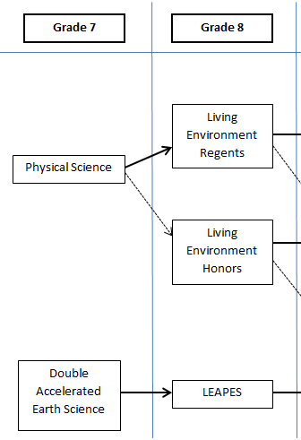

Slide 3
Living Environment
Regents Level
Meets for a double period every other day
Ecology, Biochemistry, Genetics, Human Systems, Evolution, Plants
NYS Living Environment Regents
Available Support:
Inclusion Sections
LE X Classes
Honors Level
Taught at a deeper and more enriched level
More demanding laboratory work and assignments
Material on the SAT Subject Area in Biology will be covered
NYS Living Environment Regents

Slide 4
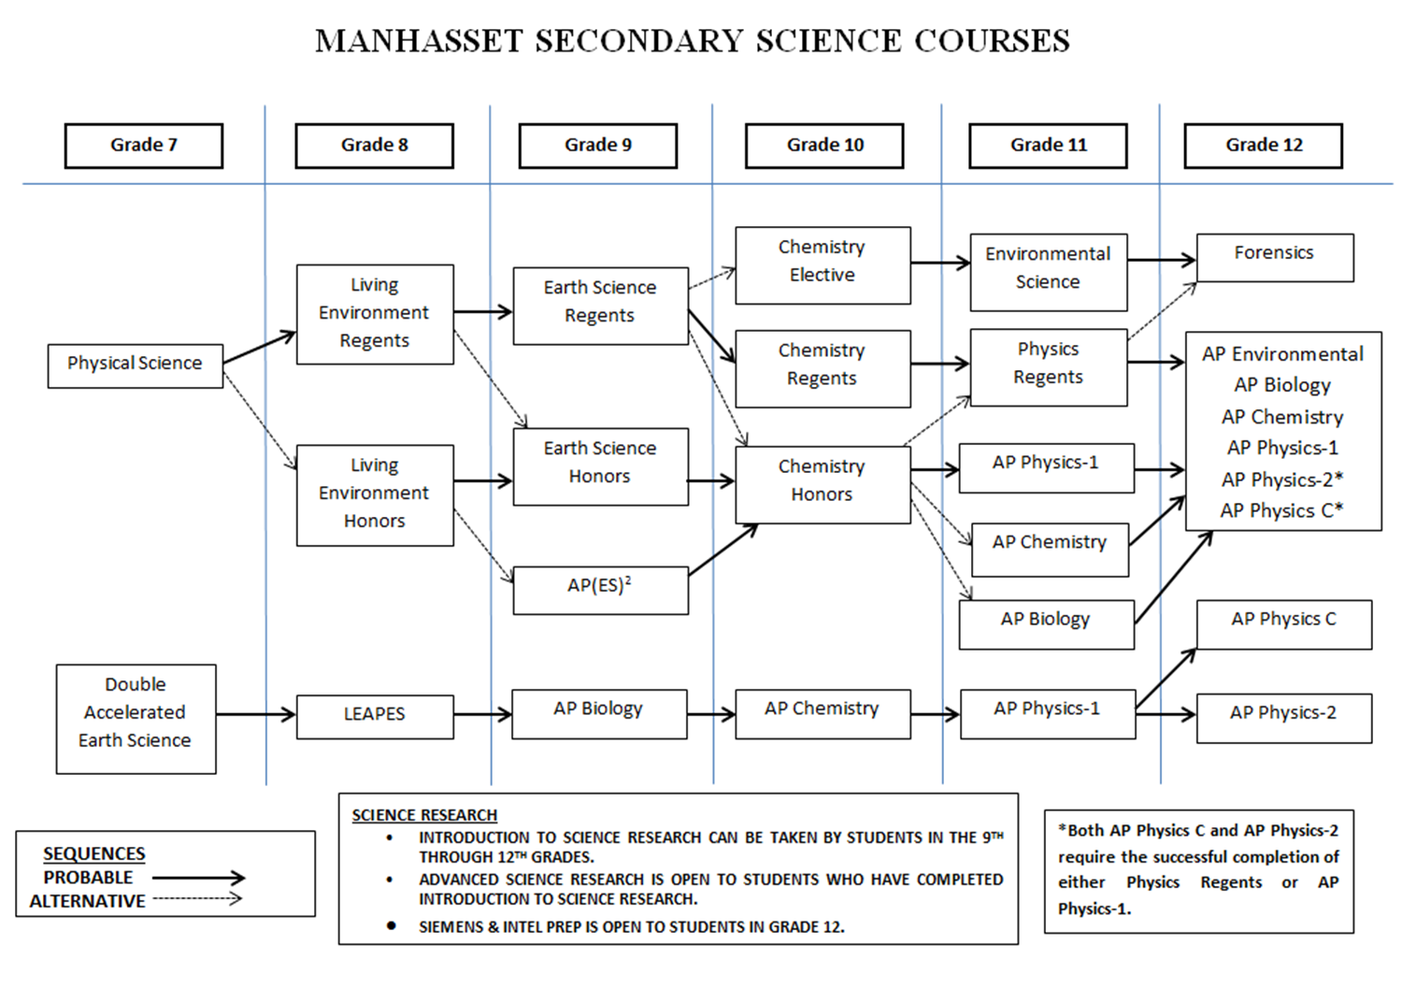
Biology
Earth Science
Chemistry
Physics

