Slide 1
PASE Presentation Science Sequence
MANHASSET SECONDARY SCHOOL

Slide 2
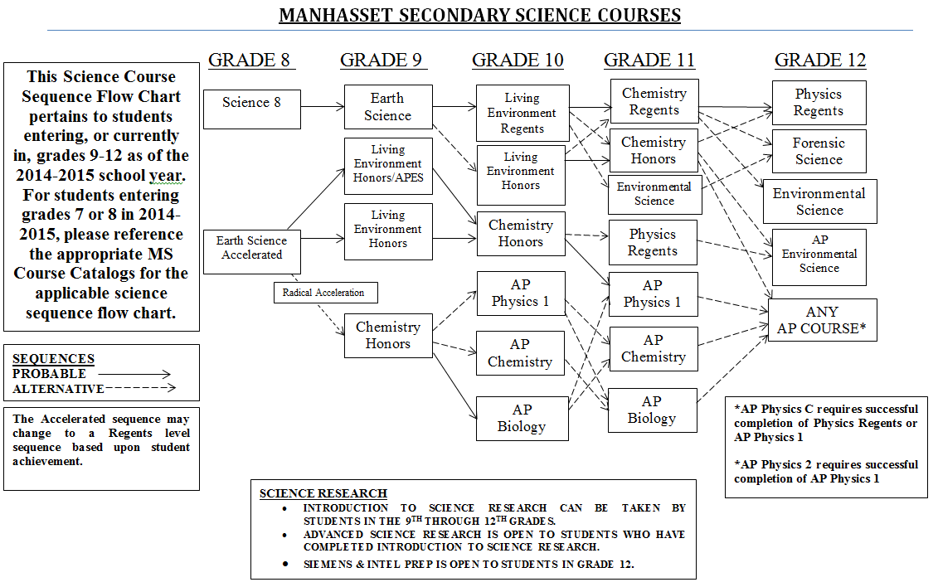
Current Science Sequence for Students in Grades 8-12

Slide 3
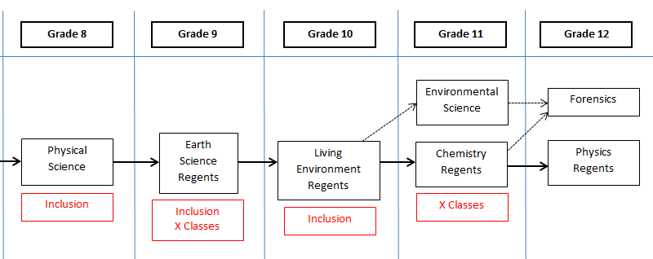

Slide 4
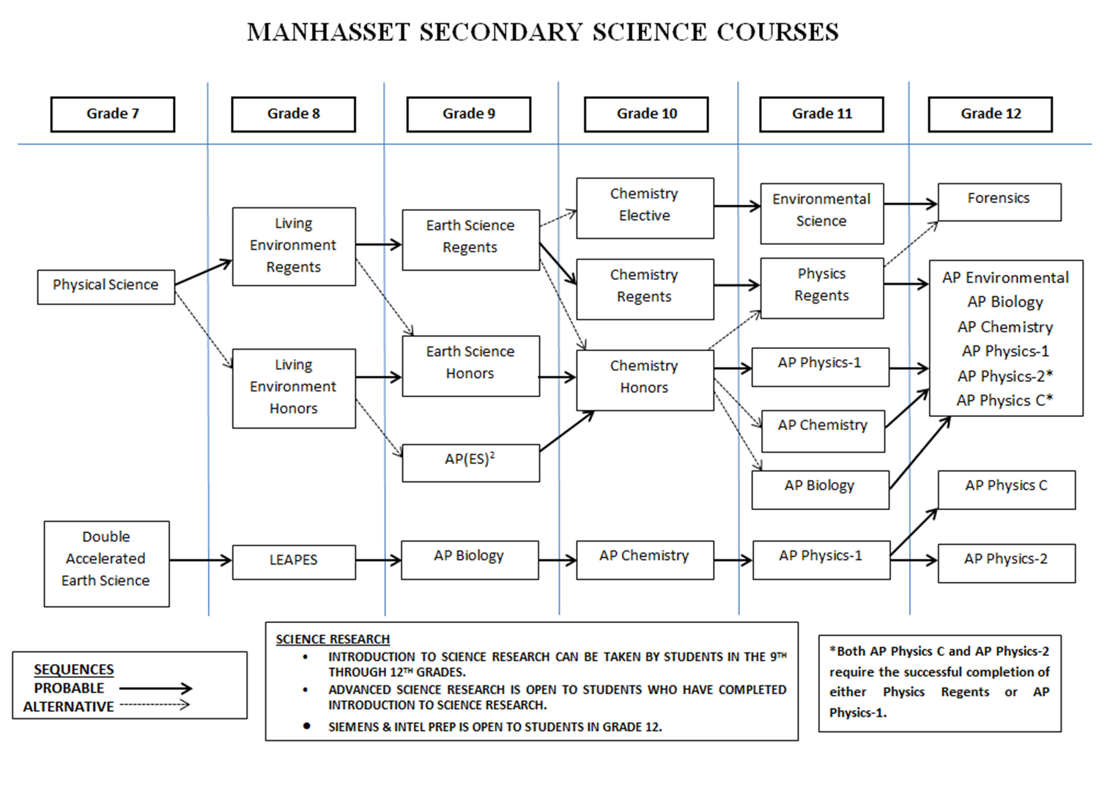
Projected Sequence for Students Currently in Grades K-7
Living Environment
Earth Science
Chemistry
Physics

Slide 5
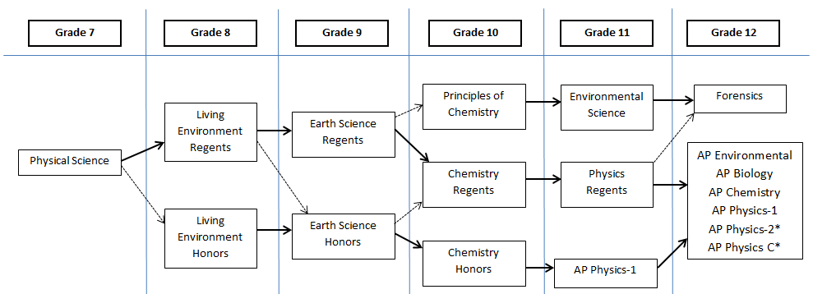
Projected Sequence for Students Currently in Grades K-7
Living Environment
Earth Science
Chemistry
Physics
2014-2015
2015-2016
2016-2017
2017-2018
2018-2019
2019-2020

Slide 6
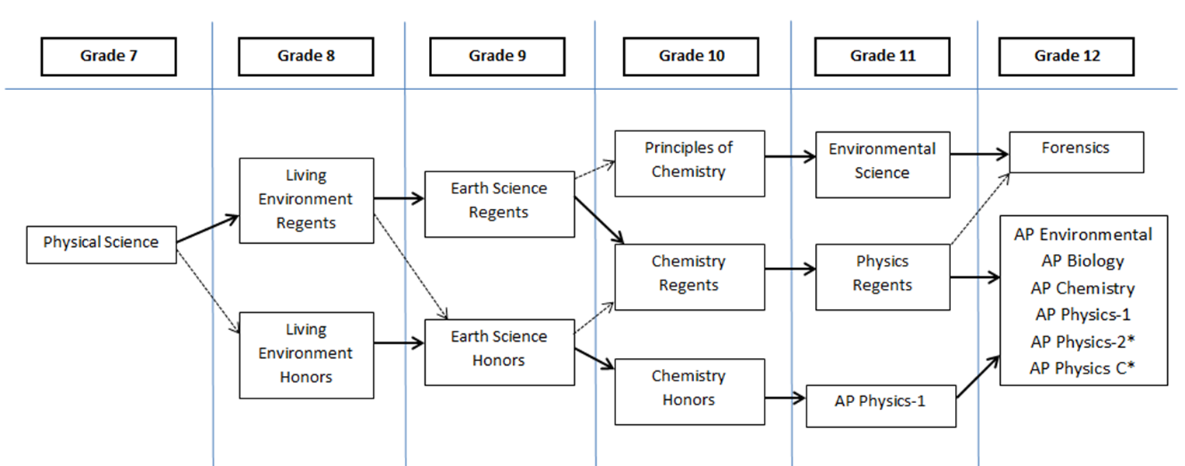
Physical Science
Support:
Inclusion Sections

Slide 7
2015-2016
Living Environment
Support:
Inclusion Sections
X Classes

Slide 8
2016-2017
Earth
Science
Support:
Inclusion Sections
X Classes

Slide 9
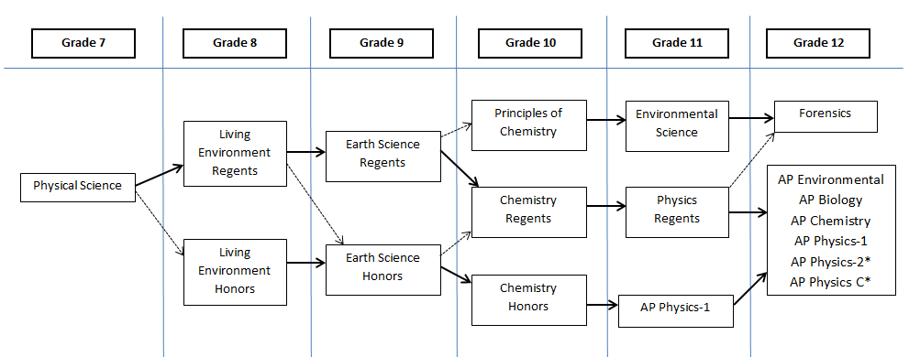
2017-2018
Principles of Chemistry
Chemistry Regents
Support:
X Classes
Inclusion Sections

Slide 10
2018-2019
Physics
Regents
Environmental Science

Slide 11
2019-2020
Forensic
Science
Other
Electives

