Slide 1
Science Sequence
MANHASSET SECONDARY SCHOOL

Slide 2
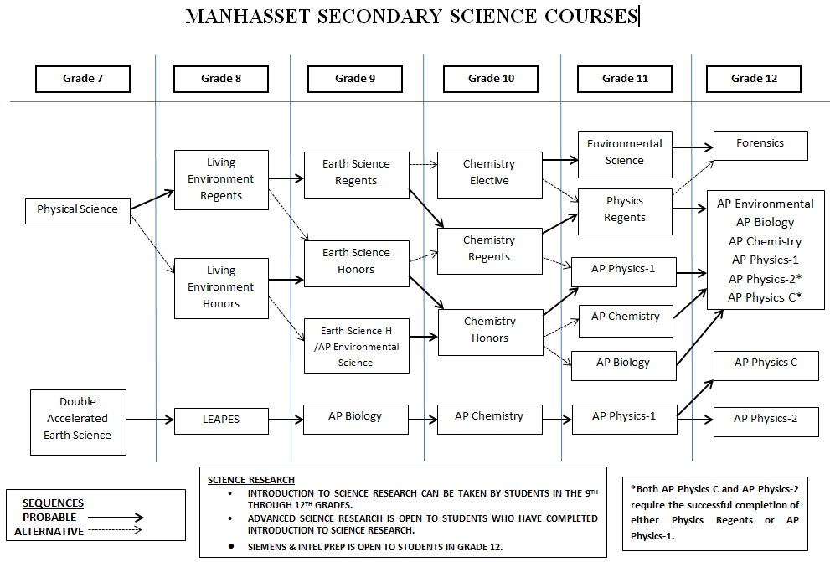

Slide 3
SAT Subject Test in Biology
How to Register
If you’re 12 years old or younger, you can only register by mail because of Internet privacy laws.
If you’re 13 or older, you can create a free College Board account and register online.
If you’re in the eighth grade or below you should not include a photo with your registration. However, you will need to have an acceptable photo ID to be admitted to the test center.

Slide 4
SAT Subject Test in Biology
Scores for Eighth-Graders and Below
If you test in the eighth grade or below, your scores are removed from your file at the end of the academic year you tested.
If you want your scores to be part of your permanent record, you must let us know before June of the year you tested. Include the following with your request:
Full identification information
Registration number
Test date
Mail your request to:
The College Board SAT Program Attention: Talent Search Scores P.O. Box 025505 Miami, FL 33102

Slide 5
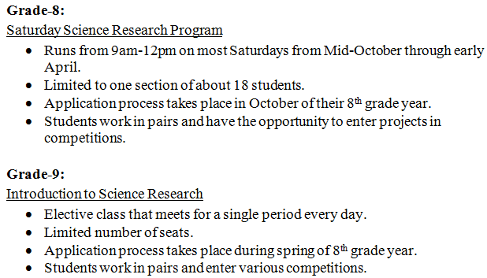
Manhasset Science Research Opportunities

Slide 6
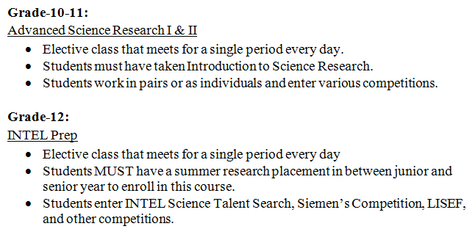
Manhasset Science Research Opportunities

