Slide 1
Science Program
MANHASSET SECONDARY SCHOOL

Slide 2
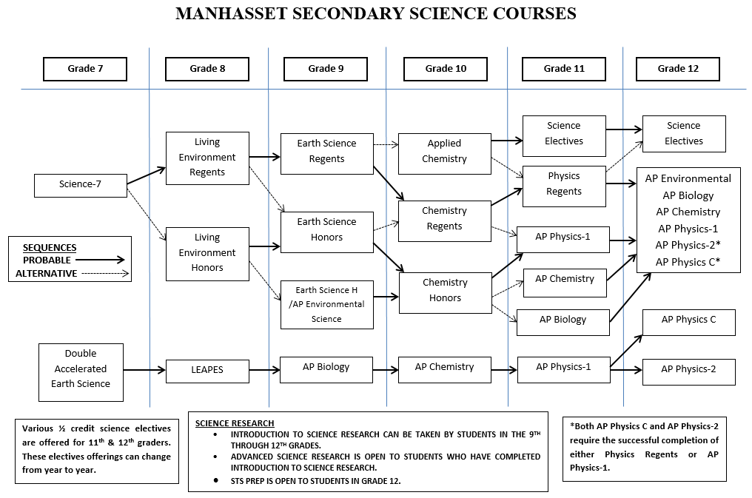

Slide 3
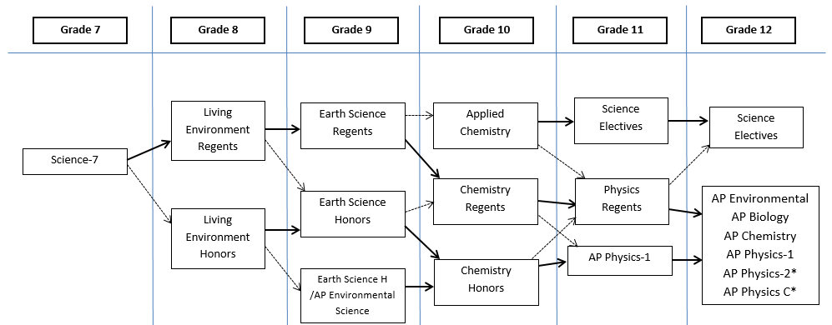
Foundation
Biology
Earth Science
Choice
Chemistry
Physics

Slide 4
Sample Path-1
Grade 7
Grade 8
Grade 9
Grade 10
Grade 11
Grade 12
Foundation
Biology
Earth Science
Choice
Chemistry
Physics
Living Environment Regents
Earth Science Regents
Chemistry Regents
Physics Regents
Science-7
AP Environmental

Slide 5
Sample Path-2
Grade 7
Grade 8
Grade 9
Grade 10
Grade 11
Grade 12
Foundation
Biology
Earth Science
Choice
Chemistry
Physics
Living Environment Honors
Earth Science H /AP Environmental Science
Chemistry Honors
AP Physics-1
AP Biology
Science-7

Slide 6
Sample Path-3
Grade 7
Grade 8
Grade 9
Grade 10
Grade 11
Grade 12
Foundation
Biology
Earth Science
Choice
Chemistry
Physics
Living Environment Regents
Earth Science Regents
Applied Chemistry
Science Electives
Science Electives
Science-7

Slide 7
Sample Path-4
Grade 7
Grade 8
Grade 9
Grade 10
Grade 11
Grade 12
Foundation
Biology
Earth Science
Choice
Chemistry
Physics
Living Environment Regents
Earth Science Honors
Chemistry Honors
AP Physics-1
Science-7
AP Physics-C

Slide 8
Sample Path-5
Grade 7
Grade 8
Grade 9
Grade 10
Grade 11
Grade 12
Foundation
Biology
Earth Science
Choice
Chemistry
Physics
Living Environment Honors
Earth Science Honors
Chemistry Regents
Physics Regents
Science-7
Electives

Slide 9
Key Points to Remember
With the exception of the AP Intensive Pathway there is no “accelerated” group, all students begin taking regents classes in grade-8.
Students can take all 4 science disciplines and still have a year left over to choose a course of interest.
Placement in the different courses each year is based on performance the previous year.
Every year provides flexible options for students as their needs and interests change.
There are “safety nets” built in for students that are not successful at a certain level.

Slide 10
AP Intensive Pathway

Slide 11
Foundation
Biology
Earth Science
Choice
Chemistry
Physics
QUESTIONS?

