Slide 1
Science, Technology, and Health Education
Manhasset Schools
2020-2021
Notes:
Thank you for giving me this opportunity to speak to you this morning. In my short time here I have been fully immersed in the planning for the reopening of schools and want to assure you that the science department has embraced this challenge. The focus is, and will continue to be, the students and providing them with the educational experience they deserve.

Slide 2
Science in a COVID-19 World
Classrooms have reduced capacity
Desks are spaced a minimum of 6 feet apart
Everyone wears a mask
Research students will be set up with materials and equipment to perform research at home
Hands-on activities in the classroom are repeated so all students that attend school can participate. Alternate activities are provided to fully remote students.
Virtual Partnerships and partnerships 6 feet apart
Online resources are utilized as much as possible
Notes:
The Science classrooms have the advantage of being lab spaces as well. When we worked over the summer to distance the desks, we were able to utilize lab tables to ensure we could accommodate students in a way that every student would be able to see the board and so every student was at least 6 feet apart.
Teachers are consistently enforcing the guidelines put out by NYSED and the Dept. Of Health to ensure the safety of everyone in the room.
Our research program continues with exemplary projects but has been modified to allow students to work safely at home. This year’s proposals are being finalized and supplies being ordered for students to begin their research. In the past, we have been able to have students work in groups, this year all the projects are individual.
Teachers are trying to incorporate as many engaging activities as possible, whenever possible the activities are hands-on with modifications for safety.
Students have always been encouraged to collaborate, embracing 21st century skills has been a focus of science instruction for years. Collaboration looks different in a COVID world but teachers are trying to incorporate it whenever possible and practical.

Slide 3
What does the hybrid model look like?
Teachers teach while hosting a Zoom meeting for remote students using district-provided laptops and Bluetooth earpieces
Teachers share the screen of the desktop in the classroom so students at home view the same SmartBoard presentation as students in class
Canvas allows for easy access to lessons, Zoom links, class assignments, and homework
Students attend school every other day according to the alphabetical split A-L, M-Z
Students utilize the “Raise Your Hand” feature to participate in class when they are remote
Students should have cameras on and be visible to teachers during instruction
Notes:
The technology piece of the hybrid model was well-planned over the summer with input from teachers in many departments. Because of the unique setting in the science rooms, their input was invaluable.
Teachers were able to participate in CANVAS training over the summer to build their CANVAS pages, which have become the go-to for students. Teachers update their pages frequently with lessons, classwork, and homework so even when teachers are not able to be in the classroom the students can still access what they need.
Our science schedule has always utilized double periods for lab instruction. With the separation of students alphabetically, we repeat the days so teachers have 2 single periods in a row followed by 2 double periods in a low so no time is lost with either group.
Students are becoming more comfortable on Zoom, rates of remote participation are increasing but there are still “camera-shy” students who teachers would love to see more on the Zoom screen. It is one of the only opportunities for teachers to see what their students look like!

Slide 4
How have we changed our instruction?
Increased use of visual representations in notes
Increased use of student-centered activities that engage students in-person and remote equally
Thoughtful use of websites, virtual labs, and simulations to supplement instruction
Virtual collaboration by students instead of in-person groups, examples include Google Docs, Google Slides, and Breakout Rooms in Zoom
Notes:
Because of the challenges with Zoom, spacing, and distancing, teachers are increasing the use of visuals in their presentations and lessons to ensure understanding and appeal to visual learners.
Teachers are encouraged to ask more questions and provide more opportunities for learning that are student-centered. With each slide in a presentation I am asking the teachers to ask themselves “What are the students doing?” and I have let them know that I hope the answer isn’t “taking notes”

Slide 5
How are labs different?
Virtual Lab sites have been incorporated and are accepted by NYS as lab experiences when accompanied by the proper documentation from students
Gloves and hand sanitizer have been provided to students so they can handle equipment and materials safely without cross contamination
Utilizing outside spaces whenever possible
Utilization of Gizmos labs school wide, new this year, as a virtual lab platform
Lab Stations designed for individual investigations of concepts with proper sanitation after use

Slide 6
How are we providing opportunities extra help?
Extra Help is being handled by individual teachers based on their comfort level and student need:
Emailing questions the night before to start class with review and re-teaching of concepts that are not clear
Open Office hours via Zoom allowing students the opportunity to drop in for questions or homework help
One-on-one by appointment, both Zoom and in-person, at teacher discretion
Additional review incorporated into the lesson and use of “Exit Tickets” to ensure understanding daily
Emails from students answered throughout the day, key questions shared with the class to avoid misconceptions that may exist

Slide 7
How are we ensuring high standards and rigorous instruction?
More frequent, varied methods of assessments instead of longer traditional exams that have integrity issues in our hybrid/remote environment
More common planning between content area teachers to share ideas, best practices, and content materials.
Extended response questions that are based on the application of concepts instead of typical recall questions

Slide 8
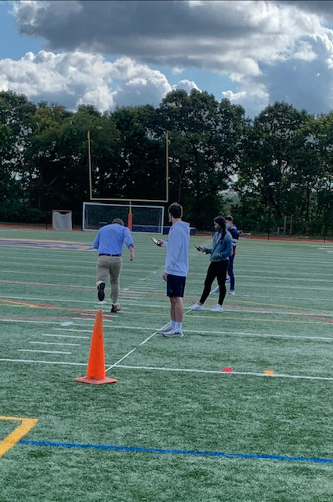
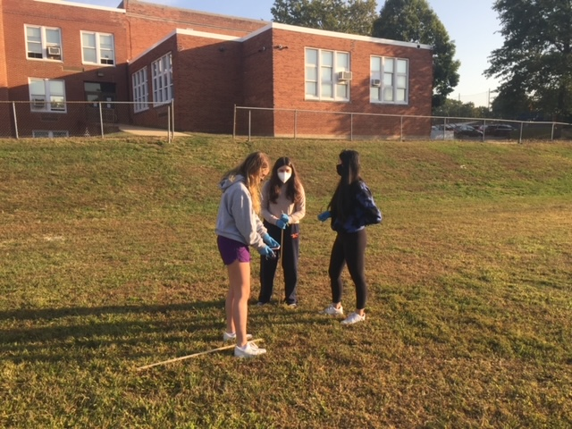
AP Physics Labs

