Slide 1
Elementary Science
Teresa McGrath
District Coordinator of Science, Technology, and Health Education

Slide 2
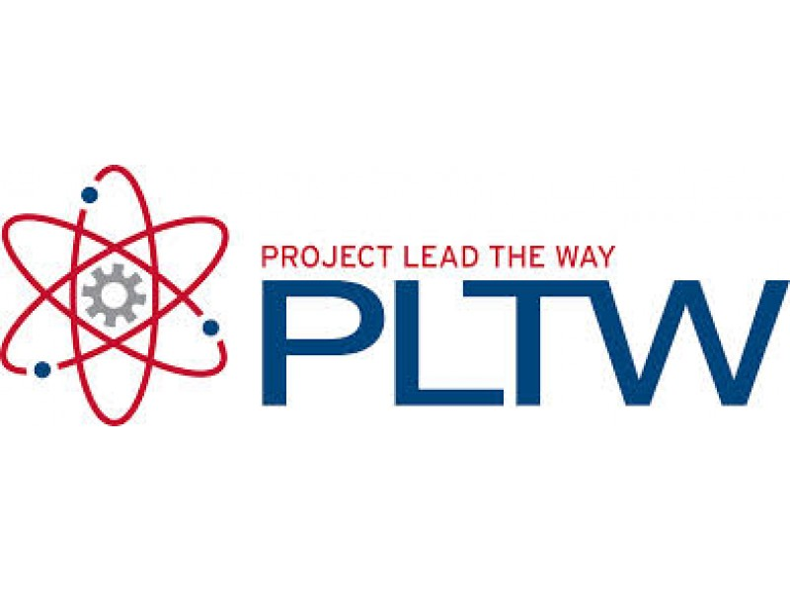
NYSSLS and Project Lead the Way
Notes:
The NYSSLS focus on three-dimensional instruction, allowing students to become involved in argumentation, problem-solving, and set the course for their own learning with the proper parameters set by teachers. Students will engage in much more hands-on and authentic instruction in science.

Slide 3
Project Lead the Way
“Launch”, K-5 curriculum
Modules connected to the NGSS (national version of NYSSLS)
Modules incorporate best practices in science education
Combine three-dimensional learning
Activity based
Project based
Problem based
Grade 2: Properties of Matter
Grade 3: Forces and Interactions
Grade 4 rollout planned for 2021-2022: Collisions
Grade 5 roll-out planned for 2022-2023: Robotics and Animation
Notes:
The district adopted Project Lead the Way because of their foundation in three-dimensional instruction and the use of inquiry and problem solving in their curriculum.

Slide 4
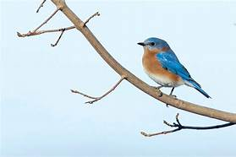
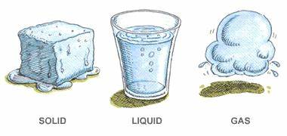
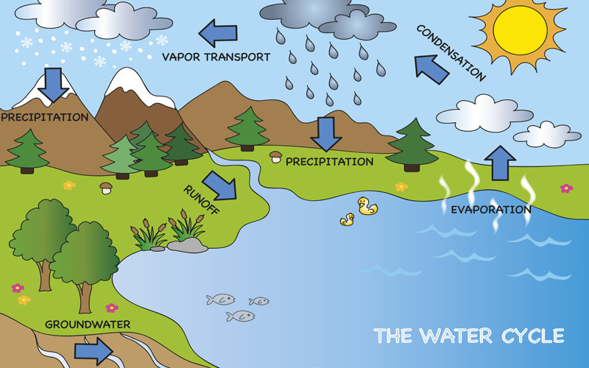
Overview of Science Topics K-5
Kindergarten: The Five Senses, Birds, Seeds
First Grade: The Solar System, Matter, Plants, Vertebrates
Second Grade: Earth Science, Properties of Matter, Interdependence in Ecosystems
Third Grade: Weather, Forces and Interactions, Ecology and Ecosystems
Fourth Grade: Glaciers, Ecosystems, The Water Cycle, Energy and Electricity
Fifth Grade: Classification, Plants, Predator-prey, Recycling, Simple Machines

Slide 5
A development of skills in 6th Grade
Biggest change from previous years is the Hybrid learning and increase in Teacher-led demonstrations as opposed to student hands-on experimentation.
Making qualitative and quantitative observations
Developing inference skills
Analyzing data
Writing lab reports, TDEC’d (Topic sentence, Detail, Explain the Detail, Conclusion)
Using the scientific method
Using scientific evidence in debates
Researching a scientific topic
Using the engineering process to solve problems/create products
Development of microscope skills
Organization and study skills
Notes:
The sixth grade teachers are committed to providing quality science instruction accompanied by the integration and development of skills that students need in high school.

Slide 6
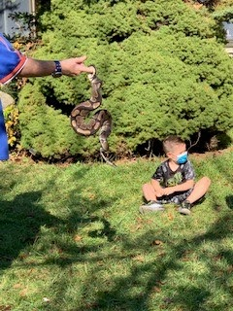
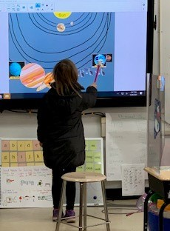
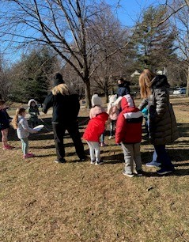
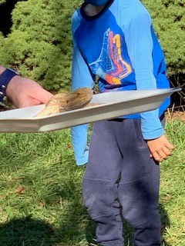
Some highlights from this year!

Slide 7
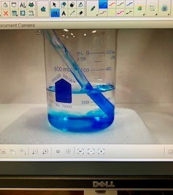
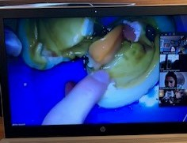
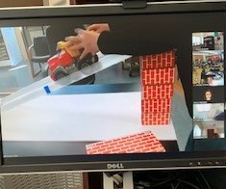
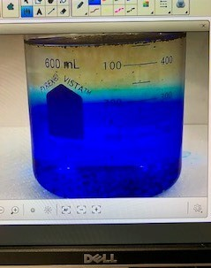
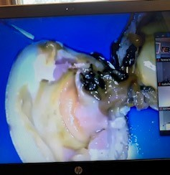
Virtual Science Demos

Slide 8
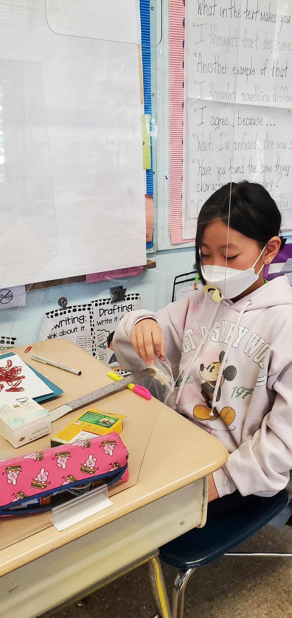
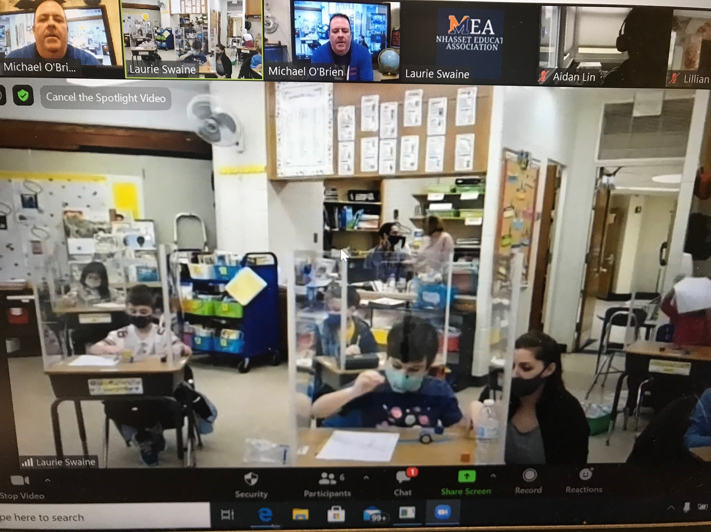
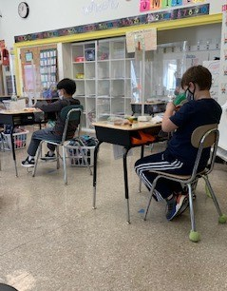
Simple Machines

Slide 9
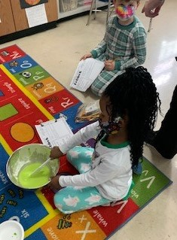
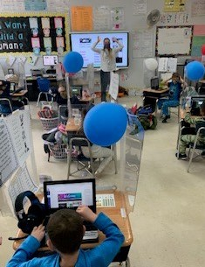
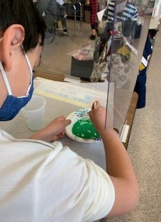
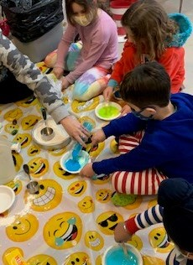
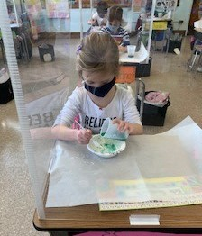
First Grade Ooblek Celebration

Slide 10
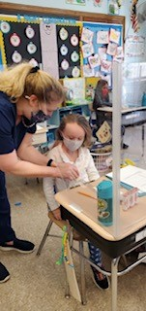
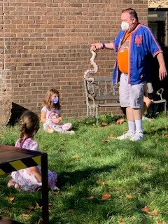
Specialists: Munsey Park/Shelter Rock
Kim Viscovich: Munsey Park
Pushing in to classes
Reinventing lessons
Using disposable materials
Maintaining high standards
Supporting all grade levels
Michael O’Brien: Shelter Rock
Teaching remotely
Reinventing lessons
Incorporating hands-on
Maintaining high standards
Supporting all grade levels

Slide 11
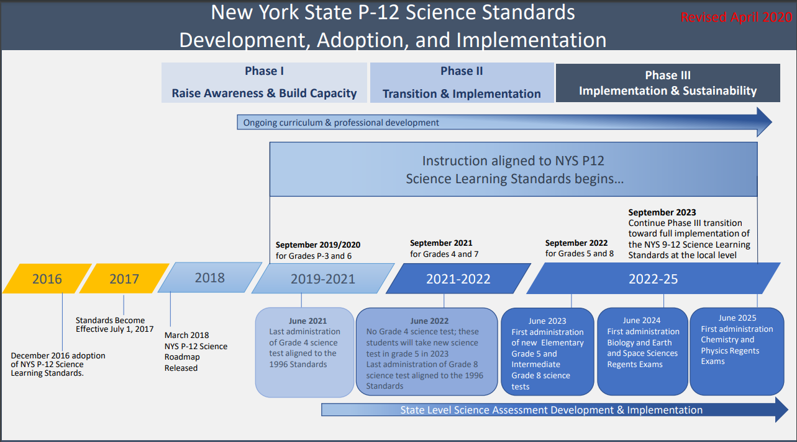
New York State Science Learning Standards
Notes:
It has been released that the written portion of the test is to be given June 7-9, this is the last administration of the science test in grade 4, next year there will be no test as those students prepare for their first test in Grade 5 in June 2023.

Slide 12
Incorporation of NYSSLS Timeline
Grades 2 and 3 already fully aligned with the NYSSLS
Grade 4 rollout of the Project Lead the Way unit “Collisions” will be the first step in fully aligning curriculum.
Grade 5 rollout of Project Lead the Way “Robotics and Animation” is planned for 2022-2023.

Slide 13
Incorporation of NYSSLS Timeline (continued)
Grade 6 curriculum is being evaluated along with Grade 7 curriculum to better align with standards and ensure fewer overlapping topics. Targeted plan for curriculum writing in summer of 2022.
Grades K and 1 are also in need of a curriculum update to align with the new standards. Curriculum writing will be planned for the summer of 2023.

Slide 14
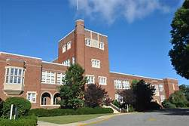
Transition to Middle School
Students will be enrolled in Science 7.
Science 7 will provide a continuation of the foundational skills and concepts needed for success in high school courses.
Students will have the opportunity to take Technology 7 as an elective course. Technology 7 is a combination of two Project Lead the Way courses:
Automation and Robotics
Flight and Space

Slide 15
Regents vs. Honors in Eighth Grade
Science 7 teachers will recommend 8th grade placement at the end of second quarter
Recommendations are revisited at the end of the third quarter and adjustments are made as needed
Students with A or A+ on the report card for both first and second quarter will be recommended for Living Environment Honors at the end of the second quarter.
Students with an overall A average at the end of the third quarter will be recommended for Living Environment Honors.
Students below an A average will be recommended for Living Environment Regents

Slide 16
AP Intensive Pathway
Students already identified as accelerated in Math will be considered for placement in Earth Science 7 Honors and the most rigorous AP Intensive Pathway.
Students that demonstrate the highest level of analytical and math skills, outstanding cognitive reasoning abilities, and an exceptional work ethic are encouraged to apply.
Applications consist of a record of assessments, any science related experience, and a personal statement from the student explaining why they would like to be considered for placement in the AP Intensive pathway.
Applications will be emailed to parents of Math accelerated students on May 10, 2021
Applications will be due to my office by June 9, 2021
A committee of teachers and administrators will meet to review applications and select students.
Parents and students will be notified of the decision in early July, 2021

Slide 17
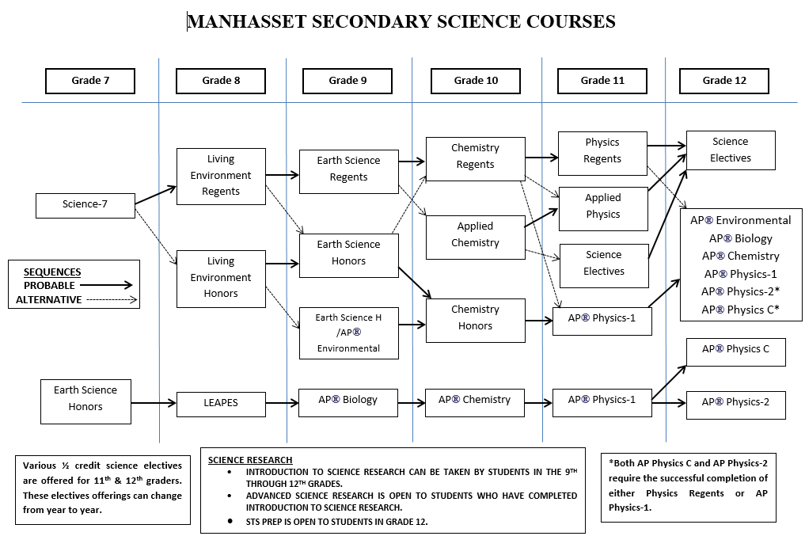
Pathways in Science
Notes:
There are opportunities every year to accelerate to Honors from the Regents level. All students that complete the Regents pathway have opportunities to take AP Classes in both 11th and 12th grade.

