Slide 1

Thrive:
Creating Inclusive Schools

Slide 2

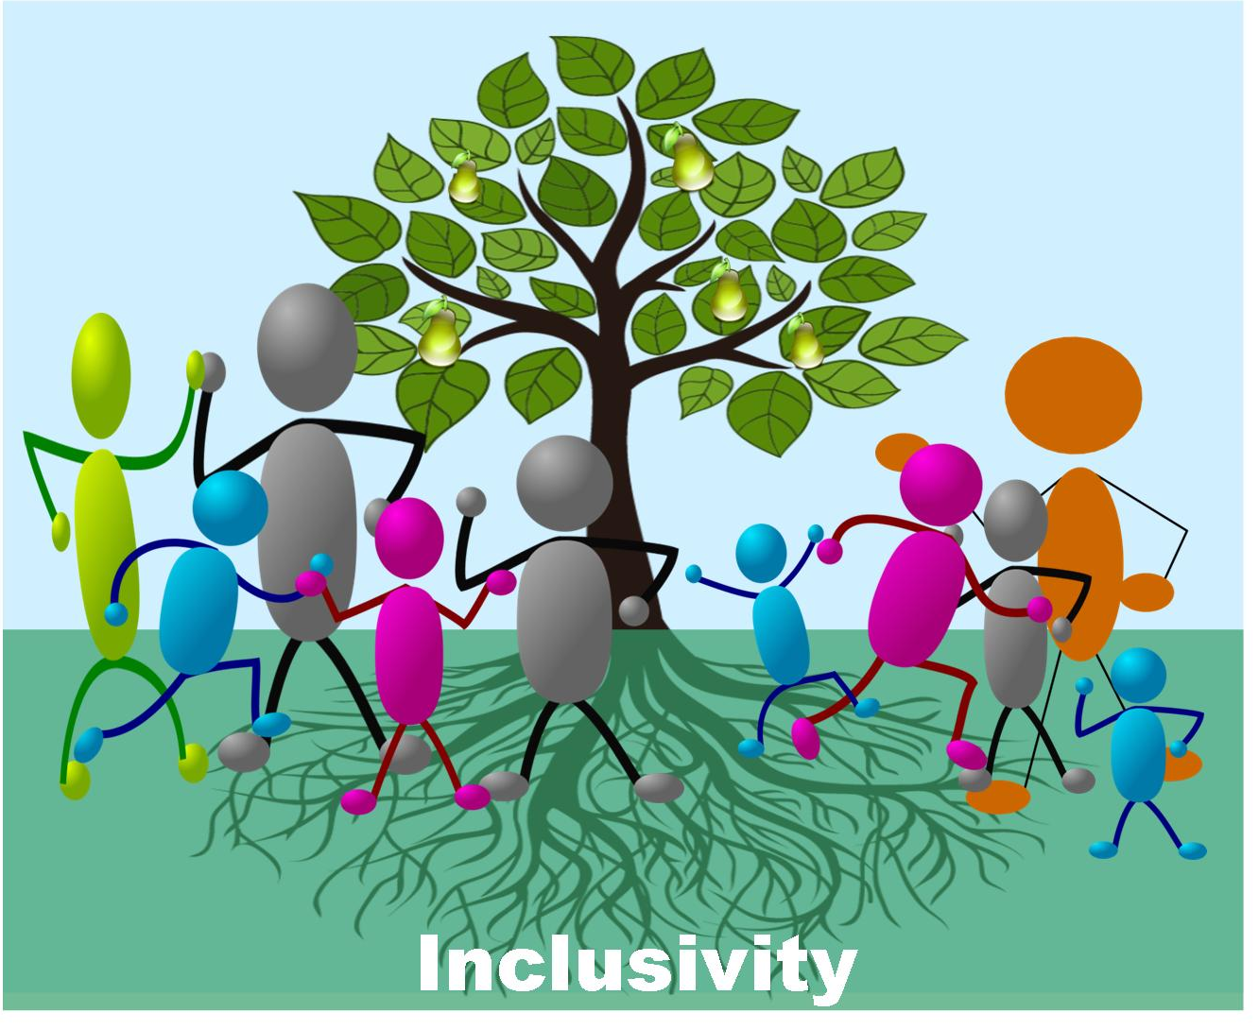


Slide 3
Write a word or a phrase
that describes something someone else has done to
make you
feel like you belong

Slide 4
Click the link to access the video: https://www.spps.org/Domain/13117

Slide 5
In Your Table Group
LISTEN and LEARN
Share your name, position, preferred pronoun and your belonging word
Talk about something in the video that didn’t surprise you because you have experienced or witnessed it yourself
Describe how your perspective on inclusivity shifted
LEAD
Discuss things that you can adopt into practice in your role to increase inclusivity

