Slide 1


Financial Statements
January 31, 2024
Eric Bush, CPA
Interim Chief Financial Officer
March 21, 2024

Slide 2

OUR VISION
Students are empowered to learn, lead, innovate and serve as productive and caring citizens within their chosen paths of success.
OUR MISSION
The Bibb County School District maximizes student achievement and social-emotional well-being by building a sense of community in safe, equitable learning environments.

Slide 3
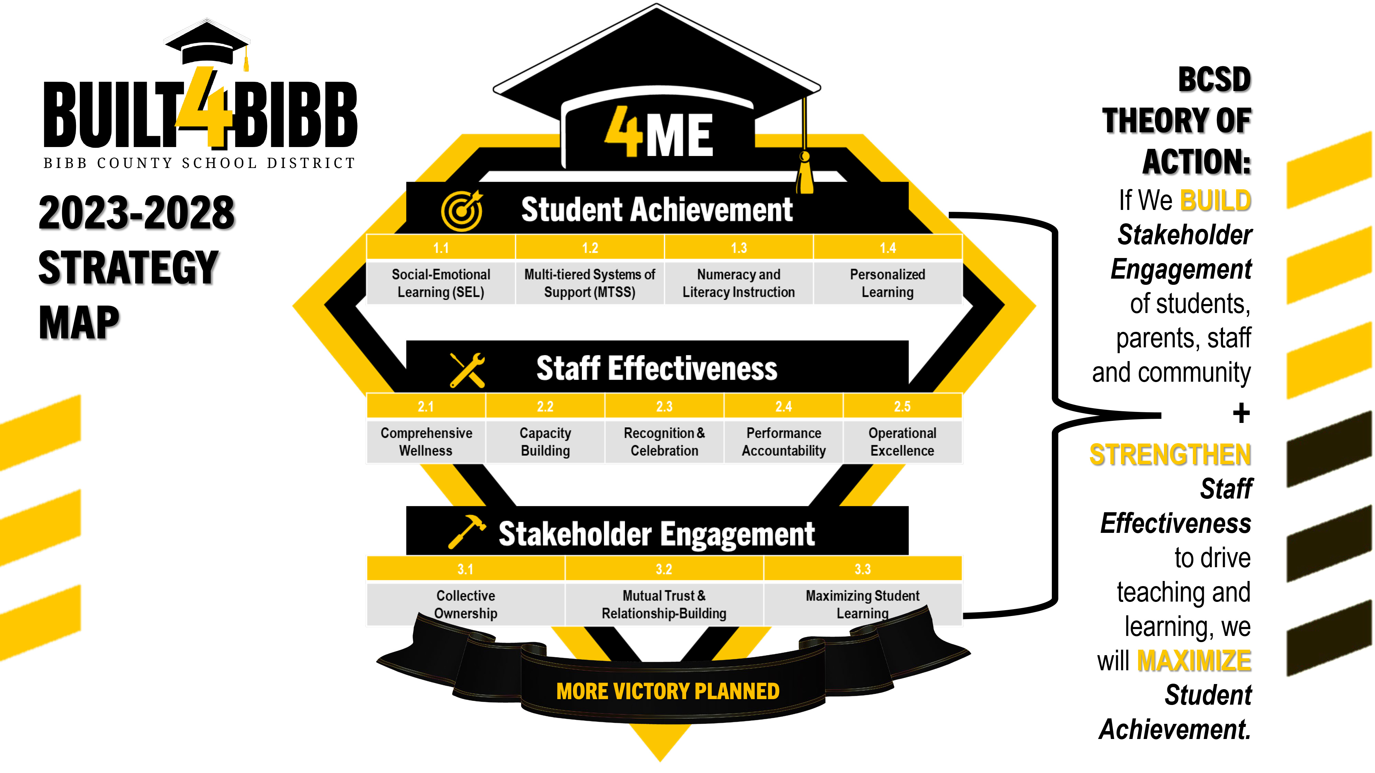

Slide 4

AGENDA
Overview
The purpose of this presentation is to present the financial results for the period ending January 31, 2024.
Roadmap
This presentation will cover the General Fund, all funds combined, ESPLOST, and Debt Service financial results for the period ending January 31, 2024.
Takeaway
This is a summary of the financial results of the period ended January 31, 2024.

Slide 5
Financial Statements
General Fund
For the Seven Months Ending
January 31, 2024
Notes:
Dr. Sims

Slide 6
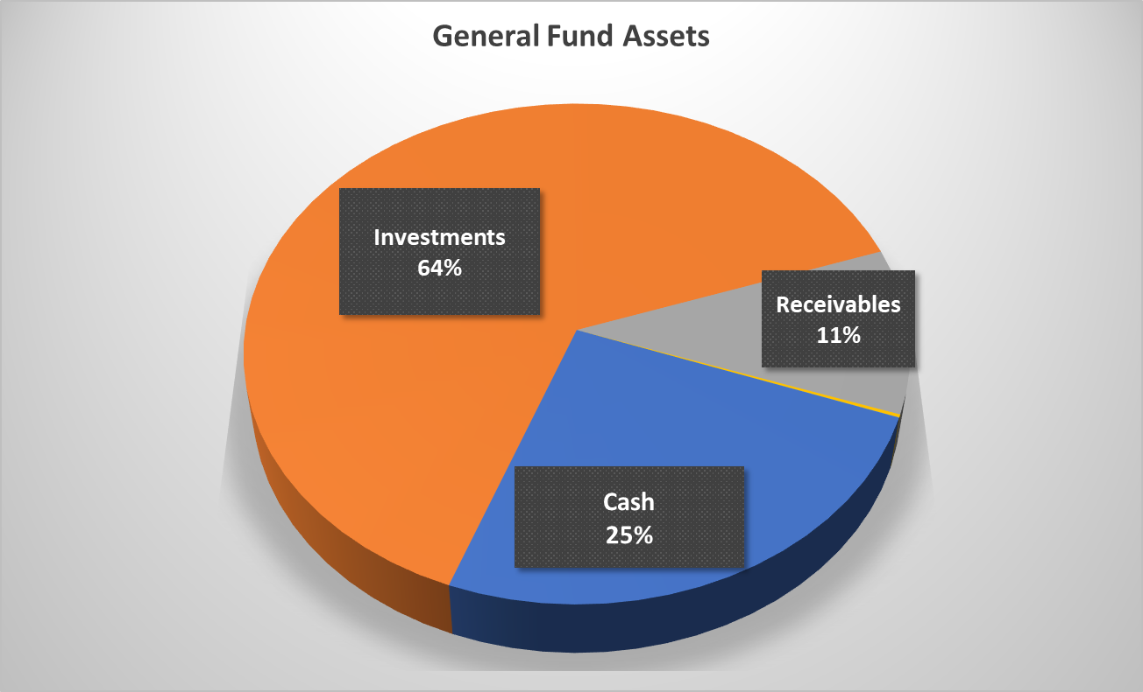
Balance Sheet – General Fund as of January 31, 2024
 |  | Current | Budget
Expenditures and Encumbrances |  | $ 141,152,901 | $ 250,041,399
Fund Balance |  | $ 85,753,129 | $ 49,511,617
Ratio of Fund Balance to Commitments |  | 5% | 20%
Notes:
Dr. Sims

Slide 7
Statement of Revenues and Expenditures for
General Fund – Seven Months Ending January 31, 2024
Notes:
Dr. Sims

Slide 8
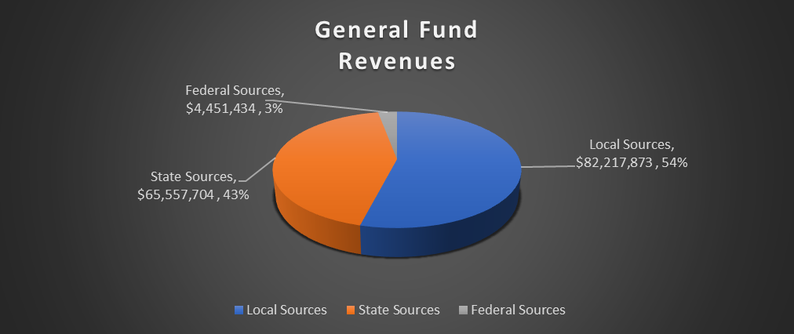
General Fund Revenues
Notes:
Dr. Sims

Slide 9
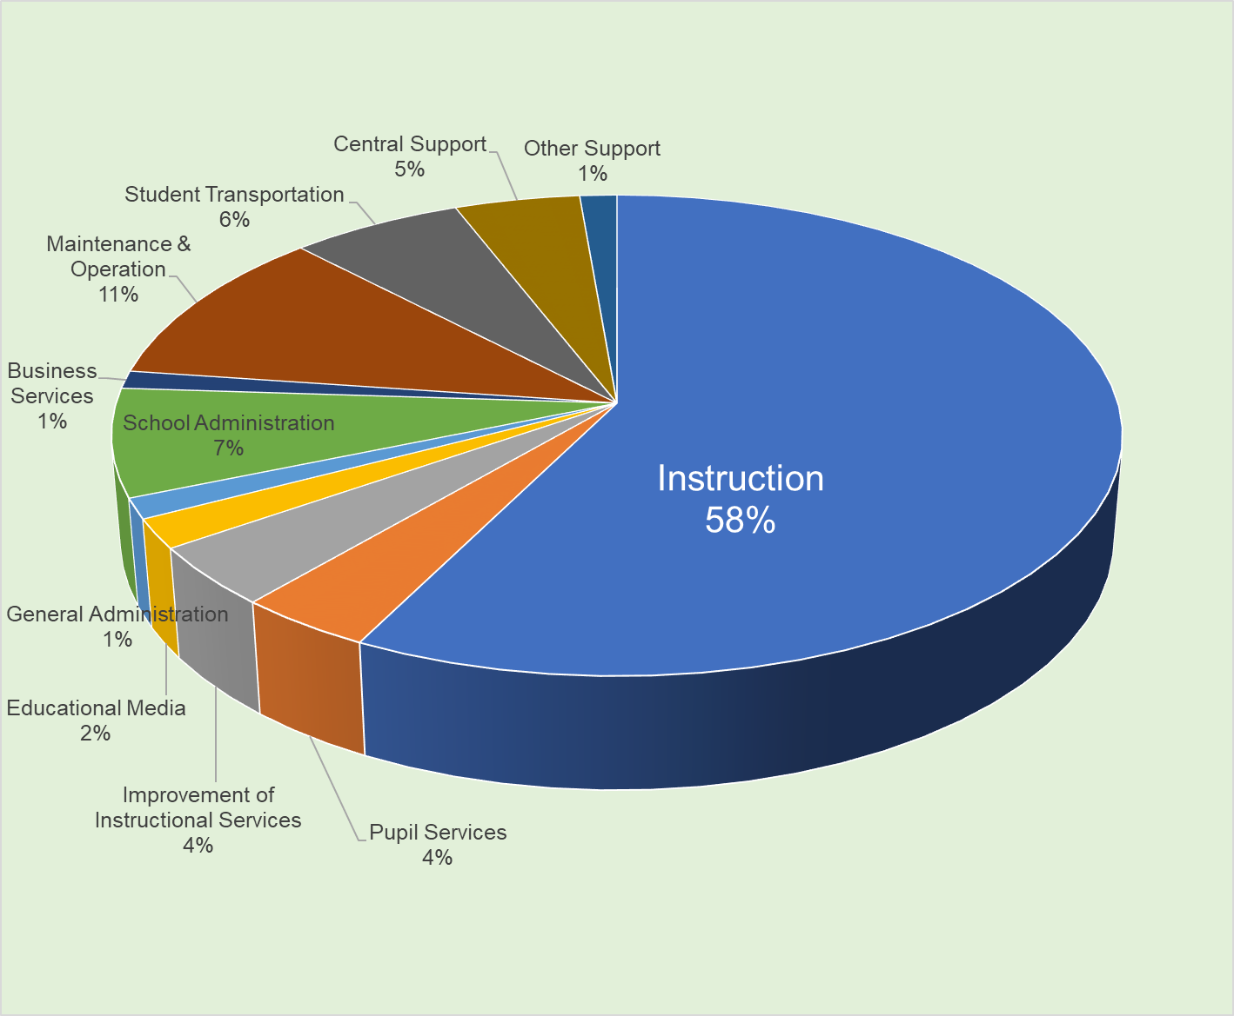
General Fund Expenditures by Function
Instruction + Pupil Services + Improvement of Instructional Services
= 66%
Notes:
Dr. Sims

Slide 10
Financial Statements
All Funds
For the Seven Months Ending
January 31, 2024
Notes:
Dr. Sims

Slide 11
Balance Sheet – All Funds as of January 31, 2024
Notes:
Dr. Sims

Slide 12
Cash and Investments on Hand
All Funds as of January 31, 2024
Notes:
Dr. Sims

Slide 13
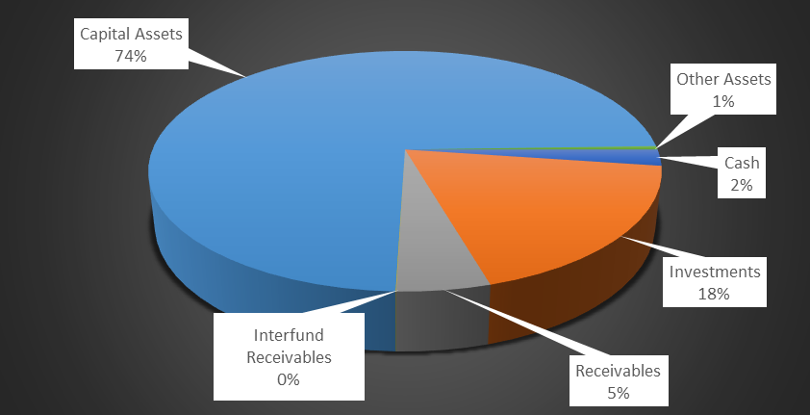
Total Assets for All Funds Combined
Notes:
Dr. Sims

Slide 14
Statement of Revenues and Expenditures for
All Funds – Seven Months Ending January 31, 2024
Notes:
Dr. Sims

Slide 15
Update on ESSER Funds –
CARES and ARP
Remaining Balances to Spend
Notes:
Dr. Sims

Slide 16
Update on ESSER Balances
Notes:
Dr. Sims

Slide 17
Update on 2021 ESPLOST,
2016 ESPLOST,
Bonds of 2020
And Debt Service Trust Account
Notes:
Dr. Sims

Slide 18
Update on 2016 ESPLOST and 2021 ESPLOST
Notes:
Dr. Sims

Slide 19
Update on Bonds of 2020 Technology Project
and Debt Service Account for Payoff on Bonds of 2020
Notes:
Dr. Sims

Slide 20

Q&A
Notes:
Dr. Sims

Slide 21

Notes:
Dr. Sims

