Slide 1


Financial Statements
May 31, 2023
Sharon Roberts, CPA
Chief Financial Officer
July 20, 2023

Slide 2

OUR MISSION
The Bibb County School District maximizes student achievement and social-emotional well-being by building a sense of community in safe, equitable learning environments.
OUR VISION
Students are empowered to learn, lead, innovate and serve as productive and caring citizens within their chosen paths of success.

Slide 3



OUR GUIDING PRINCIPLES
OUR GOALS
LEARNER
OUTCOMES
Student Achievement
Staff Effectiveness
Stakeholder Engagement
Each student
will graduate empowered to make a well-informed decision about their next step. They will learn about themselves as they engage in rigorous content and gain exposure through personalized learning experiences, thereby enlightening them to choose their most meaningful pathway.
Personalized Learning
Collaboration
Engagement
Safety
Effective Leadership

Slide 4
Financial Statements
General Fund
For the Eleven Months Ending
May 31, 2023
Notes:
Dr. Sims

Slide 5
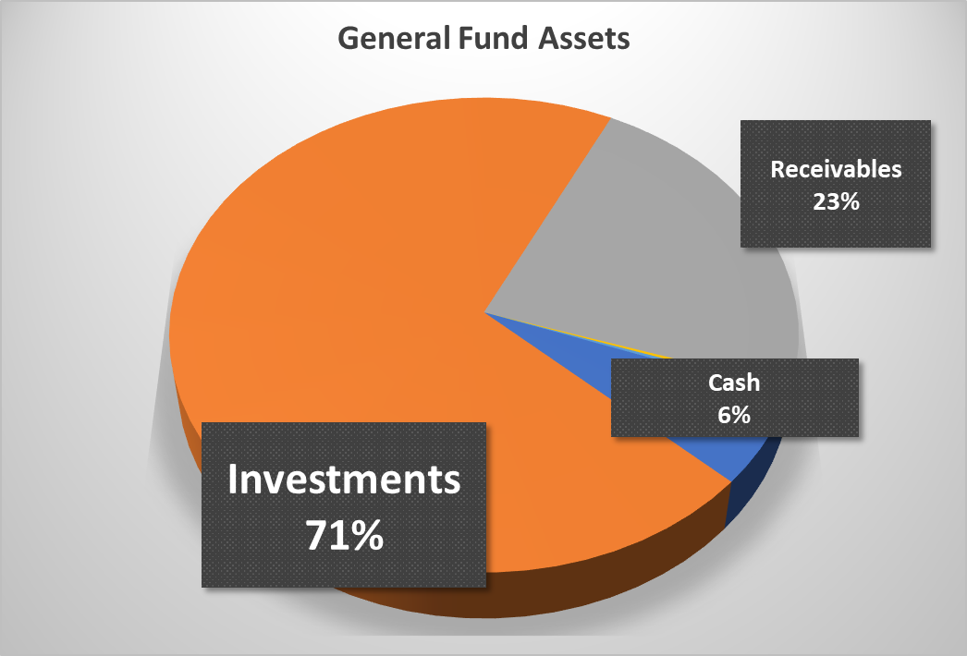
Balance Sheet – General Fund as of May 31, 2023
 |  | Current | Budget
Expenditures and Encumbrances |  | $ 218,174,283 | $ 230,513,728
Fund Balance |  | $ 75,250,640 | $ 58,835,582
Ratio of Fund Balance to Commitments |  | 34% | 26%
Notes:
Dr. Sims

Slide 6
Statement of Revenues and Expenditures for
General Fund – Eleven Months Ending May 31, 2023
Notes:
Dr. Sims

Slide 7
General Fund Revenues
Notes:
Dr. Sims

Slide 8
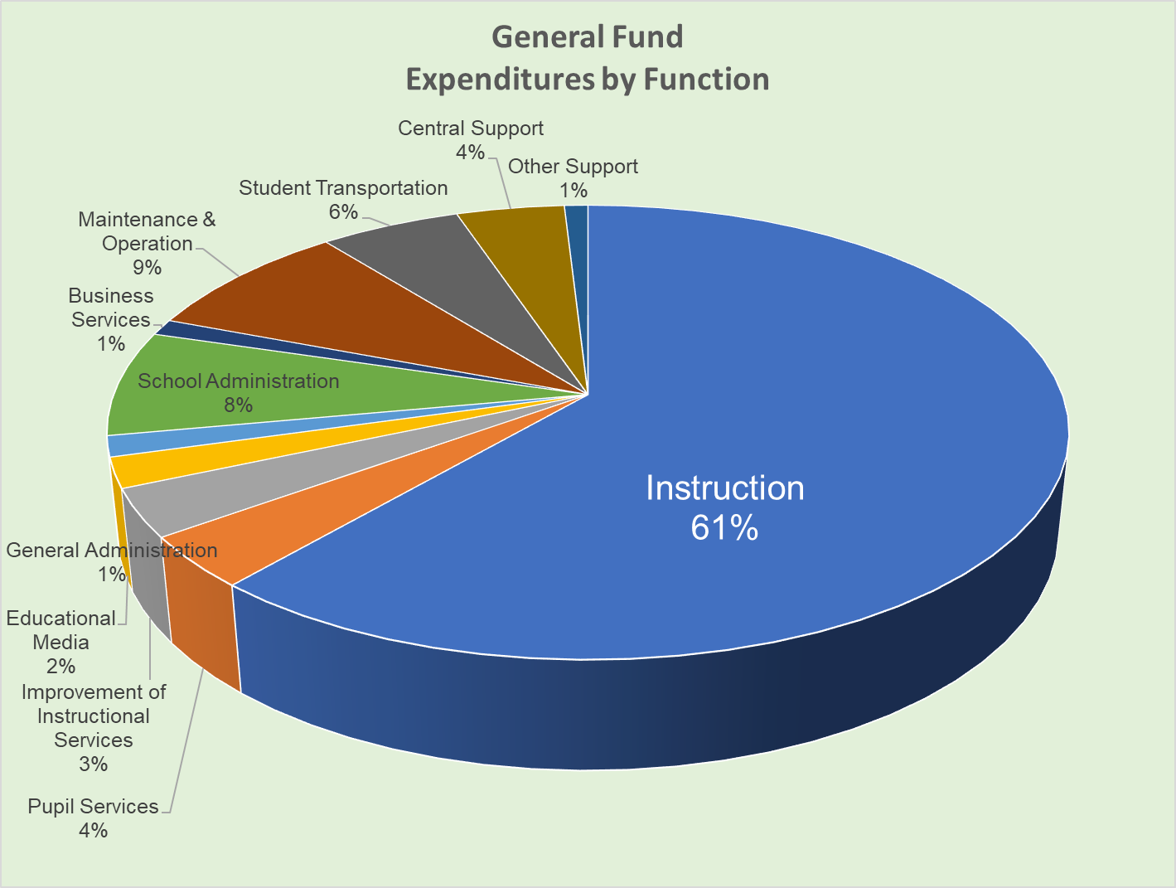
General Fund Expenditures by Function
Instruction + Pupil Services + Improvement of Instructional Services
= 68%
Notes:
Dr. Sims

Slide 9
Financial Statements
All Funds
For the Eleven Months Ending
May 31, 2023
Notes:
Dr. Sims

Slide 10
Balance Sheet – All Fund as of May 31, 2023
Notes:
Dr. Sims

Slide 11
Cash and Investments on Hand
All Funds as of May 31, 2023
Notes:
Dr. Sims

Slide 12
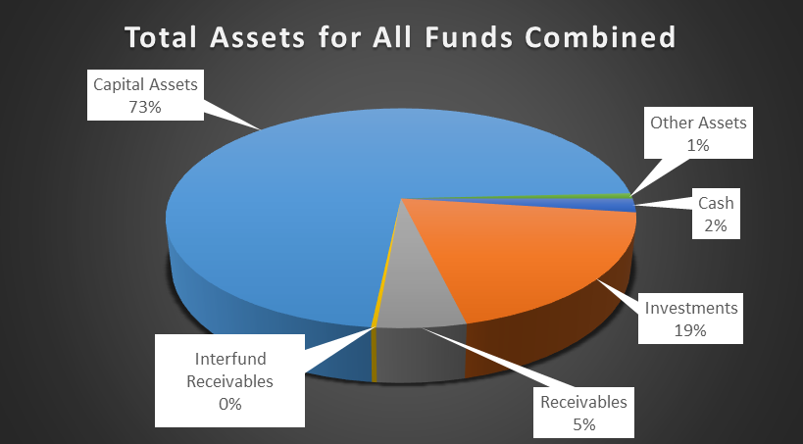
Total Assets for All Funds Combined
Notes:
Dr. Sims

Slide 13
Statement of Revenues and Expenditures for
All Funds – Eleven Months Ending May 31, 2023
Notes:
Dr. Sims

Slide 14
Update on ESSER Funds –
CARES and ARP
Remaining Balances to Spend
Notes:
Dr. Sims

Slide 15
Update on ESSER Balances
Notes:
Dr. Sims

Slide 16
Update on 2021 ESPLOST,
2016 ESPLOST,
Bonds of 2020
And Debt Service Trust Account
Notes:
Dr. Sims

Slide 17
Update on 2016 ESPLOST and 2021 ESPLOST
Notes:
Dr. Sims

Slide 18
Update on Bonds of 2020 Technology Project
and Debt Service Account for Payoff on Bonds of 2020
Notes:
Dr. Sims

Slide 19

Q&A
Notes:
Dr. Sims

Slide 20

Notes:
Dr. Sims

