Slide 1

Financial Statements
April 30, 2023
BIBB COUNTY SCHOOL DISTRICT
Leadership. Scholarship. Citizenship.
Sharon Roberts, CPA
Chief Financial Officer
June 15, 2023

Slide 2




WHAT WE BELIEVE
VISION
Each student will demonstrate
strength of character and will be college or career ready.
MISSION
The Bibb County School District develops a highly trained staff and an engaged community dedicated to educating each student for a 21st century global society.
VALUES
Competence
Loyalty
Open Communication
Defined Autonomy
Honor

Slide 3



HOW WE MAINTAIN ACCOUNTABILITY
NON-NEGOTIABLES
MTSS (RtI & PBIS)
Personalized Learning
Leader in Me
TIER 1 STRONG
Ensuring all students perform on or above grade-level
Teaching and reinforcing positive academic and social behaviors
Consistently implementing evidence-based strategies
Continually collaborating to improve student outcomes
All departments and employees play a part in us being Tier 1 Strong!

Slide 4

VICTORY IN OUR SCHOOLS
Overriding Objective = CCRPI > 70
STRATEGIC PRIORITIES
Priority 1: Get students reading on grade level.
Priority 2: Be successful on the Georgia Milestones.
Priority 3: Increase the number of students in school every day.
Priority 4: Close the knowing-doing gap.
Priority 5: Work hard to support schools.
Priority 6: Establish a culture of accountability for everyone.
STUDENT ACHIEVEMENT
Increase
Content Mastery
Increase Post School
Readiness
Increase Grad Rate and Post Secondary Options
STUDENT AND STAKEHOLDER ENGAGEMENT
Partner
with Students
Partner
with Parents
Partner
with the Community
LEADER AND TEACHER EFFECTIVENESS
Be
A PLC
Know
Technology
Do
Standards-Based Classrooms
INTERNAL PROCESSES
RELIABLE ORGANIZATION
Manage
Processes and Projects
Manage
Finances and Personnel
Manage
Perceptions
Maintain a Safe Learning Environment
LEARNING AND GROWTH
Recruit and Retain
The Right People
Respect
BCSD Values and Culture
Grow
From Evaluations

Slide 5

Financial Statements
General Fund
For the Ten Months Ending
April 30, 2023

Slide 6

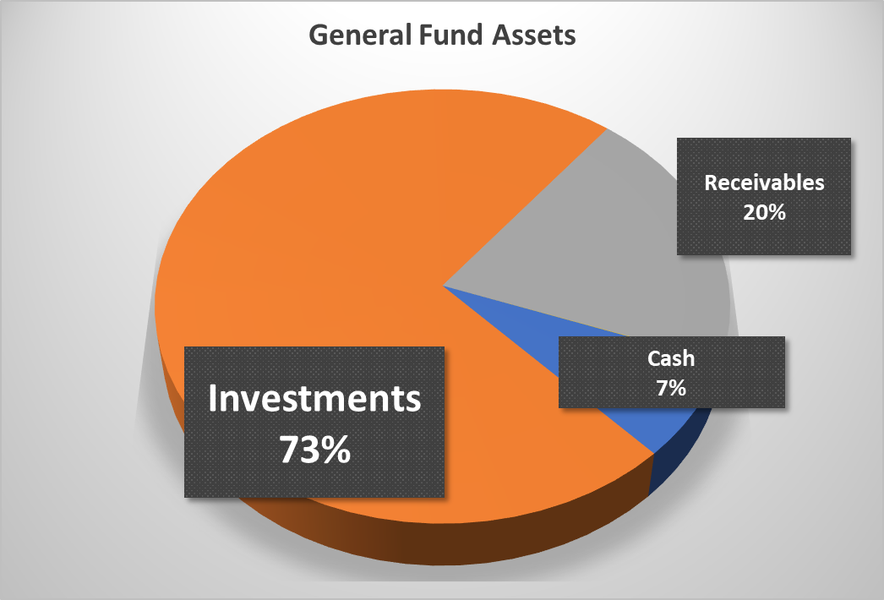
Balance Sheet
General Fund as of April 30, 2023
 |  | Current | Budget
Expenditures and Encumbrances |  | $ 195,293,351 | $ 221,911,200
Fund Balance |  | $ 81,032,135 | $ 56,810,417
Ratio of Fund Balance to Commitments |  | 41% | 26%

Slide 7
Statement of Revenues and Expenditures for
General Fund – Ten Months Ending April 30, 2023

Slide 8
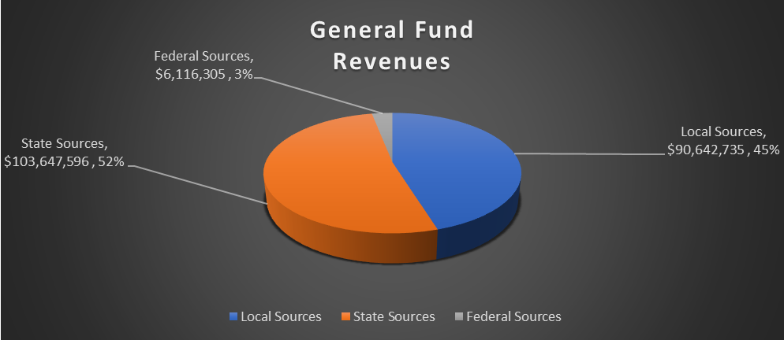

Slide 9
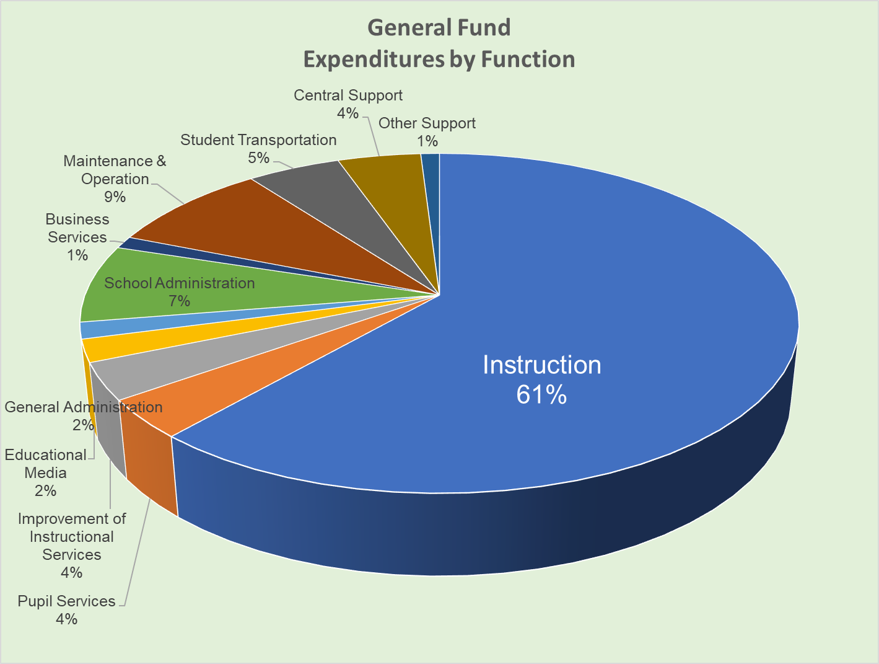
Instruction + Pupil Services + Improvement of Instructional Services
= 69%

Slide 10
Financial Statements
All Funds
For the Ten Months Ending
April 30, 2023

Slide 11
Balance Sheet
All Funds as of April 30, 2023

Slide 12
Cash and Investments on Hand
All Funds as of April 30, 2023

Slide 13
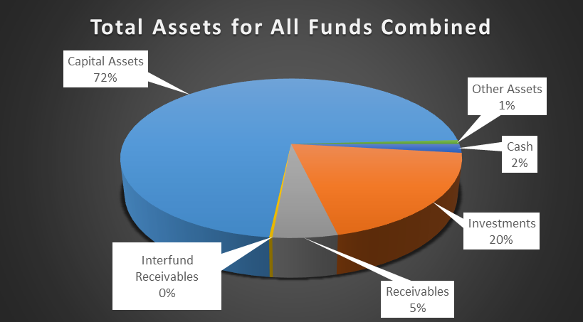

Slide 14
Statement of Revenues and Expenditures for
All Funds – Ten Months Ending April 30, 2023

Slide 15
Update on ESSER Funds –
CARES and ARP
Remaining Balances to Spend

Slide 16
Update on ESSER Balances

Slide 17
Update on 2021 ESPLOST,
2016 ESPLOST,
Bonds of 2020,
and Debt Service Trust Account

Slide 18
Update on 2016 ESPLOST and 2021 ESPLOST

Slide 19
Update on Bonds of 2020 Technology Project
and Debt Service Account for Payoff on Bonds of 2020

Slide 20


Slide 21

Leadership. Scholarship. Citizenship.

