Slide 1
Manhasset High School 11th Grade Information Night November 9, 2023 High School Counseling Department

Slide 2
SCA: Summer Studies Program
http://www.manhassetsca.org/SCAResources/summerstudies/summerstudies.html
Jennifer Klein & Priyanka Puri

Slide 3
Our Counseling Team Kerry Fallon, Director
Marcy Fogel
Jennifer Landman
Lori Margulies
Kristen Ruthkowski
Kim Cosenza
Danielle Cerulli

Slide 4
Program Purpose and Goal
Purpose: To present an overview of the post-secondary planning process
Goal: To identify and provide you with the Resources and a written guide that will help you work alongside your child throughout this process.
Post-Secondary Planning Guide

Slide 5
Post Secondary Planning Guide
A comprehensive guide designed to address the post-secondary planning process in three (3) phases:
Getting Started
Phase I: November 2023 - December 2023/January 2024
Active Searching
Phase II: January 2024 - August 2024
The Final Act
Phase III: September 2024- December 2024

Slide 6
Phase I
Getting Started
November 2023 - January 2024
Mrs. Danielle Cerulli

Slide 7
Phase I: Getting Started at Home
* Finalize a testing schedule
* Self-reflection
* Become aware of policies and practices
* Understand the “myths” related to the process
* Become familiar with the language of the process
-Using the Glossary

Slide 8
Recommendations for Phase I
Begin reading the Post-Secondary Planning Guide
Set aside time to discuss the recommended activities
Commit time and energy on both sides
Acknowledge the importance of “process” and your college/university choice being the best “fit.”
Understand that this is a test of patience, encouragement and listening skills
Be positive…everything will work out in the end

Slide 9
Standardized Testing Policies
Score Reporting Options:
SAT or ACT
Test Optional vs. Test Blind/Test Free
*Speak with each school you visit to confirm how/if scores are used.

Slide 10
Free Test Prep
SAT
Khan Academy
Free test prep and interactive support.
www.khanacademy.org
ACT
Kaplan resources available on the ACT Website
www.act.org
SAT and ACT
Method Test Prep
Access through Castle Learning

Slide 11
Getting Started in School
Student Classroom Meetings:
January 2024
Review the purpose/structure of the Post-Secondary Planning Guide
Students will complete a preliminary post-secondary
questionnaire
Students will create a Common Application Account
Students will conduct a guided college search

Slide 12
College Visits
Mini Fairs and College Rep Visits (In-person and virtual)
Future Opportunities will include:
The Spring Expo
Nassau Counselors’ Association
April 2024
NACAC Specialized Fairs
SUNY Fairs
Fall College Expo
Nassau Counselors’ Association

Slide 13
Phase II
Active Searching
January 2024 - August 2024
Mrs. Marcy Fogel

Slide 14
Phase II: Active Searching January - August
Identify your desired types of colleges
Review and refine the college search
Compare search results to Scattergrams and College Match features on Naviance
Attend the family conference with your counselor
Schedule campus visits
Attend local and regional college fairs
Register for and take standardized tests
AP’s, SAT, ACT’s

Slide 15
Post Secondary Options
Liberal Arts Colleges
Comprehensive Universities
Honors Colleges/Programs
Fine and Performing Arts Programs
Technical and Engineering Schools
Accelerated/Combined Programs
3/2 Engineering Programs
Career, Vocational, and Business Schools
Military Academies/ROTC Options
Junior and Community Colleges
(All of the above are described in the Post-Secondary Guide)

Slide 16
College Search
Goal: Decipher a list of schools that reflect student interests and needs.
To That End:
All students will conduct a guided, preliminary college search at the January meeting
Search results should be completed prior to the Junior College Conference

Slide 17
Informed College Search The List should include consideration of:
College Type
Selectivity
Program Offerings
Size of School
Location
Affiliation
Social Climate
Special Programs
Affordability

Slide 18
College Search Your list should not be:
A wish list
A list of schools taken from the back of the School Profile.
Created by parents or relatives ONLY.
Compiled from the list of schools in US News & World Report.
Limited only to schools you know

Slide 19
Naviance
College Search results should be
examined in relation to the data stored in both the College Match and Scattergram features found in Naviance.
From there, a list should be generated that contains the following elements:

Slide 20
Naviance & The Application List
Safety Schools: Student profile is well above the average mean of accepted student
Target Schools: Student profile is within the mid-50% range of admitted students
Reach Schools: Student profile is below that of admitted students.
*Scattergrams can be used to best align the list to each category

Slide 21
Scattergrams
Visual representation of student’s academic profile as compared to past MHS applicants
*Keep in mind that this is academics only
*Arrow points to student being compared
See following for examples:

Slide 22
Safety

Slide 23
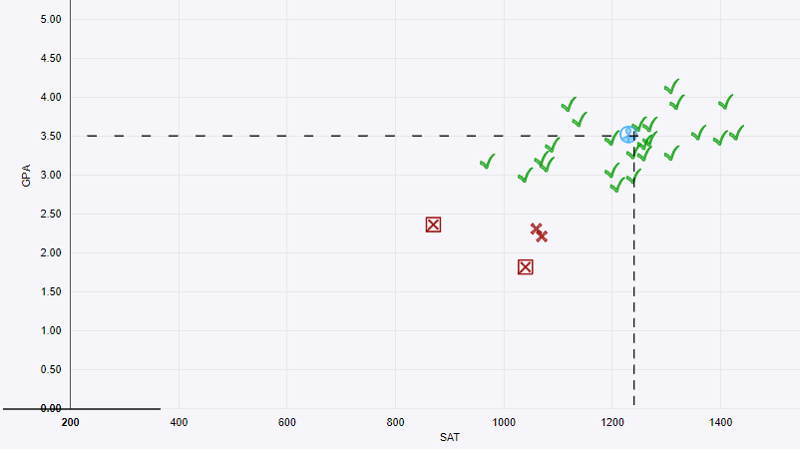
Target

Slide 24
Reach

Slide 25
The Unpredictable Schools
The student’s profile matches that of admitted students but admission is completely, “unpredictable.”
These tend to be the most highly selective schools.
As the following Scattergram will show, even students who clearly match the profile of admitted students, cannot know for sure if they will be admitted:

Slide 26
Unpredictable

Slide 27
Mrs. Jennifer Landman

Slide 28
The Family Conference
Prior to appointments, families should:
Complete the Common Application, minus the essay on the website
Complete a College Search on Naviance
*Conferences are scheduled for 90 minutes

Slide 29
Family Conference February 2024-May 2024
An extensive agenda will include a review of the student’s:
- Current academic profile (GPA/Test results)
- 12th grade projected schedule
- Academic and personal interests
- Common Application and college search results
Ample time will be allotted for questions and the counselor will make recommendations for further exploration of college choices.
When your appointment slip arrives, please review and if unable to keep it, contact the HS Counseling Office ASAP. The counselors will also be meeting with 9th Grade families and will have over 100 conferences to schedule between both groups.

Slide 30
Classified Students
Colleges and universities offer different levels of support services for students with special needs.
Post-Secondary Planning Guide includes an outline of the different levels of support and identify college and university programs.
Parents of and students with special needs should begin to consider what type(s) of support service(s) will be most helpful to meet with success in college and consider this in their search.

Slide 31
Fine and Performing Arts:
Students interested in a fine or performing arts program should:
Become familiar with the option of attending a conservatory or participating in a program within a more traditional college/university setting.
Become familiar with portfolio, recording, and audition requirements by reviewing the current application requirements.

Slide 32
Student Athletes
Athletic Recruitment is very competitive and not always
student friendly.
Prospective athletes must register with the NCAA Eligibility Center by end of 11th grade. (www.eligibilitycenter.org)
Students must monitor their NCAA GPA
Follow all leads.
Identify programs of interest and forward sports profile and academic information to the coaching staff. Students can reach out to as many schools as they would like.

Slide 33
Campus Visits/Interviews
Visit college websites to determine spring Open
House programs. All websites can be accessed
through Naviance.
Plan campus visits when students are around.
If not on a tour, sign in at the Admissions Office.
(Demonstrated interest is important to some colleges)
If possible, arrange for an interview, an overnight visit, or sit in on a class. If you have a clearly defined interest, try to meet with a department chair.

Slide 34
While On Campus Things to Consider:
* Location (distance from home and campus surroundings)
* Do I meet the entrance requirements? (reach, target, safety)
* What core courses will I be required to take?
* Are there specific opportunities related to my possible major?
* Is the size so big/small that I’ll get distracted/bored?
* Can I see myself at this school?
* Does the size limit the availability of activities?
* Are there opportunities for non fine arts, music, or theater
majors to take courses in those disciplines?
* Do I want something different/similar from my past experience?

Slide 35
Campus Visits/Interviews
Virtual and in-person tours & information sessions
Virtual and in-person individual conversations with admissions rep(s)
Using the “SET LIST”
Using as many of these suggestions as possible (especially the “SET LIST”) will help you get the best feel of the school.

Slide 36
Senior Autobiography Packet
Students are required to complete a Senior Autobiography.
Used to help the counselors write the most comprehensive letter of recommendation.
Mailed home in May - due by the end of June.
(Counselor recommendations will NOT be written if this document is not submitted)
The packet contains three (3) teacher Appraisal Summary Forms, which are given to three 11th grade teachers.
These forms are for counselor use only
Teacher Recommendation Contract

Slide 37
Teacher Recommendations
Colleges prefer 11th grade teachers
Mid-late junior year--begin to consider which
teachers you will ask
Initial requests made in May/June (when teachers are
asked to complete Appraisal Summary Forms)
Formal request/process will be made/reviewed
in September 2024

Slide 38
Phase III
The Final Act
(Pulling it all together)
September 2024 - December 2024
Ms. Kerry Fallon

Slide 39
Focus on Processing:
Student Applications
School documents, including counselor
recommendations, transcripts, etc.
Teacher Recommendations

Slide 40
Layers of Support
11th Grade Classroom Lessons (January 2024)
Small group meetings with 11th grade
Student/Counselor College Conferences (February 2024--May 2024)
12th Grade Parent/Student Night (September 2024)
Comprehensive Review of Application Process
Checklist to guide each step of process
Senior Classroom Lessons (September 2024)
Follow up to 12th Grade Parent/Student Night
Review all procedures with students
Fall Family Conferences (SEPT-OCT)
Individual student/parent conference to review college list and application procedures

Slide 41
Financial Aid Night
OCTOBER 2024
Review FAFSA process, dates and deadlines, and submission process.

Slide 42
RESOURCES
College Fairs/Representative Visits
The “SET” List
Naviance
Counseling Department Webpage
Essay Booklet
Common Application/prompts/supplementals
Planning Guide

Slide 43
Final Thoughts
*The Guide has been designed as an outline of activities that characterize the post-secondary planning process. Please share it with your child and take the time to review thoroughly.
*At every stage, please be sure to include your child in the process. They should be engaged in the planning.
*Depending on personal interests and goals, the process will be different for each student/family

Slide 44
Current Trend
* Roughly 89% of recent classes have applied
under one of the Early options
* Greater importance on having test scores
available to be delivered by the early
deadlines.
*Please keep this in mind when deciding when to test.

Slide 45
CASA
Ms. Connie Bruno
Executive Director

