Slide 1
Annual Title 1 Meeting
August 8, 2023
Notes:
Sarah

Slide 2
Purpose
The purpose of the Title I annual parent info session is to provide information to parents of participating children about the Title I program and their right to be involved in their child’s education. [Section 1118(c)(1), ESEA].

Slide 3
Title 1 Requirements
Title I, also known as the Elementary and Secondary Education Act (ESEA), requires districts and schools to provide parents with relevant information and useful resources to support them as full partners in the education of their children and offering them important insight into their children’s education.
Parents must be informed about the professional qualifications of their children’s teachers and the quality of the schools their children attend.
Title I recognizes that parents must share the responsibility for student achievement.
Any questions, comments or concerns about Title 1 are always welcomed!

Slide 4
MSEB Funds
FY24
Reading & Academic Interventionists
Behavior Interventionists
School Counselors
Alumni Transition Coordinator
FY23
Behavior Interventionists
Academic Interventionists
School Supplies

Slide 5
Our School Model
Extended Time & School Year
High-Quality Teachers & Staff
In-house Professional Development
Real-time feedback and implementation
Whole Child Focus
Family and Community Partnerships
Notes:
Amy or Chad

Slide 6
Family Involvement in School Meetings/Programs
In-person scheduled meetings
Pop-in Observations
Academic or behavioral
Scheduled Zoom meetings
Scheduled Phone-in meetings
Attend Flashlight Foundation events
Attend school wide celebrations
TNTP Family Insight Survey

Slide 7
Our Curriculum: Researched Based
More time on literacy and math
Wit & Wisdom
Eureka²
Differentiated to meet all students needs
Not just academic skills, but social/emotional skills too (life skills!)
Rigorous college ready aligned assessments
Hard work but fun work!
Notes:
Amy or Chad

Slide 8
ESSA
ESSA Highlights
ESSA includes provisions that will help to ensure success for students and schools. Below are just a few. The law:
Advances equity by upholding critical protections for America's disadvantaged and high-need students.
Requires—for the first time—that all students in America be taught to high academic standards that will prepare them to succeed in college and careers.
Ensures that vital information is provided to educators, families, students, and communities through annual statewide assessments that measure students' progress toward those high standards.
Helps to support and grow local innovations—including evidence-based and place-based interventions developed by local leaders and educators—consistent with our Investing in Innovation and Promise Neighborhoods
Sustains and expands this administration's historic investments in increasing access to high-quality preschool.
Maintains an expectation that there will be accountability and action to effect positive change in our lowest-performing schools, where groups of students are not making progress, and where graduation rates are low over extended periods of time.

Slide 9
SC Report Card Data
SC Report Card Data* can be viewed at https://www.screportcards.com.
Current ESSA Rating: Pending SC Dept. of Education release of ratings.
*Meeting Street - Brentwood and Meeting Street - Burns share the same report card. The data is not strictly representative of Meeting Street - Burns data.

Slide 10
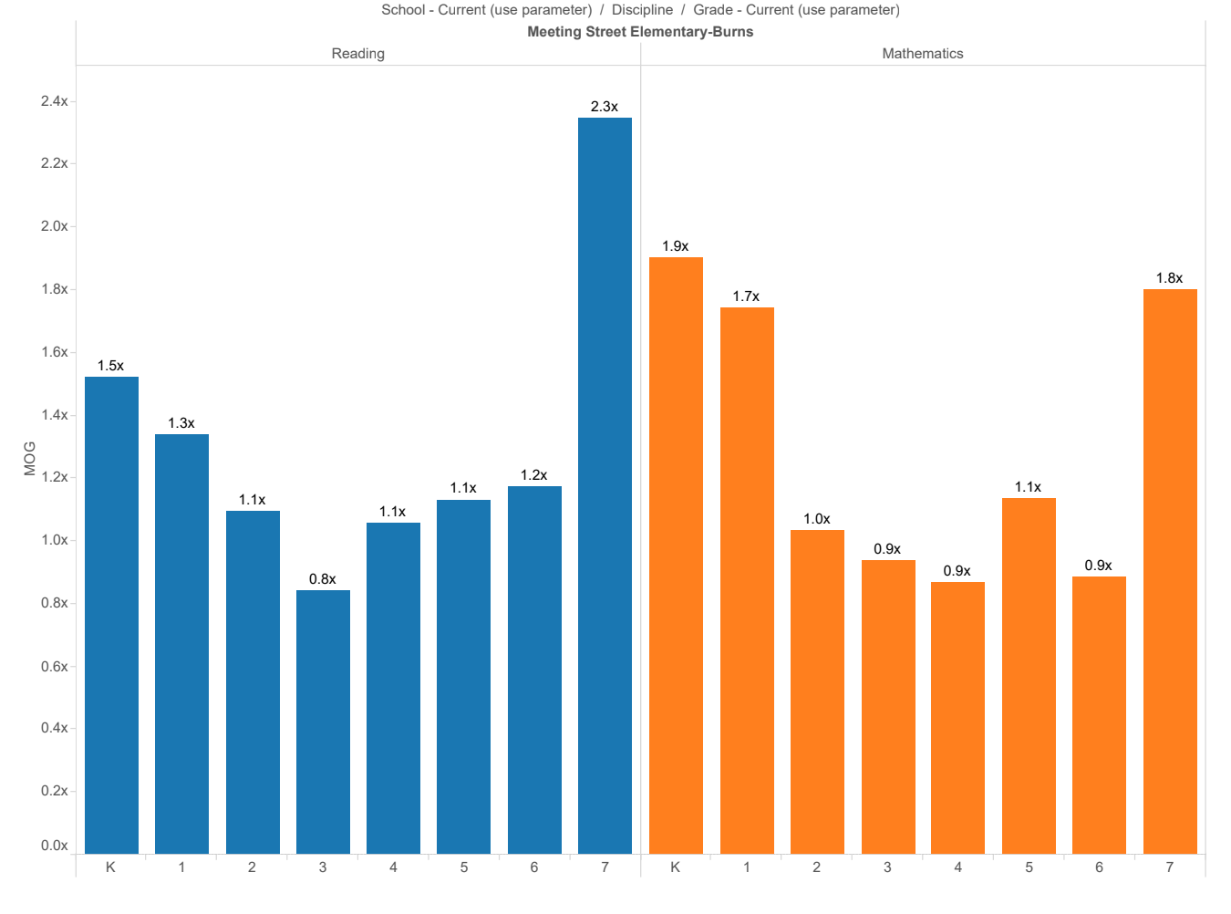
MAP Reading & Math Data

Slide 11
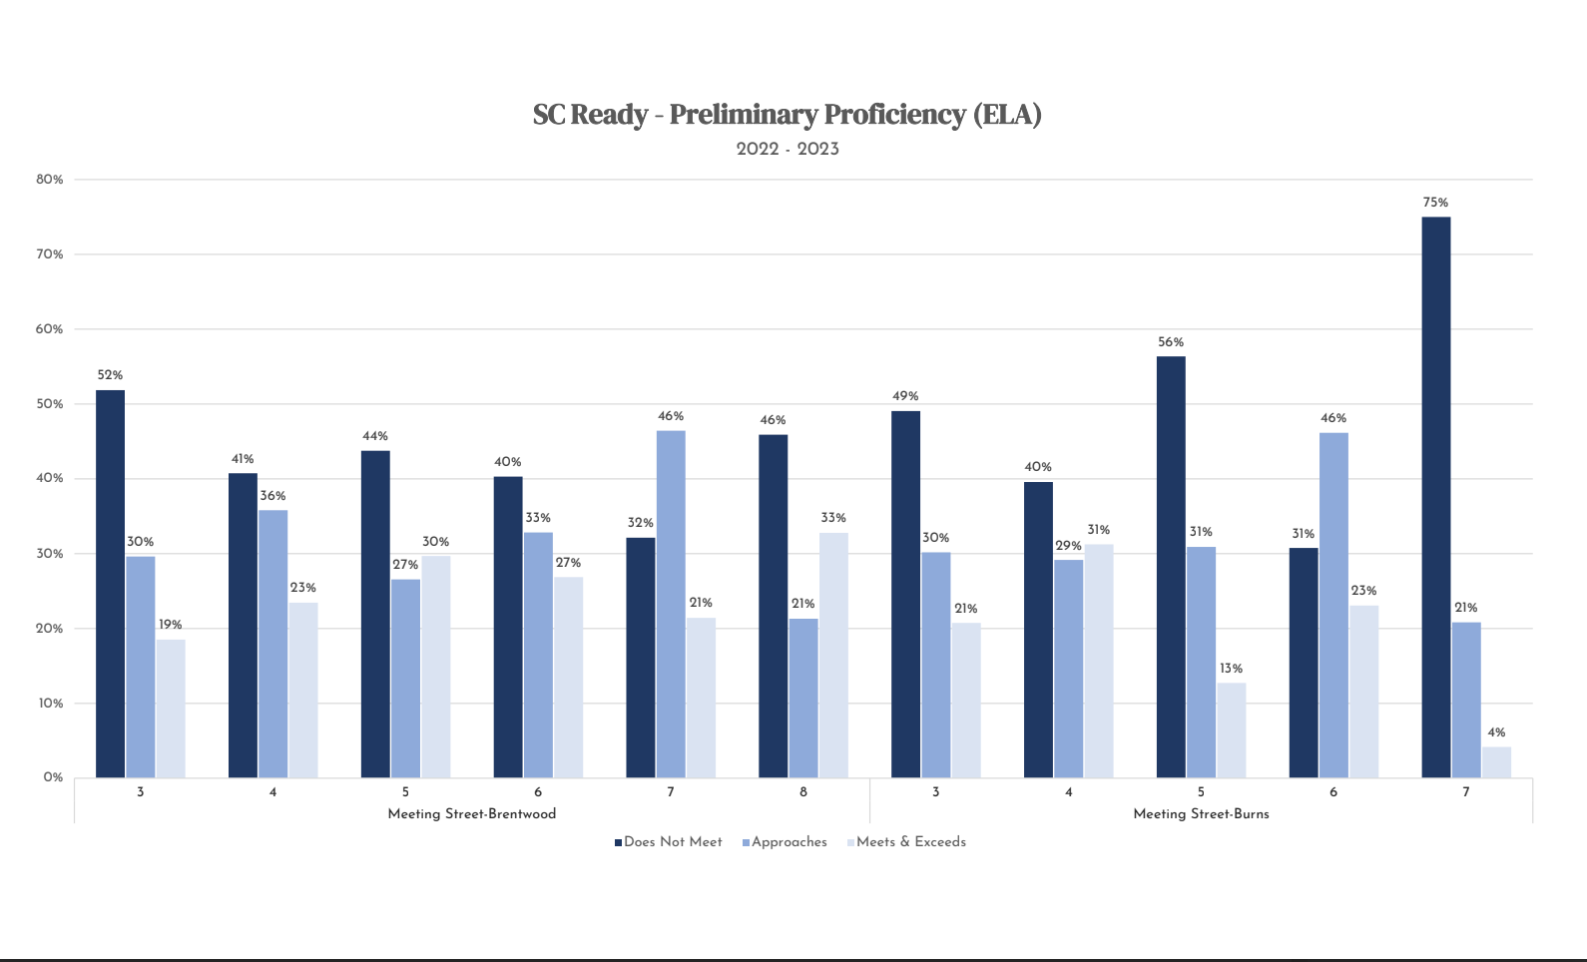
SC READY Data - ELA

Slide 12
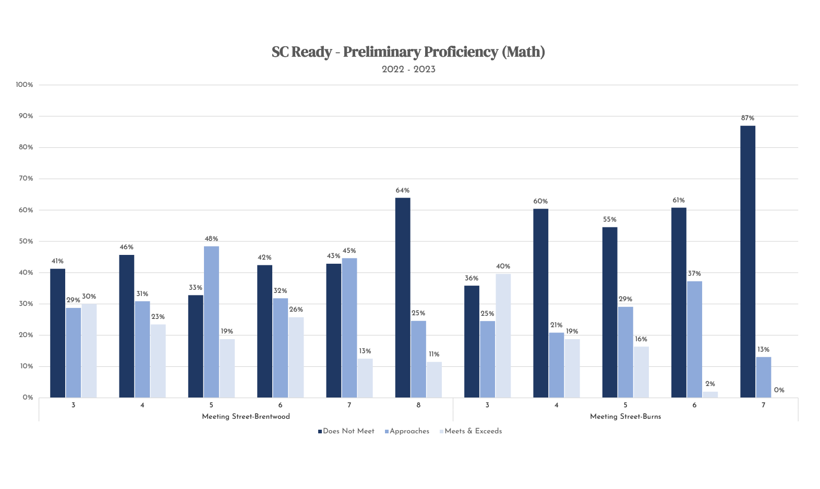
SC READY Data - Math

Slide 13
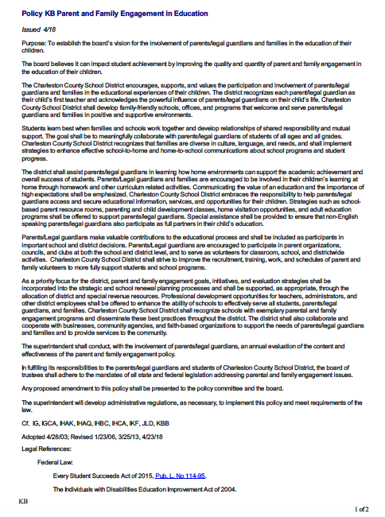
Policy KB
Parent & Family Engagement in Education

Slide 14
Parent & Family Engagement Policy
Printed and provided in English & Spanish.
Located in our Front Office.

Slide 15
Home School Compact
Printed and provided in English & Spanish.
Located in our Front Office.

Slide 16
Path to Success Skills
Notes:
Kent

Slide 17
MSS Graduate Profile

Slide 18
Student Support Services
Behavior Intervention
Crisis Intervention
School counseling
Individual counseling
Social skills groups
Family resources
Backpack Buddy
Food Pantry
Flashlight Foundation

Slide 19
Parent & Community Connections
Teacher / Parent Communication
Monthly Flashlight Foundation meetings (every 2nd Tuesday)
Parents as co-teachers
Monthly Flashlight Foundation Events
Quarterly Report Card Conferences
Beginning of Year Celebrations
End of Year Celebrations
Parent/Community Volunteers
Notes:
Pamela

Slide 20
Extended Learning Opportunities
Boys and Girls Club
Monday – Friday
3:00-6:30*
Academics, Enrichment Clubs, Supper
Interested people should apply using the link on the Meeting Street - Burns website & fliers sent home
After School Electives
Youth Baseball
Book Club
Cooking Club
Math Study Groups
Music Club
Art Club
DIY Crafts
Step
Cheerleading
Football

Slide 21
Monthly Heritage Celebrations
Black History
Hispanic Heritage
Native American
Women’s History
Asian-American/Pacific Island Heritage

Slide 22
Calendar of Parent Events
Printed and provided in English & Spanish.
Located in our Front Office.
Available August 14, 2023

