Slide 1
Unraveling the Mysteries of the EFC or
“What do you mean I can contribute $15,000 toward her education!”
By Kent McGowan
Director, Financial Aid
Buffalo State College

Slide 2
E F What?
EFC stands for
Expected
Family
Contribution

Slide 3
E F What?
What it is theoretically:
How much a family can contribute toward their son or daughter’s education that academic year.
An EFC of 5000 would mean the family can literally contribute $5000 toward their education that year.

Slide 4
E F What?
What it is actually:
A way of comparing a family’s relative financial strength to that of other applicants based on certain resources presumed to be currently available to them.
It does not look at actual consumption habits, does not look at all resources, nor does it account for shifting circumstances.

Slide 5
Establishing Aid Eligibility
Cost of Attendance
- Expected Family Contribution
Documented Need
Pell eligible EFC range is 0 - 3850

Slide 6
Choosing the EFC Formula
There are actually seven EFC formulas:
  Dependent students
    who qualify for the simplified needs test
    who don’t qualify for the simplified needs test
  Independent students without dependents other than a spouse (single or married no kids)
    who qualify for the simplified needs test
    who don’t qualify for the simplified needs test

Slide 7
Choosing the EFC Formula
  Independent students with dependents other than a spouse (single or married, have kids)
    who qualify for the simplified needs test
    who don’t qualify for the simplified needs test
  Those who qualify for an Auto Zero EFC

Slide 8
Simplified Needs Test
Used to determine whether assets are considered in the EFC calculation.
Dependent students
  Parental AGI less than $50,000 and
  Parents able to file 1040A, 1040EZ or not required to file
Independent students
  Student/Spouse AGI less than $50,000 and
  Student/Spouse able to file 1040A, 1040EZ or not required to file

Slide 9
Auto Zero EFC
If certain criteria are met, student automatically assigned an EFC of 0 regardless of what the calculated EFC would be.
Accommodates situations where student working to provide income for support of household, or where family has already shown high level of need.

Slide 10
Auto Zero EFC
Dependent students
  Parental AGI $20,000 or less
  Parents able to file 1040A, 1040EZ or not required to file, or parent or student received a “means tested federal benefit program” in prior calendar year

Slide 11
Means Tested Federal Benefit Program
Includes:
  SSI
  Food Stamps
  Free or reduced school lunches
  Temporary Assistance for Needy Families (TANF)
  Special supplemental nutrition program

Slide 12
Auto Zero EFC
Independent students with dependents other than spouse (have kids)
  Student/Spouse AGI $20,000 or less
  Student/Spouse able to file 1040A, 1040EZ or not required to file or student/spouse received a “means tested federal benefit program” in prior calendar year

Slide 13
Auto Zero EFC
Independent students without dependents other than spouse (no kids)
  Do not qualify for auto zero EFC

Slide 14
Components of the EFC
Dependent student EFC is made up of three components:
  Parent Contribution
    Available Income
    Contribution from Assets
  Student Income Contribution
  Student Contribution from Assets

Slide 15
Dependent Student Formula

Slide 16
Parents' Available Income
Total Income
– Total Allowances
Available Income

Slide 17
Parents' Total Income
  Adjusted Gross Income (AGI)
  + Untaxed Income (from Worksheets A & B)
  Income Reductions (Worksheet C)
  If not required to file taxes total income earned from work is used in place of AGI

Slide 18
Parents' Total Allowances
  US Income Tax Paid (from 1040)
  + State & other tax allowance (see table)
  + Father’s FICA allowance (see table)
  + Mother’s FICA allowance (see table)
  + Income Protection allowance (see table)
  + Employment Expense allowance

Slide 19
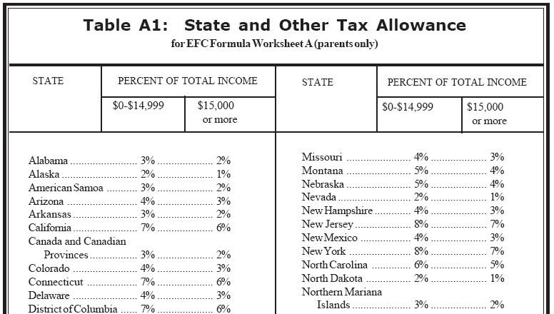

Slide 22
Employment Expense Allowance
Two working parents: 35% of the lesser of the earned income, or $3,100, whichever is less.
One-parent families: 35% of earned income, or $3,100, whichever is less.
Two-parent families, one working parent, allowance is zero.

Slide 23
Parents' Available Income
Total Income
– Total Allowances
Available Income

Slide 24
Parents' Contribution from Assets
Included:
  Value of most trust funds
  Value of educational savings plans
Not included:
  Primary residence
  Value of retirement plan or life insurance
  Family business with 100 or fewer employees
  Family farm if residence is on the farm

Slide 25
Parents' Contribution from Assets
  Discretionary Net Worth:
    Cash, savings & checking
    + Net worth of investments
    + Adjusted net worth of business/farm (see table)
    Education savings and asset protection allowance (see table)

Slide 28
Parents' Contribution from Assets
Discretionary Net Worth
X .12
Contribution from Assets

Slide 29
Parents' Contribution
Available Income
+ Contribution from Assets
Adjusted Available Income

Slide 30
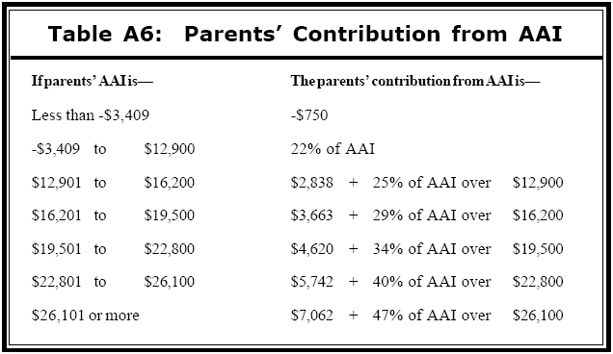

Slide 31
Parents' Contribution
Adjusted AI Contribution (from table)
divided by
Number in College
=
Parent Contribution

Slide 32
Student’s Total Income
  Adjusted Gross Income (AGI)
  + Untaxed Income (from Worksheets A & B)
  Income Reductions (Worksheet C)
  If not required to file taxes total income earned from work is used in place of AGI

Slide 33
Student’s Total Allowances
  US Income Tax Paid
  + State & other tax allowance
  + FICA allowance
  + Income Protection allowance (2,550)
  + Allowance for Parents' negative Adjusted Available Income

Slide 34
Student Income Contribution
  Total Income
  - Total Allowances
  Available Income
  X .50
  Student Income Contribution

Slide 35
Student Contribution from Assets
  Net Worth:
    Cash, savings & checking
    + Net worth of investments
    + Net worth of business/farm (not adjusted)
  Note: there is no asset protection allowance

Slide 36
Student Contribution from Assets
  Net Worth
  X .35
  Student Contribution from Assets

Slide 37
EFC
Parent Contribution
+ Student Income Contribution
+ Student Contribution from Assets
Expected Family Contribution

Slide 38
Independent Student Formulas
With Kids - Calculation identical to parent of a dependent student.
No Kids – Similar to dependent student calculation except:
  Higher income protection allowance (5,790 or 9,260)
  Employment allowance expense included
  Net worth of business/farm is adjusted
  Asset protection allowance included

Slide 39
Questions?

